Slide 1
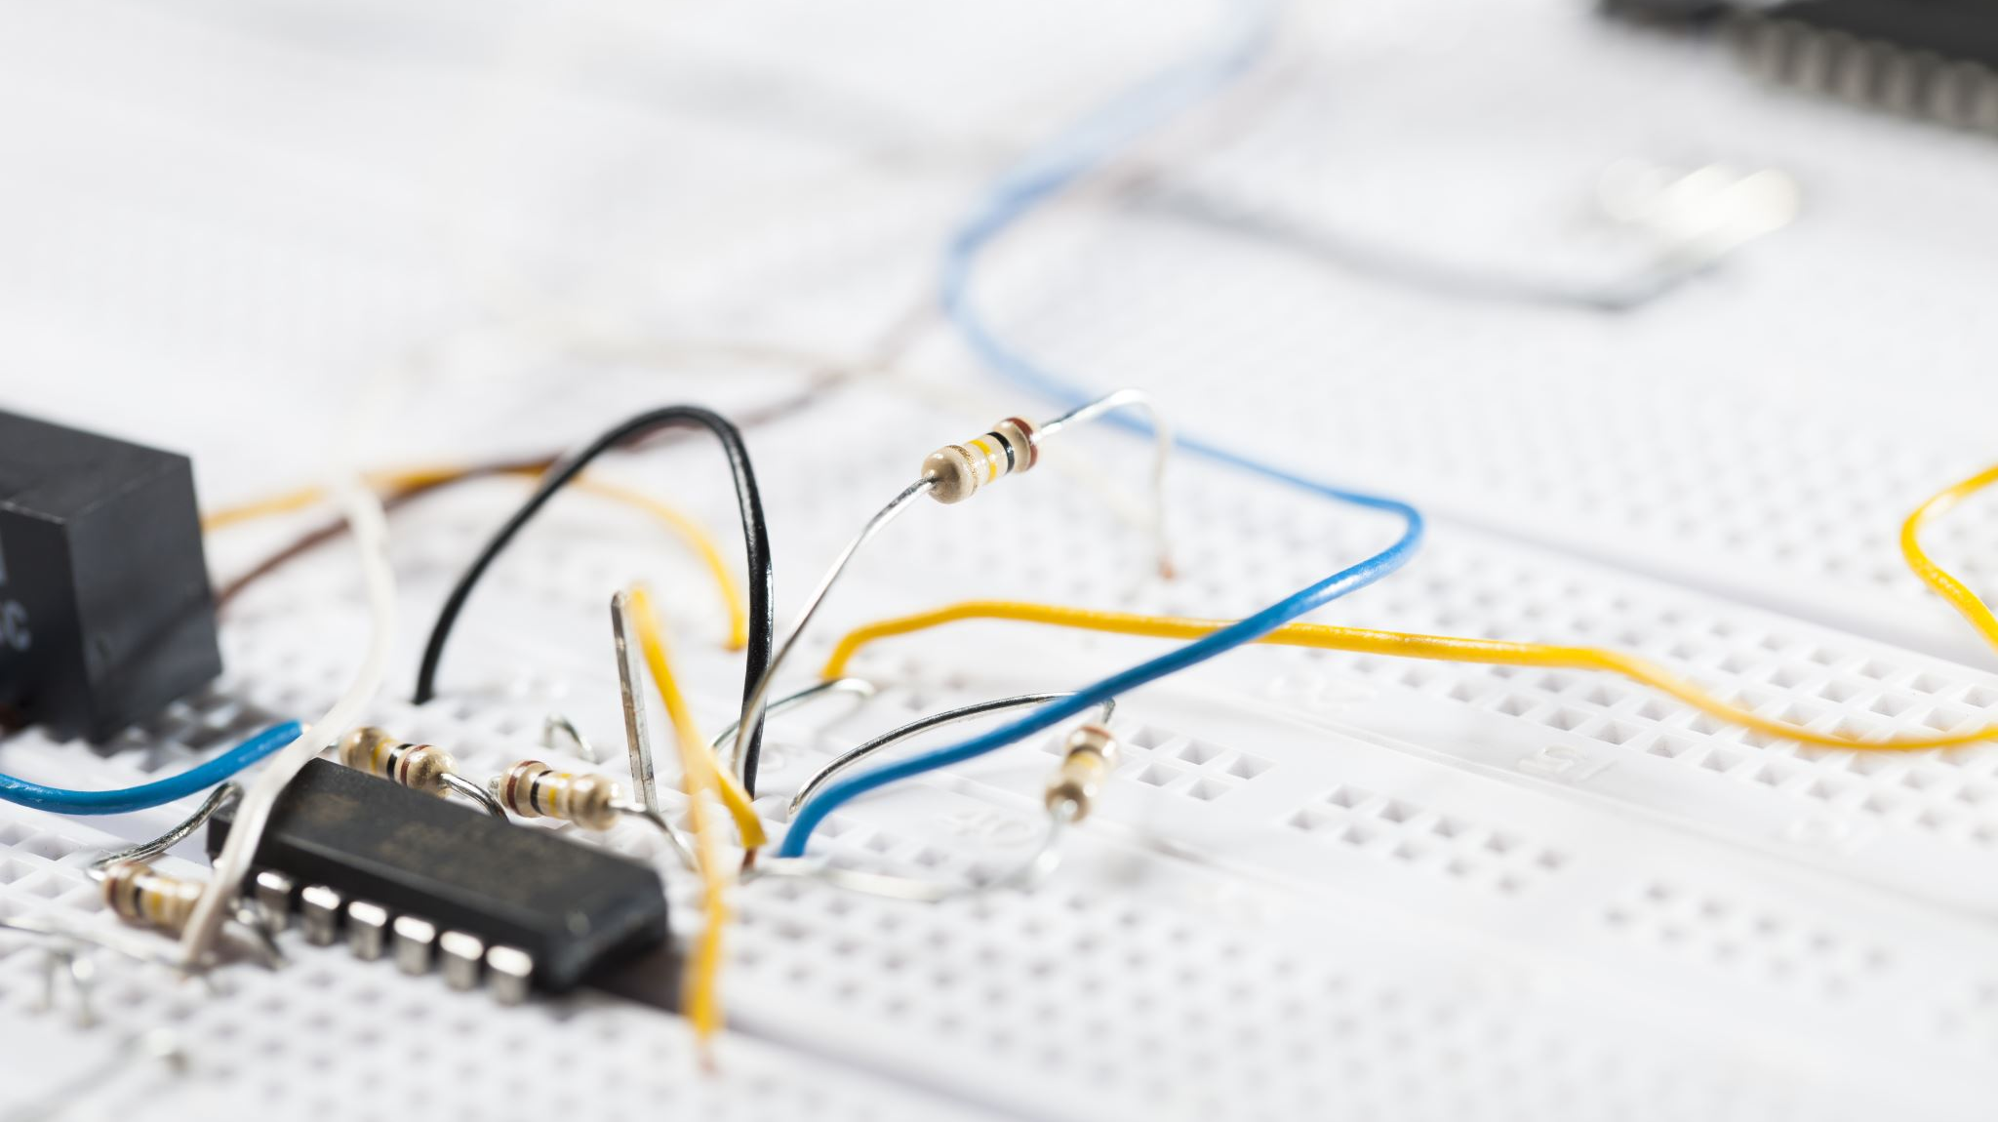
Transport Layer Berkeley Socket API – TCP and UDP

Slide 2
Berkeley Socket API
Berkeley UNIX Sockets API
Abstraction for applications to send & receive data
Applications create sockets that “plug into” network
Applications write/read to/from sockets
Implemented in the kernel
Facilitates development of network applications
Hides details of underlying protocols & mechanisms
Also in Windows, Linux, and other OS’s

Slide 3
Communications through Sockets
Client
Server
Socket interface
Application 1
Application 2
Socket interface
descriptor
User
User
descriptor
Kernel
Kernel
Socket
Socket
Application references a
socket through a descriptor
Socket bound to a port number
port number
port number
Underlying communication protocols
Underlying communication protocols
Communications network

Slide 4
Transport Protocols
Host computers run two transport protocols on top of IP to enable process-to-process communications
User Datagram Protocol (UDP) enables best-effort connectionless transfer of individual block of information
Transmission Control Protocol (TCP) enables connection-oriented reliable transfer of a stream of bytes
Two services though Sockets: connection-oriented and connection-less

Slide 5
Stream Mode of Service
Connectionless (UDP)
Immediate transfer of one block of information (boundaries preserved)
No setup overhead & delay
Destination address with each block
Send/receive to/from multiple peer processes
Best-effort service only
Possible out-of-order
Possible loss
Connection-oriented (TCP)
First, setup connection between two peer application processes
Then, reliable bidirectional in-sequence transfer of byte stream (boundaries not preserved in transfer)
Multiple write/read between peer processes
Finally, connection release

Slide 6
Client & Server Differences
Server
Specifies well-known port # when creating socket
May have multiple IP addresses (net interfaces)
Waits passively for client requests
Client
Assigned ephemeral port #
Initiates communications with server
Needs to know server’s IP address & port #
DNS for URL & server well-known port #
Server learns client’s address & port #

Slide 7
Socket Calls for Connection-Oriented Mode
Server does Passive Open
socket call creates socket to listen for connection requests
Server specifies type: TCP (stream)
socket call returns: non-negative integer descriptor; or -1 if unsuccessful
Server
socket()
bind()
listen()
Client
accept()
socket()
Blocks
Connect negotiation
connect()
Data
write()
read()
write()
Data
read()
close()
close()

Slide 8
Socket Calls for Connection-Oriented Mode
Server
bind assigns local address & port # to socket with specified descriptor
Can wildcard IP address for multiple net interfaces
bind call returns: 0 (success); or -1 (failure)
Failure if port # already in use or if reuse option not set
socket()
bind()
listen()
Client
accept()
socket()
Blocks
Connect negotiation
connect()
Data
write()
read()
write()
Data
read()
close()
close()

Slide 9
Socket Calls for Connection-Oriented Mode
listen indicates to TCP readiness to receive connection requests for socket with given descriptor
Parameter specifies max number of requests that may be queued while waiting for server to accept them
listen call returns: 0 (success); or -1 (failure)
Server
socket()
bind()
listen()
Client
accept()
socket()
Blocks
Connect negotiation
connect()
Data
write()
read()
write()
Data
read()
close()
close()

Slide 10
Server
Server calls accept to accept incoming requests
accept blocks if queue is empty
socket()
bind()
listen()
Client
accept()
socket()
Blocks
Connect negotiation
connect()
Data
write()
read()
write()
Data
read()
close()
close()

Slide 11
Socket Calls for Connection-Oriented Mode
Client does Active Open
socket call creates socket to connect to server
Client specifies type: TCP (stream)
socket call returns: non-negative integer descriptor; or -1 if unsuccessful
Server
socket()
bind()
listen()
Client
accept()
socket()
Blocks
Connect negotiation
connect()
Data
write()
read()
write()
Data
read()
close()
close()

Slide 12
Server
connect establishes a connection on the local socket with the specified descriptor to the specified remote address and port #
connect returns 0 if successful; -1 if unsuccessful
socket()
bind()
listen()
Client
accept()
socket()
Note: connect initiates TCP three-way handshake
Blocks
Connect negotiation
connect()
Data
write()
read()
write()
Data
read()
close()
close()

Slide 13
Socket Calls for Connection-Oriented Mode
accept wakes with incoming connection request
accept fills client address & port # into address structure
accept call returns: descriptor of new connection socket (success); or -1 (failure)
Client & server use new socket for data transfer
Original socket continues to listen for new requests
Server
socket()
bind()
listen()
Client
Socket Calls for Connection-Oriented Mode
accept()
socket()
Blocks
Connect negotiation
connect()
Data
write()
read()
write()
Data
read()
close()
close()

Slide 14
Data Transfer
Client or server call write to transmit data into a connected socket
write call returns: # bytes transferred (success); or -1 (failure); blocks until all data transferred
Server
socket()
bind()
listen()
Client
accept()
socket()
Blocks
Connect negotiation
connect()
Data
write()
read()
write()
Data
read()
close()
close()

Slide 15
Data Transfer
Client or server call read to receive data from a connected socket
read specifies: socket descriptor; pointer to a buffer; amount of data
read call returns: # bytes read (success); or -1 (failure); blocks if no data arrives
Server
socket()
bind()
listen()
Client
accept()
socket()
Note: write and read can be called multiple times to transfer byte streams in both directions
Blocks
Connect negotiation
connect()
Data
write()
read()
write()
Data
read()
close()
close()

Slide 16
Connection Termination
Client or server call close when socket is no longer needed
close specifies the socket descriptor
close call returns: 0 (success); or -1 (failure)
Server
socket()
bind()
listen()
Client
Note: close initiates TCP graceful close sequence
accept()
Socket Calls for Connection-Oriented Mode
socket()
Blocks
Connect negotiation
connect()
Data
write()
read()
write()
Data
read()
close()
close()

Slide 17
Berkeley Socket API - UDP

Slide 18

Stream Mode of Service
Connectionless (UDP)
Immediate transfer of one block of information (boundaries preserved)
No setup overhead & delay
Destination address with each block
Send/receive to/from multiple peer processes
Best-effort service only
Possible out-of-order
Possible loss

Slide 19
Socket Calls for Connection-Less Mode
Server starts first
Socket call creates socket of type UDP (datagram)
socket call returns: descriptor; or -1 if unsuccessful
bind assigns local address & port # to socket with specified descriptor
Server
socket()
bind()
Client
recvfrom()
socket()
Blocks until server receives data from client
Data
sendto()
sendto()
Data
recvfrom()
close()
close()

Slide 20
Socket Calls for Connection-Less Mode
recvfrom copies bytes received in specified socket into a specified location
recvfrom blocks until data arrives
Server
socket()
bind()
Client
recvfrom()
socket()
Blocks until server receives data from client
Data
sendto()
sendto()
Data
recvfrom()
close()
close()

Slide 21
Socket Calls for Connection-Less Mode
Client started
socket creates socket of type UDP (datagram)
socket call returns: descriptor; or -1 if unsuccessful
Server
socket()
bind()
Client
recvfrom()
socket()
Data
Blocks until server receives data from client
sendto()
sendto()
Data
recvfrom()
close()
close()

Slide 22
sendto transfer bytes in buffer to specified socket
sendto specifies: socket descriptor; pointer to a buffer; amount of data; flags to control transmission behavior; destination address & port #; length of destination address structure
sendto returns: # bytes sent; or -1 if unsuccessful
Server
socket()
bind()
Client
recvfrom()
socket()
Blocks until server receives data from client
Data
sendto()
sendto()
Data
recvfrom()
close()
close()

Slide 23
Server
recvfrom wakes when data arrives
recvfrom specifies: socket descriptor; pointer to a buffer to put data; max # bytes to put in buffer; control flags; copies: sender address & port #; length of sender address structure
recvfrom returns # bytes received or -1 (failure)
socket()
bind()
Client
recvfrom()
socket()
Note: recvfrom returns data from at most one send, i.e. from one datagram
Blocks until server receives data from client
Data
sendto()
sendto()
Data
recvfrom()
close()
close()

Slide 24
Socket Calls for Connection-Less Mode
Socket Close
Client or server call close when socket is no longer needed
close specifies the socket descriptor
close call returns: 0 (success); or -1 (failure)
Server
socket()
bind()
Client
recvfrom()
socket()
Data
Blocks until server receives data from client
sendto()
sendto()
Data
recvfrom()
close()
close()

