Slide 1

Transport Layer
Congestion Control

Slide 2

DATA TRAFFIC
The main focus of congestion control and quality of service is data traffic.
In congestion control, traffic congestion is avoided.

Slide 3
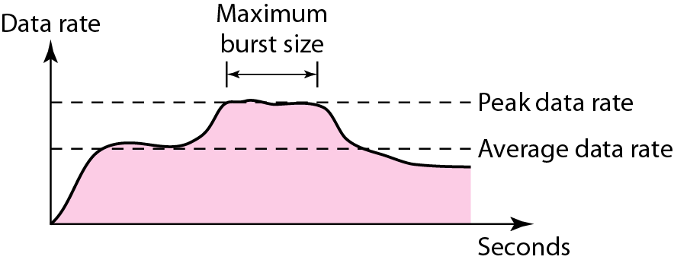
Traffic descriptors
Traffic descriptors are qualitative values that represent a data flow.
Average Data Rate: It indicates the average bandwidth needed by the traffic.
The peak data rate defines the maximum data rate of the traffic. It indicates the peak bandwidth that the network needs for traffic to pass through without changing its data flow.
The maximum burst size normally refers to the maximum length of time the traffic is generated at the peak rate.
The effective bandwidth is the bandwidth that the network needs to allocate for the flow of traffic. The effective bandwidth is a function of three values: average data rate, peak data rate, and maximum burst size.
Traffic flow

Slide 4
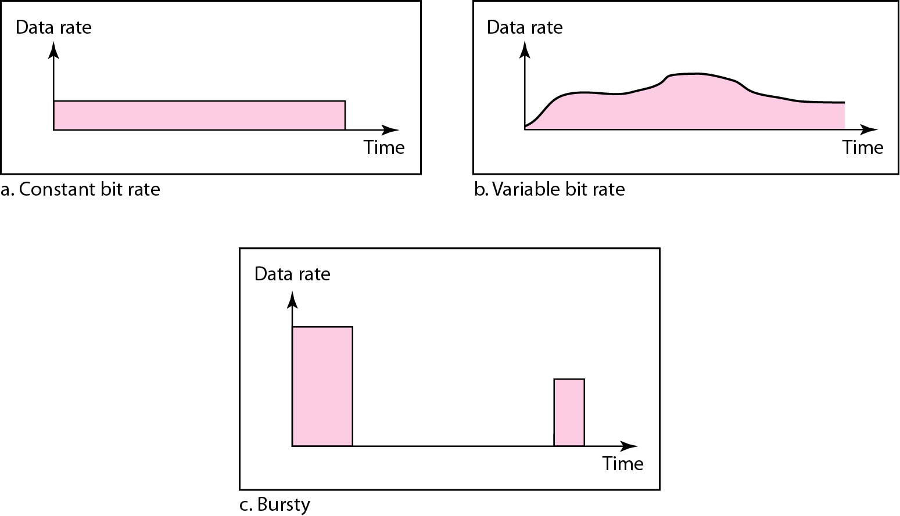
Three traffic profiles
A constant-bit-rate (CBR), or a fixed-rate, traffic model has a data rate that does not change.
In the variable-bit-rate (VBR) category, the rate of the data flow changes in time, with the changes smooth instead of sudden and sharp
In the bursty data category, the data rate changes suddenly in a very short time.

Slide 5
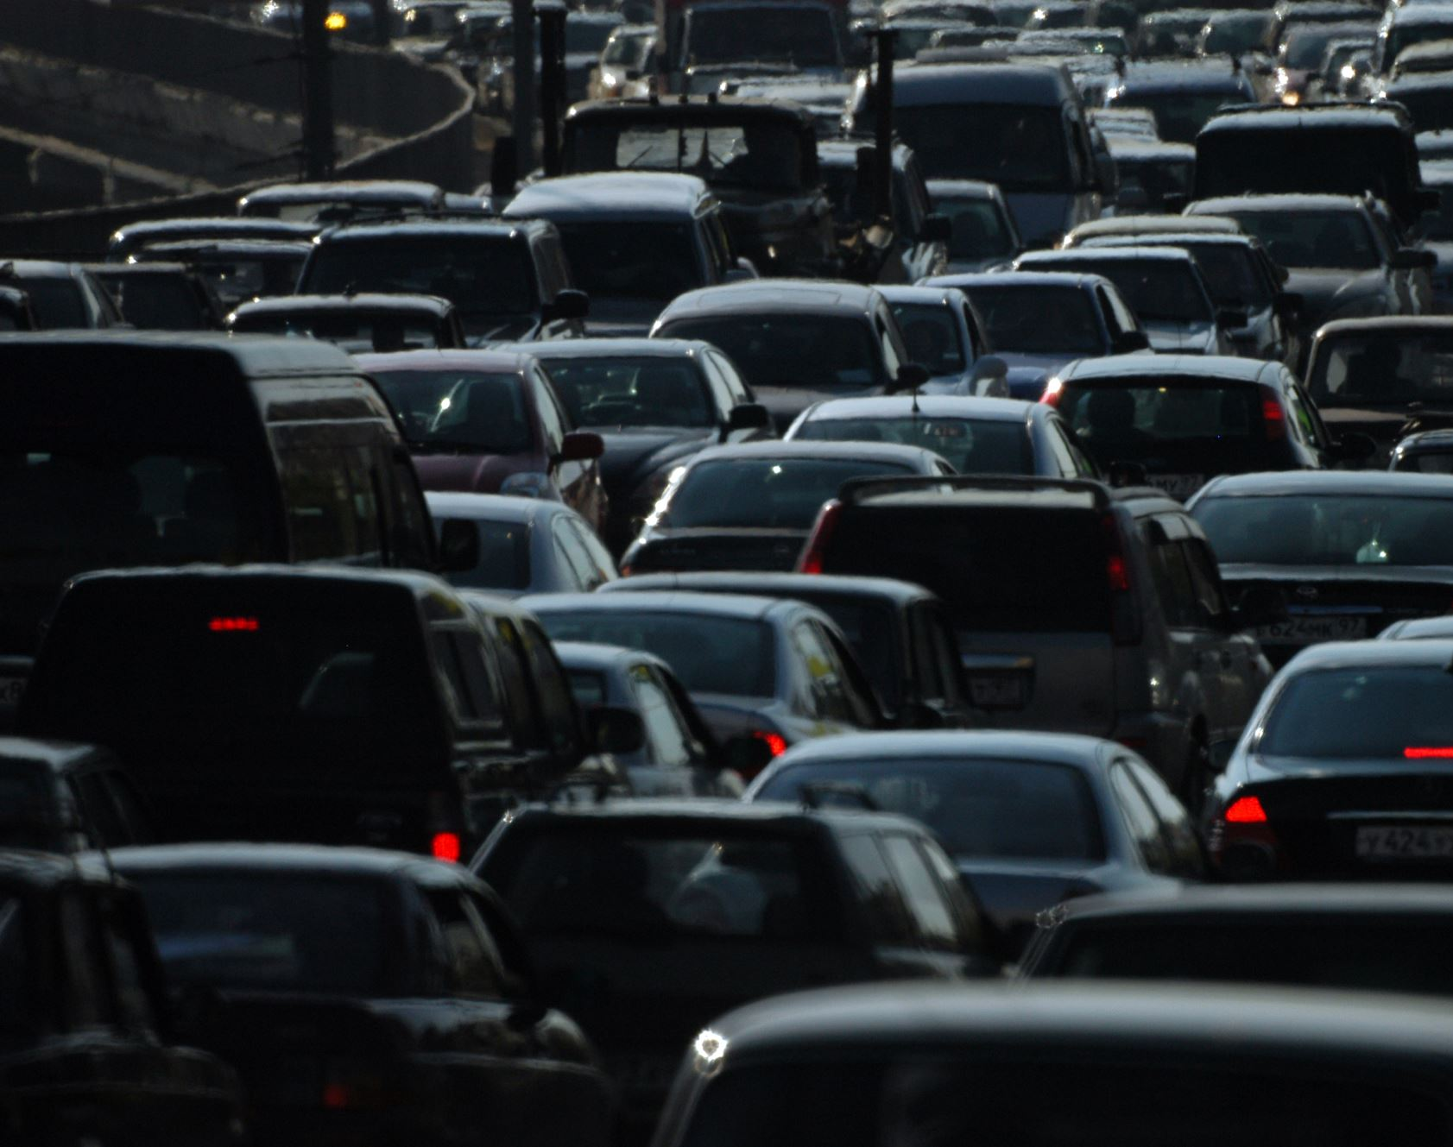
CONGESTION
Congestion in a network may occur if the load on the network i.e. the number of packets sent to the network is greater than the capacity of the network (the number of packets a network can handle).
Congestion control refers to the mechanisms and techniques to control the congestion and keep the load below the capacity.

Slide 6
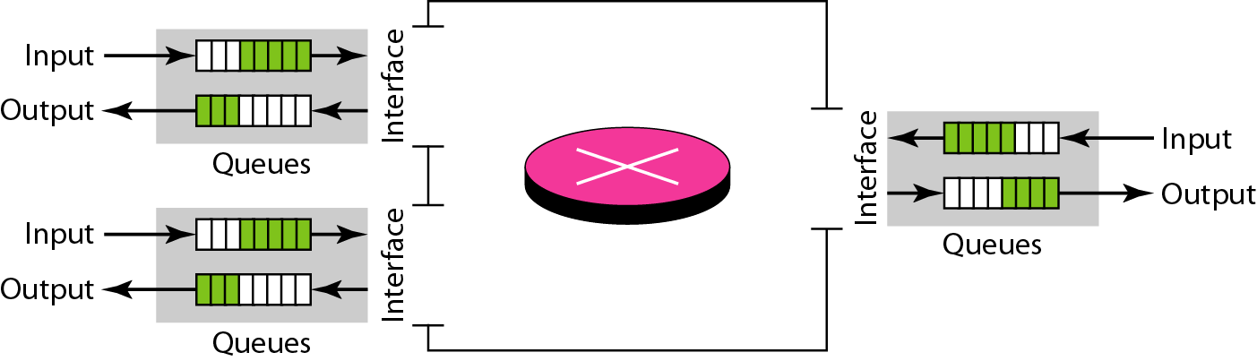
Queues in a router
Congestion in a network or internetwork occurs because routers and switches have queues-buffers that hold the packets before and after processing. When a packet arrives at the incoming interface, it undergoes three steps before departing,
1. The packet is put at the end of the input queue while waiting to be checked.
2. The processing module of the router removes the packet from the input queue once it reaches the front of the queue and uses its routing table and the destination address to find the route.
3. The packet is put in the appropriate output queue and waits its turn to be sent.

Slide 7
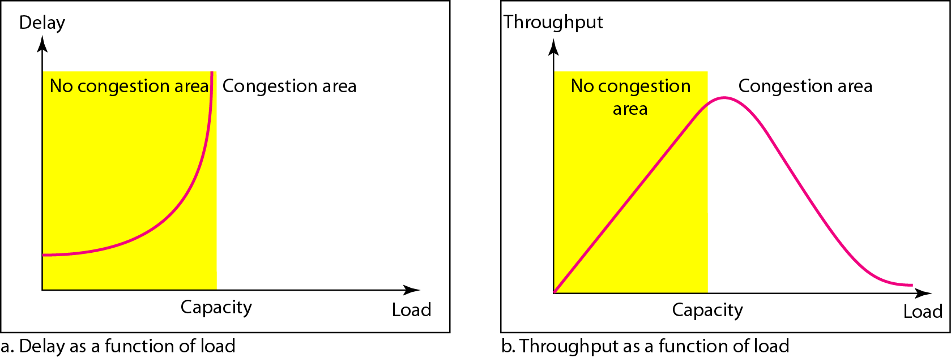
Network Performance
Congestion control involves two factors that measure the performance of a network: Delay and Throughput
Delay- If load << capacity of the network, the delay is at a minimum. This minimum delay is composed of propagation delay and processing delay, both of which are negligible. If load reaches the network capacity, the delay increases sharply because we now need to add the waiting time in the queues to the total delay.
Delay becomes infinite when the load is greater than the capacity.
Throughput- Throughput in a network can be defined as the number of packets passing through the network in a unit of time.
Packet delay and throughput as functions of load

Slide 8

CONGESTION CONTROL
Congestion control refers to techniques and mechanisms that can either prevent congestion, before it happens, or remove congestion, after it has happened.
In general, congestion control mechanisms can be divided into two broad categories:
open-loop congestion control (prevention)
closed-loop congestion control (removal).

Slide 9
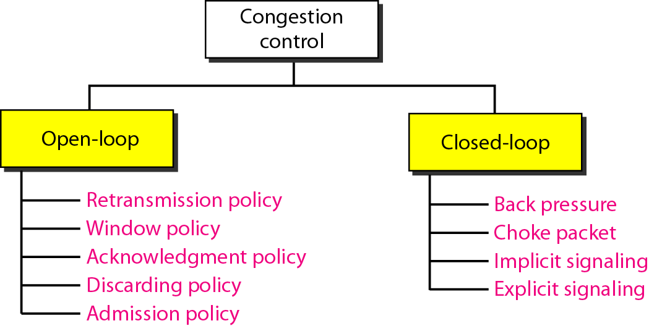
Congestion control categories
In open-loop congestion control, policies are applied to prevent congestion before it happens.
The retransmission policy and the retransmission timers must be designed to optimize efficiency and at the same time prevent congestion.
The Selective Repeat window is better than the Go-Back-N window for congestion control

Slide 10
Congestion control categories- Open Loop
The acknowledgment policy imposed by the receiver may also affect congestion. If the receiver does not acknowledge every packet it receives, it may slow down the sender and help prevent congestion
A good discarding policy by the routers may prevent congestion and at the same time may not harm the integrity of the transmission.
An admission policy, which is a quality-of-service mechanism, can also prevent congestion in virtual-circuit networks.

Slide 11
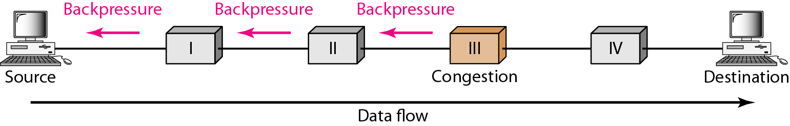
Congestion control categories- Closed Loop
Closed-loop congestion control mechanisms try to alleviate congestion after it happens.
Congestion control mechanism in which a congested node stops receiving data from the immediate upstream node or nodes.
The backpressure technique can be applied only to virtual circuit networks, in which each node knows the upstream node from which a flow of data is Coming.
Backpressure method for alleviating congestion

Slide 12
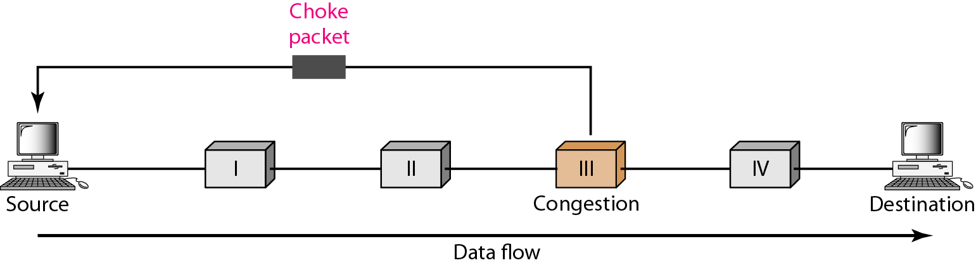
Choke packet
A choke packet is a packet sent by a node to the source to inform it of congestion.
In implicit signalling- there is no communication between the congested node or nodes and the source
Explicit Signaling- The node that experiences congestion can explicitly send a signal to the source or destination.
In TCP
The sender has two pieces of information: the receiver-advertised window size and the congestion window size. The actual size of the window is the minimum of these two.
Actual window size = minimum (rwnd, cwnd)

Slide 13
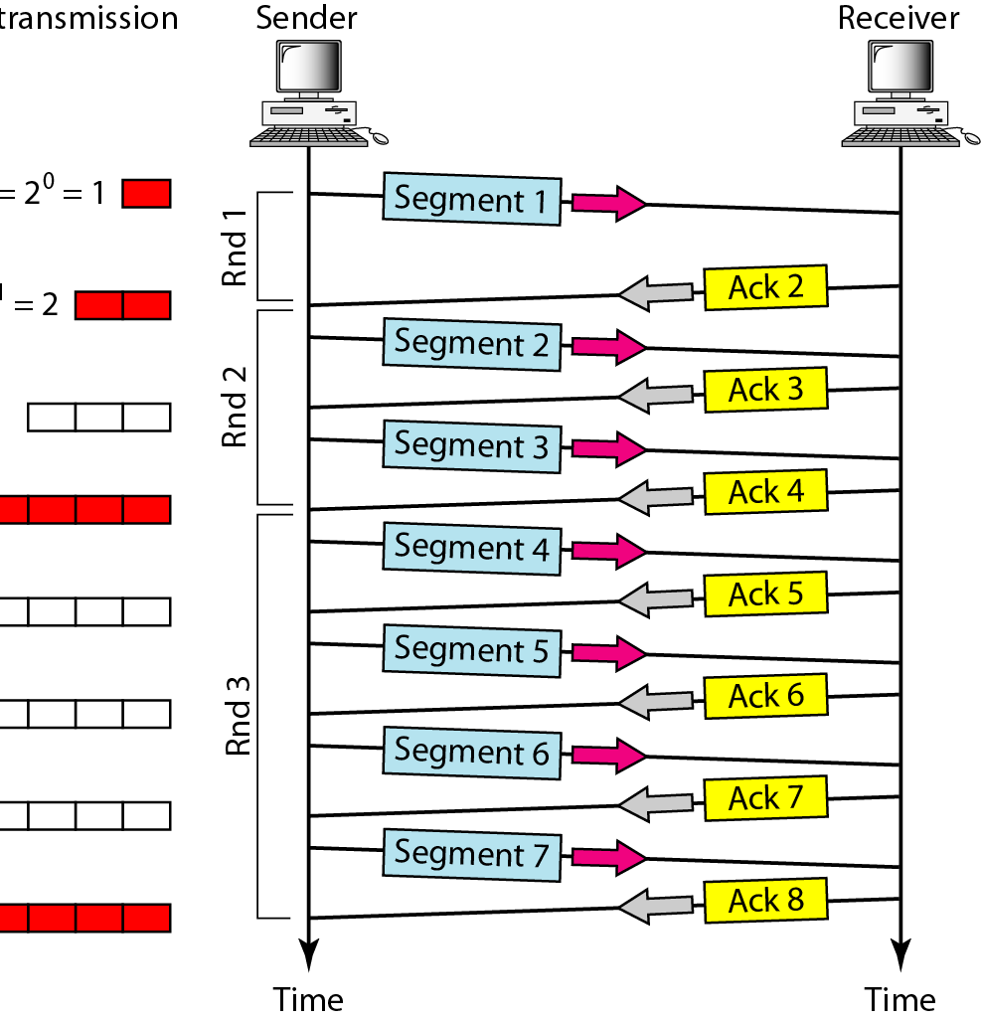
Congestion Policy
TCP's general policy for handling congestion is based on three phases:
Slow start
Congestion avoidance
Congestion detection.
In the slow-start algorithm, the size of the congestion window increases exponentially until it reaches a threshold.
The sender keeps track of a variable named ssthresh (slow-start threshold). In most implementations the value of ssthresh is 65,535 bytes.
Rate is exponential as shown below:
Start ..... cwnd=1
After round 1 ..... cwnd= 2¹ =2
After round 2 ..... cwnd= 2² =4
After round 3 ..... cwnd= 2³ =8

Slide 14
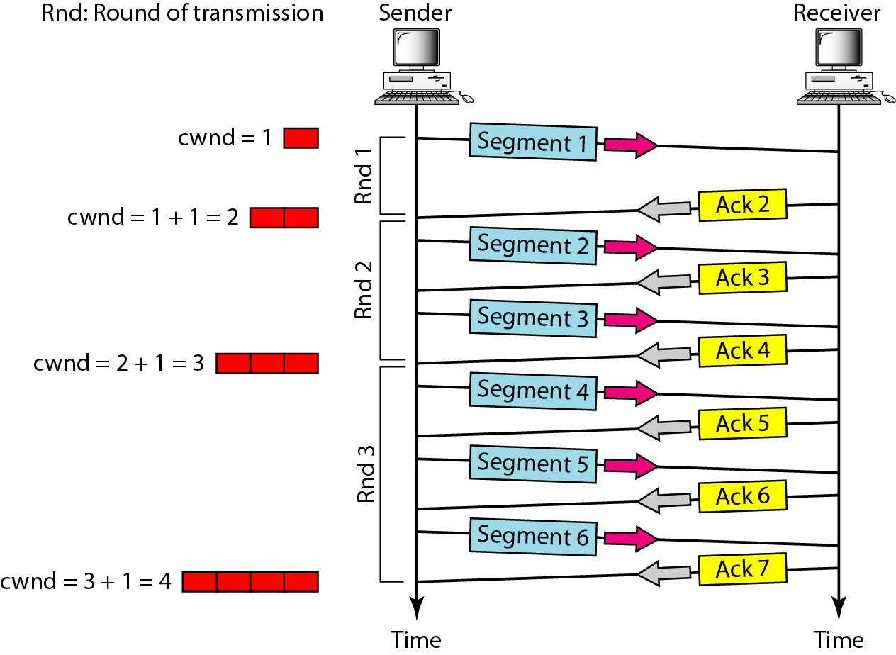
Congestion avoidance & Congestion detection
Congestion avoidance, additive increase
In the congestion avoidance algorithm, the size of the congestion window increases additively until congestion is detected.
TCP defines another algorithm called congestion avoidance, which undergoes an additive increase instead of an exponential one.
  Start cwnd=1
  After round 1 cwnd= 1+ 1 =2
  After round 2 cwnd=2+ 1 =3
  After round 3 cwnd=3+ 1 =4
Congestion detection, Multiplicative Decrease
If congestion occurs, the congestion window size must be decreased.
The only way - retransmit a segment.
Retransmission can occur in one of two cases: timer times out or when three ACKs are received.
An implementation reacts to congestion detection in one of the following ways:
❏ If detection is by time-out, a new slow start phase starts.
❏ If detection is by three ACKs, a new congestion avoidance phase starts.

Slide 15
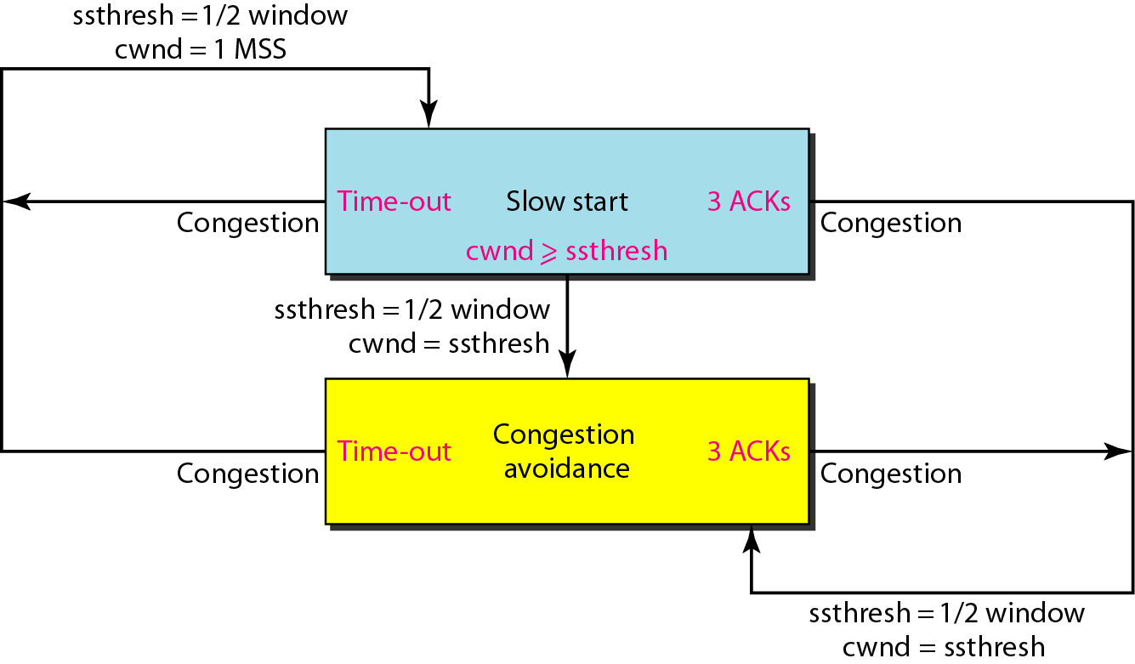
TCP congestion policy summary
Summary of the congestion policy of TCP and the relationships between the three phases.
AIMD (Additive Inverse and Multiplicative Decrease)

Slide 16
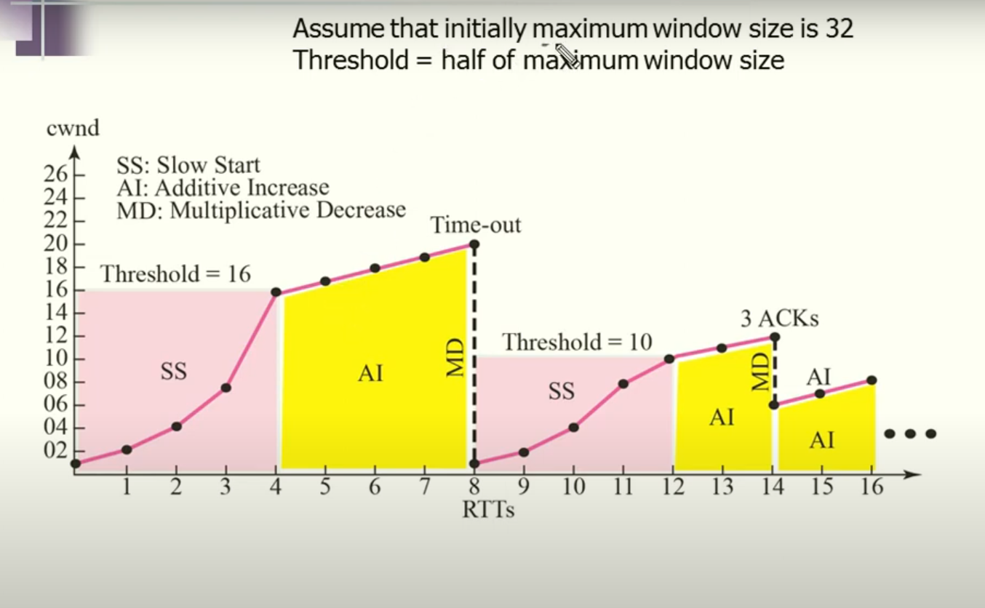
TCP congestion policy
Assume a TCP connection with an initial maximum window size of 32 MSS. Calculate the CWND or MSS values for each RTT from 1 to 16, assuming MSS = 1, and express the window size growth across different TCP phases.
CONSIDER THE FOLLOWING CASES:
Time-out and
3 Ack

Slide 17
TCP congestion policy
Consider a TCP connection operating at a point of time with the congestion window of size 12 MSS (Maximum Segment Size), when a timeout occurs due to packet loss. Assuming that all the segments transmitted in the next two RTTs (Round Trip Time) are acknowledged correctly, the congestion window size (in MSS) during the third RTT will be __________.

Slide 18
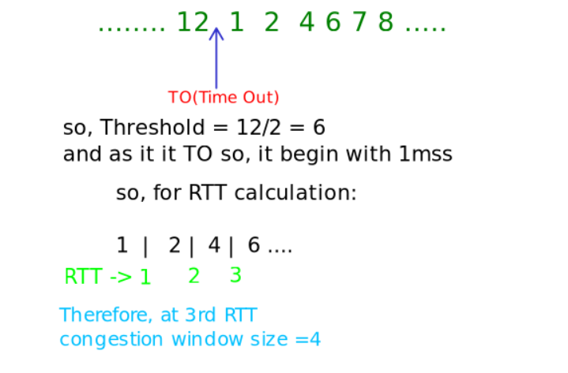
TCP congestion policy
Consider a TCP connection operating at a point of time with the congestion window of size 12 MSS (Maximum Segment Size), when a timeout occurs due to packet loss. Assuming that all the segments transmitted in the next two RTTs (Round Trip Time) are acknowledged correctly, the congestion window size (in MSS) during the third RTT will be __________.

