Slide 1

Transport Layer protocols

Slide 2

Types of Protocols
UDP
TCP
SCTP

Slide 3
USER DATAGRAM PROTOCOL (UDP)
The User Datagram Protocol (UDP) is called a connectionless, unreliable transport protocol.
UDP is a very simple protocol using a minimum of overhead. If a process wants to send a small message and does not care much about reliability, it can use UDP.
Sending a small message by using UDP takes much less interaction between the sender and receiver than using TCP or SCTP.

Slide 4
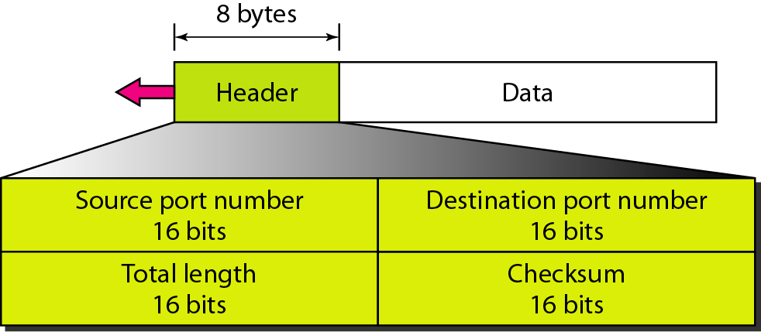
User datagram format
Source port number- This is the port number used by the process running on the source host.
Destination port number- This is the port number used by the process running on the destination host.
Length- This is a 16-bit field that defines the total length of the user datagram, header plus data.
Checksum- This field is used to detect errors over the entire user datagram (header plus data).
UDP length
= IP length – IP header’s length

Slide 5
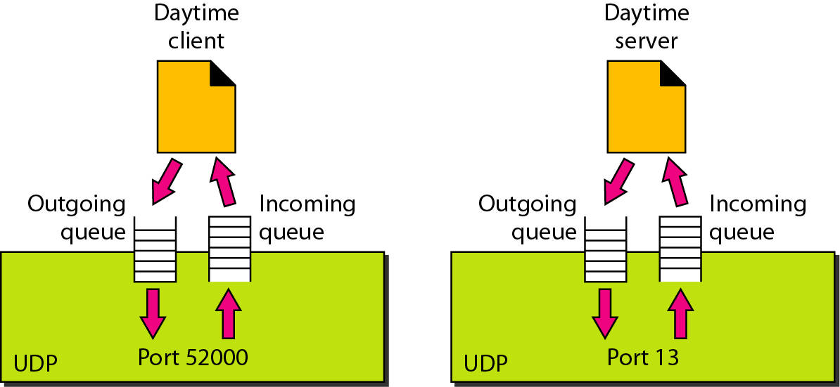
UDP Operation
Connectionless Services
    Each user datagram sent by UDP is an independent datagram.
Flow and Error Control
    UDP is a very simple, unreliable transport protocol. There is no flow control and hence no window mechanism. The receiver may overflow with incoming messages.
Encapsulation and Decapsulation
    To send a message from one process to another, the UDP protocol encapsulates and decapsulates messages in an IP datagram.
Queuing
    In UDP, queues are associated with ports
Queues in UDP

Slide 6
Transmission Control Protocol (TCP)
TCP is a connection-oriented protocol; it creates a virtual connection between two TCPs to send data.
Flow Control- This is done to prevent the receiver from being overwhelmed with data. TCP uses a byte-oriented flow control.
Error Control- Error detection and correction in TCP is achieved through the use of three simple tools: checksum, acknowledgment, and time-out.
Congestion Control- TCP, unlike UDP, takes into account congestion in the network. The amount of data sent by a sender is not only controlled by the receiver (flow control), but is also determined by the level of congestion in the network.

Slide 7
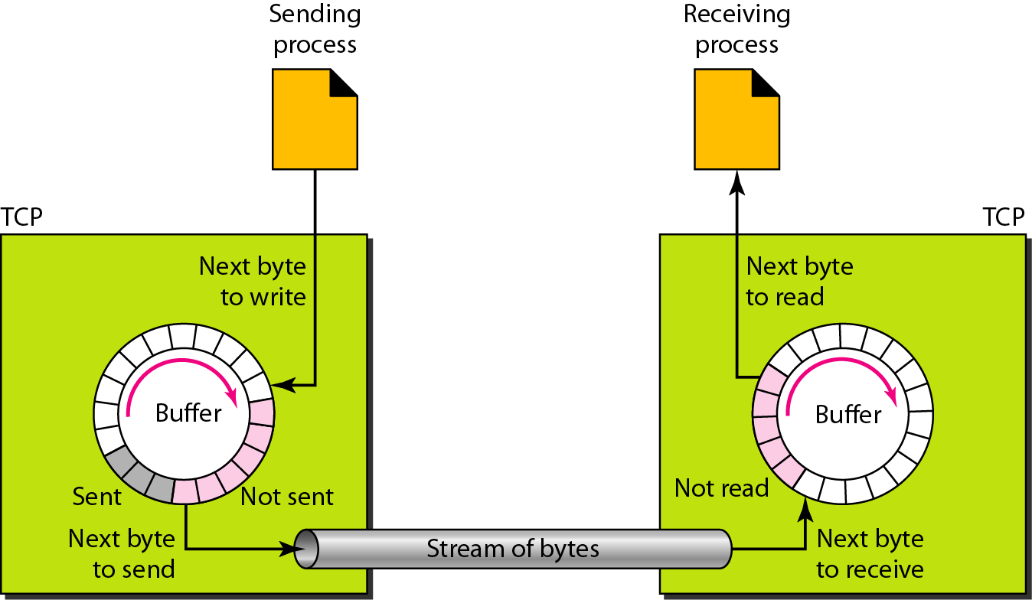
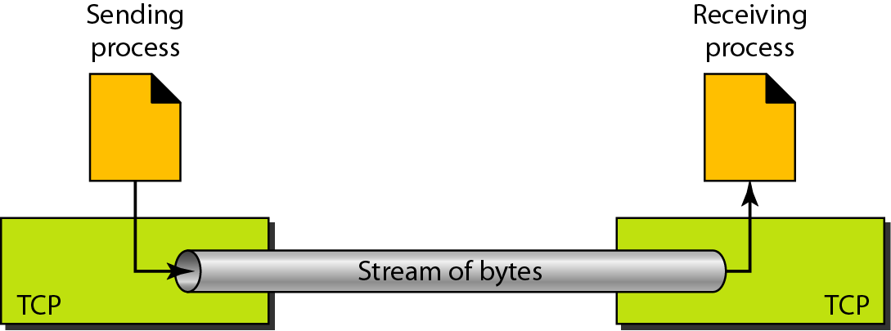
TCP is a stream-oriented protocol. Data is delivered as a stream of bytes
The sending process produces (writes to) and the receiving process consumes (reads from) the stream of bytes.
Buffers are also necessary for flow and error control mechanisms used by TCP.
Buffer is implemented using a circular array of 1-byte locations.
Two buffers of 20 bytes each; normally the buffers are hundreds or thousands of bytes, depending on the implementation.
Stream delivery
Sending and receiving buffers

Slide 8
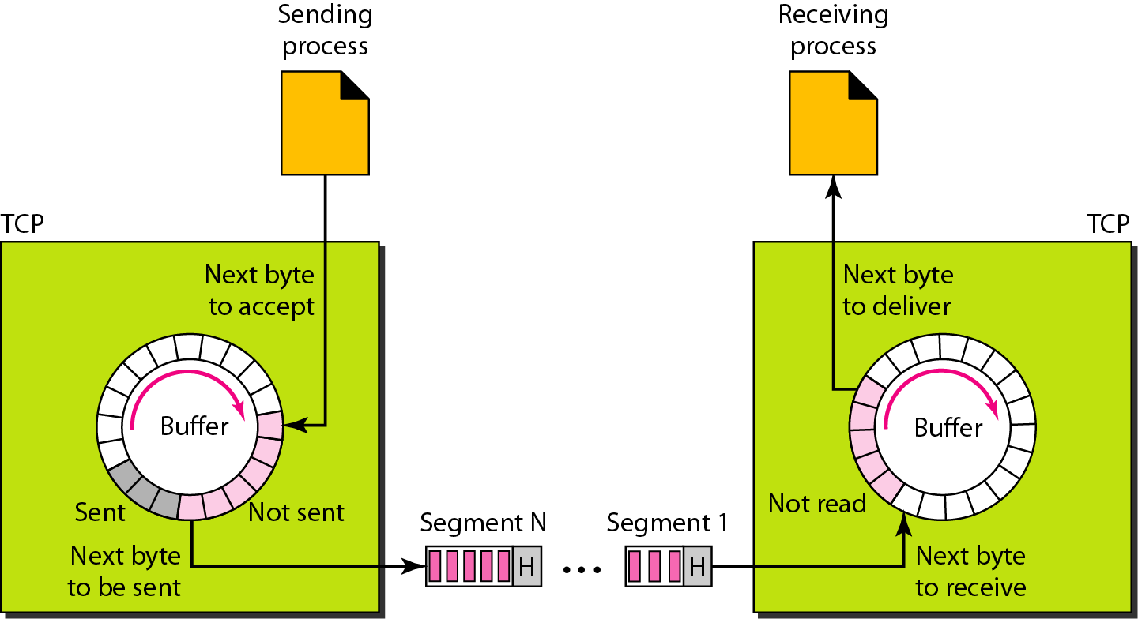
TCP segments
Although buffering handles the disparity between the speed of the producing and consuming processes, The IP layer, as a service provider for TCP, needs to send data in packets, not as a stream of bytes.
At the transport layer, TCP groups a number of bytes together into a packet called a segment.
The bytes of data being transferred in each connection are numbered by TCP.
The numbering starts with a randomly generated number.
If the randomly generated sequence number is x, the first data byte is numbered x + 1.
The value of the acknowledgment field in a segment defines the number of the next byte a party expects to receive. The acknowledgment number is cumulative.

Slide 9
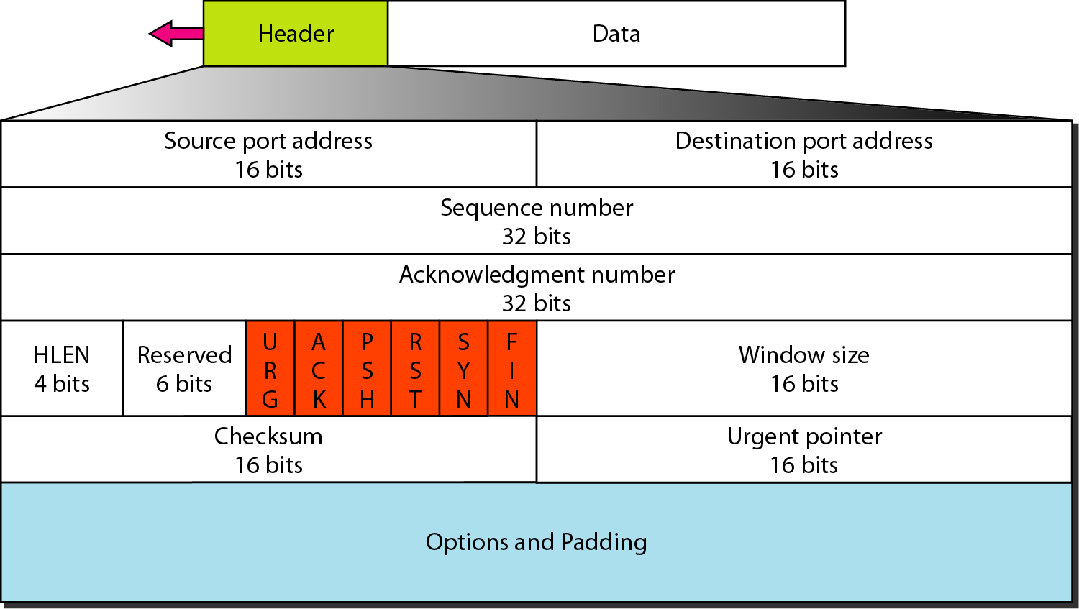
TCP segment format
20 to 60 B header
Source port address
Destination port address
Sequence number- defines the number assigned to the first byte of data contained in this segment.
Acknowledgment number- defines the byte number that the receiver of the segment is expecting to receive from the other party
Header- length- number of 4-byte words in the TCP header.
Reserved.- This is a 6-bit field reserved for future use.
. Control- This field defines 6 different control bits or flags.
Window size- This field defines the size of the window, in bytes, that the other party must maintain
TCP segment format

Slide 10
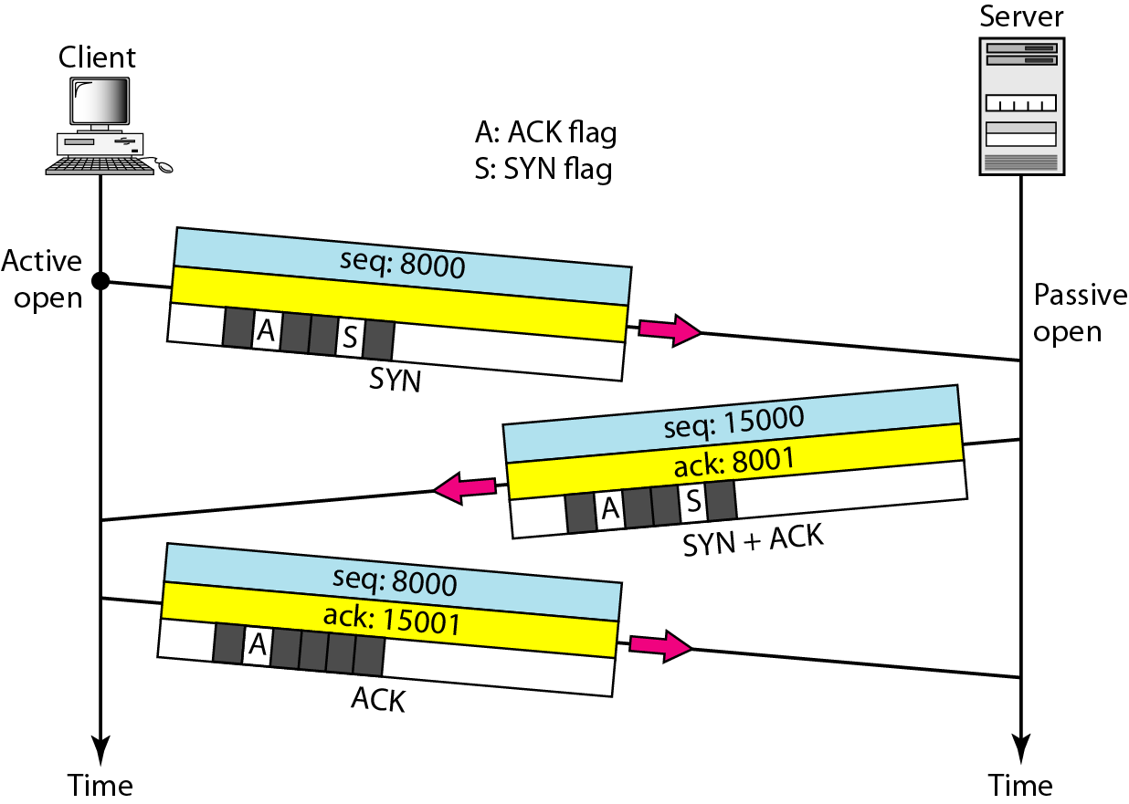
Connection establishment
using three-way handshaking
The server program tells its TCP that it is ready to accept a connection. This is called a request for a passive open.
The client program issues a request for an active open.
The client sends the first segment, a SYN segment, in which only the SYN flag is set. This segment is for synchronization of sequence numbers. When the data transfer starts, the sequence number is incremented by 1.
The server sends the second segment, a SYN +ACK segment, with 2 flag bits set: SYN and ACK.
A SYN segment cannot carry data, but it consumes one sequence number.
A SYN + ACK segment cannot
carry data, but does consume one
sequence number.
An ACK segment, if carrying no data, consumes no sequence number.

Slide 11
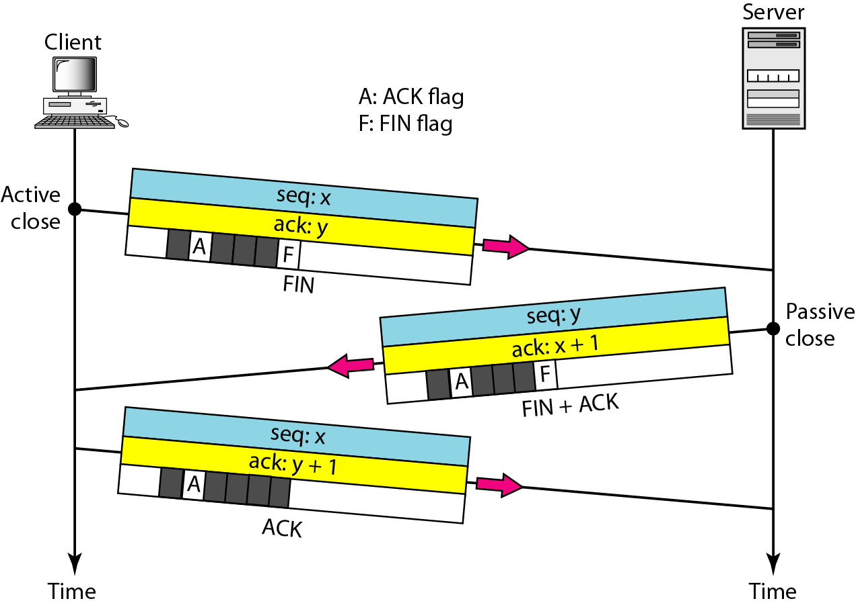
Connection termination using
three-way handshaking
The FIN segment consumes one sequence number if it does not carry data
The FIN + ACK segment consumes
one sequence number if it
does not carry data

Slide 12
SCTP
Stream Control Transmission Protocol (SCTP) is a new reliable, message-oriented transport layer protocol.
SCTP, however, is mostly designed for Internet applications that need a more sophisticated service than TCP can provide.
SCTP combines the best features of UDP and TCP.

Slide 13
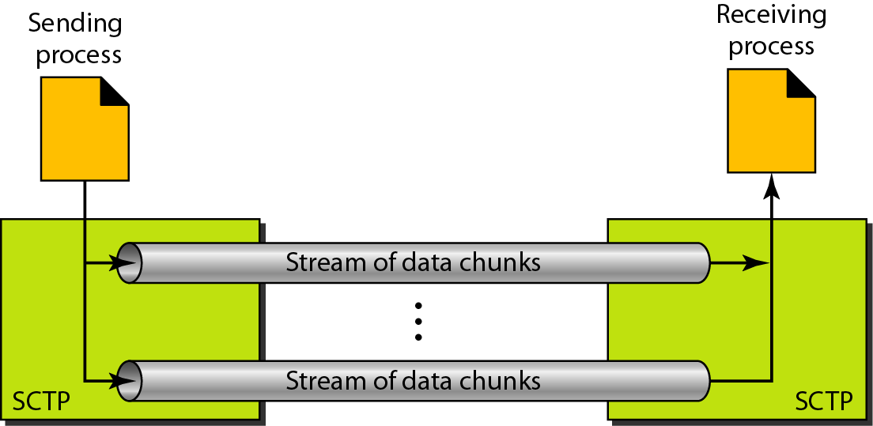
Connection-Oriented Service
Connection-oriented protocol.
In SCTP, a connection is called an association.
The two SCTPs establish an association between each other.
Data are exchanged in both directions.
The association is terminated.
Multiple-stream concept

Slide 14
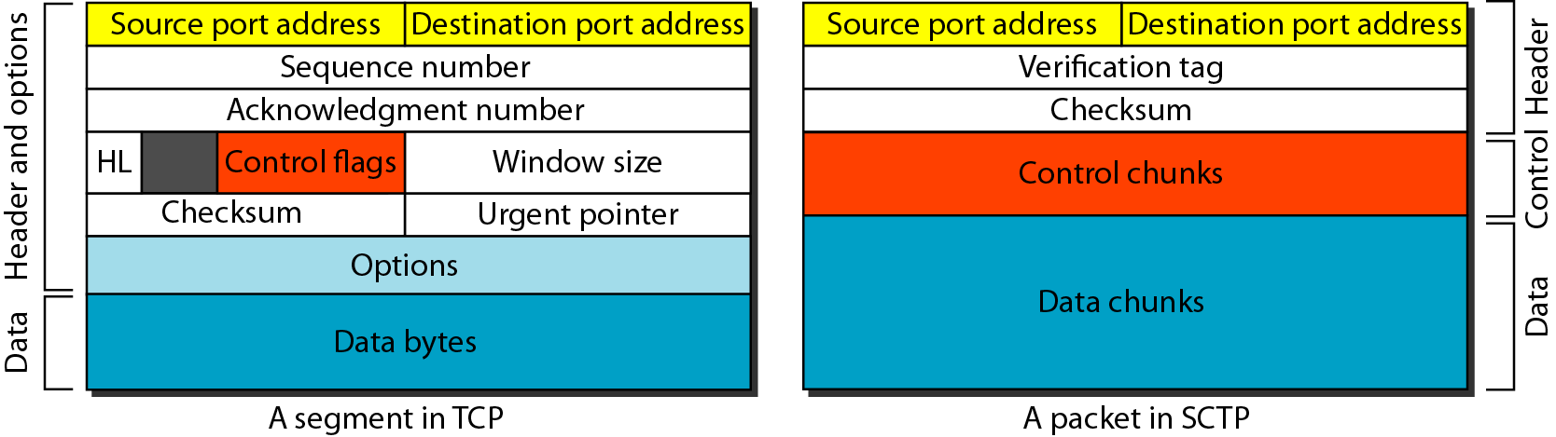
Comparison between a TCP segment and an SCTP packet
In SCTP, control information and data information are carried in separate chunks.
The verification tag in SCTP is an association identifier

Slide 15
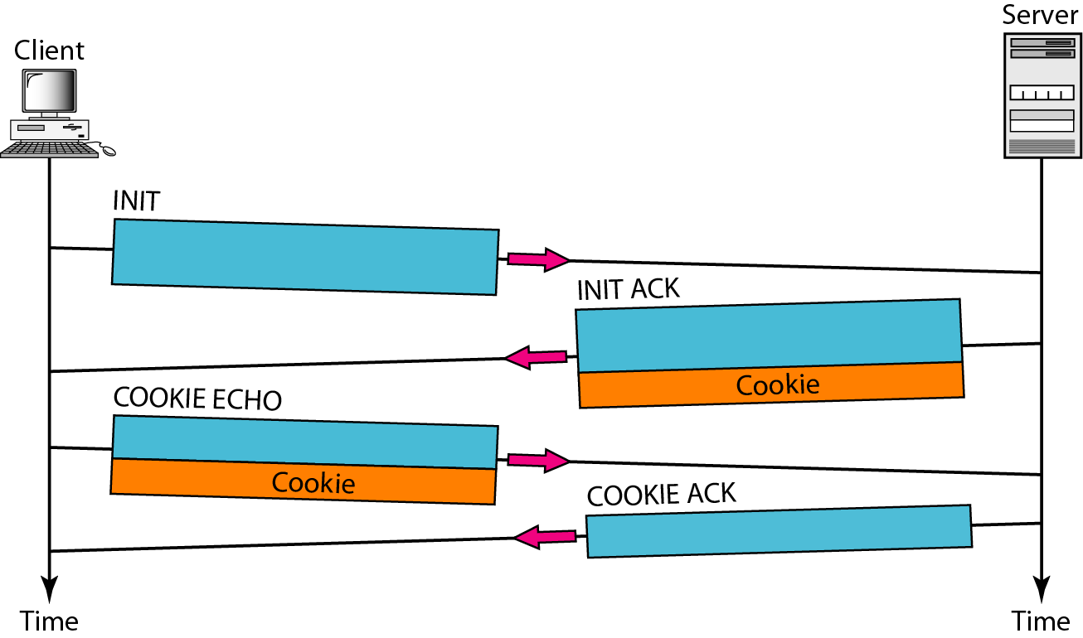
Four-way handshaking
SCTP introduces an extra step to verify the client's legitimacy before allocating server resources. This is achieved using a cookie mechanism — preventing DoS attacks and spoofing.
Steps in SCTP Four-Way Handshake:
INIT (Step 1) – Client → Server
  The client sends an INIT chunk to begin the association.
  Contains: Initiation Tag, Advertised Receiver Window, Number of Outbound Streams, etc.
INIT ACK (Step 2) – Server → Client
  The server replies with an INIT ACK chunk.
  Includes a State Cookie (a signed summary of the connection info).
  The server does not yet reserve any resources.
COOKIE ECHO (Step 3) – Client → Server
  The client returns the State Cookie in a COOKIE ECHO chunk.
  This proves the client's identity and that it received the server's INIT ACK.
COOKIE ACK (Step 4) – Server → Client
  If the cookie is valid, the server creates the association and responds with a COOKIE ACK.
  Connection (association) is now established.

Slide 16
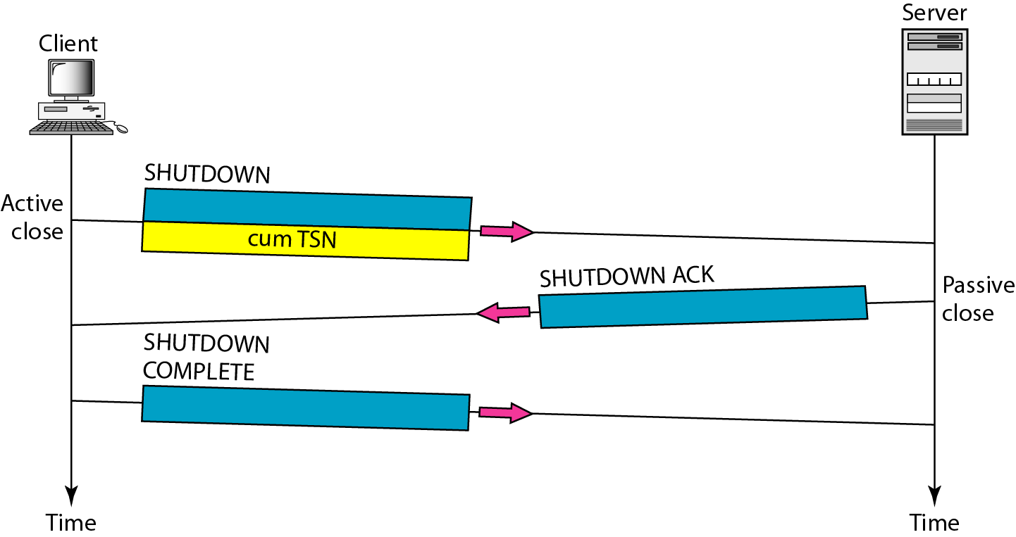
Association termination
In SCTP, either of the two parties involved in exchanging data (client or server) can close the connection
If one end closes the association, the other end must stop sending new data.

Slide 17
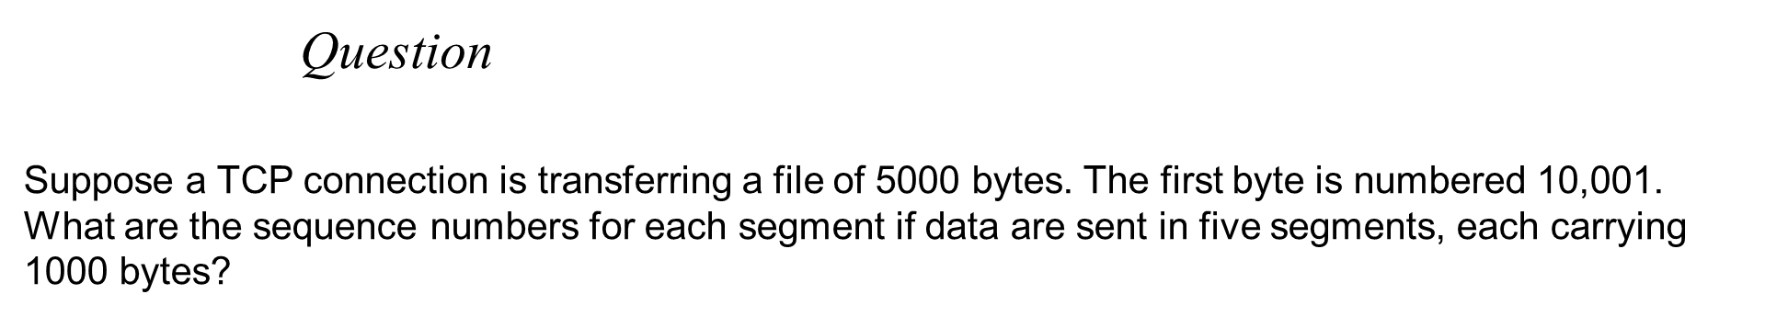
Solution
Segment 1 Sequence Number: 10,001 (range: 10,001 to 11,(00)
Segment 2 Sequence Number: 11,001 (range: 11,001 to 12,000)
Segment 3 Sequence Number: 12,001 (range: 12,001 to 13,000)
Segment 4 Sequence Number: 13,001 (range: 13,001 to 14,000)
Segment 5 Sequence Number: 14,001 (range: 14,001 to 15,000)

Slide 18

Question
Following is the dump of TCP header
05320017 00000001 00000000 500207FF 00000000
Find out source port and destination port number.
Ans- Source Port (0532)16=1330 and Destination Port (0017)16=23

