Slide 1

Transport Layer- Quality of Service

Slide 2

QUALITY OF SERVICE
Quality of service (QoS) is an internetworking issue
In quality of service, an appropriate environment for the traffic is created.
Informally, QoS can be defined as quality of service as something a flow seeks to attain.

Slide 3
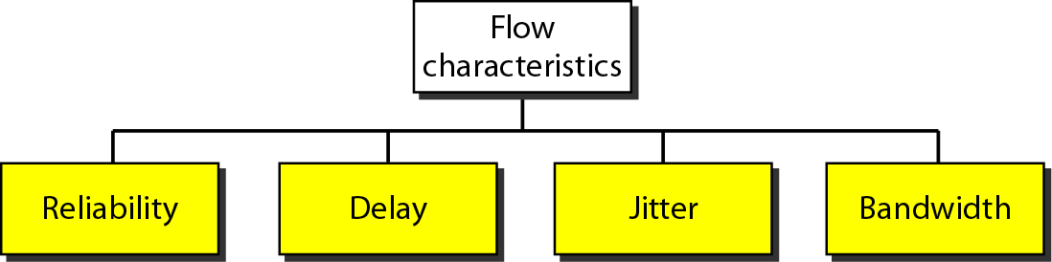
Flow characteristics
Reliability is a characteristic that a flow needs. Lack of reliability means losing a packet or acknowledgment, which entails retransmission.
Minimum delay needed- telephony, audio conferencing, video conferencing, and remote log-in,
Delay is Less important in case of file transfer or e-mail.
Jitter is defined as the variation in the packet delay. High jitter means the difference between delays is large; low jitter means the variation is small.
Different applications need different bandwidths.

Slide 4

TECHNIQUES TO IMPROVE QoS
Techniques that can be used to improve the quality of service.
Four common methods:
Scheduling
Traffic shaping
Admission control
Resource reservation

Slide 5
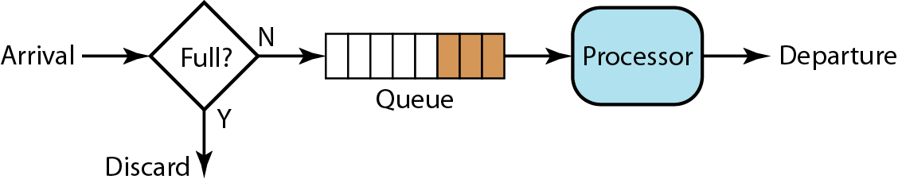
FIFO queue
In first-in, first-out (FIFO) queuing, packets wait in a buffer (queue) until the node (router or switch) is ready to process them.
If the average arrival rate is higher than the average processing rate, the queue will fill up and new packets will be discarded

Slide 6
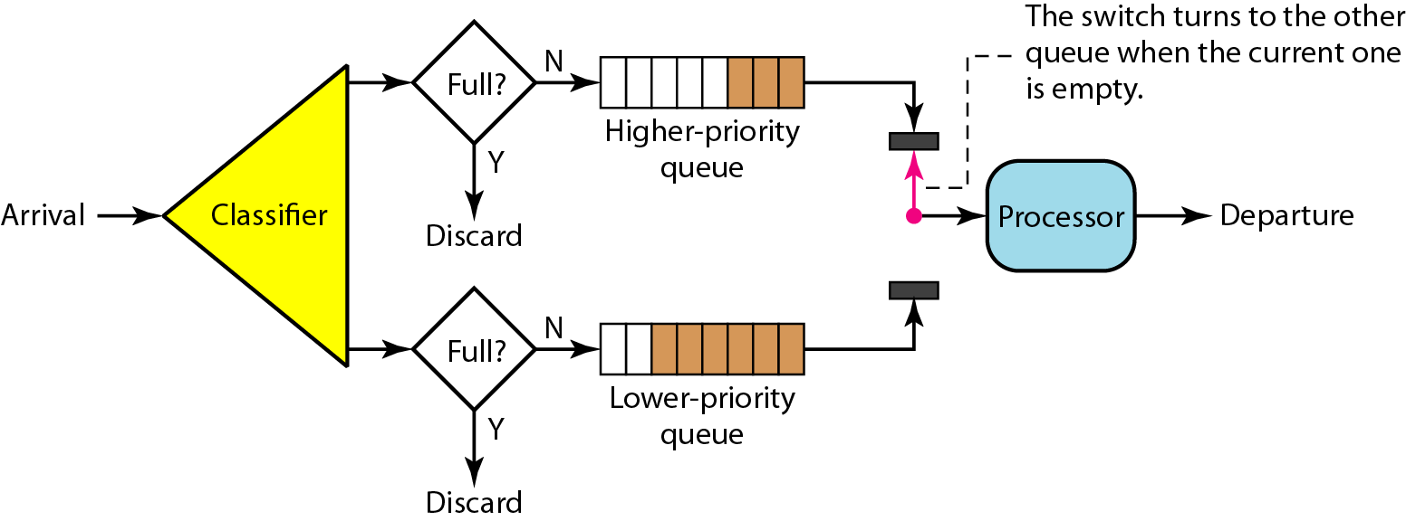
Priority queuing
Packets are first assigned to a priority class. Each priority class has its own queue.
The packets in the highest-priority queue are processed first. Packets in the lowest-priority queue are processed last.
Potential drawback- Starvation

Slide 7
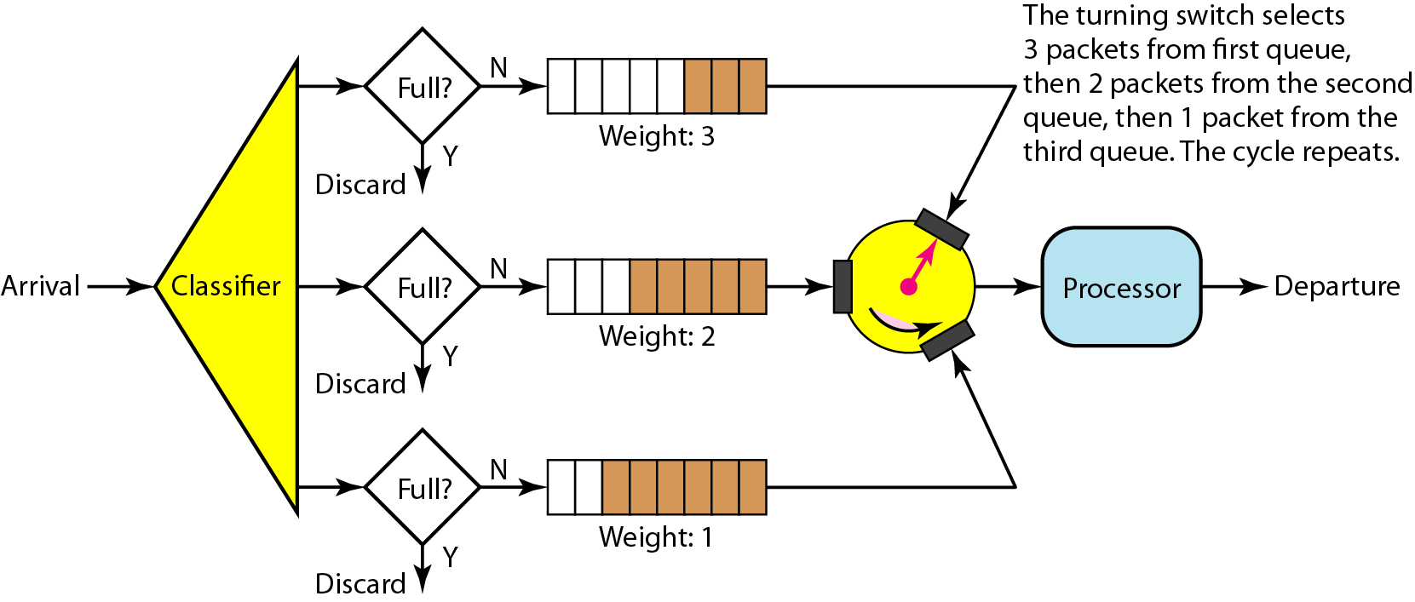
Weighted fair queuing
A better scheduling method is weighted fair queuing. In this technique, the packets are still assigned to different classes and admitted to different queues.
The queues, however, are weighted based on the priority of the queues; higher priority means a higher weight.
The system processes packets in each queue in a round-robin fashion with the number of packets selected from each queue based on the corresponding weight.

Slide 8

Traffic Shaping
Traffic shaping is a mechanism to control the amount and the rate of the traffic sent to the network.
Two techniques can shape traffic:
Leaky bucket
Token bucket.

Slide 9
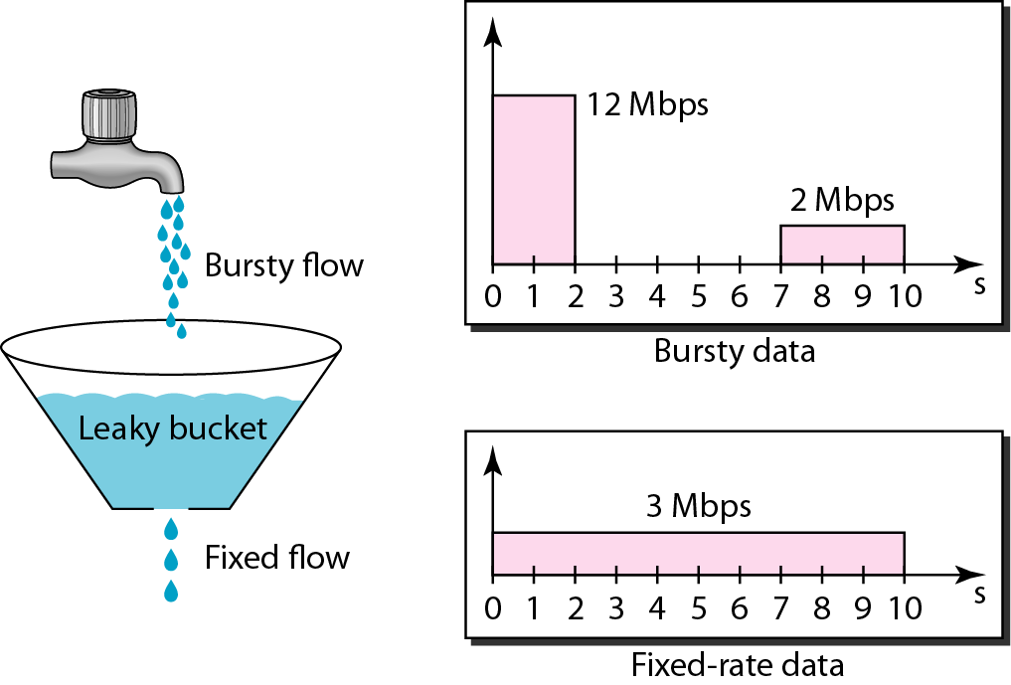
Leaky bucket
In networking, a technique called leaky bucket can smooth out bursty traffic. Bursty chunks are stored in the bucket and sent out at an average rate.
Host sends a burst of data at a rate of 12 Mbps for
2 s, Total data= 24Mb,
Idle time for host =5 s
data rate= 2 Mbps for 3 s, Total data = 6 Mb.
Total data sent by host = 30 Mb in 10 s.
The leaky bucket smooths the traffic by sending out data at a rate of 3 Mbps during the same 10 s
Here, leaky bucket may prevent congestion.

Slide 10
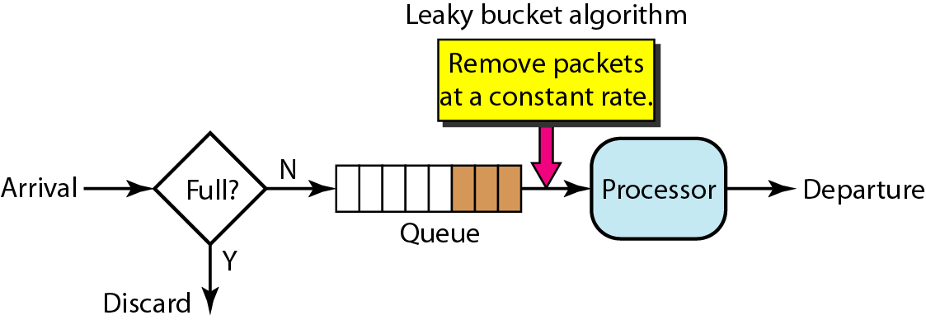
Leaky bucket implementation
A leaky bucket algorithm shapes bursty traffic into fixed-rate traffic by averaging the data rate. It may drop the packets if the bucket is full.

Slide 11
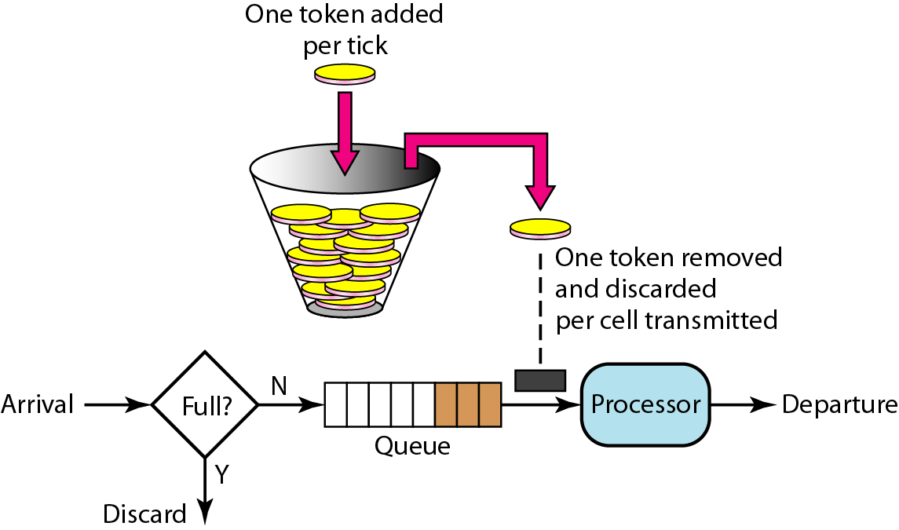
Token bucket
The leaky bucket is very restrictive. It does not credit an idle host. The time when the host was idle is not taken into account.
The token bucket algorithm allows idle hosts to accumulate credit for the future in the form of tokens.
For each tick of the clock, the system sends n tokens to the bucket. The system removes one token for every cell (or byte) of data sent.
The token bucket allows bursty traffic at a regulated maximum rate.

Slide 12

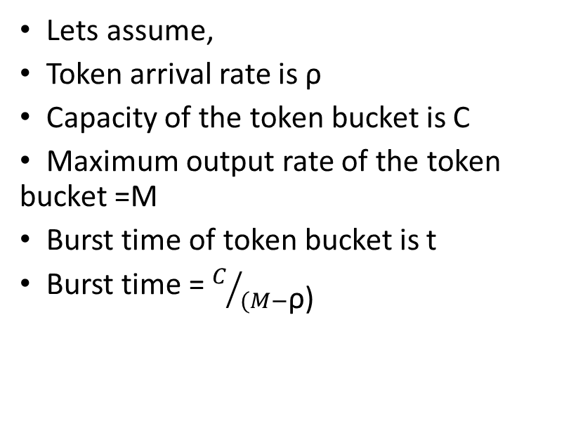
Token bucket
Lets assume,
Token arrival rate is ρ
Capacity of the token bucket is C
Maximum output rate of the token bucket =M
Burst time of token bucket is t
Burst time = $C/{(M−\text{ρ}\text{)}}$

Slide 13
Resource reservation-
A flow of data needs resources such as a buffer, bandwidth, CPU time, and so on. The quality of service is improved if these resources are reserved beforehand.
Admission control-
Admission control refers to the mechanism used by a router, or a switch, to accept or reject a flow based on predefined parameters called flow specifications.
Before a router accepts a flow for processing, it checks the flow specifications to see if its capacity (in terms of bandwidth, buffer size, CPU speed, etc.) and its previous commitments to other flows can handle the new flow.
Resource reservation and Admission control

Slide 14
Question
In a leaky bucket used to control liquid flow, how many gallons of liquid are left in the bucket if the output rate is 5 gal/min, there is an input burst of 100 gal/min for 12 s, and there is no input for 48 s?
Input: (100/60) × 12 + 0 × 48 = 20 gallons
Output: 5 gallons
Left in the bucket: 20 − 5 = 15

Slide 15
Question
A computer on a 10Mbps network is regulated by a token bucket. The token bucket is filled at a rate of 2Mbps. It is initially filled to capacity with 16Megabits. What is the maximum duration for which the computer can transmit at the full 10Mbps?
1.6 seconds
2 seconds
5 seconds
8 seconds
Capacity of the token bucket (C)=16Mbits Maximum possible transmission rate (M)=10Mbps So, the maximum burst
Rate ρ = 2Mbps
time =C/(M−ρ)=16/(10−2)=2seconds H

