Slide 1

Application Layer Domain Name System

Slide 2
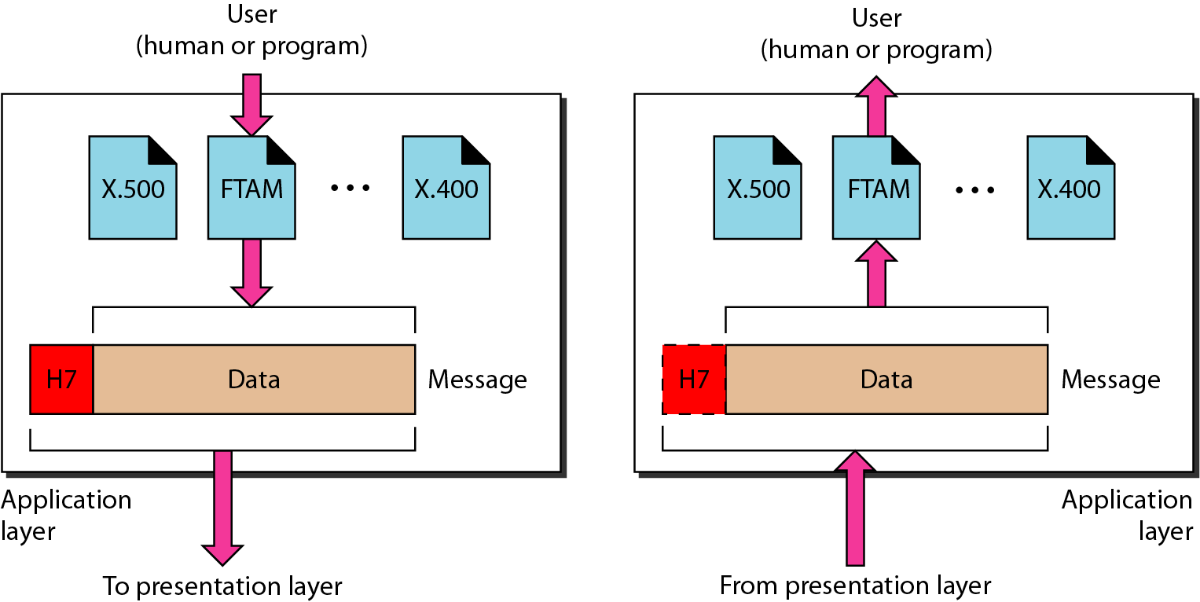
Application Layer
The application layer is responsible for providing services to the user.
File Transfer
Electronic Mail
Remote Login
WWW
Multimedia
Common Protocols- DNS, HTTP, FTP, SMTP etc.

Slide 3
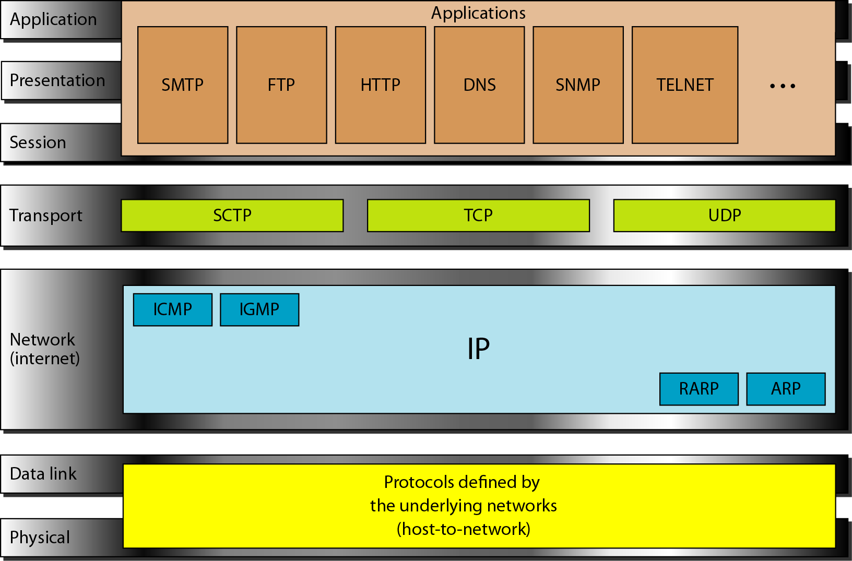
Application Layer Protocols

Slide 4
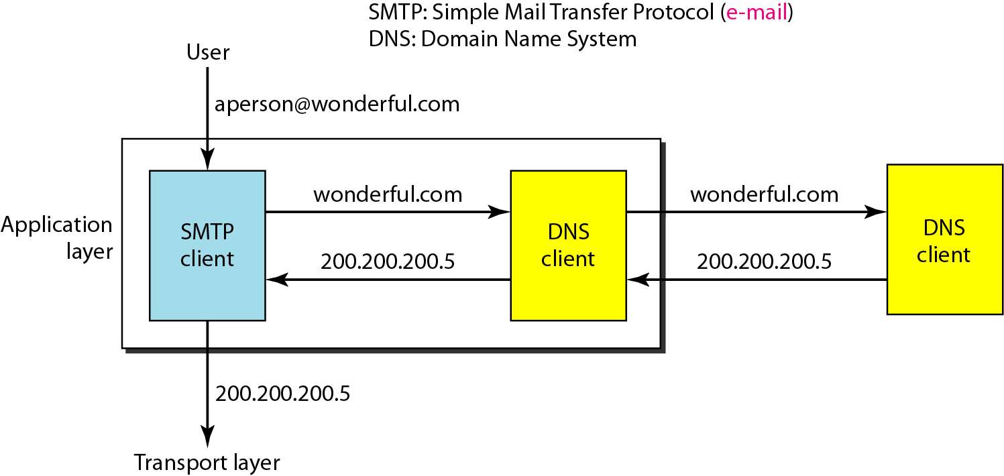
The client/server programs can be divided into two categories:
Programs that can be directly used by the user, such as e-mail,
Programs that support other application programs.
The Domain Name System (DNS) is a supporting program that is used by other programs such as e-mail.
A user of an e-mail program may know the e-mail address of the recipient; however, the IP protocol needs the IP address. The DNS client program sends a request to a DNS server to map the e-mail address to the corresponding IP address.
DNS service
An example of how a DNS client/server program can support an e-mail program to find the IP address of an e-mail recipient

Slide 5

NAME SPACE
To be unambiguous, the names assigned to machines must be carefully selected from a name space with complete control over the binding between the names and IP addresses.
A name space that maps each address to a unique name can be organized in two ways:
Flat- A name in this space is a sequence of characters without structure. The names may or may not have a common section
Hierarchical- In a hierarchical name space, each name is made of several parts.

Slide 6

DOMAIN NAME SPACE
To have a hierarchical name space, a domain name space was designed.
In this design the names are defined in an inverted-tree structure with the root at the top.
The tree can have only 128 levels: level 0 (root) to level 127.

Slide 7
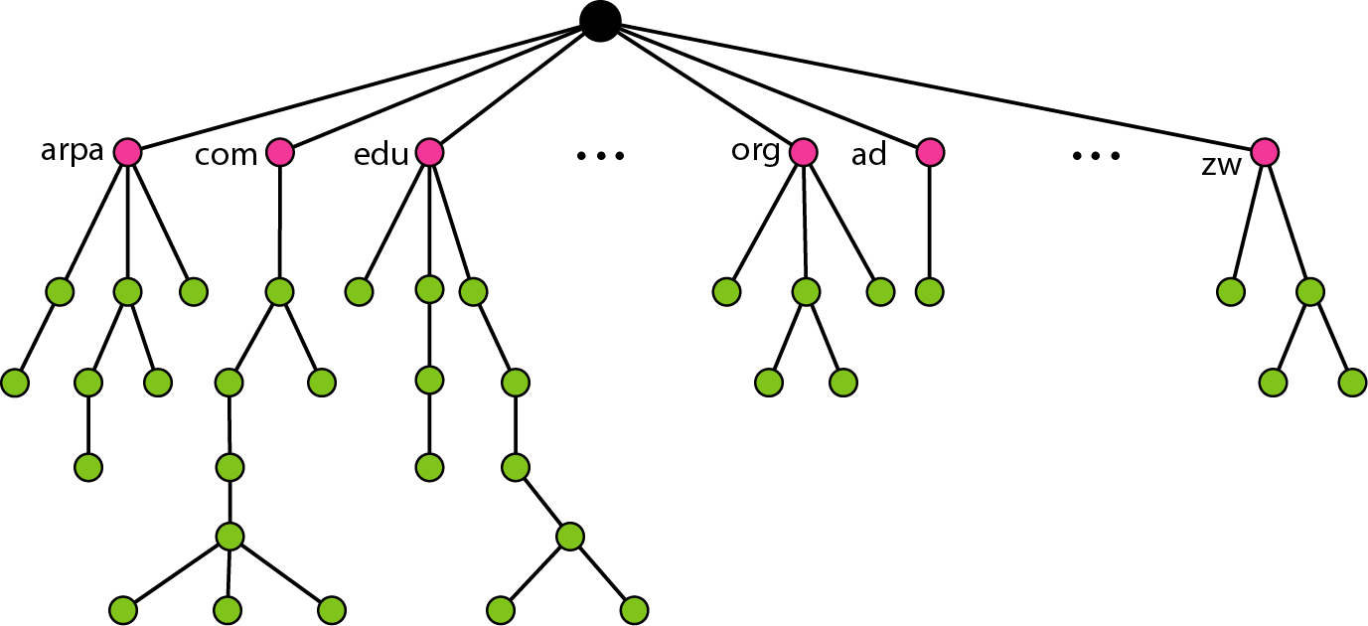
DOMAIN NAME SPACE
Each node in the tree has a label, which is a string with a maximum of 63 characters.
The root label is a null string (empty string).
DNS requires that children of a node have different labels, which guarantees the uniqueness of the domain names.

Slide 8
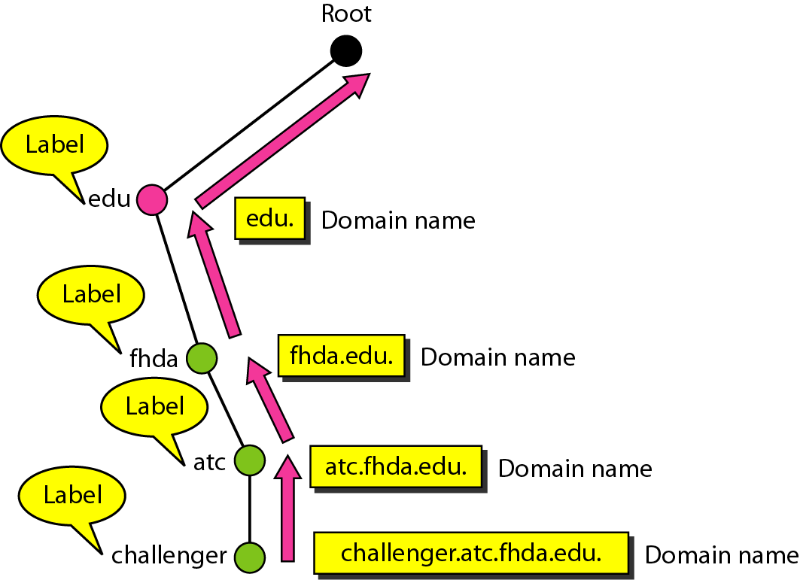
Domain names and labels
Each node in the tree has a domain name. A full domain name is a sequence of labels separated by dots (.). The domain names are always read from the node up to the root.
The last label is the label of the root (null). This means that a full domain name always ends in a null label, which means the last character is a dot because the null string is nothing.

Slide 9
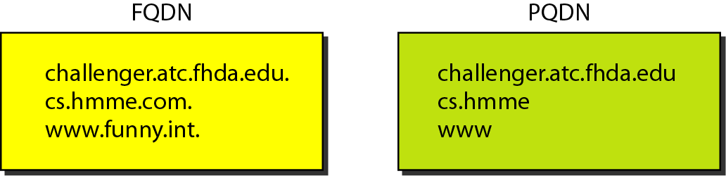
Fully Qualified Domain Name (FQDN)
If a label is terminated by a null string, it is called a fully qualified domain name. An FQDN is a domain name that contains the full name of a host
Partially Qualified Domain Name (PQDN)
If a label is not terminated by a null string. A PQDN starts from a node, but it does not reach the root. It is used when the name to be resolved belongs to the same site as the client. Here the resolver can supply the missing part, called the suffix, to create an FQDN.
FQDN and PQDN

Slide 10
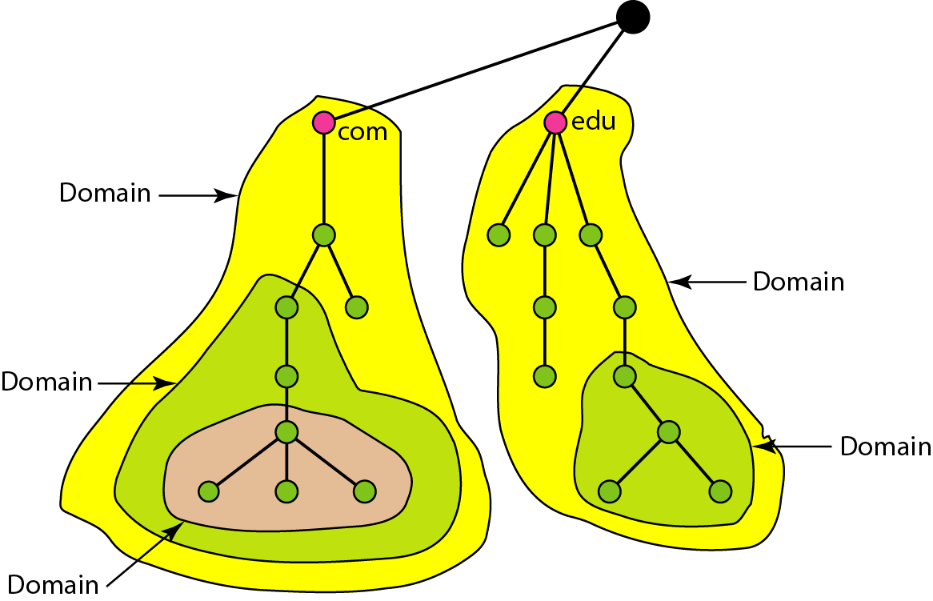
Domains
A domain is a subtree of the domain name space. The name of the domain is the domain name of the node at the top of the subtree

Slide 11
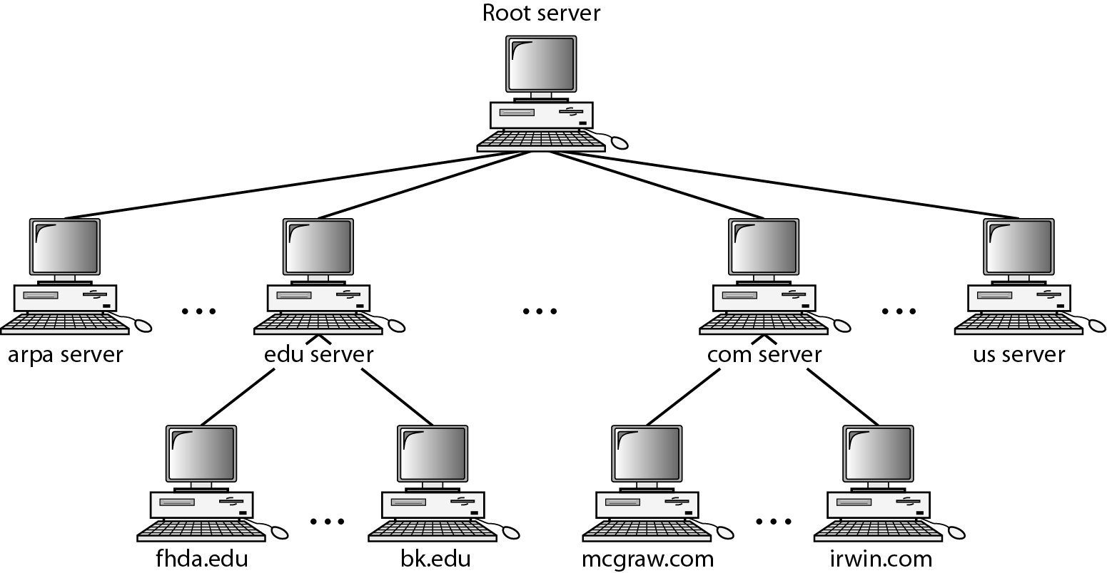
DISTRIBUTION OF NAME SPACE
The information contained in the domain name space must be stored.
However, it is very inefficient and also unreliable to have just one computer store such a huge amount of information.
Hierarchy of name servers

Slide 12
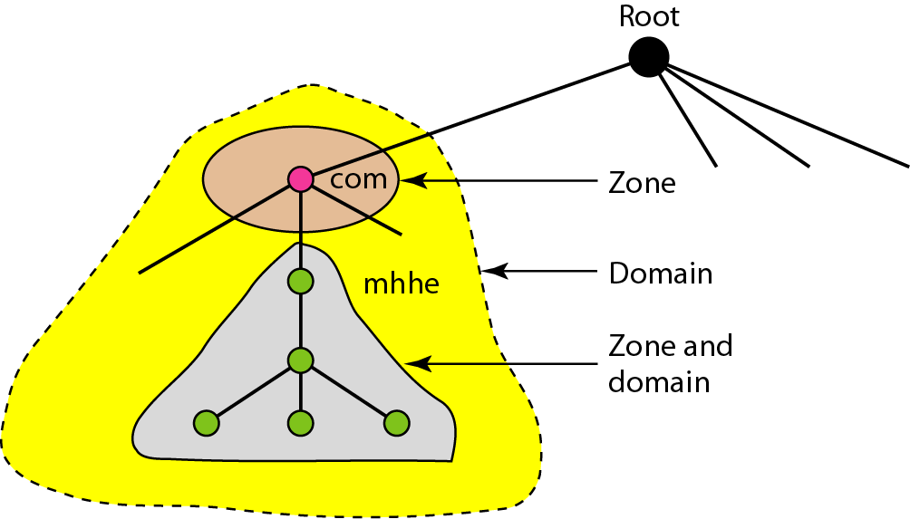
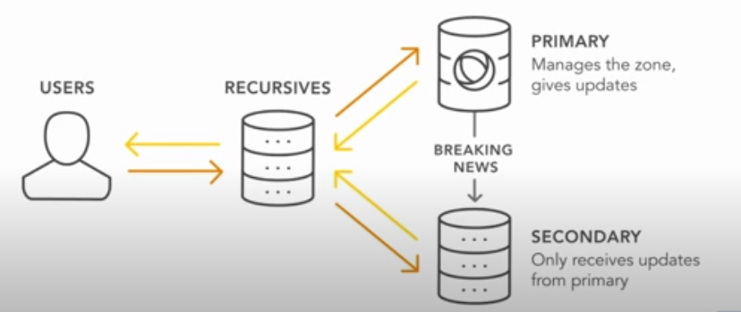
Zones and domains
A primary server loads all information from the disk file; the secondary server loads all information from the primary server.
When the secondary downloads information from the primary, it is called zone transfer.

Slide 13
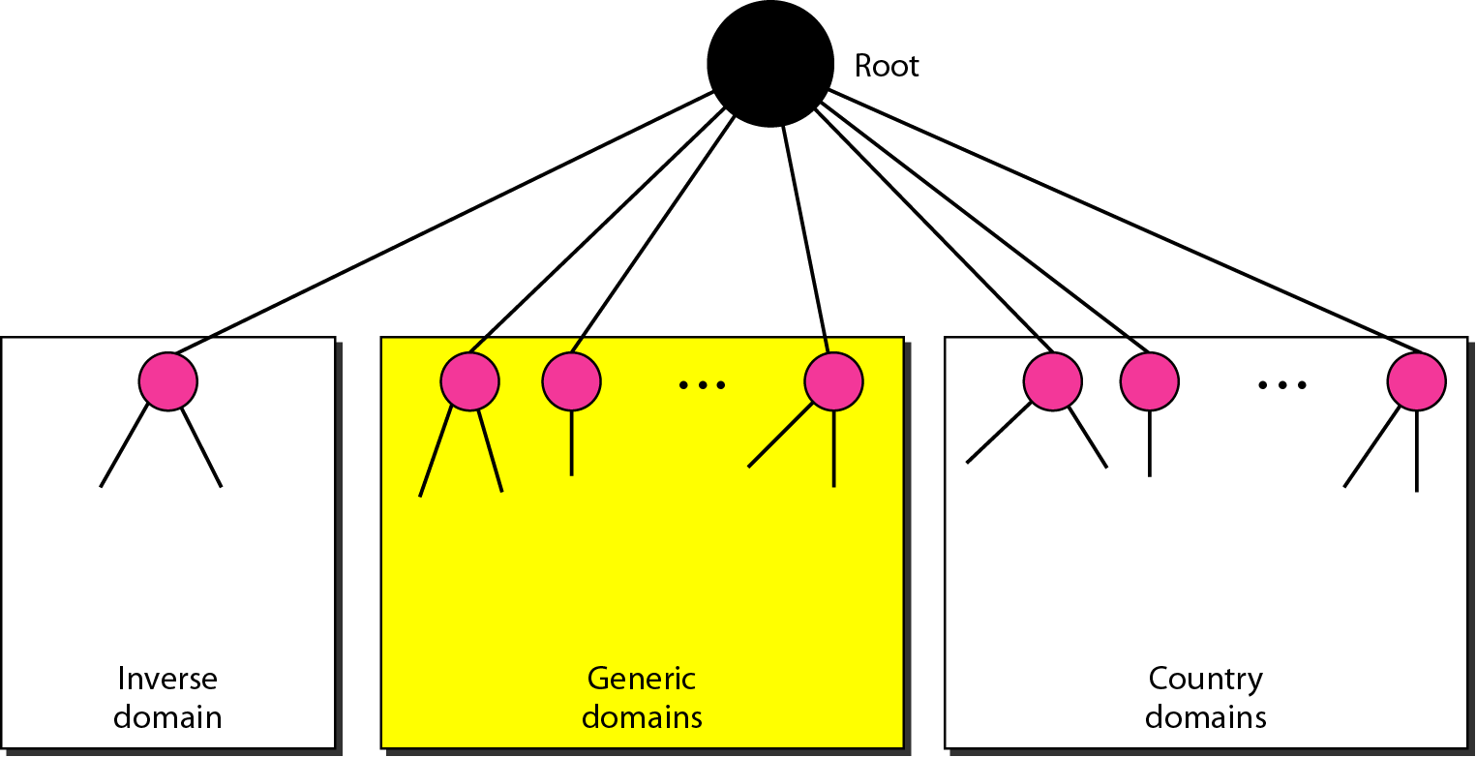
DNS IN THE INTERNET
DNS is a protocol that can be used in different platforms.
In the Internet, the domain name space (tree) is divided into three different sections:
Generic domains
Country domains
Inverse domain.
DNS IN THE INTERNET

Slide 14
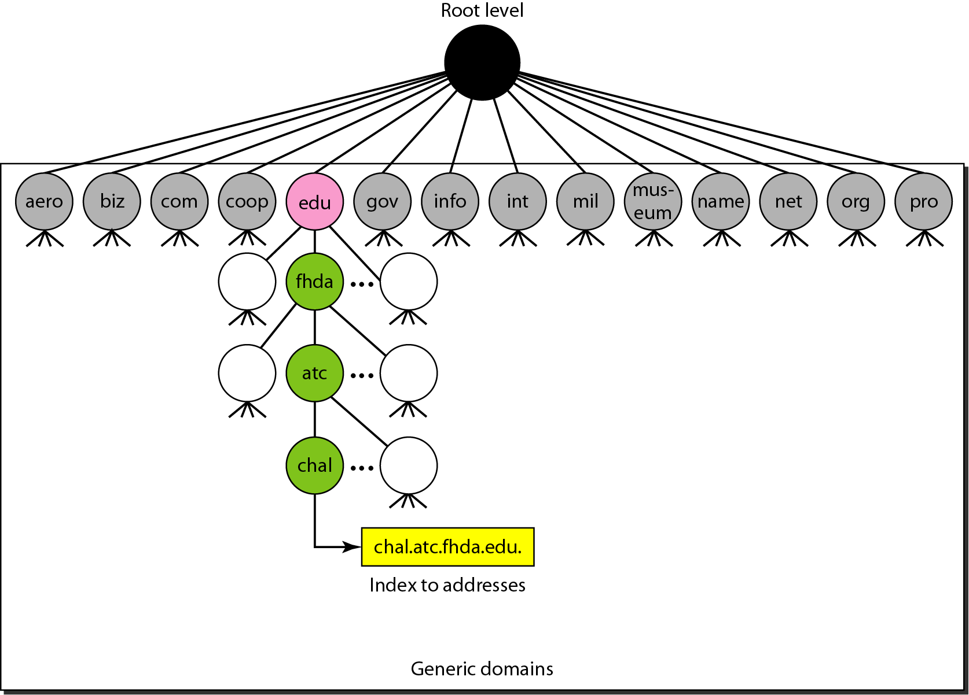
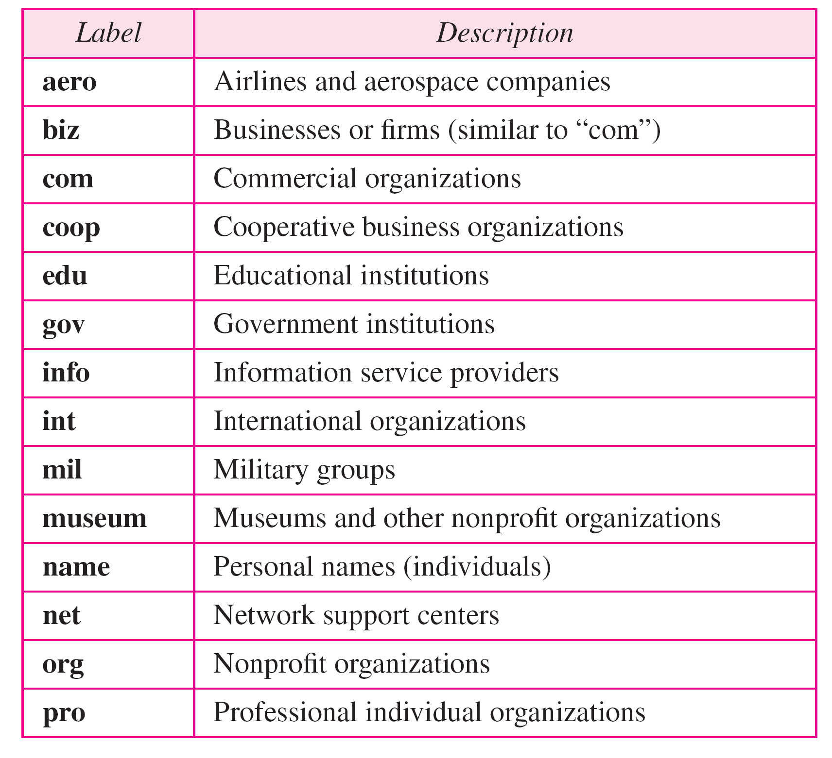
Generic domains
The generic domains define registered hosts according to their generic behavior. Each node in the tree defines a domain, which is an index to the domain name space database
Generic domain labels

Slide 15
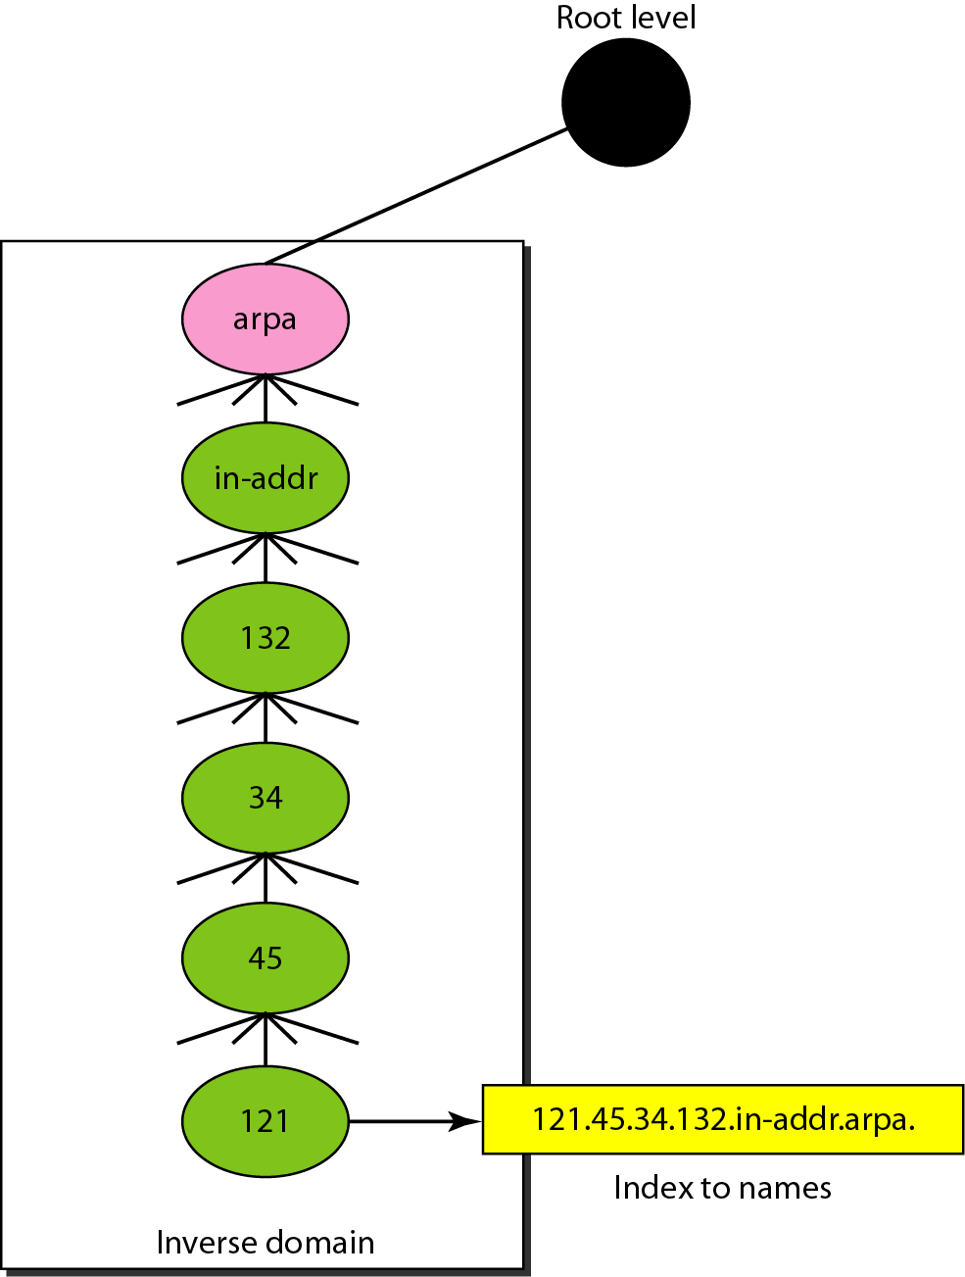
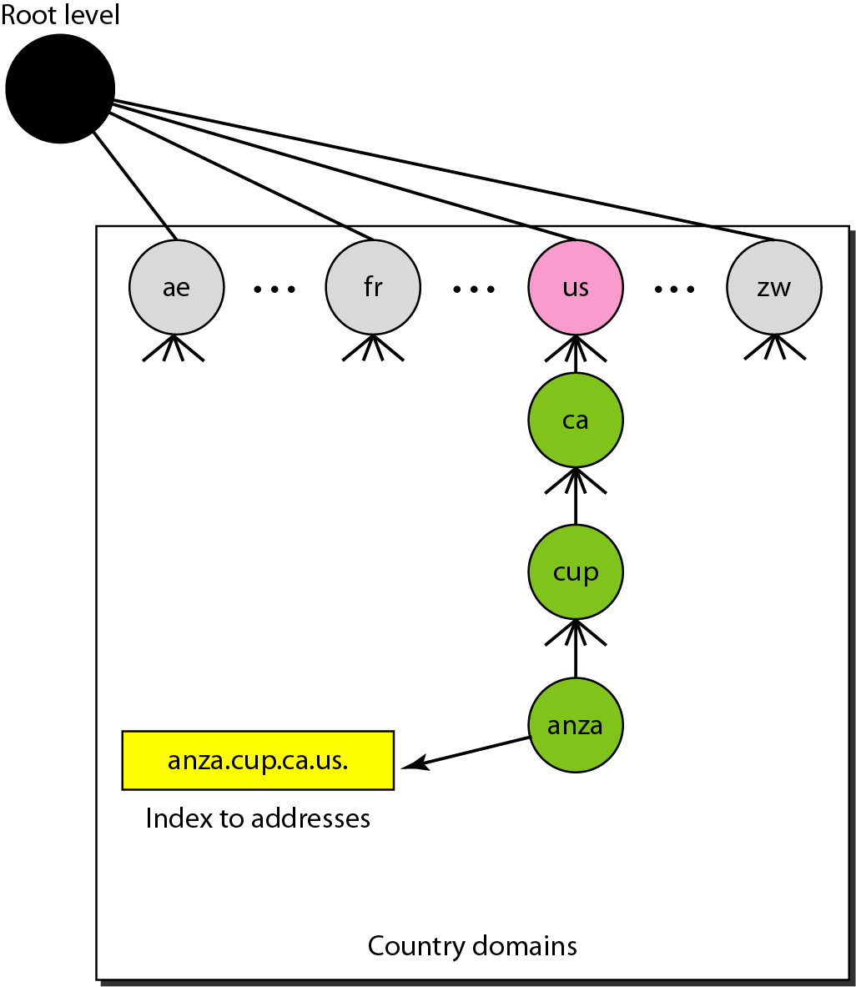
Country domains and Inverse domain
The country domains section uses two-character country abbreviations (e.g., us for United States, in for India).
The inverse domain is used to map an address to a name.

Slide 16
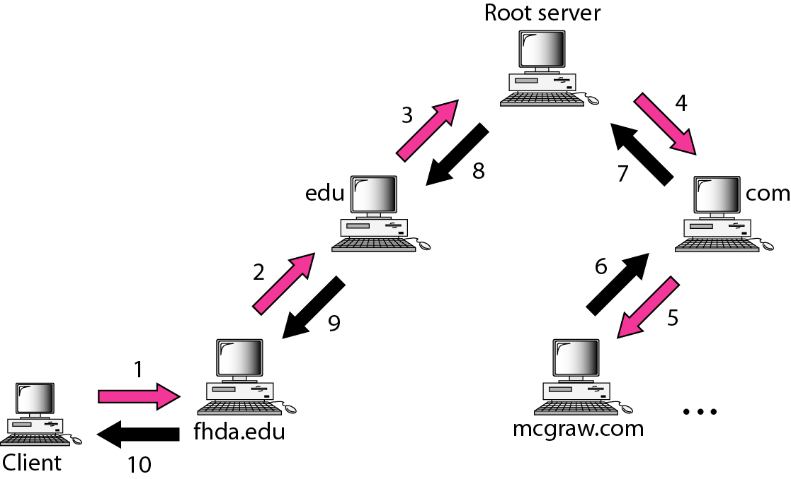
RESOLUTION
Mapping a name to an address or an address to a name is called name-address resolution.
DNS is designed as a client/server application. A host that needs to map an address to a name or a name to an address calls a DNS client called a resolver.
The resolver accesses the closest DNS server with a mapping request. If the server has the information, it satisfies the resolver; otherwise, it either refers the resolver to other servers or asks other servers to provide the information.

Slide 17
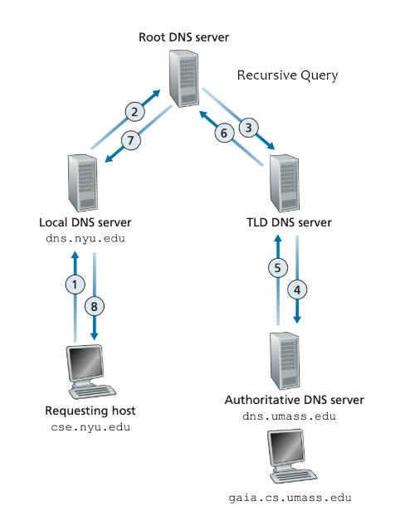
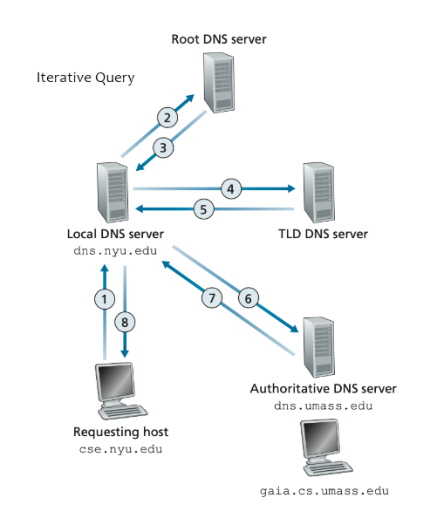
DNS Query DNS - Recursive vs Iterative Query
Recursive
Iterative

Slide 18
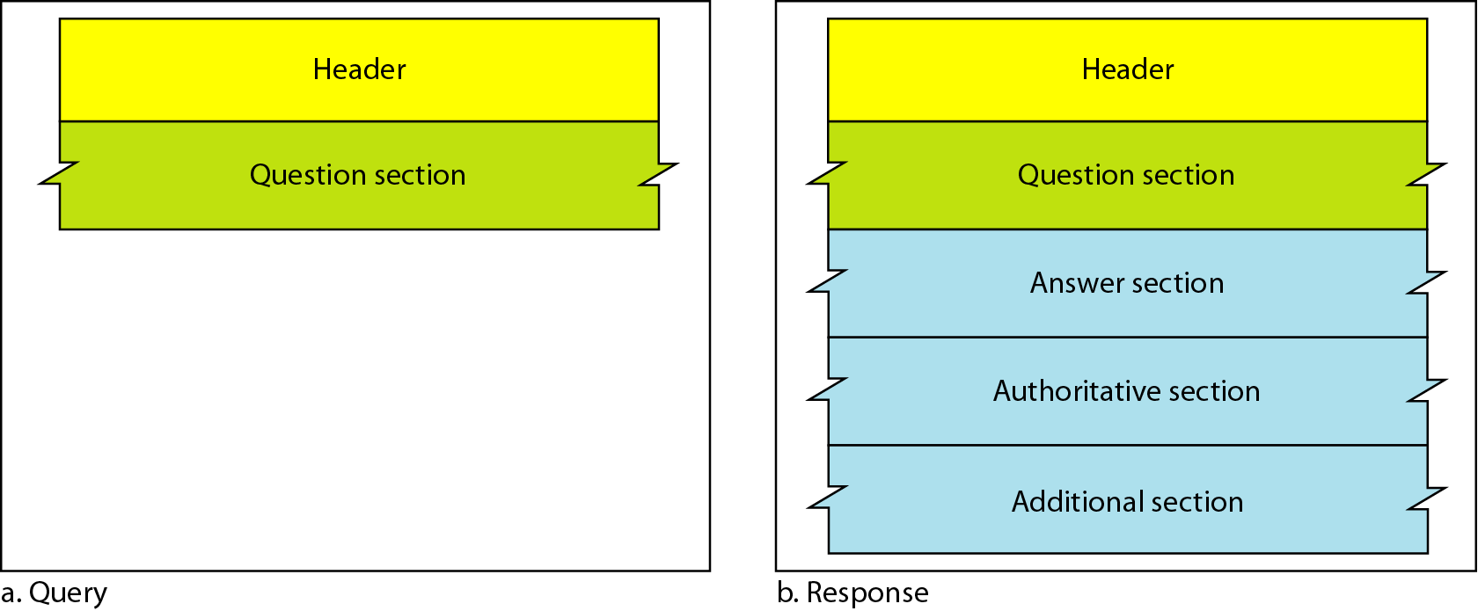
DNS MESSAGES
DNS has two types of messages: query and response. Both types have the same format.
The query message consists of a header and question records; the response message consists of a header, question records, answer records, authoritative records, and additional records.

Slide 19
ENCAPSULATION
DNS can use either UDP or TCP. In both cases the well-known port used by the server is port 53.
UDP is used when the size of the response message is less than 512 bytes because most UDP packages have a 512-byte packet size limit.
If the size of the response message is more than 512 bytes, a TCP connection is used.

Slide 20

Who translates internet domain and host names to IP address.
a) domain name system b) routing information protocol c) network time protocol d) internet relay chat

Slide 21

Question
Which DNS client maps an address to a name especially when required a host?
a) Resolver b) Mapper c) Primary Server d) Secondary Server

