Slide 1

Application Layer Remote Logging and Electronic Mail

Slide 2

REMOTE LOGGING
It would be impossible to write a specific client/server program for each demand. The better solution is a general-purpose client/server program that lets a user access any application program on a remote computer.
TELNET (TerminaL Network) is a general-purpose client/server application program.
It is the standard TCP/IP protocol for virtual terminal service as proposed by the International Standard Organization (ISO).
TELNET enables the establishment of a connection to a remote system in such a way that the local terminal appears to be a terminal at the remote system.

Slide 3
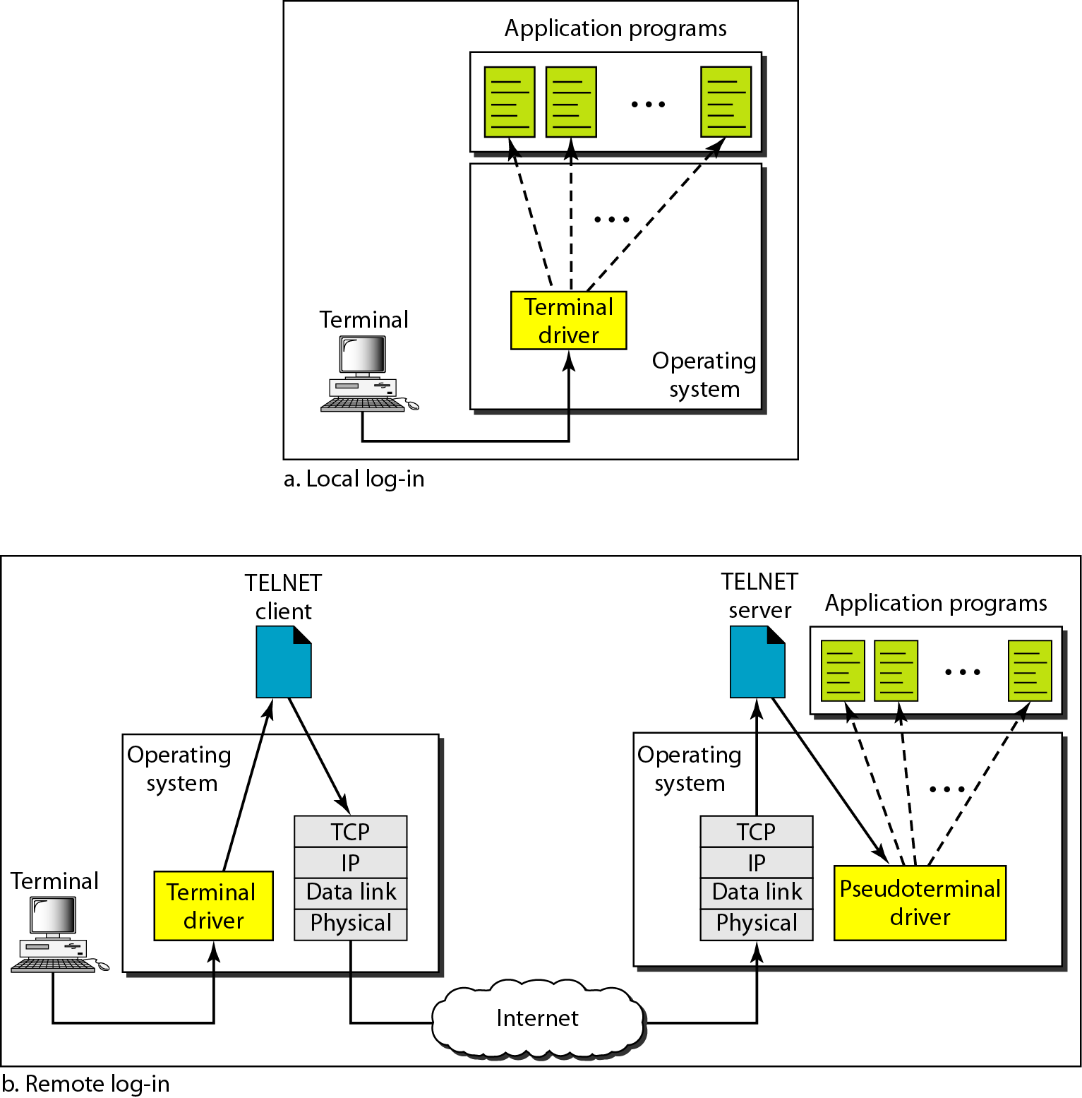
Local and remote log-in
When a user logs into a local timesharing system, it is called local log-in. As a user types at a terminal or at a workstation running a terminal emulator, the keystrokes are accepted by the terminal driver.
When a user wants to access an application program or utility located on a remote machine, user performs remote log-in. Here the TELNET client and server programs come into use.
The user sends the keystrokes to the terminal driver, where the local operating system accepts the characters but does not interpret them.
The characters are sent to the TELNET client, which transforms the characters to a universal character set called network virtual terminal (NVT) characters and delivers them to the local TCP/IP protocol stack.

Slide 4
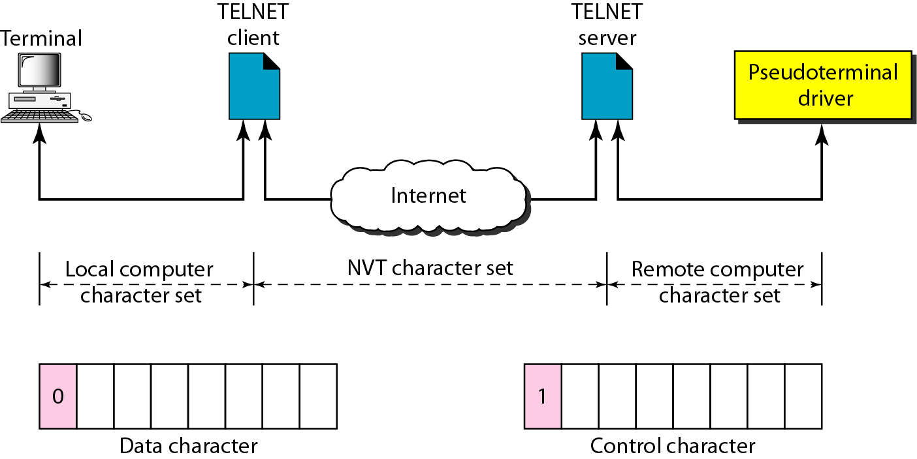
Concept of NVT(Network Virtual Terminal )
NVT uses two sets of characters, one for data and the other for control. Both are 8-bit bytes.
For data, NVT is an 8-bit character set in which the 7 lowest-order bits are the same as ASCII and the highest-order bit is 0.
To send control characters between computers (from client to server or vice versa), NVT uses an 8-bit character set in which the highest-order bit is set to 1.
Examples of control characters
EOF- End of File ; EOR- End of Record

Slide 5
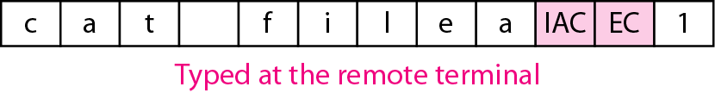
An example of embedding
TELNET uses only one TCP connection. The server uses the well-known port 23, and the client uses an ephemeral port. The same connection is used for sending both data and control characters.
TELNET accomplishes this by embedding the control characters in the data stream. However, to distinguish data from control characters, each sequence of control characters is preceded by a special control character called interpret as control (lAC).
For example, imagine a user wants a server to display a file (filel) on a remote server. It can be written as
catfile1
suppose the name of the file has been mistyped (filea instead of file1). The user uses the backspace key to correct this situation.
catfilea<backspace>l

Slide 6

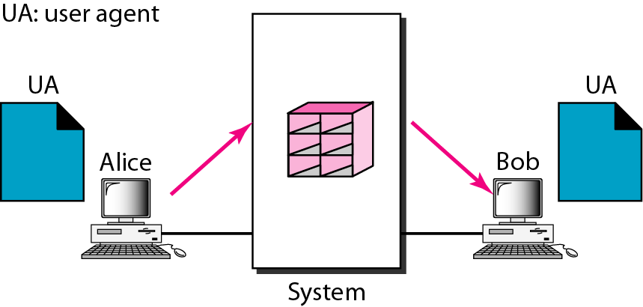
ELECTRONIC MAIL
One of the most popular Internet services is electronic mail (e-mail).
The sender and the receiver of the e-mail are users (or application programs) on the same system; they are directly connected to a shared system. The administrator has created one mailbox for each user where the received messages are stored.
When Alice, a user, needs to send a message to Bob, another user, Alice runs a user agent (UA) program to prepare the message and store it in Bob's mailbox.
When the sender and the receiver of an e-mail are on the same system, we need only two user agents.
One of the scenario in electronic mail

Slide 7
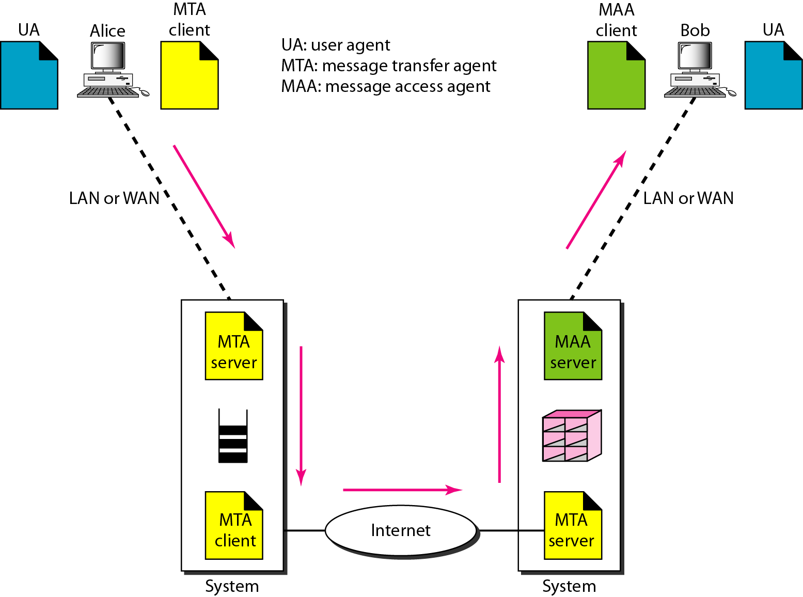
Electronic mail
After the message has arrived at Bob's mail server, Bob needs to retrieve it. Here, we need another set of client/server agents, which we call message access agents (MAAs).
Bob uses an MAA client to retrieve his messages. The client sends a request to the MAA server, which is running all the time, and requests the transfer of the messages.
When both sender and receiver are connected to the mail server via a LAN or a WAN, we need two UAs, two pairs of MTAs and a pair of MAAs.

Slide 8
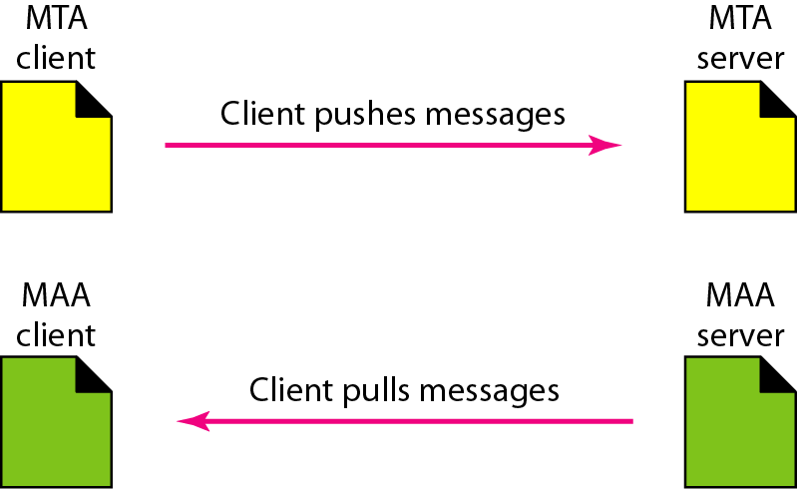
Push versus pull in electronic email
A MTA client/server program is a push program: the client pushes the message to the server.
Bob needs a pull program. The client needs to pull the message from the server

Slide 9
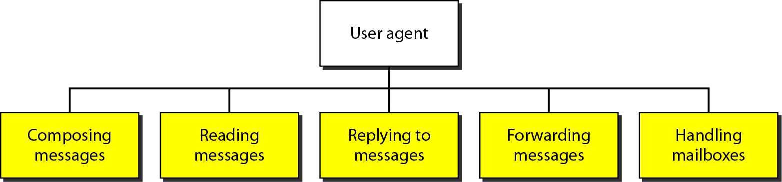
Services of user agent
A user agent is a software package (program) that composes, reads, replies to, and forwards messages. It also handles mailboxes.
Composing Message- A user agent helps the user compose the e-mail message to be sent out.
Reading Messages- The second duty of the user agent is to read the incoming messages.
Replying to Messages- After reading a message, a user can use the user agent to reply to a message.
Forwarding Messages- It is defined as sending the message to a third party. A user agent allows the receiver to forward the message, with or without extra comments, to a third party.
Handling Mailboxes- A user agent normally creates two mailboxes: an inbox and an outbox.

Slide 10
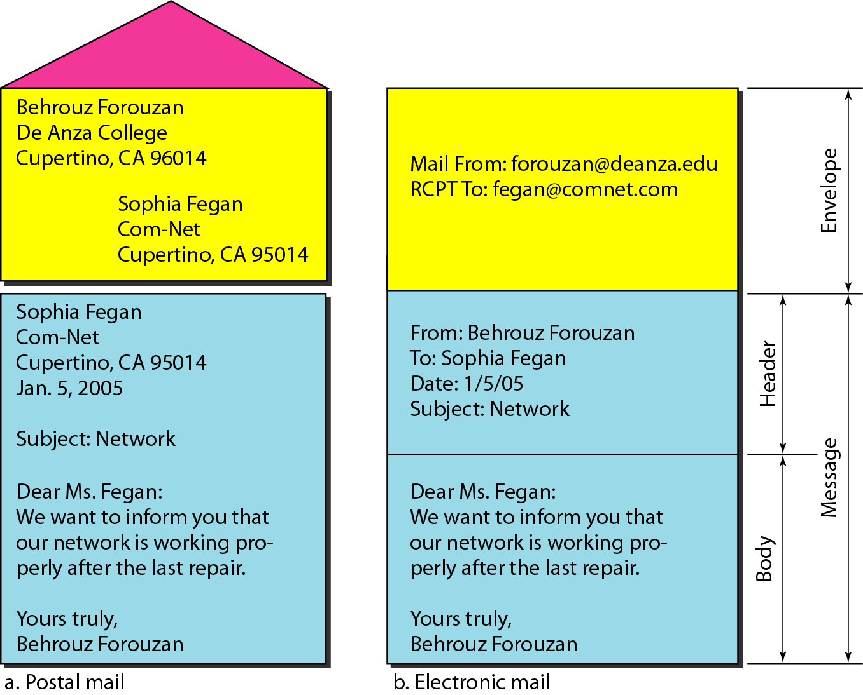
User Agent Types
There are two types of user agents:
command-driven
GUI-based.
Command-driven user agents are mail, pine, and elm.
GUI-based user agents are Eudora, Outlook, and Netscape.
Format of an e-mail

Slide 11
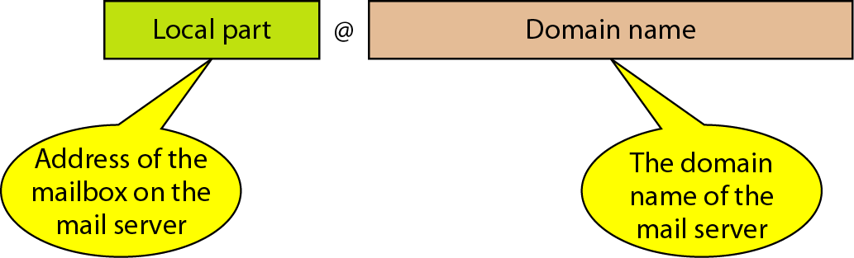
E-mail address
To deliver mail, a mail handling system must use an addressing system with unique addresses. In the Internet, the address consists of two parts: a local part and a domain name, separated by an @ sign
Local Part- The local part defines the name of a special file, called the user mailbox, where all the mail received for a user is stored for retrieval by the message access agent.
Domain Name- The second part of the address is the domain name.

Slide 12

Q1
________ among the below specified illustrations the category of GUI
a) mail b) pine c) Outlook & Netscape d) All of the above

Slide 13
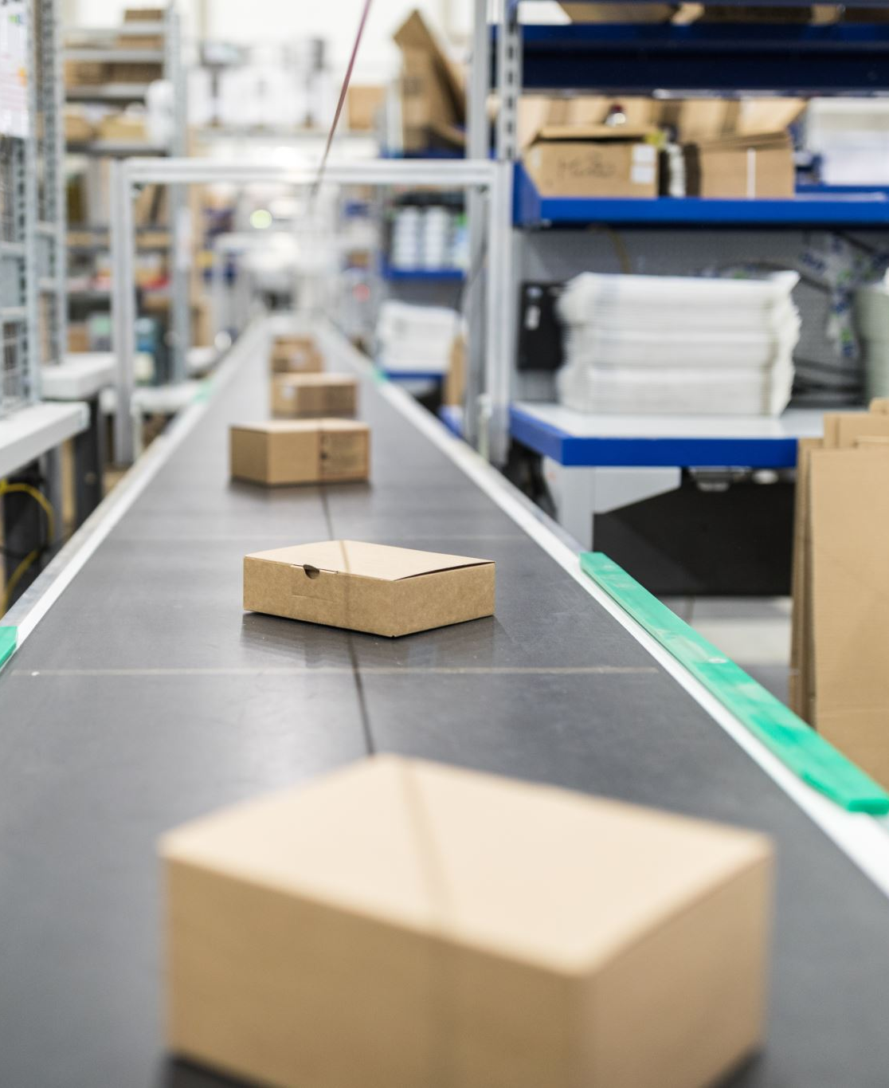
Q2
The _______ acts like a mail router, accepting messages from both MTAs and MUAs.
a) Mail user agent(MUA) b) Mail transfer agent(MTA) c) Mail delivery agent(MDA) d) Mail send agent(MSA)

