Slide 1

Application Layer- MIME, SMTP and FTP

Slide 2
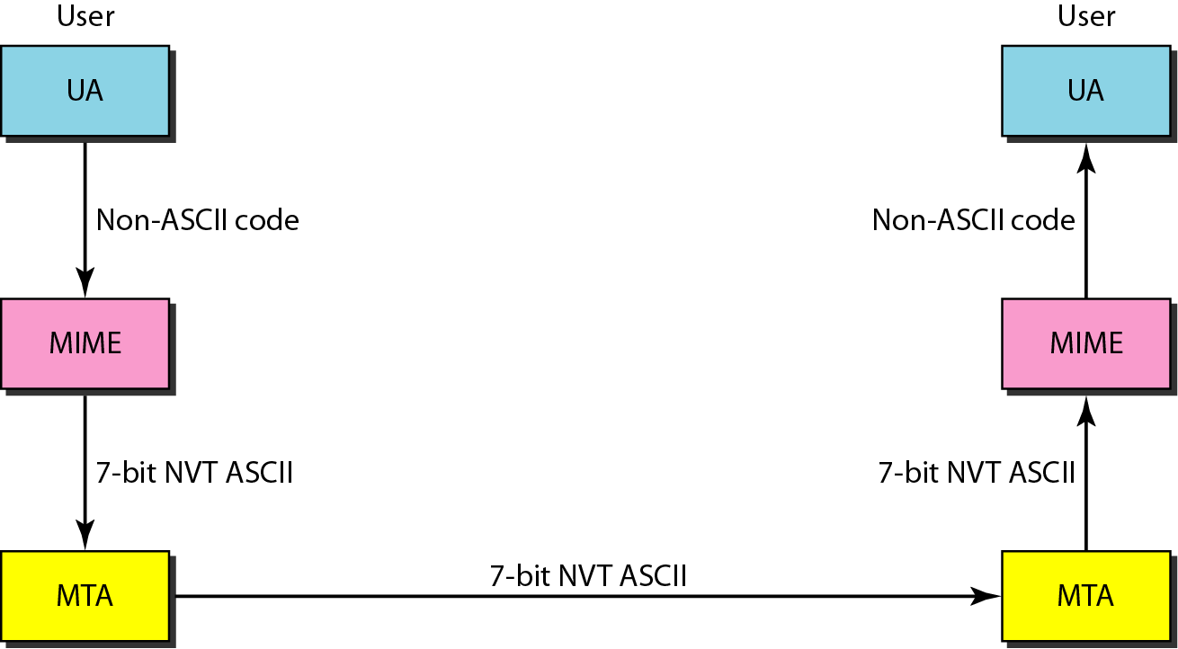
Multipurpose Internet Mail Extensions (MIME)
MIME is a supplementary protocol that allows non-ASCII data to be sent through e-mail. MIME transforms non-ASCII data at the sender site to NVT ASCII data and delivers them to the client MTA to be sent through the Internet.
The message at the receiving side is transformed back to the original data.
MIME can be defined as a set of software functions that transforms non-ASCII data (stream of bits) to ASCII data and vice versa.

Slide 3
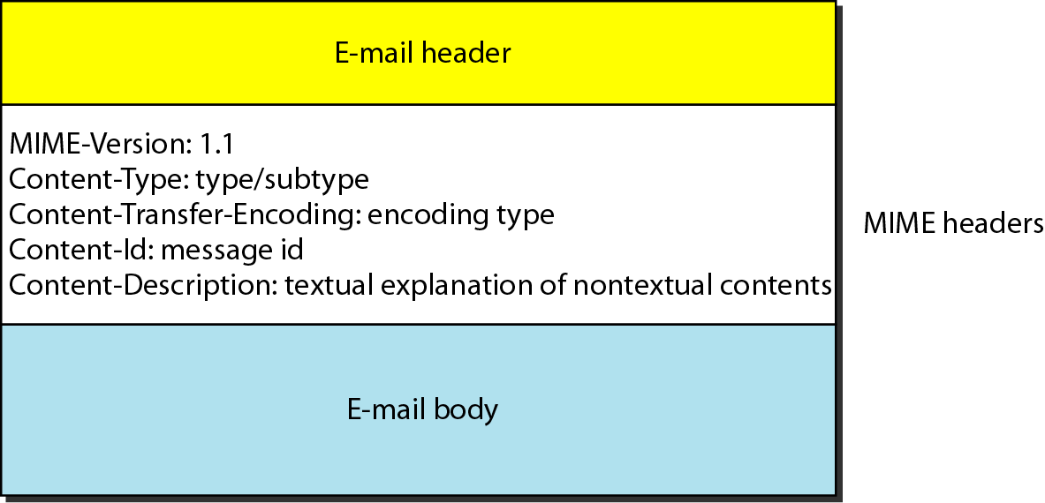
MIME header
Version- defines the version of the protocol
Content type- defines the type e.g.- text, audio or video
Content transfer encoding - defines the method used for encoding
Content id- Unique identifier
Content description- defines Email body is text audio or video

Slide 4
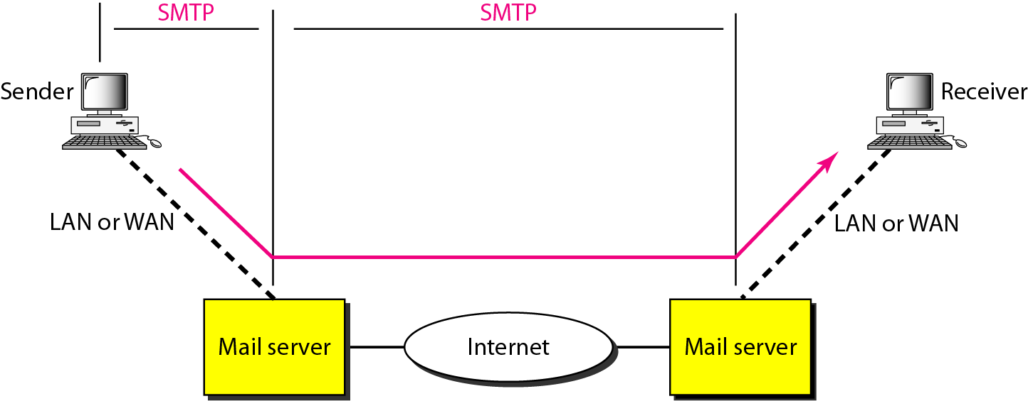
Simple Mail Transfer Protocol (SMTP)
The actual mail transfer is done through message transfer agents. To send mail, a system must have the client MTA, and to receive mail, a system must have a server MTA.
The formal protocol that defines the MTA client and server in the Internet is called the Simple Mail Transfer Protocol (SMTP).

Slide 5
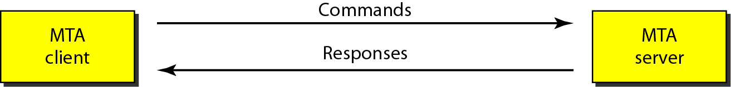

SMTP uses commands and responses to transfer messages between an MTA client and an MTA server
Commands and responses
Command format

Slide 6
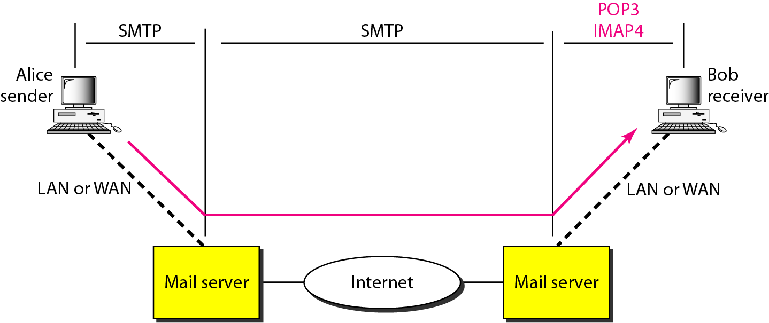
Message Access Agent: POP3 and IMAP4
The first and the second stages of mail delivery use SMTP. However, SMTP is not involved in the third stage because SMTP is a push protocol; it pushes the message from the client to the server.
Currently two message access protocols are available: Post Office Protocol, version 3 (POP3) and Internet Mail Access Protocol, version 4 (IMAP4).

Slide 7
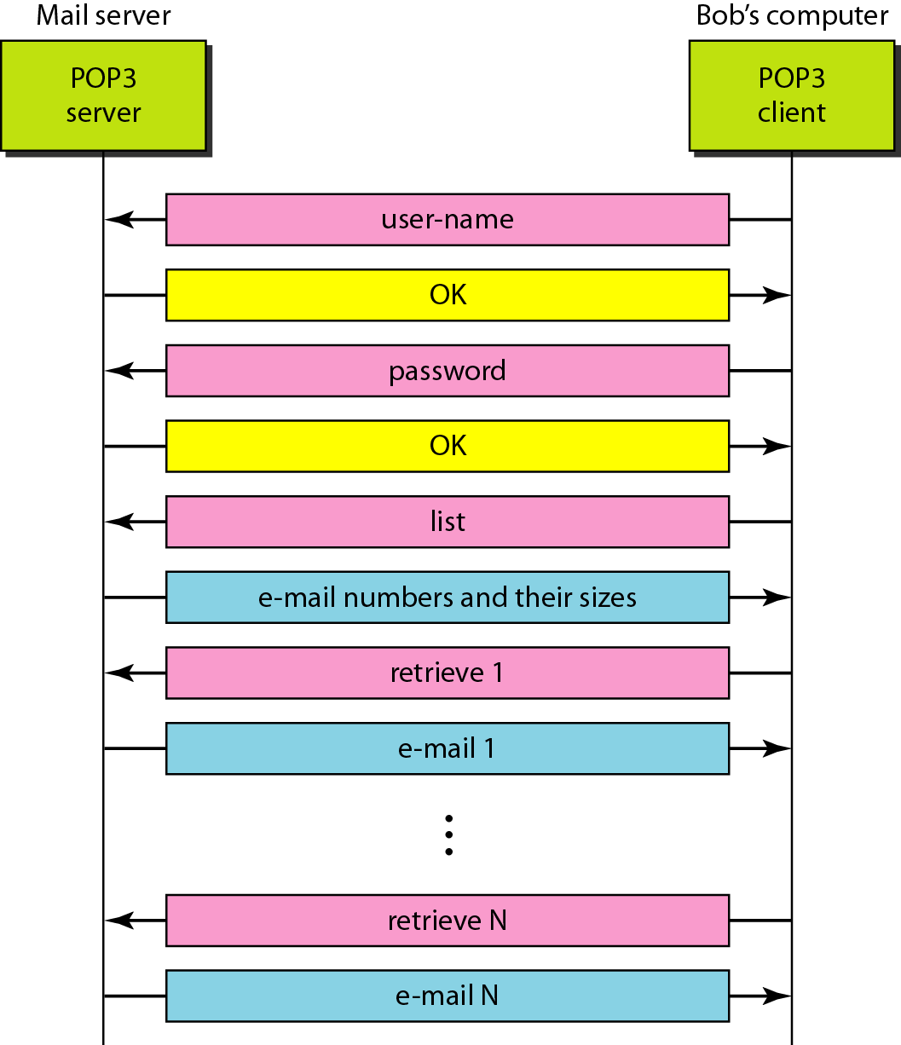
The exchange of commands and responses in POP3
Post Office Protocol, version 3 (POP3) is simple and limited in functionality. The client POP3 software is installed on the recipient computer; the server POP3 software is installed on the mail server.
POP3 has two modes: the delete mode and the keep mode. In the delete mode, the mail is deleted from the mailbox after each retrieval. In the keep mode, the mail remains in the mailbox after retrieval.

Slide 8
Internet Mail Access Protocol, version 4
(IMAP 4)
IMAP4 is similar to POP3, but it has more features; IMAP4 is more powerful and more complex.
POP3 is deficient in several ways.
It does not allow the user to organize his/her mail on the server; the user cannot have different folders on the server.
It does not allow the user to partially check the contents of the mail before downloading.
IMAP4
A user can check the e-mail header prior to downloading.
A user can search the contents of the e-mail for a specific string of characters prior to downloading.
A user can partially download e-mail. This is especially useful if bandwidth is limited and the e-mail contains multimedia with high bandwidth requirements.
A user can create, delete, or rename mailboxes on the mail server.
A user can create a hierarchy of mailboxes in a folder for e-mail storage.

Slide 9

FILE TRANSFER
Transferring files from one computer to another is one of the most common tasks expected from a networking or internetworking environment.
File Transfer Protocol (FTP) is the standard mechanism provided by TCP/IP for copying a file from one host to another

Slide 10
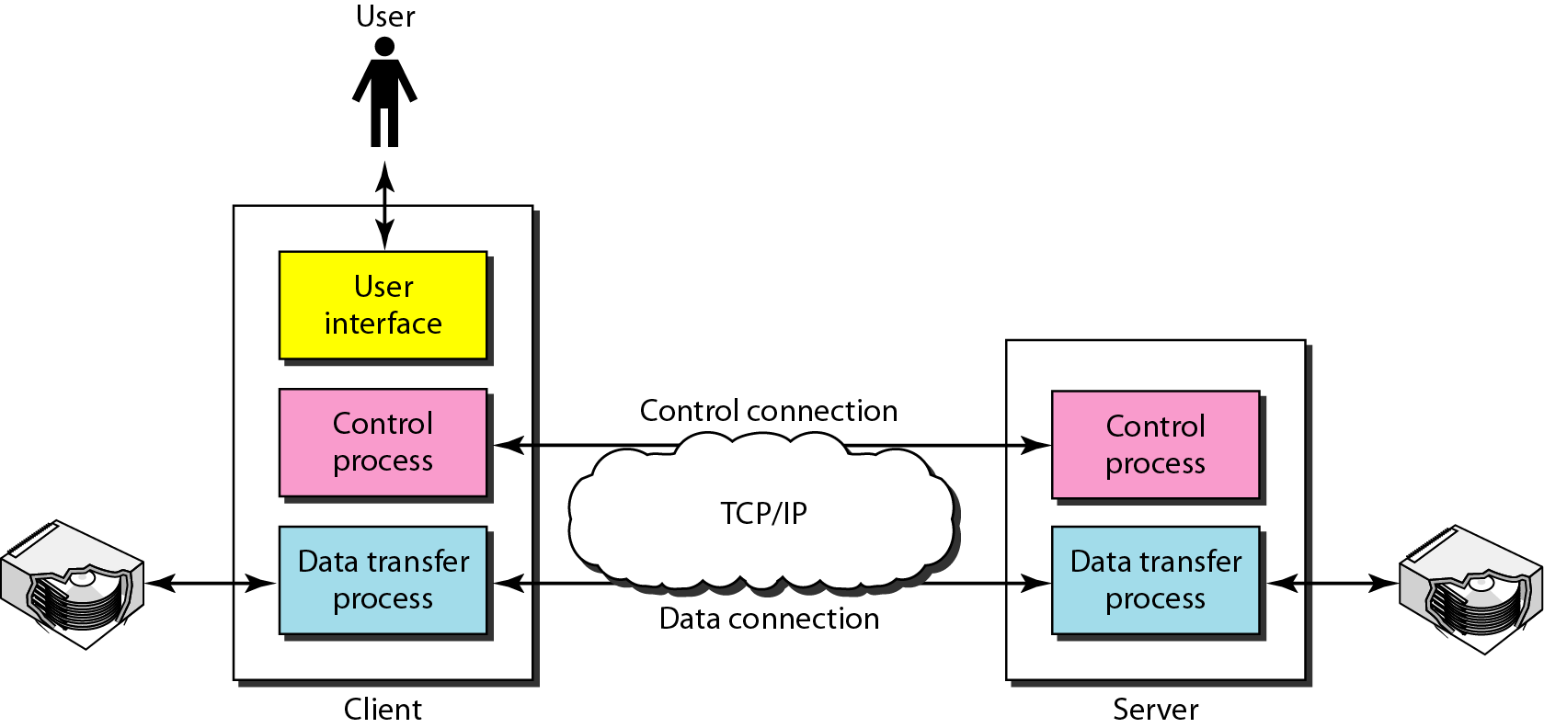
File Transfer Protocol(FTP)
FTP uses the services of TCP. It needs two TCP connections.
The well-known port 21 (control connection) and port 20 (data connection).
The control connection is made between the control processes. The data connection is made between the data transfer processes.
The control connection remains connected during the entire interactive FTP session. The data connection is opened and then closed for each file transferred.

Slide 11
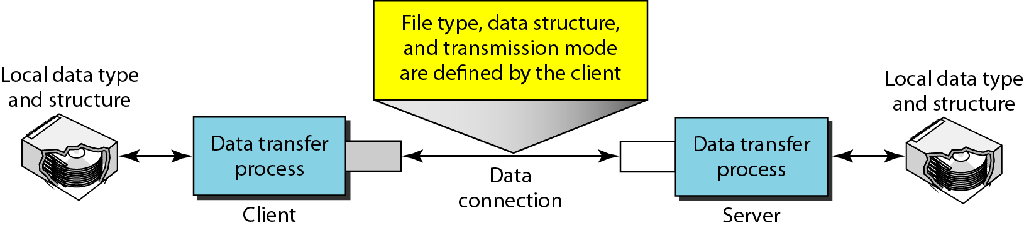
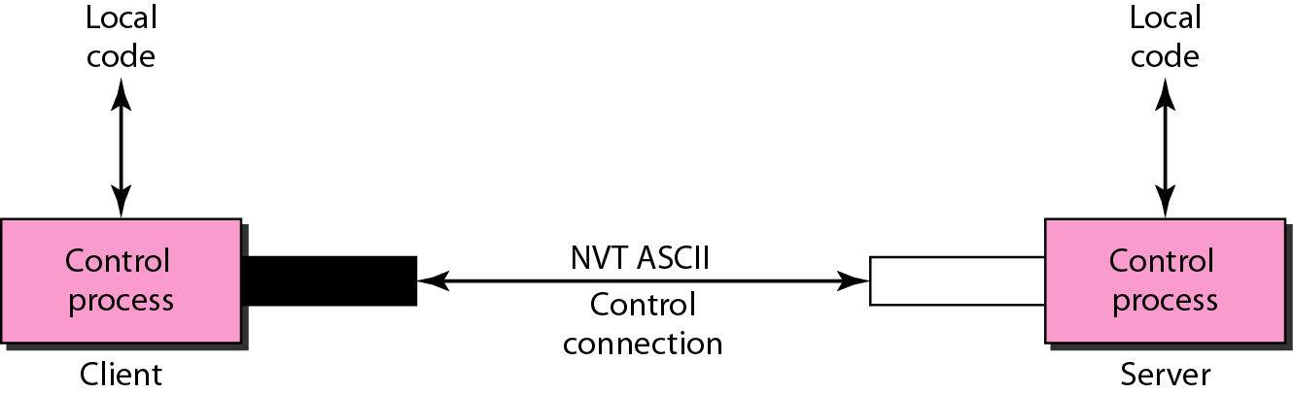
Using the control connection
Using the data connection
FTP uses the same approach as SMTP to communicate across the control connection. It uses the 7-bit ASCII character set.
Communication is achieved through commands and responses.
File transfer occurs over the data connection under the control of the commands sent over the control connection.
The client must define the type of file to be transferred, the structure of the data, and the transmission mode.
FTP :- Not a secure protocol as data being transferred is not encrypted

Slide 12

Secure File Transfer Protocol (SFTP) & Trivial File Transfer Protocol (TFTP)
SFTP
It is similar to FTP except it uses a layer of security.
Data is encrypted using secure shell.
It authenticates the user and the server.
It is connection-oriented protocol.
It uses port number 22 for file transfer
TFTP
It is used to transfer files in local area network
It is a connectionless protocol and use UDP
It does not provide security during data transfer.

Slide 13

Questions
_________is limited to 7-bit ASCII text, with a maximum line length 1000 characters.
A. SMTP B. MIME C. POP D. MTA

Slide 14

Question
The well-known port of SMTP server is_________.
110
25
50
20

