Slide 1

Application Layer
WWW and HTTP

Slide 2

ARCHITECTURE
The World Wide Web (WWW) is a repository of information linked together from points all over the world.
The WWW today is a distributed client/server service, in which a client using a browser can access a service using a server.
The service provided is distributed over many locations called sites.

Slide 3
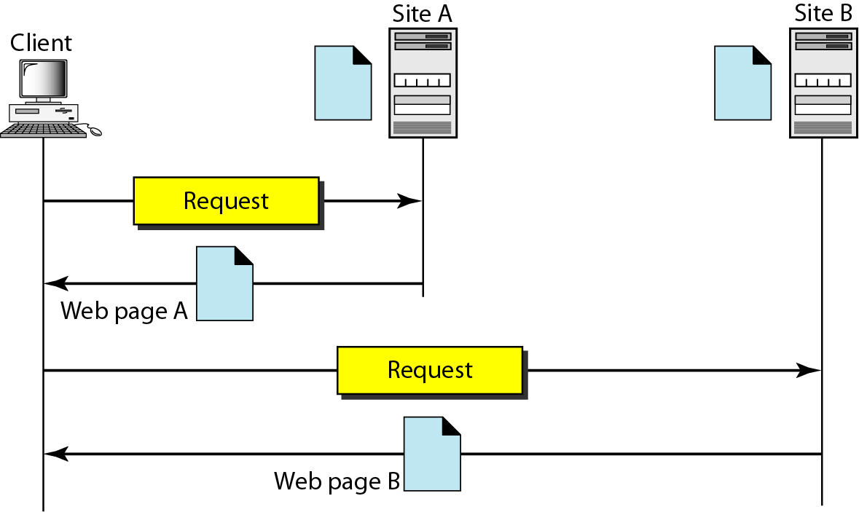
Architecture of WWW
Each site holds one or more documents, referred to as Web pages. Each Web page can contain a link to other pages in the same site or at other sites. The pages can be retrieved and viewed by using browsers
The client needs to see some information that it knows belongs to site A. It sends a request through its browser, a program that is designed to fetch Web documents.
The request, among other information, includes the address of the site and the Web page, called the URL
The server at site A finds the document and sends it to the client.

Slide 4
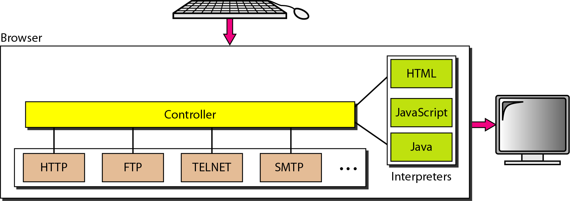
Browser
Each browser usually consists of three parts: a controller, client protocol, and interpreters.
The controller receives input from the keyboard or the mouse and uses the client programs to access the document.
Controller uses one of the interpreters to display the document on the screen.
To improve efficiency, servers normally store requested files in a cache in memory; memory is faster to access than disk.

Slide 5
A URL is a standard for specifying any kind of information on the Internet. The URL defines four things: protocol, host computer, port, and path
The protocol is the client/server program used to retrieve the document.
The host is the computer on which the information is located, although the name of the computer can be an alias.
The URL can optionally contain the port number of the server. If the port is included, it is inserted between the host and the path, and it is separated from the host by a colon.
Path is the pathname of the file where the information is located.
Uniform Resource Locator (URL)

Slide 6

WEB DOCUMENTS
The documents in the WWW can be grouped into three broad categories: static, dynamic, and active.
The category is based on the time at which the contents of the document are determined.

Slide 7
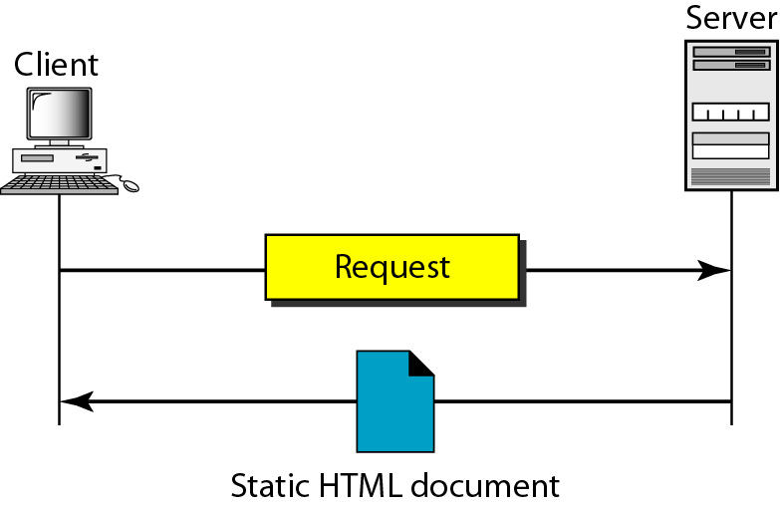
Static document
Static documents are fixed-content documents that are created and stored in a server.
The client can get only a copy of the document. In other words, the contents of the file are determined when the file is created, not when it is used.

Slide 8
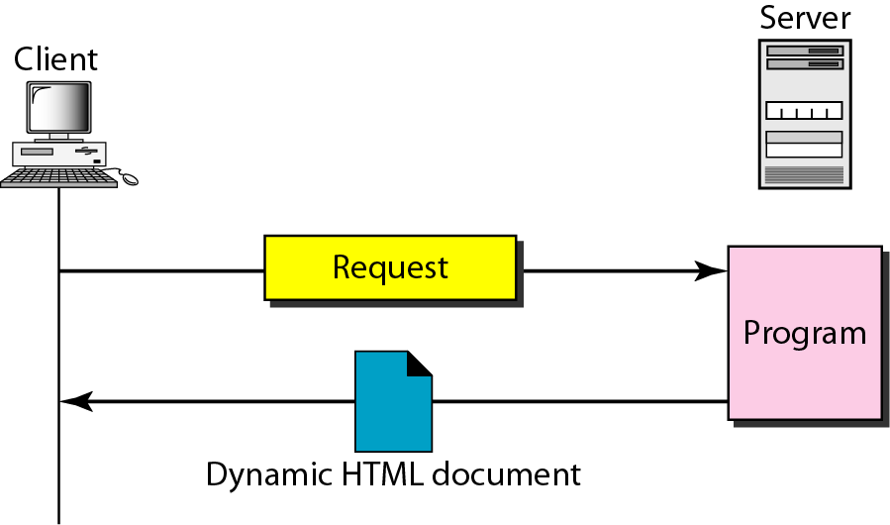
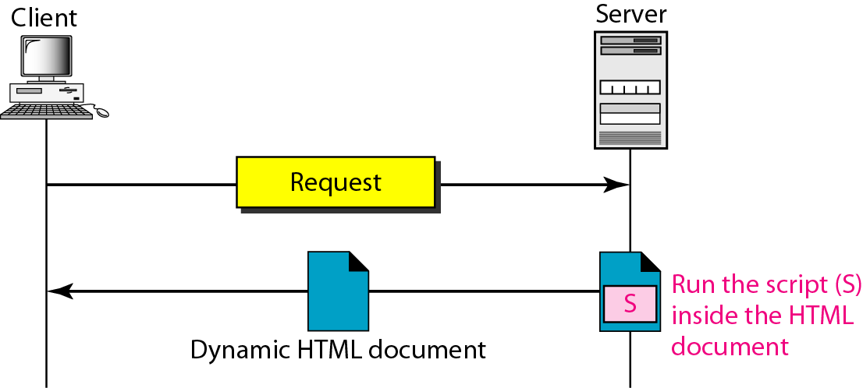
Dynamic document using CGI
Dynamic document is created by a Web server whenever a browser requests the document.
When a request arrives, the Web server runs an application program or a script that creates the dynamic document. dynamic document example- is the retrieval of the time and date from a server.
Dynamic documents are sometimes referred to as server-site dynamic documents.
The Common Gateway Interface (CGI) is a technology that creates and handles dynamic documents. CGI is a set of standards that defines how a dynamic document is written, how data are input to the program, and how the output result is used.

Slide 9
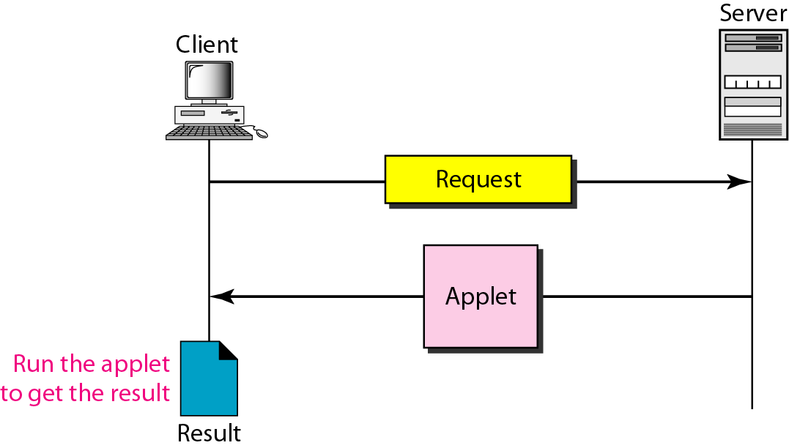
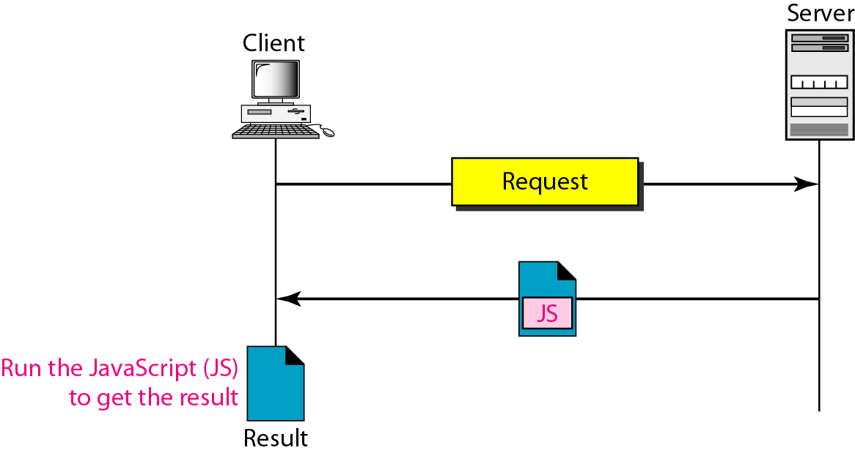
Active document
For many applications, we need a program or a script to be run at the client site. These are called active documents, e. g.- Java Applets
Active documents are sometimes referred to as client-site dynamic documents
Active document using Java applet
Active document using client-site script

Slide 10
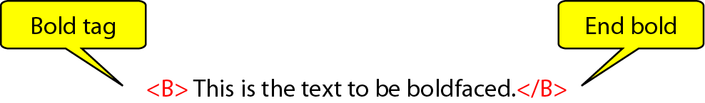
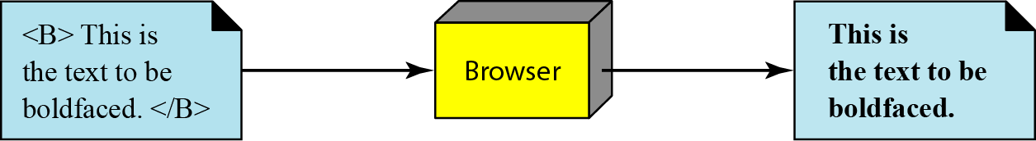
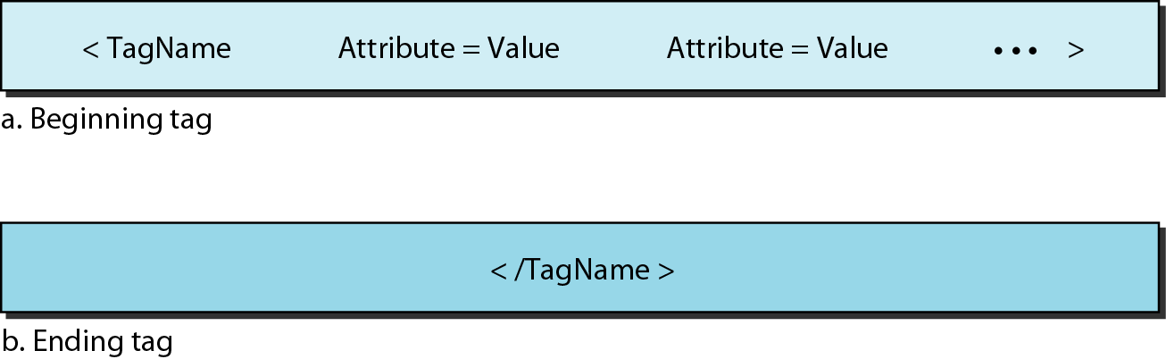
Hypertext Markup Language (HTML)
HTML is a language for creating Web pages.
The term markup language comes from the book publishing industry
The two tags <B> and </B> are instructions for the browser. When the browser sees these two marks, it knows that the text must be boldfaced
Boldface tags
Beginning and ending tags

Slide 11

Hypertext Transfer Protocol (HTTP)
HTTP is a protocol used mainly to access data on the World Wide Web.
HTTP functions as a combination of FTP and SMTP.
HTTP uses the services of TCP on well-known port 80.

Slide 12
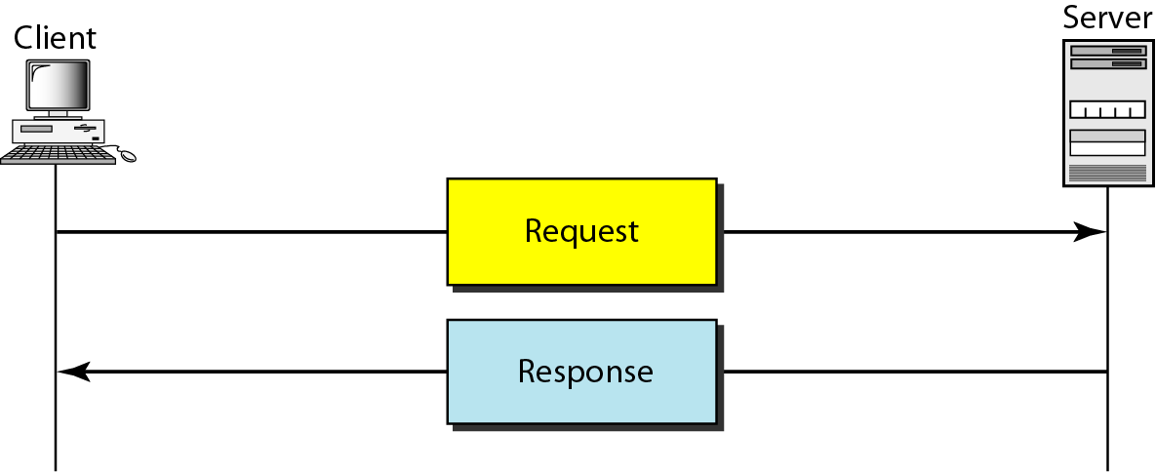
HTTP transaction
Although HTTP uses the services of TCP, HTTP itself is a stateless protocol.
The client initializes the transaction by sending a request message. The server replies by sending a response.
The formats of the request and response messages are similar.. A request message consists of a request line, a header, and sometimes a body.
A response message consists of a status line, a header, and sometimes a body.

Slide 13
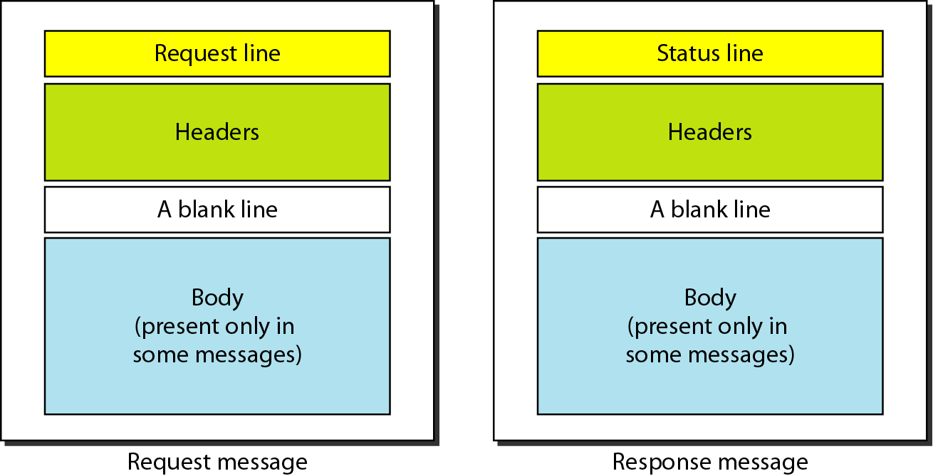
Request and response messages

Slide 14
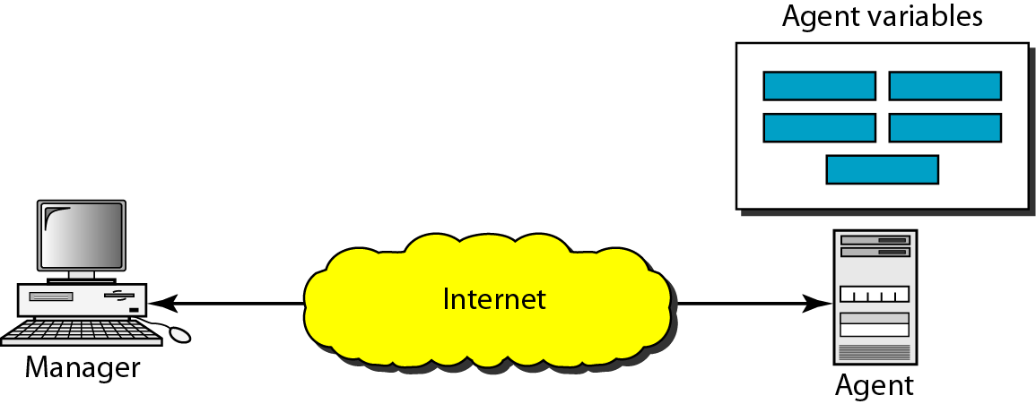
SIMPLE NETWORK MANAGEMENT PROTOCOL (SNMP)
SNMP is a framework for managing devices in an internet using the TCP/IP protocol suite.
It provides a set of fundamental operations for monitoring and maintaining an internet.
SNMP defines the format of packets exchanged between a manager and an agent.
It reads and changes the status (values) of objects (variables) in SNMP packets.

Slide 15

Question
Which of the following is an application layer service?
a) Network virtual terminal
b) File transfer, access, and management
c) Mail service
d) All of the mentioned

