Slide 1

Network Security

Slide 2
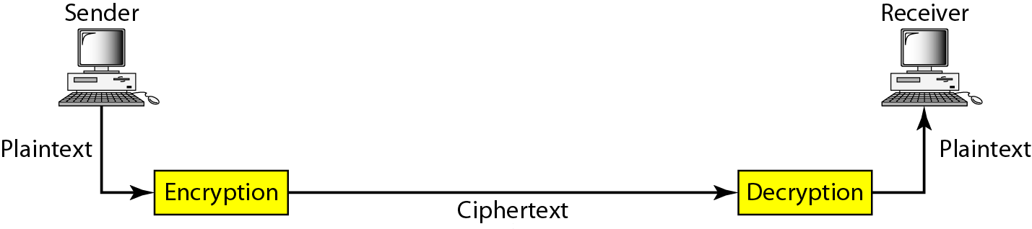
Cryptography
Cryptography, a word with Greek origins, means "secret writing."
Cryptography Components:-
Plaintext and Ciphertext- The original message, before being transformed, is called plaintext. After the message is transformed, it is called ciphertext.
An encryption algorithm transforms the plaintext into ciphertext; a decryption algorithm transforms the ciphertext back into plaintext.
Cipher- Encryption and decryption algorithms as ciphers. The term cipher is also used to refer to different categories of algorithms in cryptography.
Key- A key is a number (or a set of numbers) that the cipher, as an algorithm, operates on.
Cryptography components

Slide 3
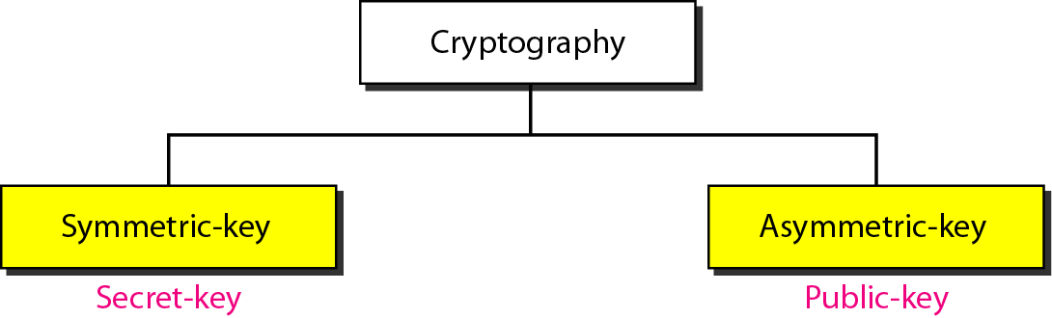
Categories of cryptography
All the cryptography algorithms (ciphers) can be divide into two groups:
Symmetric key (also called secret-key) cryptography algorithms
Asymmetric (also called public-key) cryptography algorithms.

Slide 4
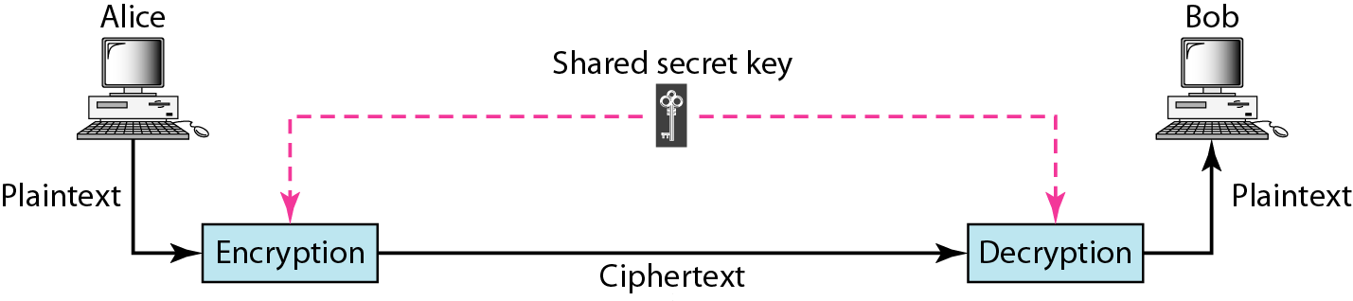
Symmetric-key cryptography
In symmetric-key cryptography, the same key is used by both parties.
The sender uses this key and an encryption algorithm to encrypt data; the receiver uses the same key and the corresponding decryption algorithm to decrypt the data.

Slide 5
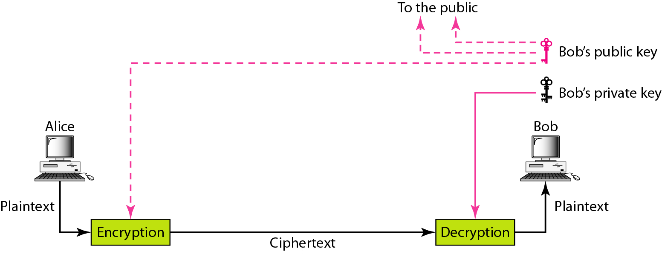
Asymmetric-key cryptography
In asymmetric or public-key cryptography, there are two keys:
a private key and a public key.
The private key is kept by the receiver. The public key is announced to the public.

Slide 6
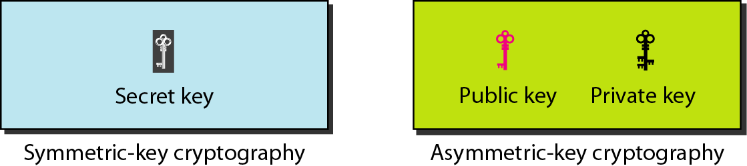
Keys used in cryptography
Three types of keys in cryptography: the secret key, the public key, and the private key.
The first, the secret key, is the shared key used in symmetric-key cryptography.
The second and the third are the public and private keys used in asymmetric-key cryptography.

Slide 7
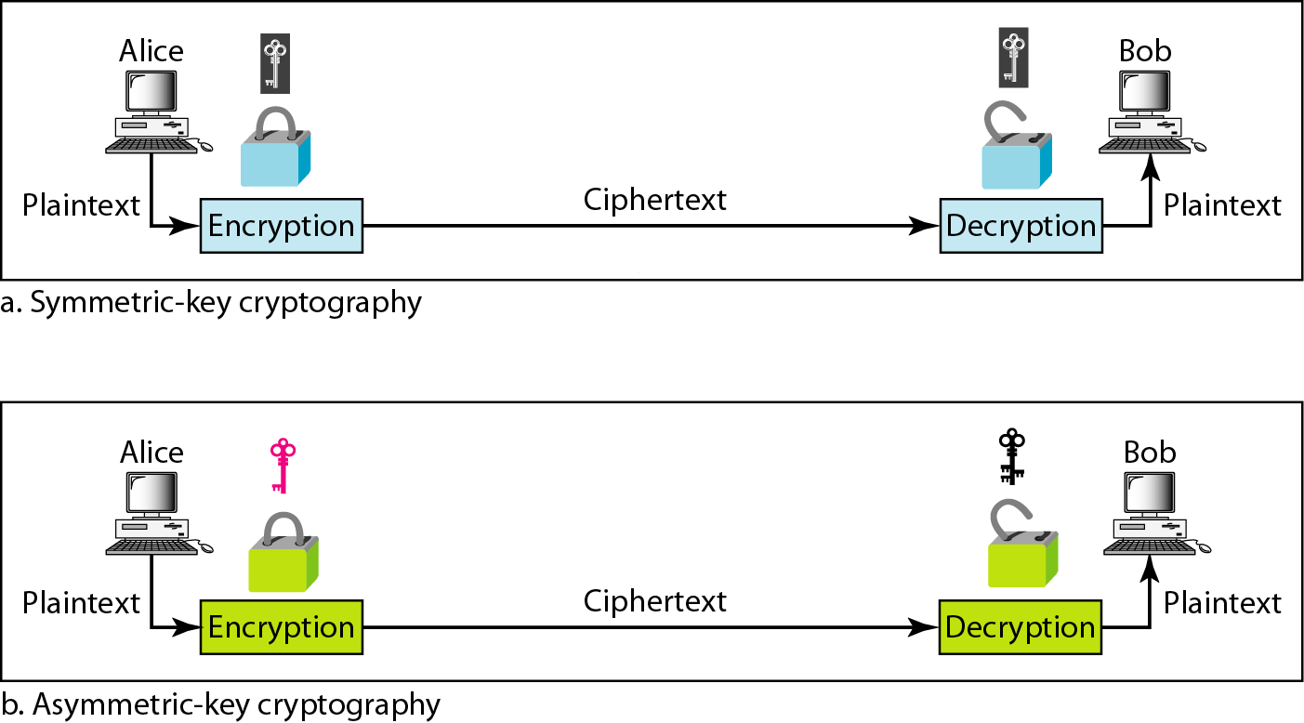
Comparison between two categories of cryptography
Encryption can be thought of as electronic locking; decryption as electronic unlocking.
The sender puts the message in a box and locks the box by using a key; the receiver unlocks the box with a key and takes out the message.

Slide 8
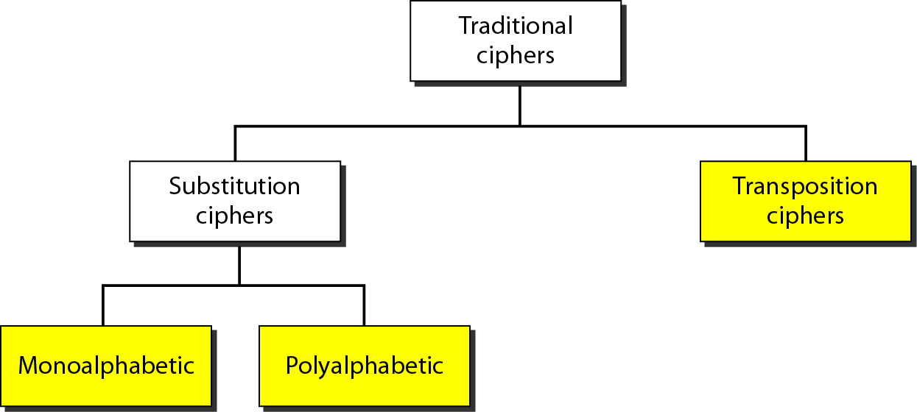
SYMMETRIC-KEY CRYPTOGRAPHY
Traditional ciphers
The traditional ciphers, which are character-oriented. Although these are now obsolete.
With the advent of the computer, ciphers need to be bit-oriented. This is so because the information to be encrypted is not just text; it can also consist of numbers, graphics, audio, and video data.
A substitution cipher replaces one symbol with another.
A transposition cipher reorders (permutes) symbols in a block of symbols.
In a monoalphabetic cipher, a character (or a symbol) in the plaintext is always changed to the same character (or symbol) in the ciphertext regardless of its position in the text.
Simple Modern Ciphers
XOR Cipher
Rotation Cipher

Slide 9
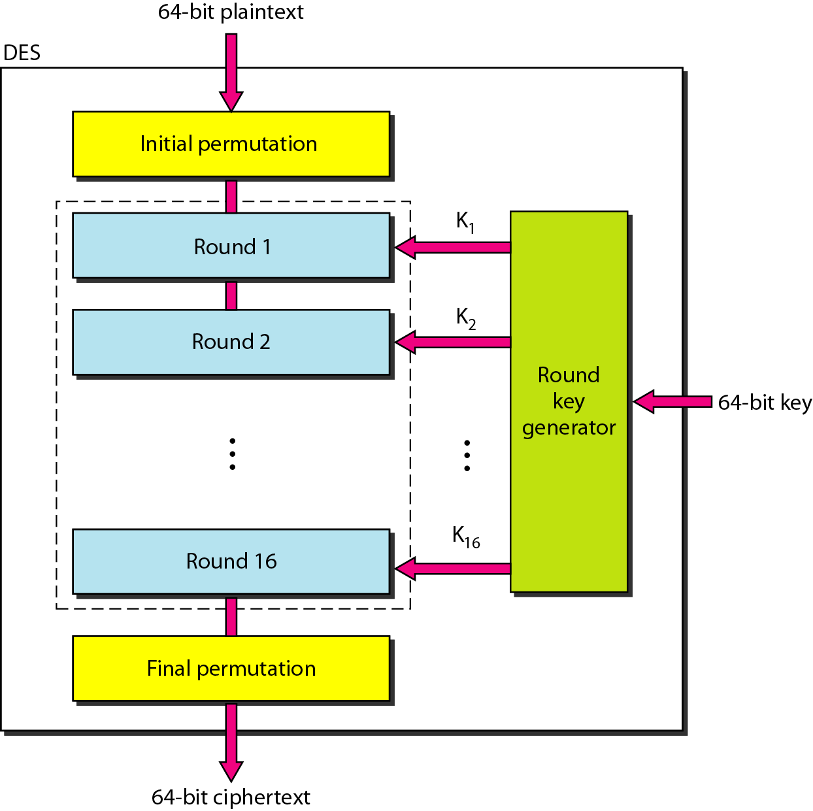
Modern Round Ciphers
Two modem symmetric-key ciphers:
Data Encryption Standard (DES)
Advanced Encryption Standard (AES)
These ciphers are referred to as block ciphers because they divide the plaintext into blocks and use the same key to encrypt and decrypt the blocks.
The algorithm encrypts a 64-bit plaintext block using a 64-bit key
DES

Slide 10
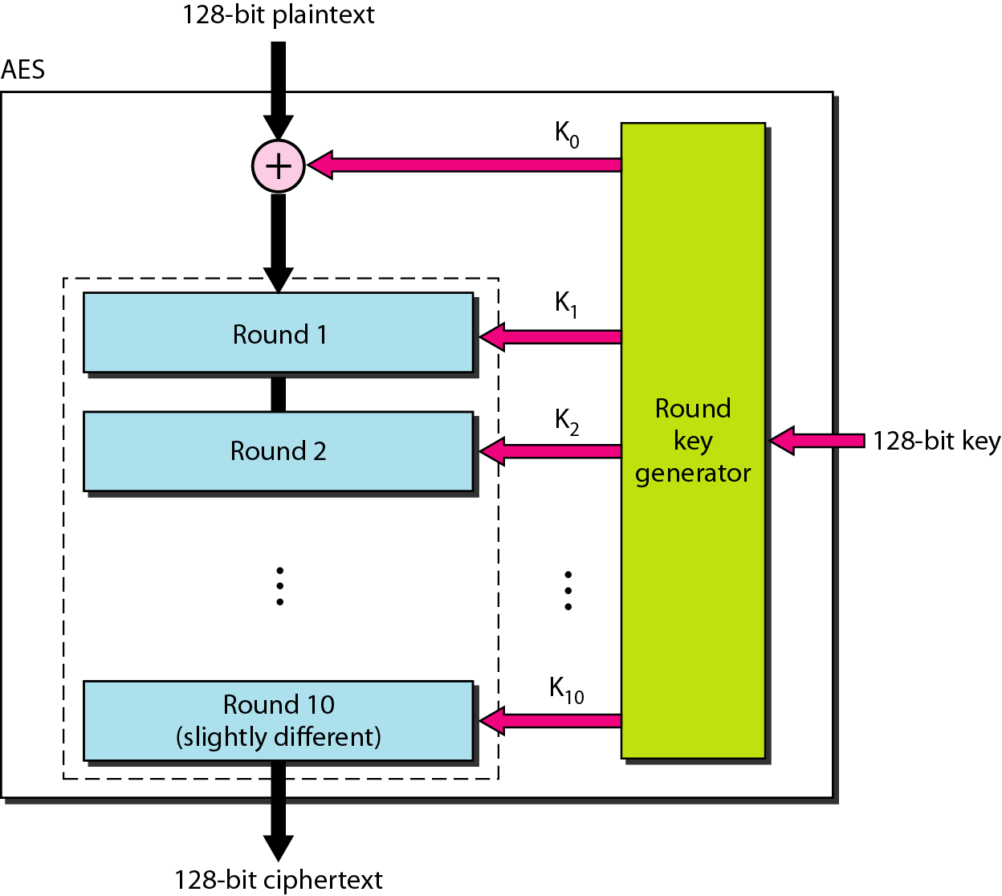
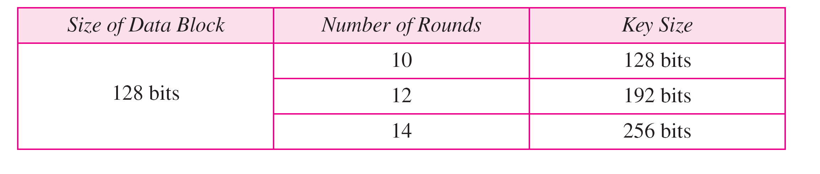
AES
The Advanced Encryption Standard (AES) was designed because DES's key was too small. Although Triple DES increased the key size, the process was too slow.
The National Institute of Standards and Technology (NIST) chose the Rijndael algorithm, as the basis of AES. AES is a very complex round cipher. AES is designed with three key sizes: 128, 192, or 256 bits.
AES configuration

Slide 11

ASYMMETRIC-KEY CRYPTOGRAPHY
An asymmetric-key (or public-key) cipher uses two keys: one private and one public.
Two algorithms:
RSA
Diffie-Hellman.

Slide 12
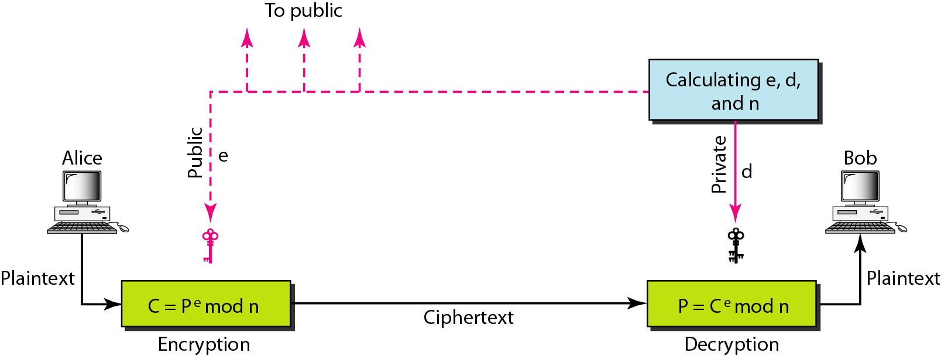
RSA
The most common public key algorithm is RSA, named for its inventors Rivest, Shamir, and Adleman (RSA). It uses two numbers, e and d, as the public and private keys
In RSA, e and n are announced to the public; d and Φ are kept secret.
Steps to select the private and public keys:
Bob chooses two very large prime numbers p and q.
Bob multiplies the above two primes to find n, the modulus for encryption and decryption.
n = p X q.
3. Bob calculates another number
Փ = (p -1) X (q - 1).
4. Bob chooses a random integer e. He then calculates d so that d x e=1 mod Փ .
5. Bob announces e and n to the public; he keeps Փ and d secret.

Slide 13
Encryption
Anyone who needs to send a message to Bob can use n and e. For example, if Alice needs to send a message to Bob, she can change the message, usually a short one, to an integer. This is the plaintext. She then calculates the ciphertext, using e and n.
C= P^{e}(modn)
Alice sends C, the ciphertext, to Bob.
Decryption
Bob keeps Փ and d private. When he receives the ciphertext, he uses his private key d to decrypt the message:
P= C^{d}(modn)
Restriction
For RSA to work, the value of P must be less than the value of n. If P is a large number,
the plaintext needs to be divided into blocks to make P less than n.

Slide 14
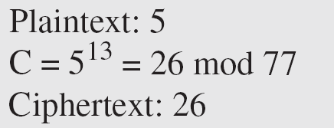
Example
Bob chooses 7 and 11 as p and q and calculates n = 7 · 11 = 77. The value of Φ = (7 − 1) (11 − 1) or 60. Now he chooses two keys, e and d. If he chooses e to be 13, then d is 37. Now imagine Alice sends the plaintext 5 to Bob. She uses the public key 13 to encrypt 5.

Slide 15
Example
Bob receives the ciphertext 26 and uses the private key 37 to decipher the ciphertext:
The plaintext 5 sent by Alice is received as plaintext 5 by Bob.

