Slide 1


Computer Networks(CSET207)
Dr. Vikas Tyagi
Assistant Professor

Slide 2
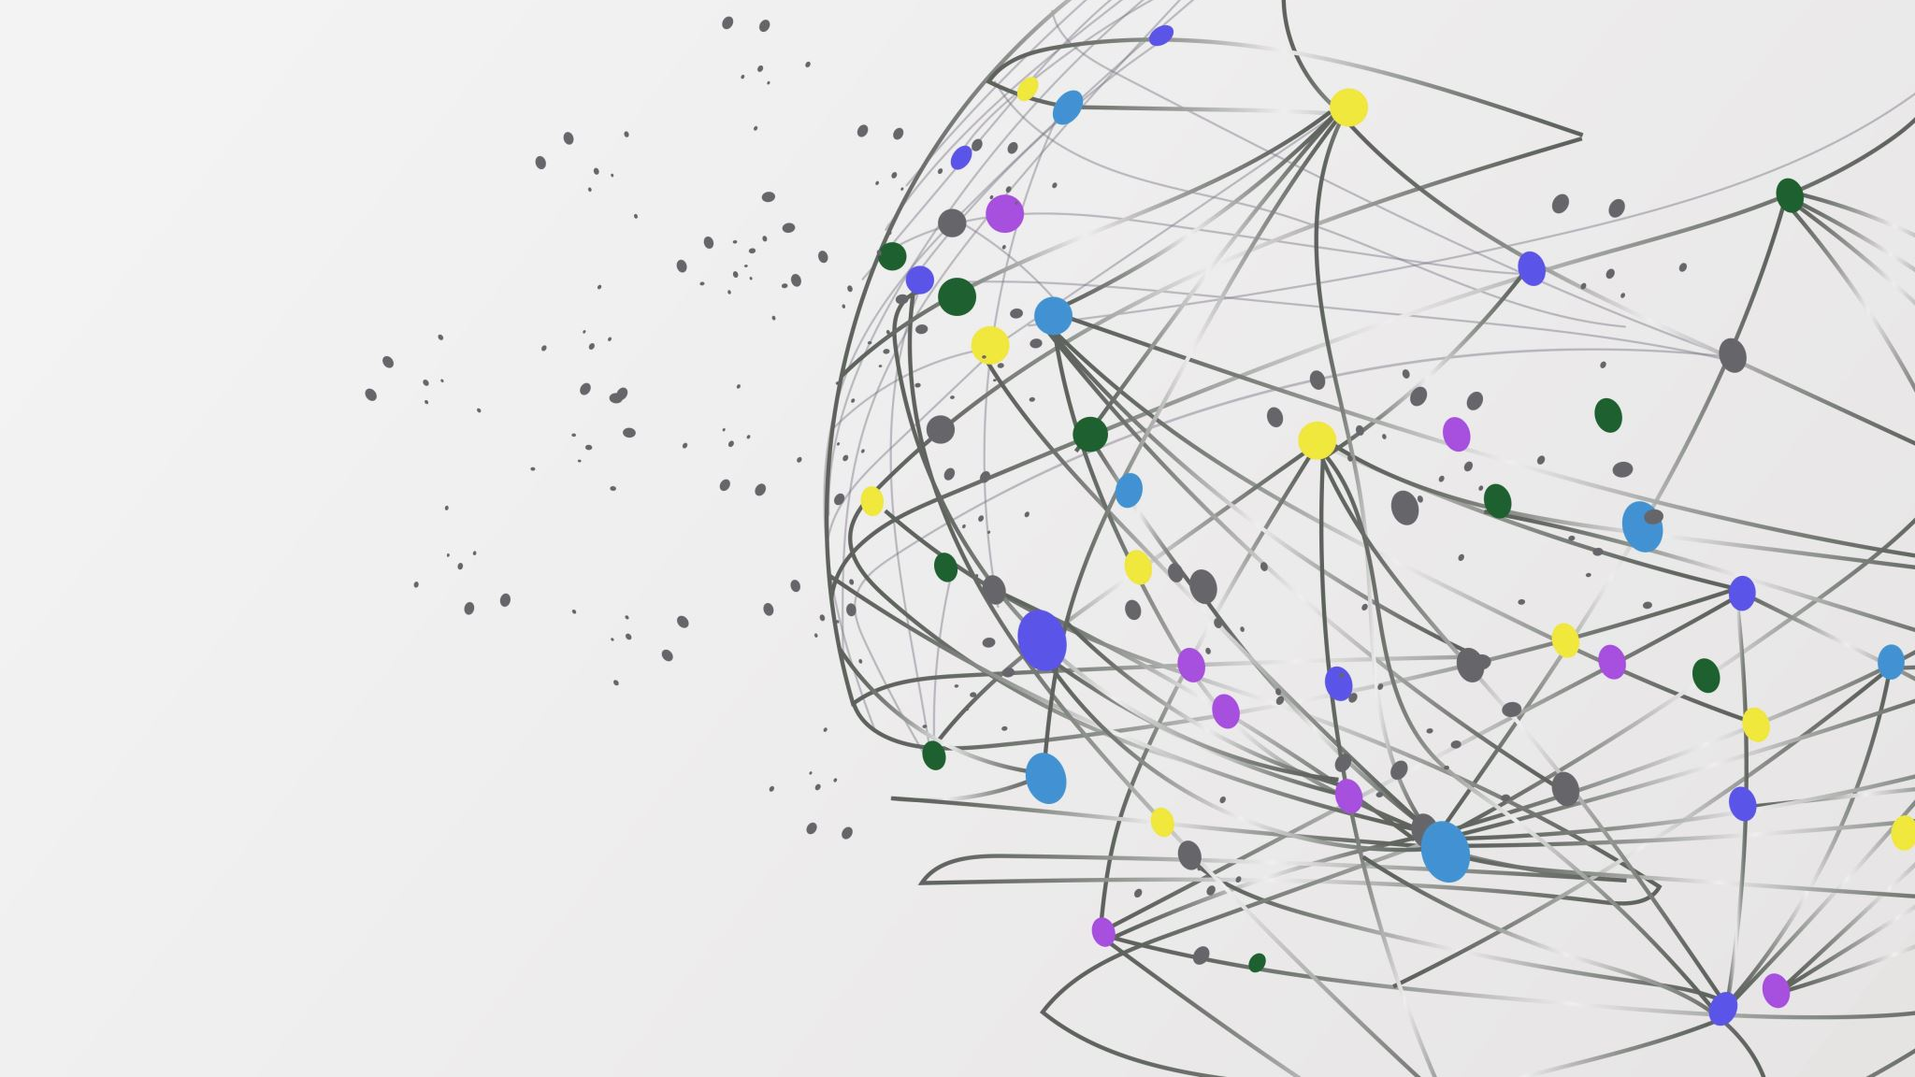
Introduction to Computer Networks

Slide 3

Outline
  Why Computer Networks?
  Computer network basics
  Applications of Computer Networks
  Transmission media

Slide 4
Course Structure
Module 1 (9 hours)
Why Computer Networks: Applications of Networks, Transmission Media, Connecting Devices, Local Area Networks: LAN topologies: Bus topology, Ring topology, Star topologies, Mesh topology, Hybrid topology, OSI reference model, TCP/IP Protocol suite, Physical Layer: Services, Line coding scheme, Modulation, Multiplexing, Switching methods, Ethernet, Bluetooth, Wi-Fi, Wi-Fi Direct, WPA/WPA2/WPA3, Data Link layer: Services, Framing, Switches.
Module 2 (8 hours)
Reliable Data Delivery: Error detection, Error Correction, Flow control: Stop and wait, Go Back-N, Flow control: S-R Protocol, Error control (Retransmission techniques, timers), Medium Access sub layer - Channel Allocations, LAN protocols
/ALOHA protocols, CSMA, CSMA/CD, Network Layer Protocols: Services (IP, ICMP), IP addressing, sub netting, Super netting (CIDR), IPV4, IPV6.
Module 3 (9 hours)
Routing and Forwarding, Static and dynamic routing, Unicast and Multicast Routing, Distance-Vector Routing, Link-State Routing, Shortest path computation-Dijkstra's algorithm, Address mapping-ARP, RARP, BOOTP, DHCP, Transport Layer: Services, UDP and TCP segment formats, connection establishment and termination, Expert Lecture from Industry, Congestion control, Congestion control: Open Loop and closed loop, Quality of service, Flow characteristics, Techniques to improve QoS.

Slide 5
Course Structure
Module 4 (7 hours)
Session Layer: Services, Protocols, Presentation layer: Services, Protocols, Application layer: Services, DNS, SIP, RTP, Telnet/SSH, HTTP, HTTPS, Remote login, Electronic mail, SMTP, FTP Commands and Replies, WWW, SNMP, Addressing Schemes, Uniform Resource Identifiers.
Module 5 (9 hours)
Principles of Cryptography, Symmetric key, Public key, Authentication protocols, Digital signatures, Firewalls, Security in different layers: Secure E-mail SSL, IP security, Advanced Topics in CN: Dark Net, CASS: Content-Aware Search System, Service-centric networking, Software-defined networking, Cloud Systems: Services, Data center, 4G and 5G Networks, Body area sensor Networks, Satellite networks, SWARM networks.

Slide 6
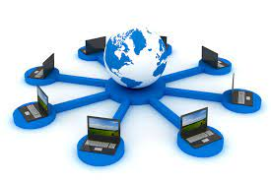
Computer network basics
  Network: A set of devices (or nodes) connected by media link is called a Network.
  A node can be a device which can send or receiving data generated by other nodes on the network like a computer, printer etc.
  The links connecting the devices are called Communication channels.
  Computer network is a telecommunication channel used to share data connected to the same network.
  The best example of computer network is Internet.

Slide 7

Why Computer Networks?
File/Application sharing- users can transfer data files through a network
Hardware sharing- enables users in a network to share hardware devices, such as printers and hard drives;
Client-server model- allows data to be stored on servers where end-user devices (or clients) can access that data;
Voice over IP (VoIP) - enables users to send voice data through internet protocols
Storage- enables users to access data that's stored remotely or on other network devices.

Slide 8

Computer network application
  Marketing and sales: –Marketing professionals collect, exchange, and analyzes data relating to customer requirements and product development cycles.
  Manufacturing: – computer-assisted manufacturing (CAM) and computer –assisted designing (CAD) both of which permit multiple users to work on a project simultaneously.
  Financial Services: It includes credit history searches, foreign exchange and investment services, and Electronic Funds Transfer (EFT).
  Teleconferencing:- Conferences are possible to occur without the participants being in the same place. It includes simple text conferencing, voice conferencing, and video conferencing.
  Cable Television:- It can include video on request.

Slide 9
Computer network application
  Electronic Messaging:– Electronic mail (e-mail)
  Electronic Data Interchange (EDI):– EDI permits business information to be transferred without using paper.
  Directory services: –It is possible to store the last of files in a central location to speed worldwide search operations.
  Cellular Telephone: –cellular network make it possible to maintain wireless phone connections even while travelling over large distances.

Slide 10
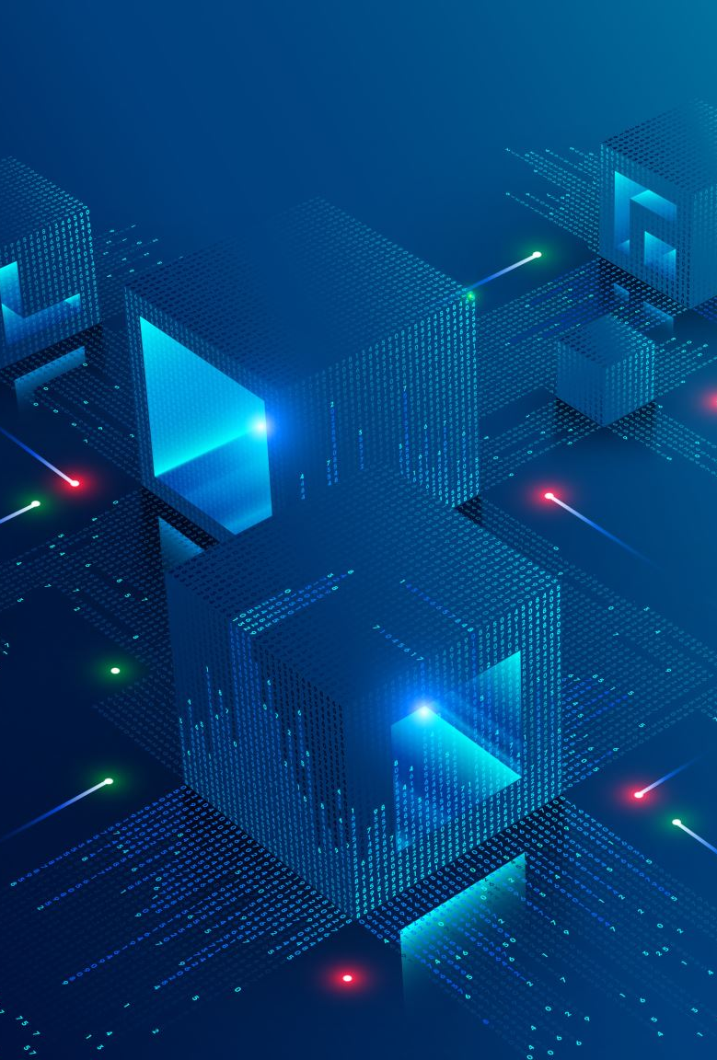
Data Communication
  The exchange of data between two devices through a transmission medium is called Data Communication.
  Communication Types:
    Local communication: The communicating devices are in the same geographical area, same building, or face-to-face etc.
    Remote communication: The devices are communicating over a distance
      The effectiveness of a data communication can be measured through the following features :
        Delivery: Delivery should be done to the correct destination.
        Timeliness: Delivery should be on time.
        Accuracy: Data delivered should be accurate.

Slide 11
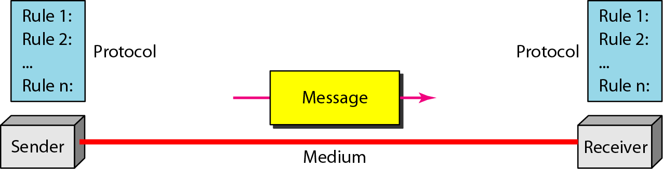
Data communication: Components
  Message: It is the information to be delivered.
  Sender: Sender is the person who is sending the message.
  Receiver: Receiver is the person to whom the message is being sent to.
  Medium: It is the medium through which the message is sent.
  Protocol: These are some set of rules which govern data communication.

Slide 12

Connection types
  A Network is nothing, but a connection made through connection links between two or more devices.
  There are two ways to connect the devices :
    Point-to-Point connection or dedicated connection
    Multipoint connection or shared connection

Slide 13
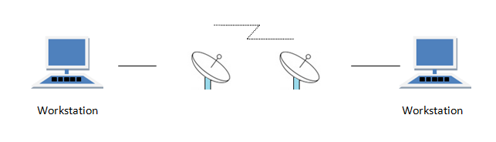
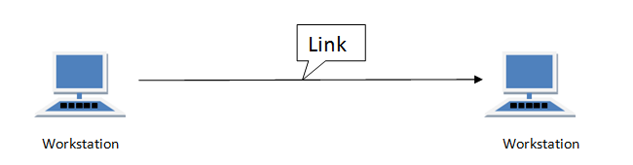
Connection types: Point to point
  Communication link between two devices and it is simple to establish.
  For example, computer connected by telephone line, connection between remote control and Television.

Slide 14
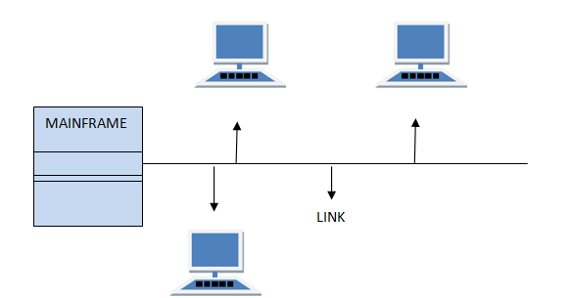
Connection types: Multipoint
  The link is shared in space shared, or time shared between many devices

Slide 15

A _______ is the physical path over which a message travels.
Path
Medium
Protocol
Route

Slide 16
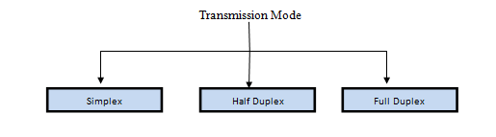
Transmission Modes
  It refers to the mechanism of transferring of data between two devices connected over a network.
  These modes direct the direction of flow of information.

Slide 17
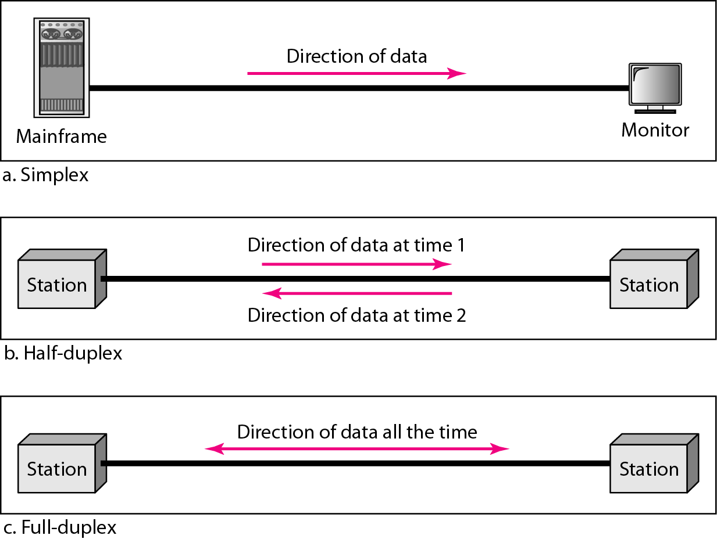
Transmission Modes
  Simplex mode
  Half Duplex mode
  Full Duplex mode

Slide 18

Three or more devices share a link in ________ connection.
Unipoint
Multipoint
Point to point
Simplex

Slide 19
Transmission Media
A transmission medium can be broadly defined as anything that can carry information from a source to a destination.
In data communication, The transmission medium is usually free space, metallic cable, or fiber-optic cable.
Computers and other telecommunication devices use signals to represent data.
These signals are transmitted from one device to another in the form of electromagnetic energy, which is propagated through transmission media.

Slide 20
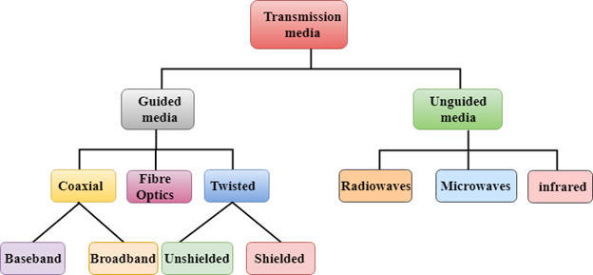
Transmission Media

Slide 21
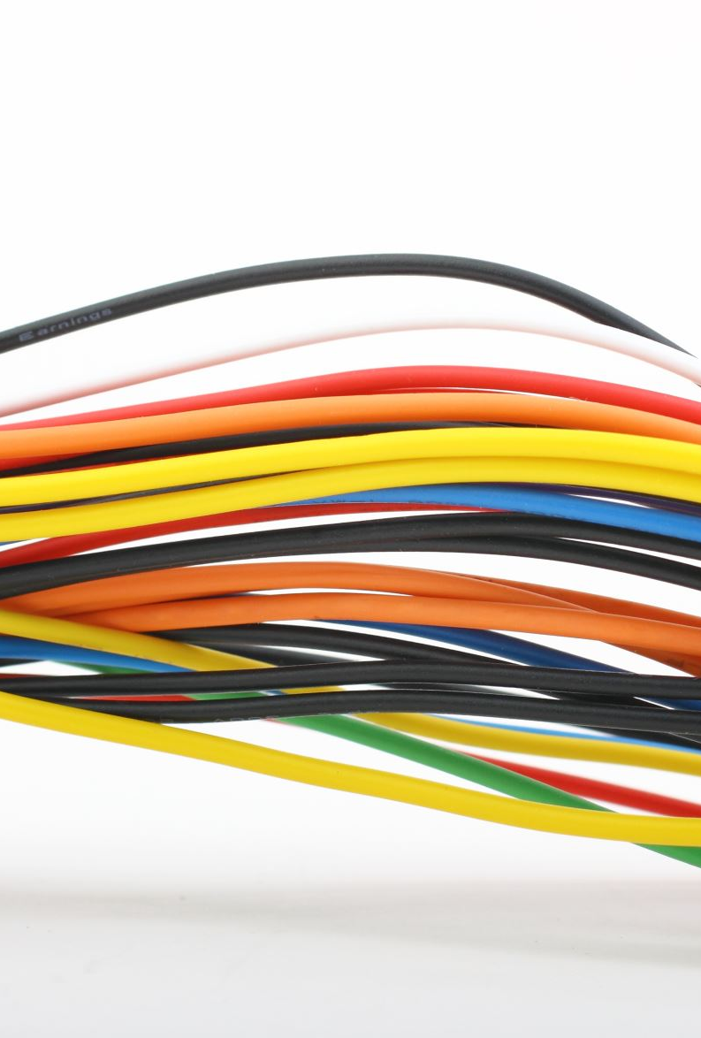
Transmission Media : Guided
  A signal travelling along guided media is directed and contained by the physical limits of the medium.
  Twisted-pair and coaxial cable use metallic (copper) conductors that accept and transport signals in the form of electric current.
  Optical fiber is a cable that accepts and transports signals in the form of light.

Slide 22
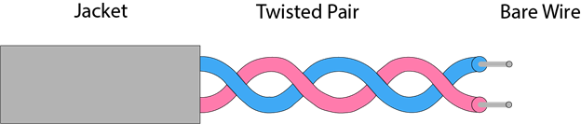
Guided : Twisted pair cable
  A physical media made up of a pair of cables twisted with each other.
  One of the wires is used to carry signals to the receiver, and the other is used only as a ground reference.
  The receiver uses the difference between the two.
  A twisted pair cable is cheap as compared to other transmission media.
  Installation of the twisted pair cable is easy, and it is a lightweight cable.
  A pair of wire is twisted over a double helix.
  Twisted-pair cables are used in telephone lines to provide voice and data channels.

Slide 23
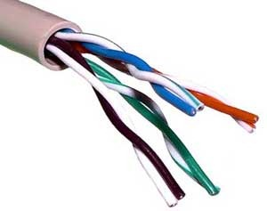
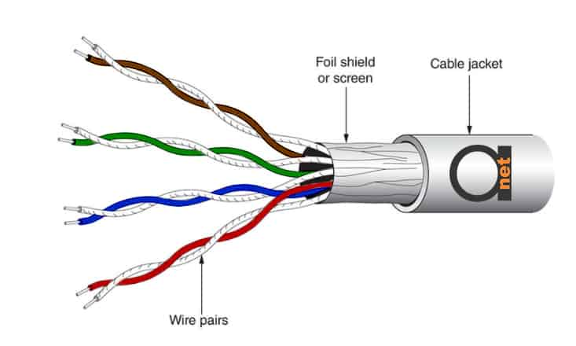
Guided : Unshielded twisted pair (UTP) Vs Shielded twisted pair (STP)
  UTP
  This type of cable can block interference and does not depend on a physical shield for this purpose.
  In computer network, Cat-5, Cat-5e, and Cat-6 cables are mostly used.
  UTP cables are connected by RJ45 connectors (RJ stands for registered jack).
  STP
  STP cable includes a particular jacket for blocking outside interference.
  It is used in rapid data rate Ethernet, in voice & data channels of telephone lines.
  Eliminates crosstalk and comparatively faster
  It is bulkier and more expensive

Slide 24
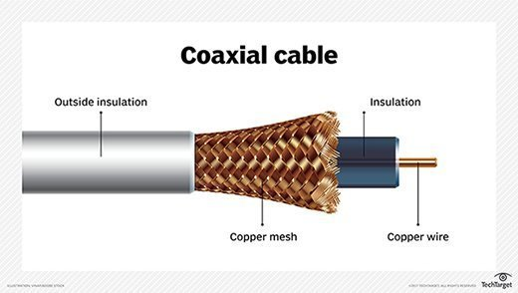
Guided : Coaxial
  Coaxial cable (or coax) carries signals of higher frequency ranges than those in twisted-pair cable
  Coaxial - It contains two conductors parallel to each other.
  The middle core is made up of non-conductive cover that separates the inner conductor from the outer one and is responsible for the data transferring whereas the copper mesh prevents from Electromagnetic interference.
  Categories of coax
  RG-59 (Cable TV),
  RG-58 (Thin Ethernet), and RG-11 (Thick Ethernet).
  Advantage
high speed data transmission.
Better shielding as compared to twisted pair cable.
It provides higher bandwidth.
Disadvantage
More expensive as compared to twisted pair cable. If any fault occurs in the cable causes the failure in the entire network Attenuation is much higher in coaxial cable than in twisted-pair cable. Requires the frequent use of repeaters.

Slide 25
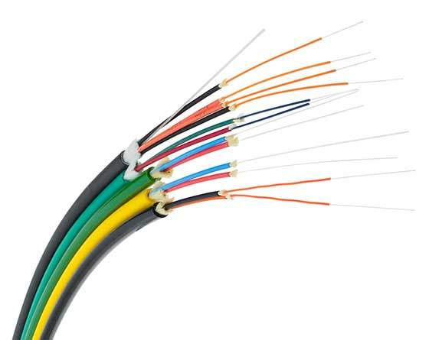
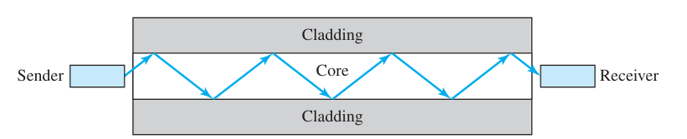
Guided: Fiber Optic
  A fiber-optic cable is made of glass or plastic and transmits signals in the form of light.
  It works on the properties of light and provides highest speed.
  Optical fibers use reflection to guide light through a channel.
  The plastic coating protects the optical fibers from heat, cold, electromagnetic interference from other types of wiring.
  Data transfer modes:
    Single mode fiber: Carry a single ray of light
    Multimode fiber: Carry multiple beams of light.
Advantage
Greater Bandwidth and Faster speed Longer distances
  To connect and access fiber optic special type of connectors are used (e.g. Subscriber Channel (SC), Straight Tip (ST), or MT-RJ.
Disadvantage
It is more expensive as compared copper cable Installation & maintenance is difficult

Slide 26
Question
Which of the following is not a guided media?
a) Fiber optical cable
b) Coaxial cable
c) Wireless LAN
d) Copper wire

Slide 27
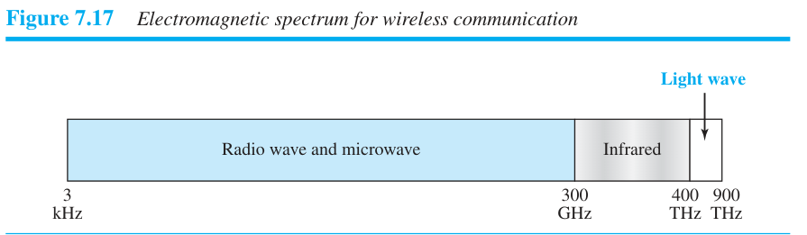
UNGUIDED MEDIA: WIRELESS
Unguided medium transport electromagnetic waves without using a physical conductor.
Signals are normally broadcast through free space and thus are available to anyone who has a device capable of receiving them.

