Slide 1


Computer Networks(CSET207)
Dr. Vikas Tyagi
Assistant Professor

Slide 2
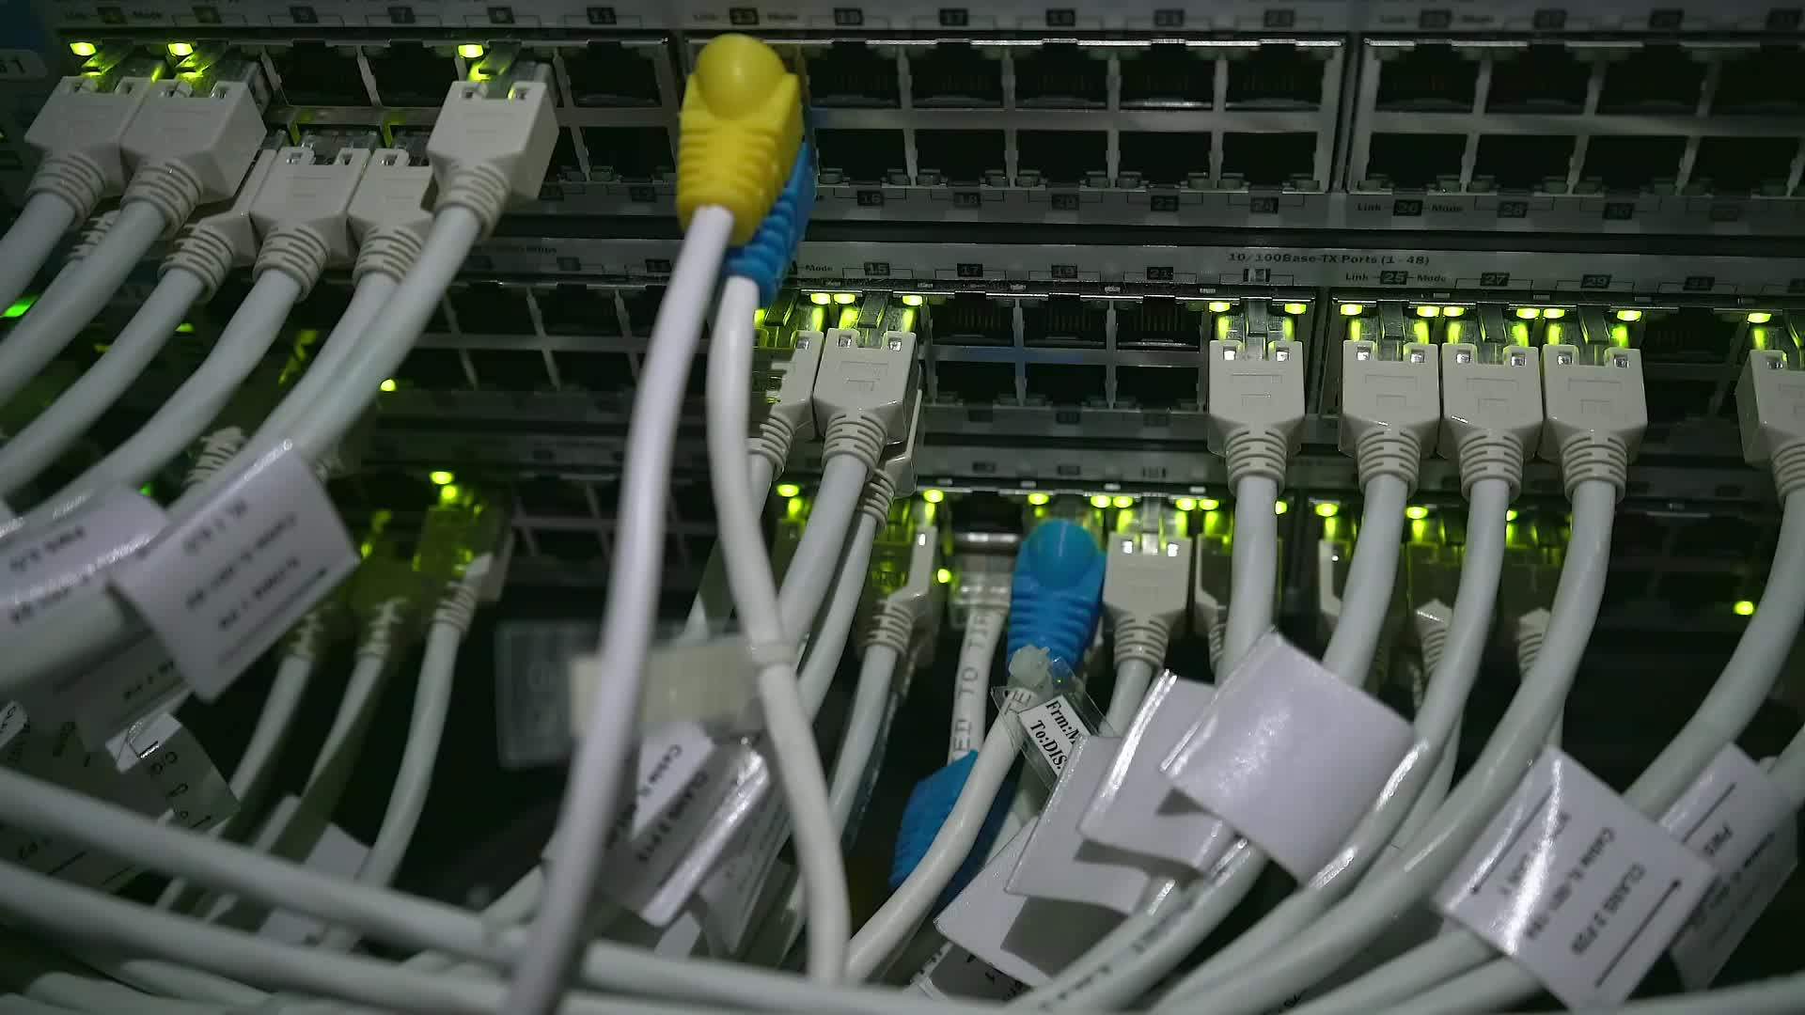
Computer Networks: Devices, Network types, topologies
These slides are partially based on slides assembled by B. A. Forouzan, with grateful acknowledgement of the many others who made their course materials freely available online.

Slide 3

Outline
Network devices
Network types
Network topologies

Slide 4
Network devices
NIC Hub Bridge Switch | Repeater Router Gateway Firewall

Slide 5
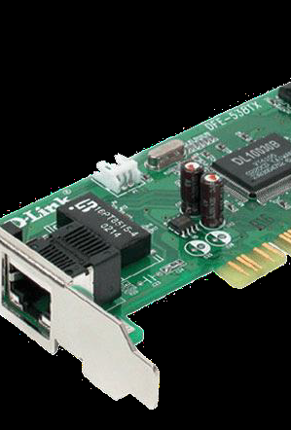
Network devices: NIC
NIC is used to connect host devices to the network media.
Each gadget that must be associated with a network must have a network interface card.
A NIC is a printed circuit board that fits into the expansion slot of a bus on a computer motherboard.
NICs are sometimes called network adapters.
Each NIC is identified by a unique code called a Media Access Control (MAC) address.
This address is used to control data communication for the host on the network.

Slide 6
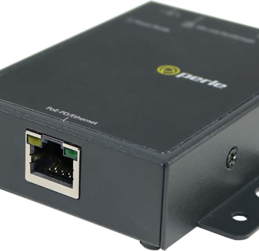
Network devices: Repeater
A repeater is a network device used to regenerate a signal.
Repeaters regenerate analog or digital signals that are distorted by transmission loss due to attenuation.
A repeater does not make an intelligent decision concerning forwarding packets
Operates at the physical layer of the OSI model

Slide 7
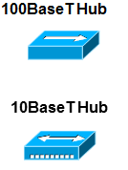
Networking devices: Hubs
A hub is a hardware device used at the physical layer to connect multiple devices in the network.
A hub has multiple ports.
A hub is a multi-port repeater.
Hubs cannot filter data, so data packets are sent to all connected devices.
Hubs concentrate on connections.
Hubs take a group of hosts and allow the network to see them as a single unit. This is done passively, without any other effect on the data transmission.
Active hubs concentrate hosts and regenerate signals.

Slide 8
How Does a Network Hub Work?
A hub is a multiport device, which has multiple ports in a device and shares the data to multiple ports altogether. A hub acts as a dumb switch that does not know, which data needs to be forwarded where so it broadcasts or sends the data to each port.
The collision domain of all hosts connected through hub remains one.

Slide 9
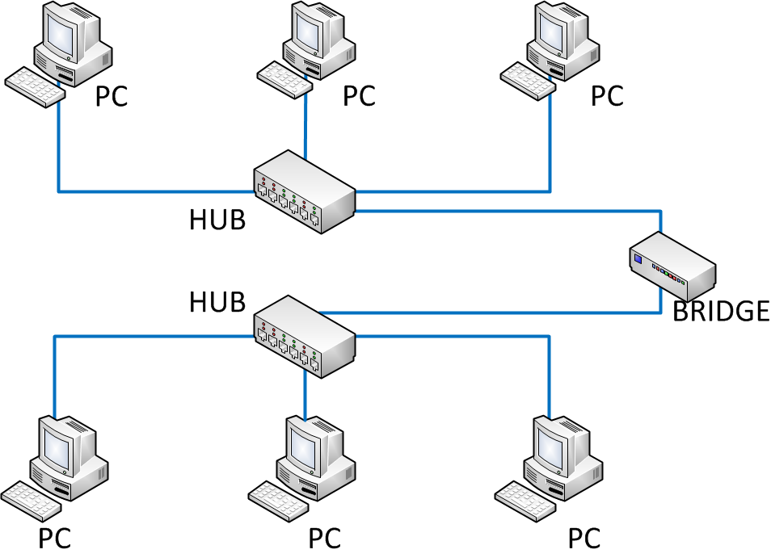
Networking devices: Bridges
A bridge in a computer network is a device used to connect multiple LANs together with a larger Local Area Network (LAN).
A bridge is a repeater, with add on the functionality of filtering content by reading the MAC addresses of source and destination.
Bridges provide connections between LANs working on same protocol.
A bridge operates at the data link layer.
It has a single input and single output port, thus making it a 2 port device.

Slide 10
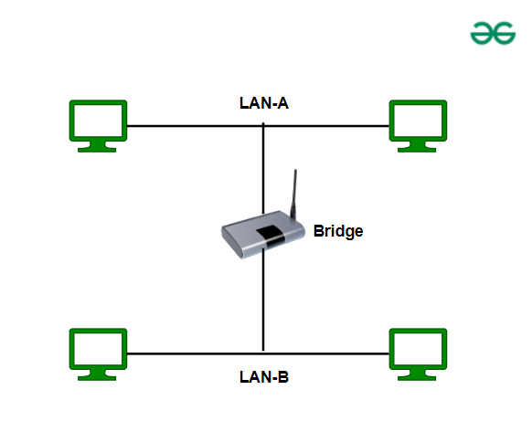
Working of Bridges
Receiving Data: The bridge gets data packets (or frames) from both network segments A and B.
Building a Table: It creates a table of MAC addresses by looking at where the data is coming from to know which device is on which segment.
Filtering Data: If the data from network A is meant for a device also on network A, the bridge stops it from going further.
Forwarding Data: If the data from network A is meant for a device on network B, the bridge sends it to the correct place on network B.
Repeating for Both Sides: The bridge does the same thing for data coming from network B.

Slide 11
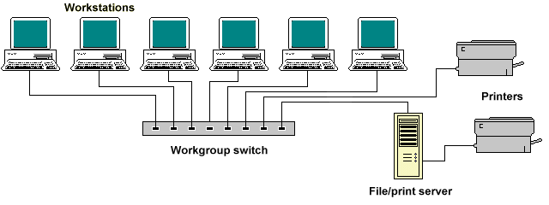
Network devices: Switches
The Switch is a network device that is used to segment the networks into different subnetworks called subnets or LAN segments.
Switches add more intelligence to data transfer management.
Determine if data should remain on a LAN and transfer data only to the connection that needs it.
A switch is a multiport bridge with a buffer and a design that can boost its efficiency.
A switch is a data link layer device.
It operates in full duplex mode.
The switch can perform error checking before forwarding data.

Slide 12
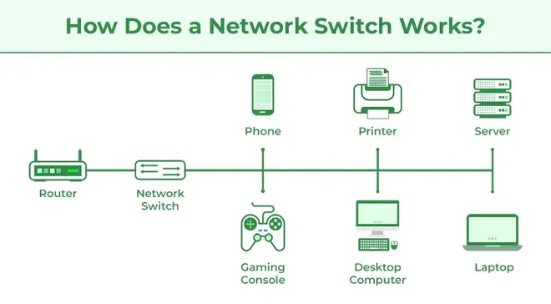
How Does a Network Switch Works?
When the source wants to send the data packet to the destination, the packet first enters the switch and the switch reads its header and finds the MAC address of the destination to identify the device then it sends the packet out through the appropriate ports that lead to the destination devices.
Switch establishes a temporary connection between the source and destination for communication and terminates the connection once the conversation is done. Also, it offers full bandwidth to network traffic going to and from a device simultaneously to reduce collision.

Slide 13
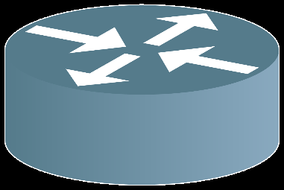
Network devices: Routers
A Router is a networking device that forwards data packets between computer networks.
A router is a device or a hardware which is responsible for receiving, analyzing and forwarding the data packets to other networks.
It is used in the LAN and WAN domain.
A router operates on layer 3 of the OSI model.
A router installs routing details for multiple networks and routing traffic based upon the destination address.
The router performs functions, such as forwarding, routing, Network Address Translation(NAT), security, QoS, etc.

Slide 14
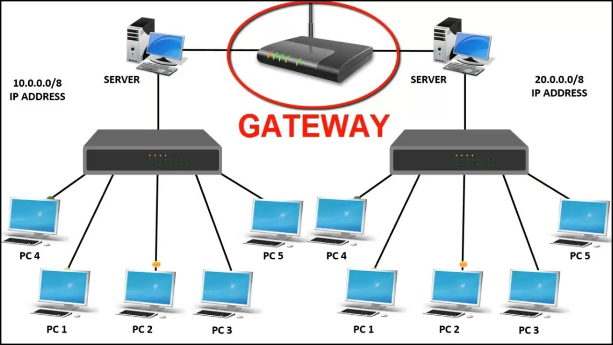
Network devices: Gateways
A gateway is a network connectivity device that connects two different configuration networks.
Gateways are also known as protocol converters.
A gateway is situated at a network edge and manages all data that enters or exits the network.
A device used for the communication among the networks which have a different set of protocols.
It is used to communicate using multiple protocols to connect a bunch of networks
A gateway operates up to layer 5 of the OSI model.
It is used to differentiate what is inside the network and what is outside the network.

Slide 15
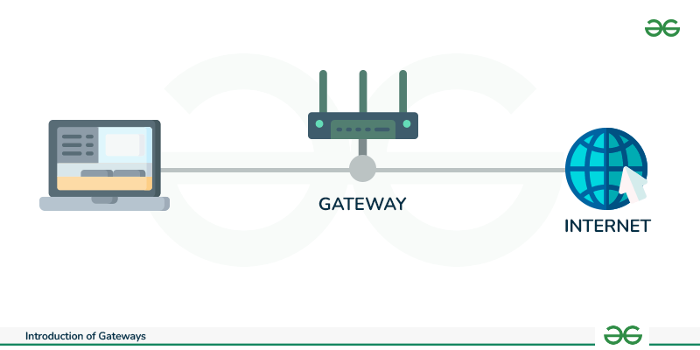
How Gateways Work?
The gateway receives data from devices within the network.
After receiving data the gateway intercept and analyze data packets, which include analyzing packet header, payload etc.
Based on the analysis of the data packets, the gateway calculate an appropriate destination address of data packet. It then routes the data packets to their destination address.
In some cases, the gateway might also want to transform the format of the obtained data to ensure compatibility at the receiver.
Once the data packets have been analyzed, routed, and converted, then the gateway sends the last packets to their respective destinations address inside the network.

Slide 16
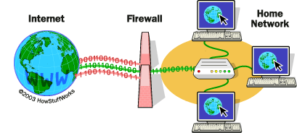
Network devices: Firewall
A firewall is a network security device, either hardware or software-based, which monitors all incoming and outgoing traffic and based on a defined set of security rules accepts, rejects, or drops that specific traffic.
A firewall is a network device/software for controlling security and access rules.
Firewalls are placed internal networks and external networks such as the Internet.
Firewalls are typically configured to reject access requests from unrecognized sources while allowing actions from recognized ones.

Slide 17
Network Types
Personal Area Network (PAN)
Local Area Network (LAN)
Metropolitan Area Network (MAN)
Wide Area Network (WAN)

Slide 18
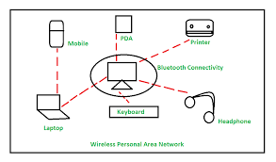
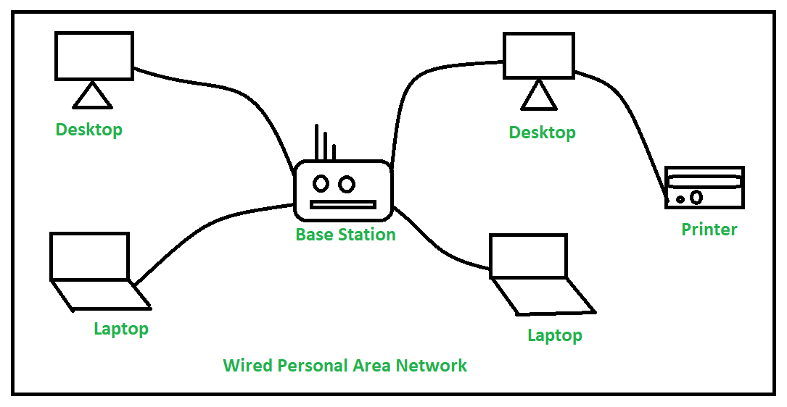
Network Types: PAN
Deployed mainly in a home environment, connecting one or more computers, printers, phones, other personal gadgets through modem either in wired or wireless mode.
It serves the purpose of sharing documents & photos within nodes, accessing the internet and entertainment.

Slide 19
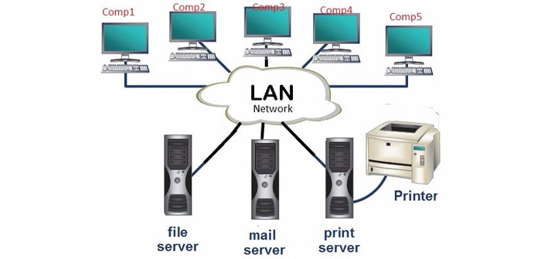
Network Types: LAN
LAN connects computers and other equipment within a premise or building.
Computers and devices are connected through Hub, switches, network adapters, cables, and optic fibers.
In modern LAN, computers are connected in wireless mode through access points (Antenna).
Routers are found at the boundary of a LAN, connecting them to the larger WAN.
A LAN can be logically split into multiple Virtual local area networks (VLANs).
What is a VLAN? A VLAN is a subnetwork within a LAN that groups devices together logically, even if they are not physically connected on the same switch.

Slide 20
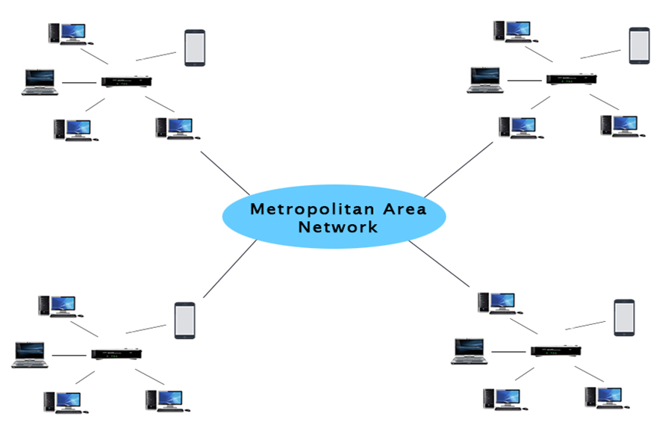
Network Types: MAN
MAN is a network that covers a larger geographic area by interconnecting a different LAN to form a larger network.
MAN has a range of 5-50km.
In MAN, various LANs are connected to each other through a telephone exchange line.
The most widely used protocols are RS-232, Frame Relay, ATM, ISDN, etc.
Use cases: Communication between the banks in a city, airline reservation, communication in the military.

Slide 21
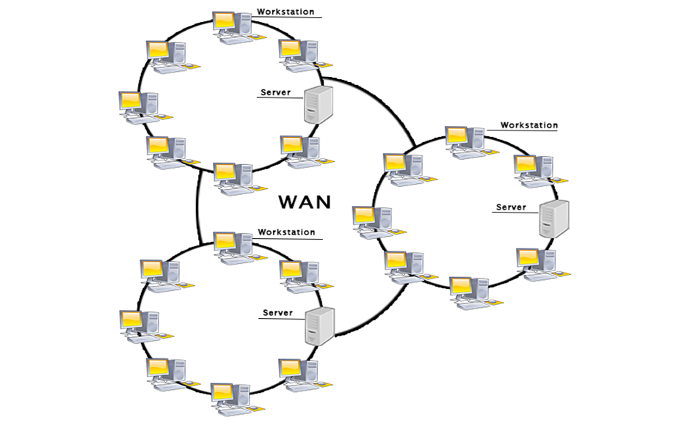
Network Types: WAN
WAN extends over a large geographical area such as states or countries.
WAN spans over a large geographical area through a telephone line, fiber optic cable or satellite links.
Internet is one of the biggest WAN in the world.
WAN is widely used in the field of Business, government, education, sharing of message, software and resources, global business, high bandwidth

Slide 22
Network Types: WAN
WAN extends over a large geographical area such as states or countries.
WAN spans over a large geographical area through a telephone line, fiber optic cable or satellite links.
Internet is one of the biggest WAN in the world.
WAN is widely used in the field of Business, government, education, sharing of message, software and resources, global business, high bandwidth

Slide 23
Network Topology
Bus
Ring
Star
Tree(Hierarchical)
Mesh
Hybrid

Slide 24
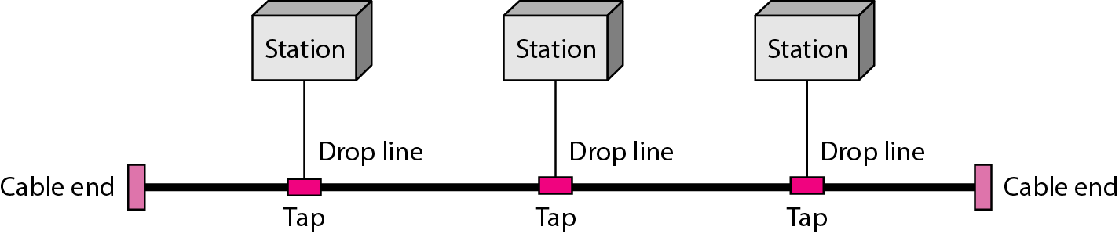
Bus Topology
All devices share single communication line or cable.
It is one of the simple forms of networking where a failure of a device does not affect the other devices. But failure of the shared communication line can make all other devices stop functioning.

Slide 25
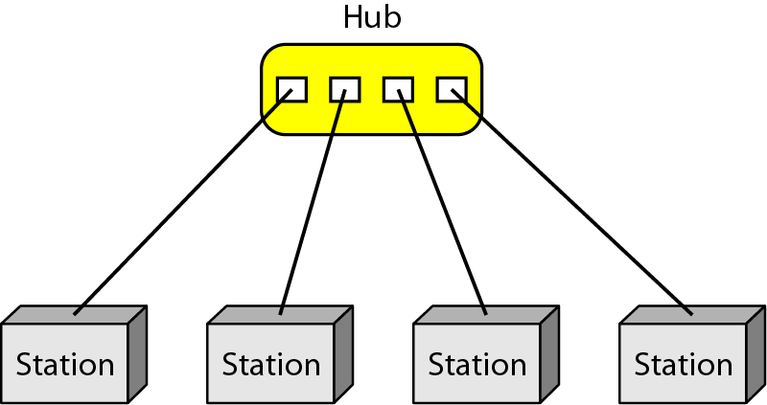
Star Topology
All hosts are connected to a central device, known as hub device, using a point-to point connection.
The hub device can be any of the following:
Layer-1 device such as hub or repeater
Layer-2 device such as switch or bridge
Layer-3 device such as router or gateway

Slide 26
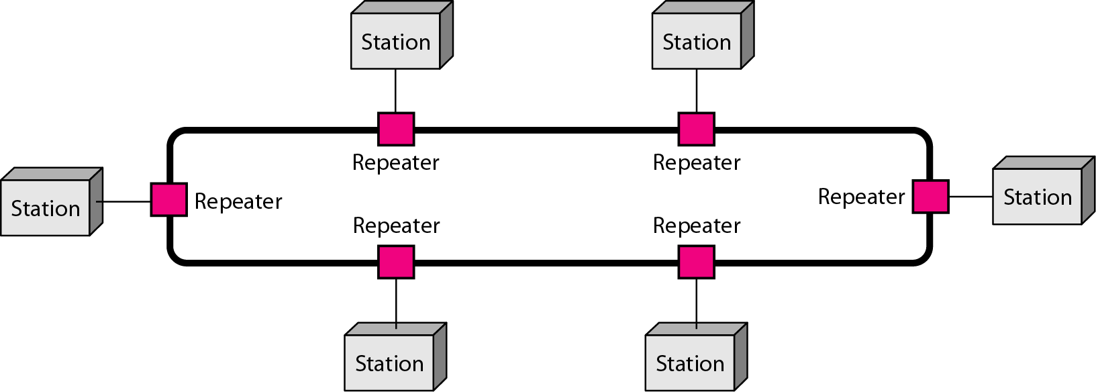
Ring Topology
Each host machine connects to exactly two other machines, creating a circular network structure.
When one host tries to communicate or send message to a host which is not adjacent to it, the data travels through all intermediate hosts.

Slide 27
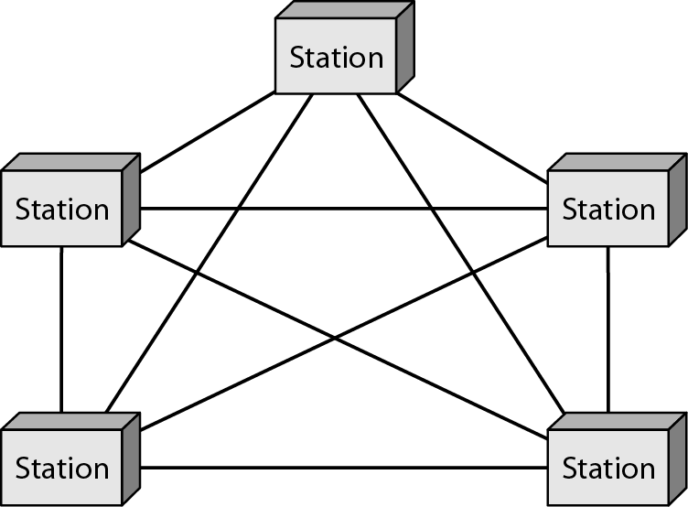
Mesh Topology
A host is connected to one or multiple hosts.
This topology has hosts in point-to-point connection with every other host or may also have hosts which are in point-to-point connection to few hosts only.
Types of Mesh technology
Full Mesh: All hosts have a point-to-point connection to every other host in the network. It provides the most reliable network structure among all network topologies.
Partially Mesh: Not all hosts have point-to-point connection to every other host. Hosts connect to each other in some arbitrarily fashion.

Slide 28
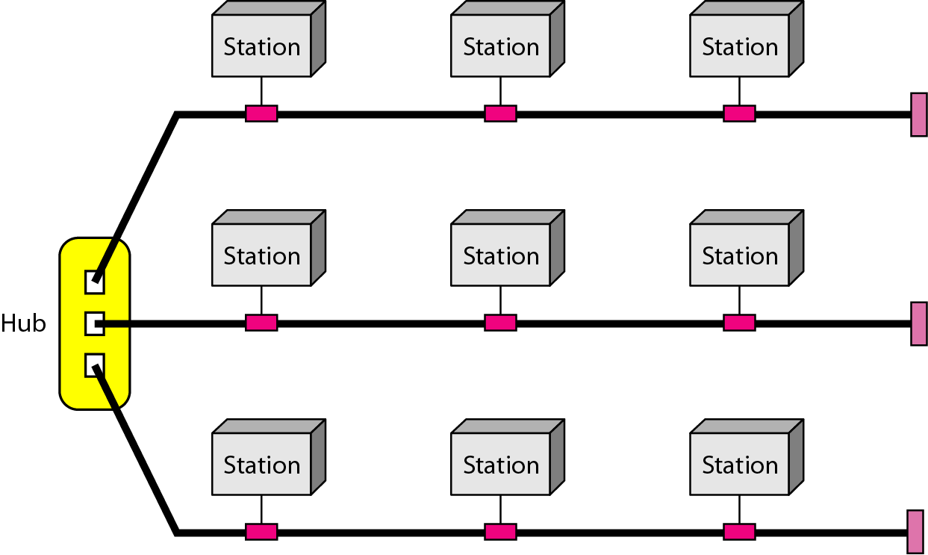
Hybrid Topology
A network structure whose design contains more than one topology is said to be hybrid topology.
Hybrid topology inherits merits and demerits of all the incorporating topologies.
The combining topologies may contain attributes of Star, Ring, Bus topologies.

Slide 29
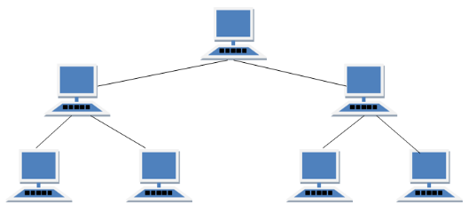
Network Topology : Tree/ Hierarchal
Nodes are connected hierarchically, with all the nodes connected to the topmost node or root node.
Tree topology has at least three levels of hierarchy.
It is an extension of Bus topology and Star topology.
It is best if the workstations are situated in groups, for easy working and managing.

