Slide 1
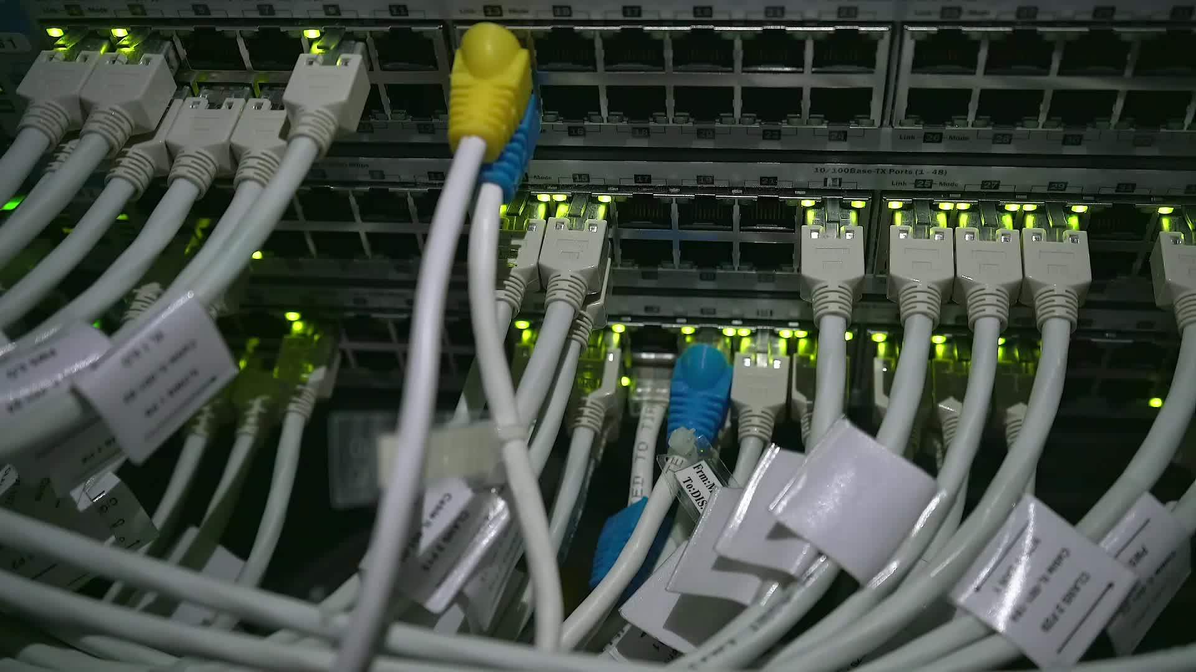
Network Models: OSI Reference Model-Part 1
These slides are partially based on slides assembled by B. A. Forouzan, with grateful acknowledgement of the many others who made their course materials freely available online.

Slide 2
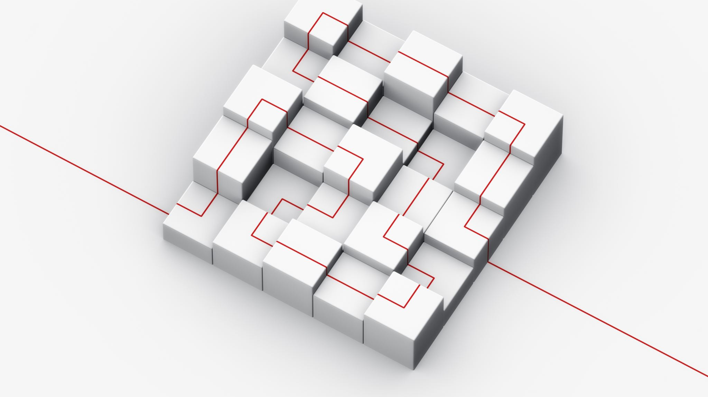
Outline
Network model : Layered Architecture
OSI model-Physical, Datalink, Network Layers

Slide 3

Network Model: Layered Architecture
Network model describes the architecture, components, and design used to establish communication between the source and destination systems.
A communication system is a complex piece of hardware and software.
A single, complex, unstructured program with many interacting components is very difficult to test and modify.
To overcome such problem, the ISO has developed a layered approach.

Slide 4

Network Model: Layered Architecture
Elements:
Service: It is a set of actions that a layer provides to the higher layer.
Protocol: It defines a set of rules that a layer uses to exchange the information with peer entity.
Interface: It is a way through which the message is transferred from one layer to another layer.
There are 2 predominant models available based on layered approach.
Open Systems Interconnection (OSI) Model
Transmission Control Protocol/Internet Protocol (TCP/IP) Model

Slide 5
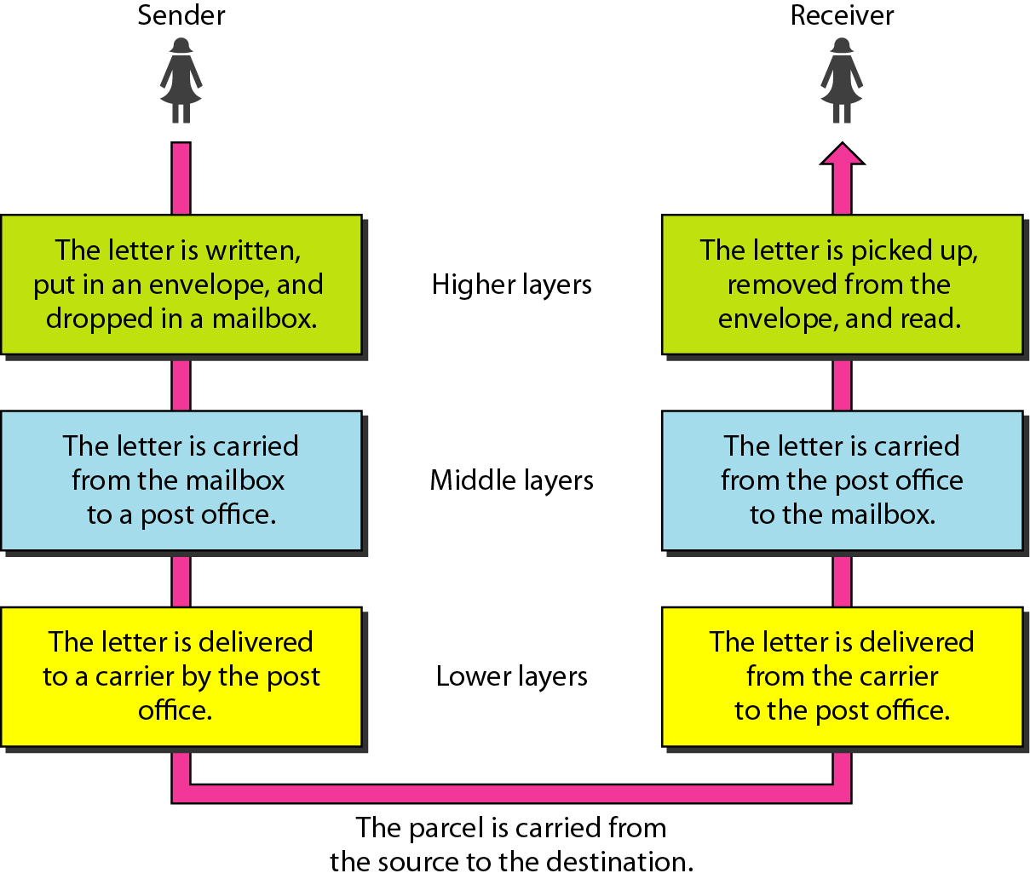
Layered Architecture Example

Slide 6
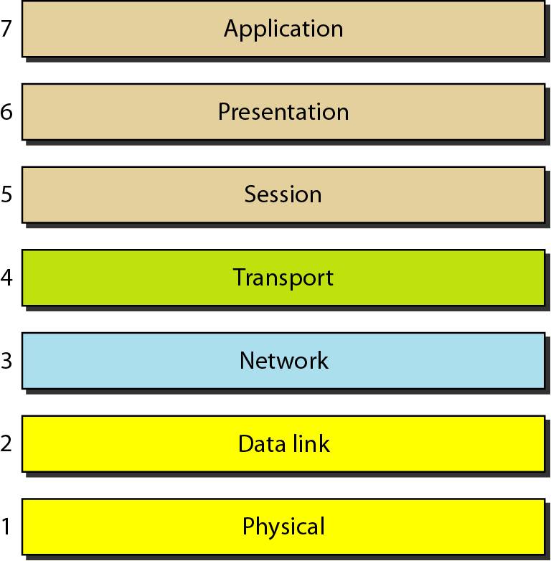
Layers of OSI Model
OSI model was developed by the International Organization for Standardization (ISO) in1984.
It is a reference model

Slide 7
OSI Unified View: Protocols
The processes at layer n are referred to as layer n entities
The machines at the same layer use a set of precise and unambiguous rules called the layer-n protocol.
Layer-n peer processes communicate by exchanging Protocol Data Units (PDUs)
n-PDUs
n
Entity
n
Entity
Layer n peer protocol

Slide 8
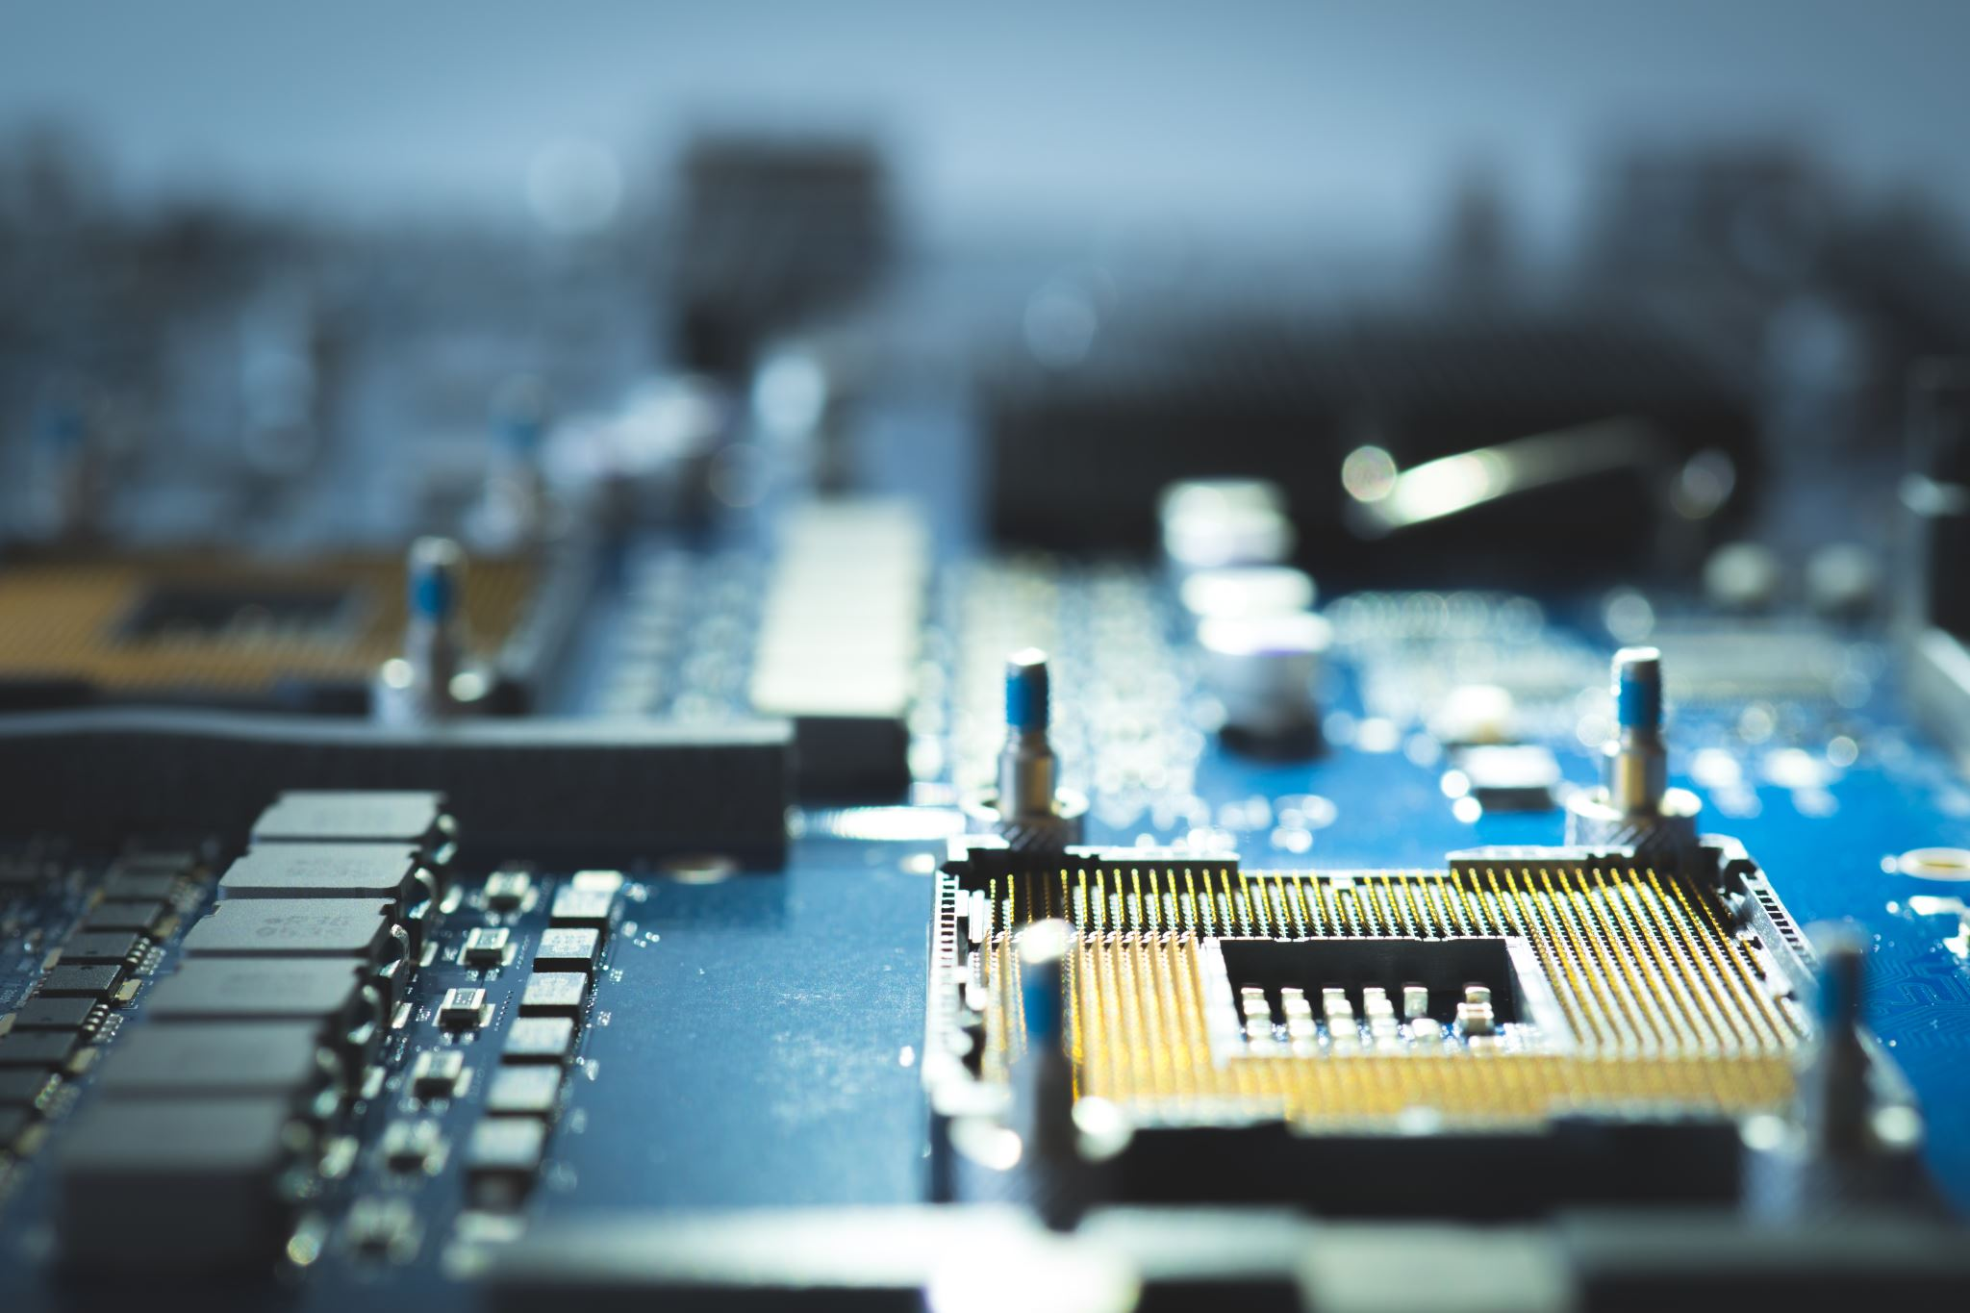
OSI Unified View: Services
Layer n+1 transfers information by invoking the services provided by layer n
Services are available at Service Access Points (SAP’s)
Each layer passes data & control information to the layer below it until the physical layer is reached and transfer occurs
The data passed to the layer below is called a Service Data Unit (SDU); SDU’s are encapsulated in PDU’s

Slide 9
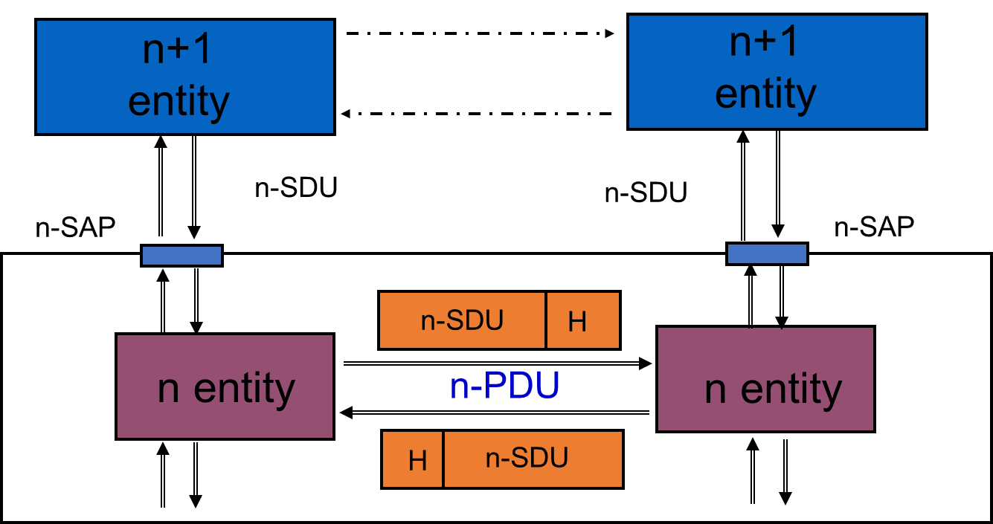
Layers, Services & Protocols
Layer n
SDU
Payload
Layer n+1
header
SDU
Trailer
PDU at layer n+1

Slide 10
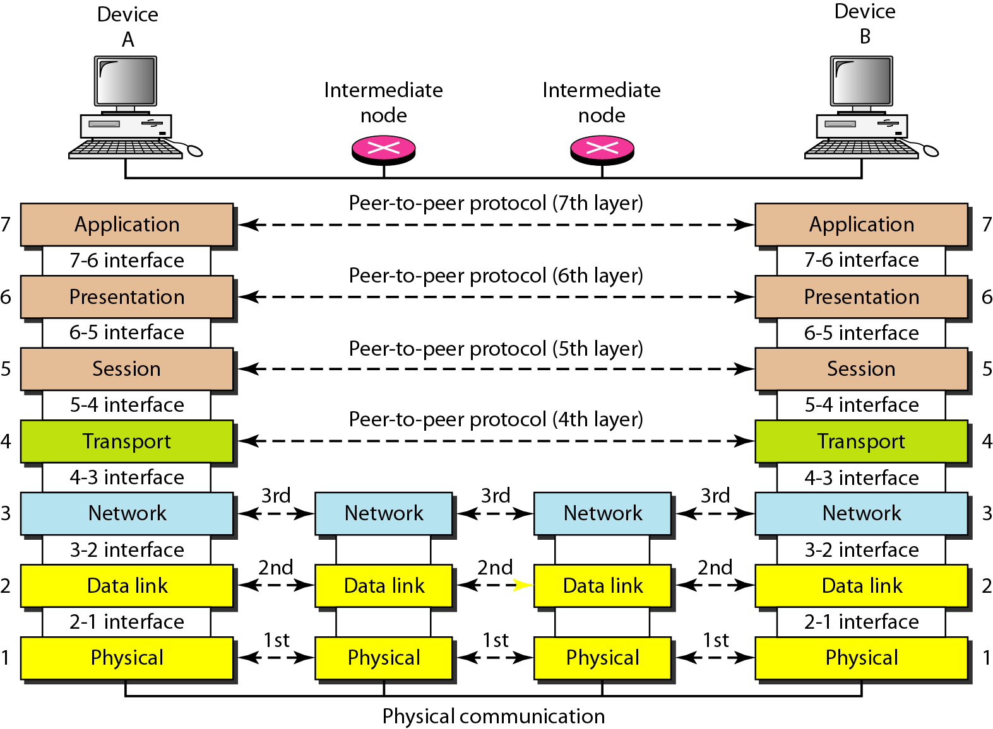
Interaction between the layers

Slide 11
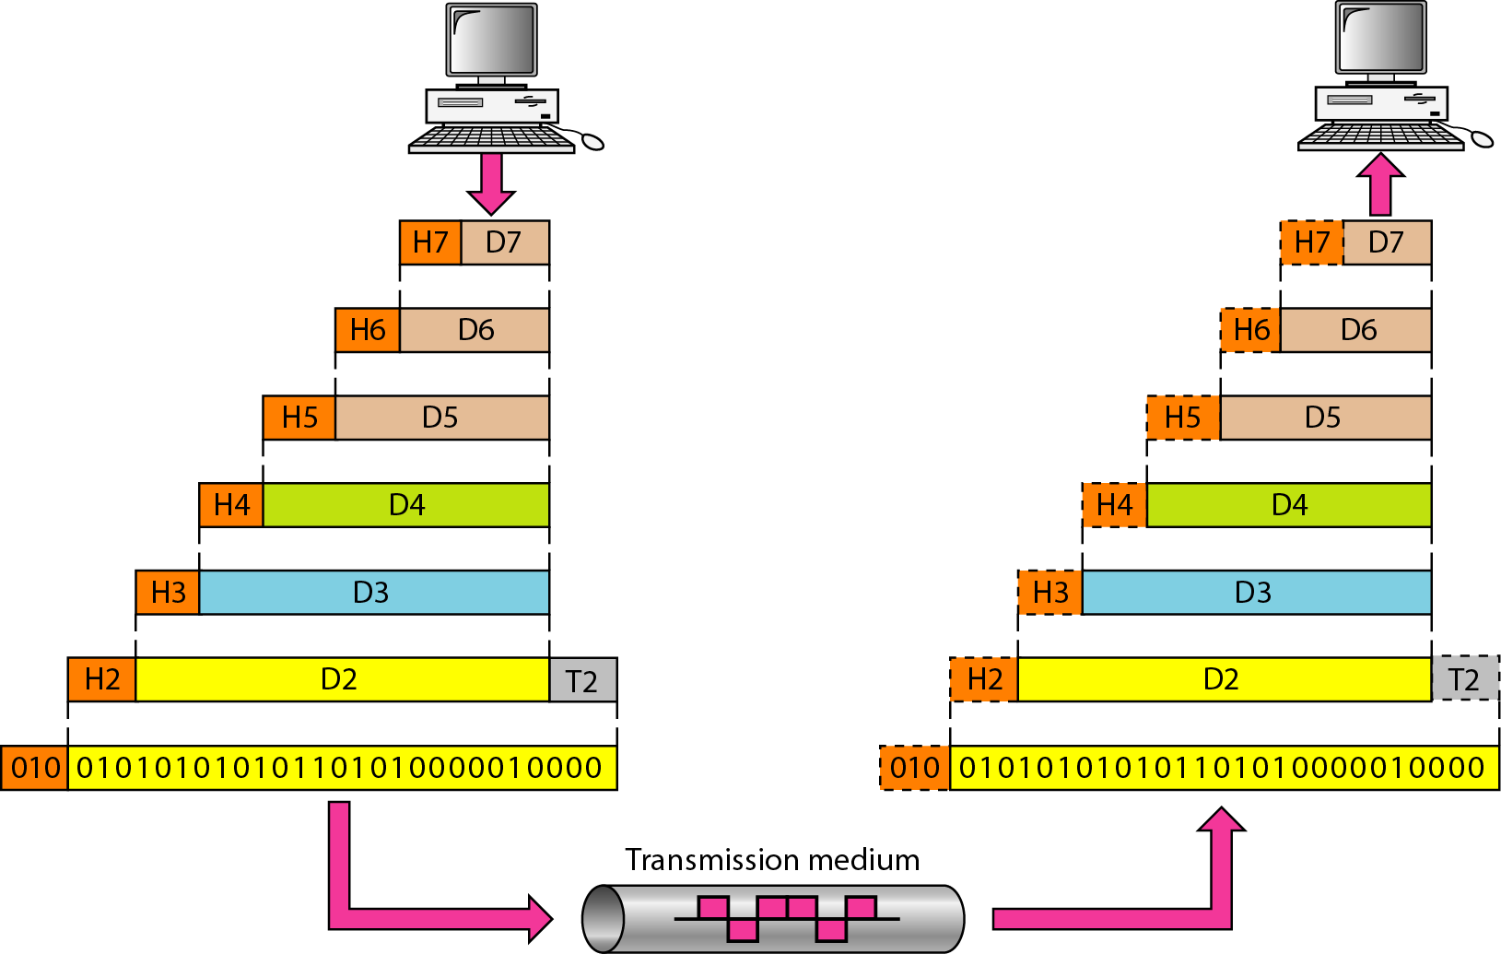
Exchange using OSI Model

Slide 12
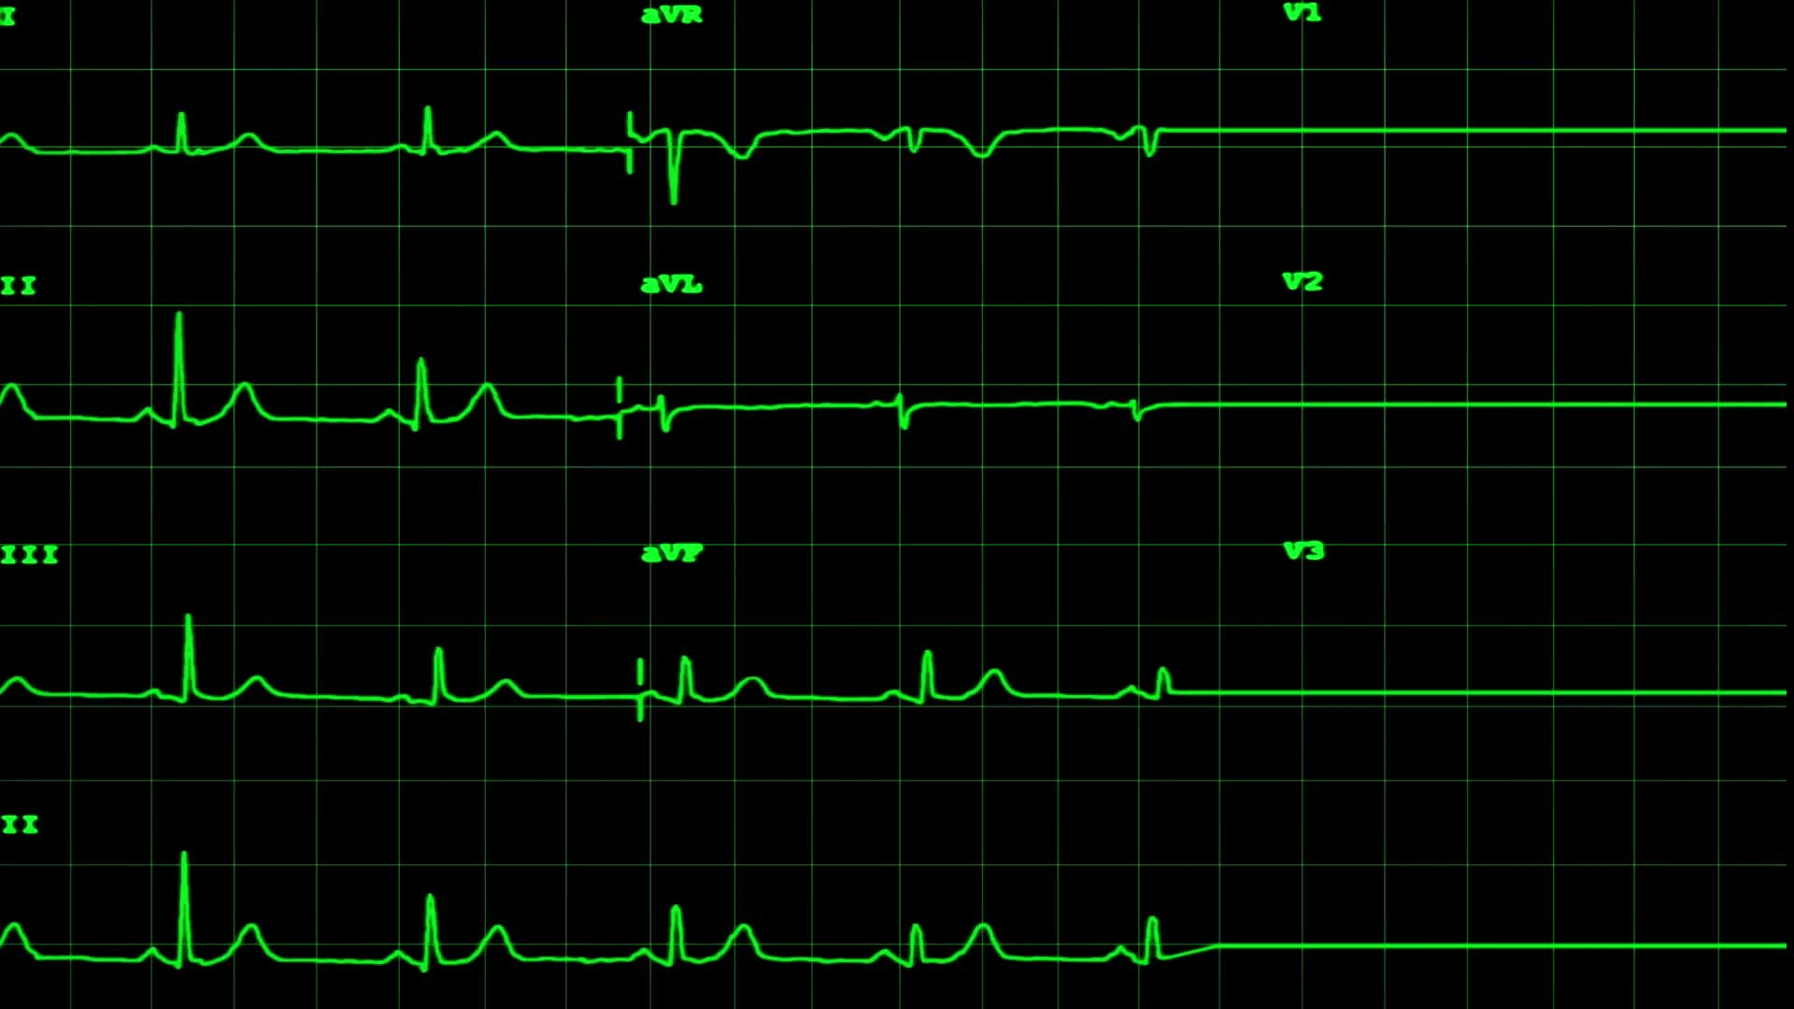
OSI Model: Physical Layer
Physical layer transmits the individual bits from one node to another node.
It establishes, maintains and deactivates the physical connection.
Hub, Repeater, Modem, Cables are Physical Layer devices.
Functions:
Line Configuration: It defines the way how two or more devices can be connected physically.
Data Transmission: It defines the transmission mode between two devices on the network.
Topology: It defines the way how network devices are arranged.
Signals: It determines the type of the signal used for transmitting the information.

Slide 13
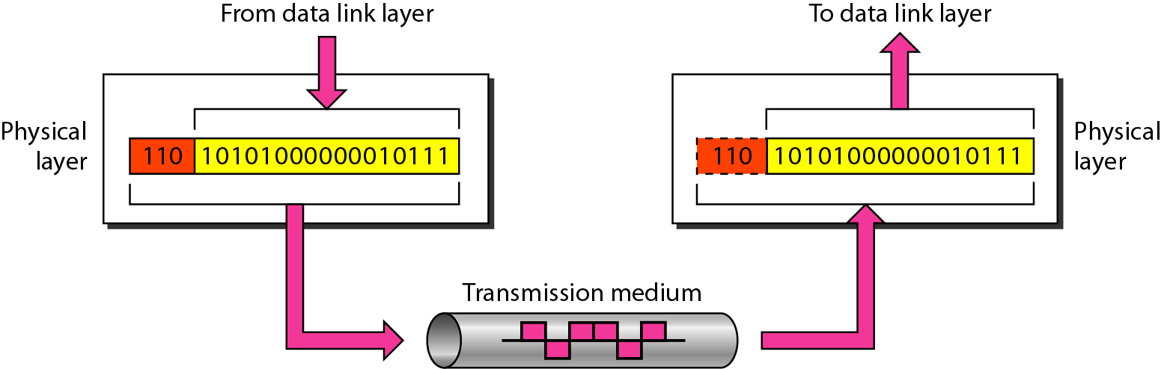
OSI Model: Physical Layer

Slide 14
OSI Model: Data Link Layer
Packet in Data Link layer is referred to as Frame.
Responsible for the error-free and efficient communication between two or more devices.
Provides unique identification of each device that resides on a local network.
Switch & Bridge are Data Link Layer devices.
It contains two sub-layers:
Logical Link Control: Transfer the packets to the Network layer and provides flow control.
Media Access Control: Provides link between the Logical Link Control layer and the network's physical layer and is used for transferring the packets over the network.

Slide 15
OSI Model: Data Link Layer
Functions:
Framing: Conversion from raw bit stream into packets. Frame contains header, packets and trailer
Physical Addressing: Providing address to source and destination device.
Flow Control: Technique through which the constant data rate is maintained on both the sides so that no data get corrupted.
Error Control: Error control is achieved by adding a calculated value CRC (Cyclic Redundancy Check)
Access Control: Used to determine which device has control over the shared link at a given time.

Slide 16
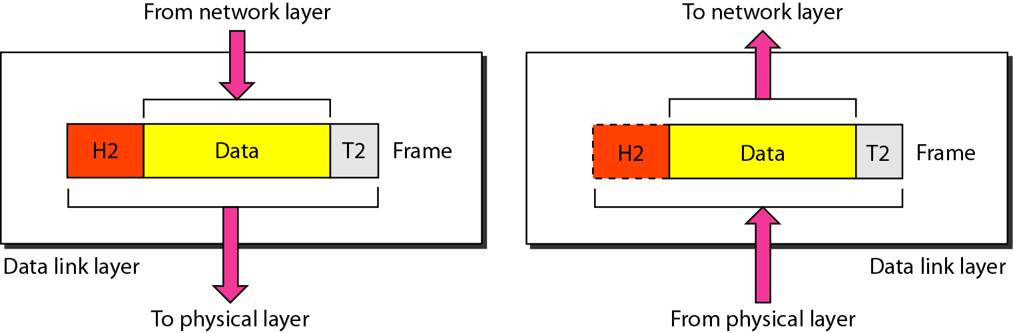
OSI Model: Data Link Layer

Slide 17
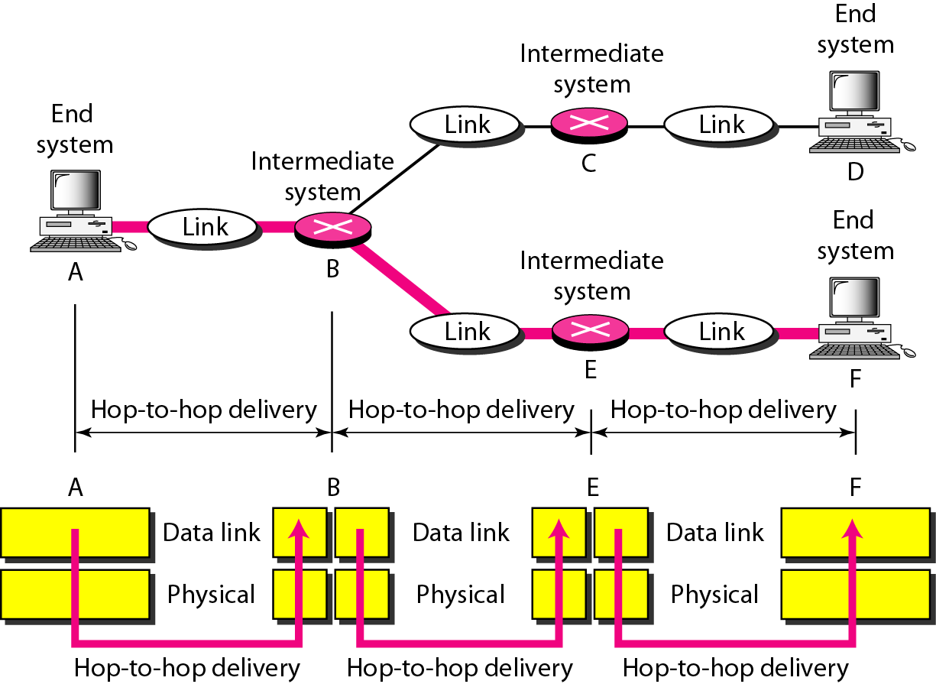
OSI Model: Data Link Layer

Slide 18
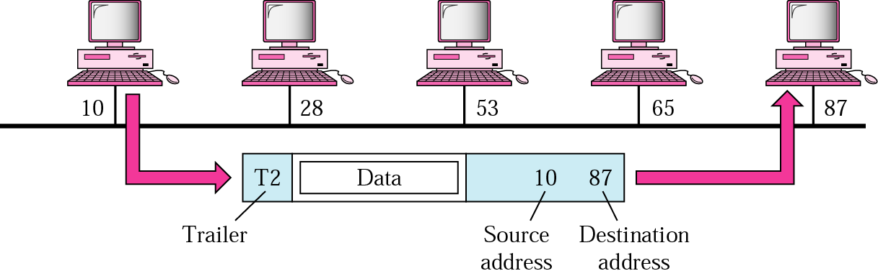
OSI Model: Data Link Layer
Example:
A node with physical address 10 sends a frame to a node with physical address 87. At the data link level this frame contains physical addresses in the header. The trailer usually contains extra bits needed for error detection

Slide 19
OSI Model: Network Layer
It manages logical addressing, tracks the location of devices on the network.
It determines the best path to move data from source to the destination based on the network conditions, the priority of service, and other factors.
Routers are used to provide the routing services within an internetwork.
The protocols used to route the network traffic are IPv4 and Ipv6.

Slide 20
OSI Model: Network Layer
Functions:
Internetworking: Provides a logical connection between different devices.
Addressing: Source and destination address are added to the header of the frame to identify the device on the internet.
Routing: It determines the best optimal path out of the multiple paths from source to the destination.
Packetizing: Process of converting the upper layer data into packets using Internet protocol (IP).
Congestion control

Slide 21
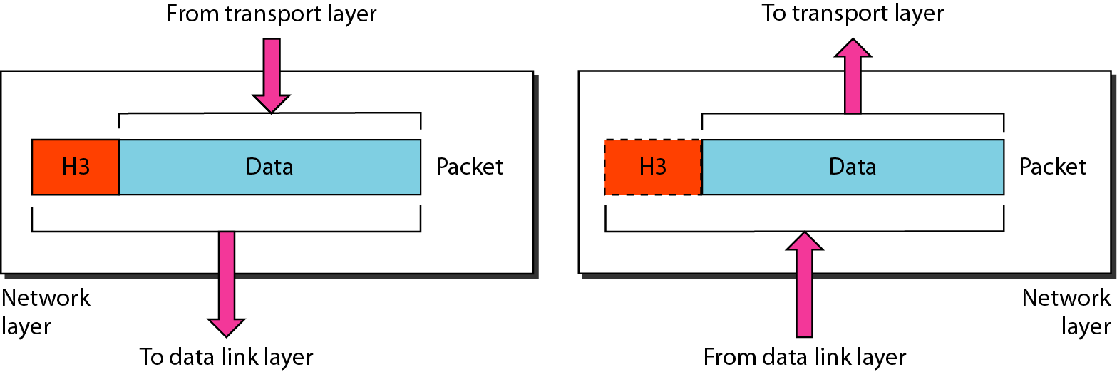
OSI Model: Network Layer

Slide 22
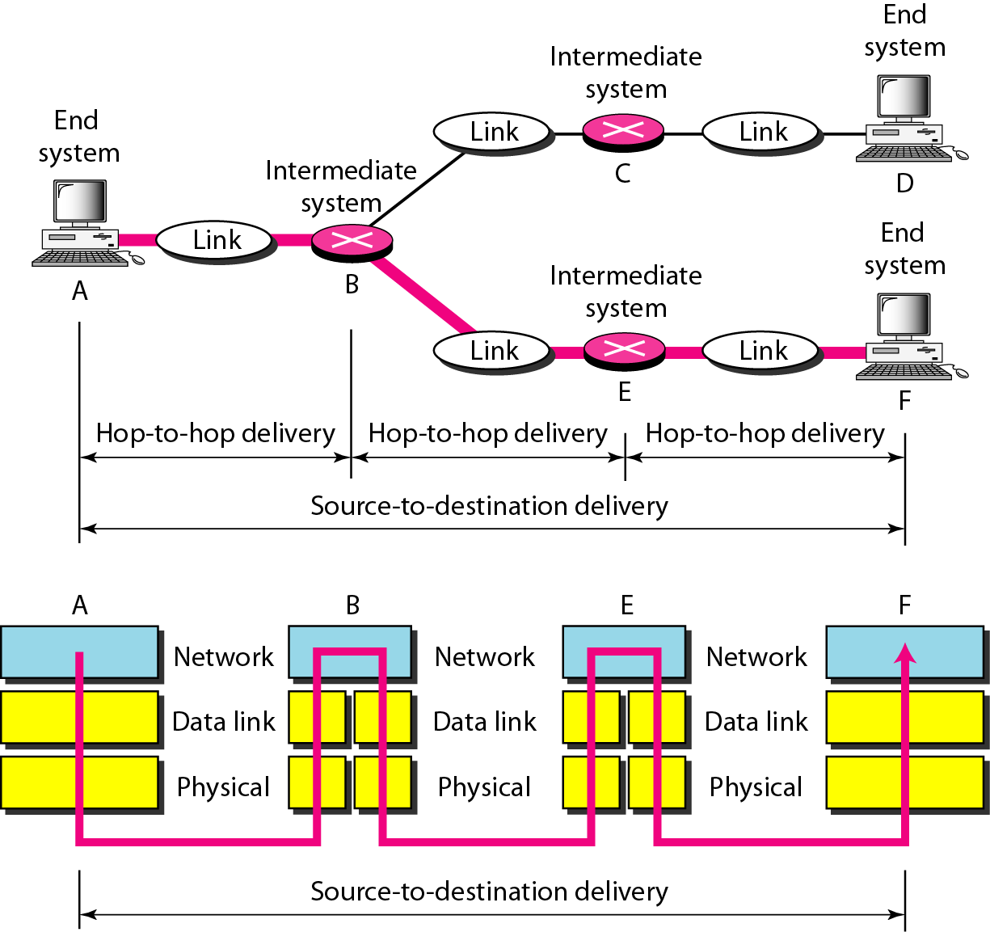
OSI Model: Network Layer

Slide 23
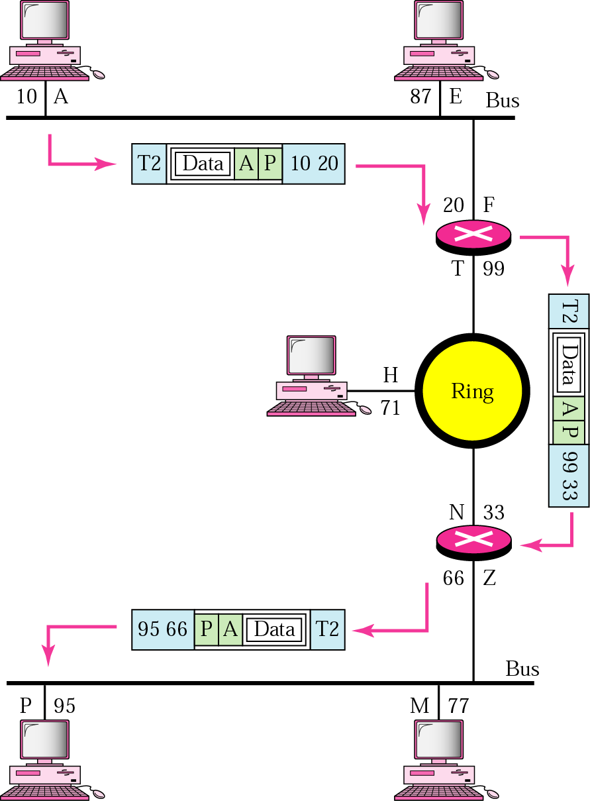
OSI Model: Network Layer
Example:
We want to send data from a node with network address A and physical address 10, located on one LAN, to a node with a network address P and physical address 95, located on another LAN. Because the two devices are located on different networks, we cannot use physical addresses only; the physical addresses only have local influence. What we need here are universal addresses (network/logical address) that can pass through the LAN boundaries.

Slide 24
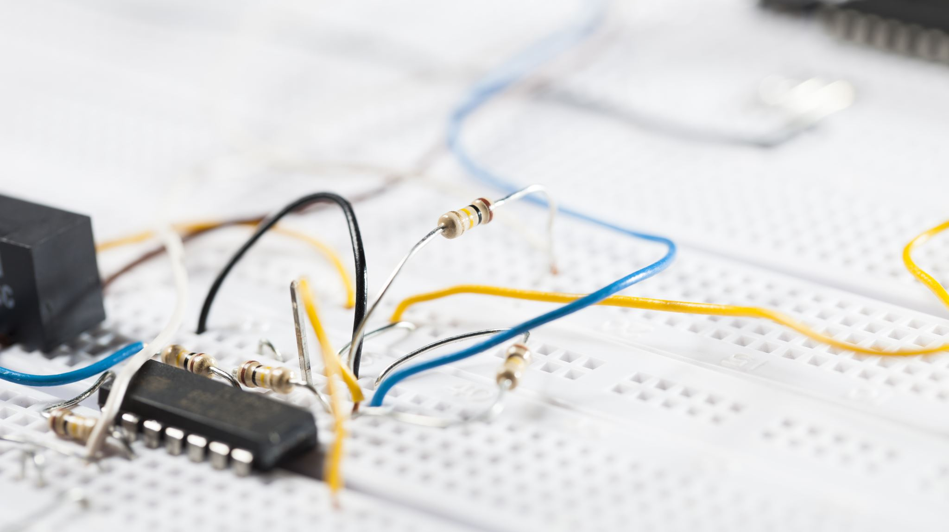
Q1
Which of following operates primarily at Layer 2 of the OSI model ?
Hubs
Switches
Routers
Repeaters

Slide 25

Q2. What is the proper name for a "chunk" of information transmitted as a single unit at any layer of the OSI model?
Frame
Message Transmission Unit
Payload
Protocol Data Unit

