Slide 1
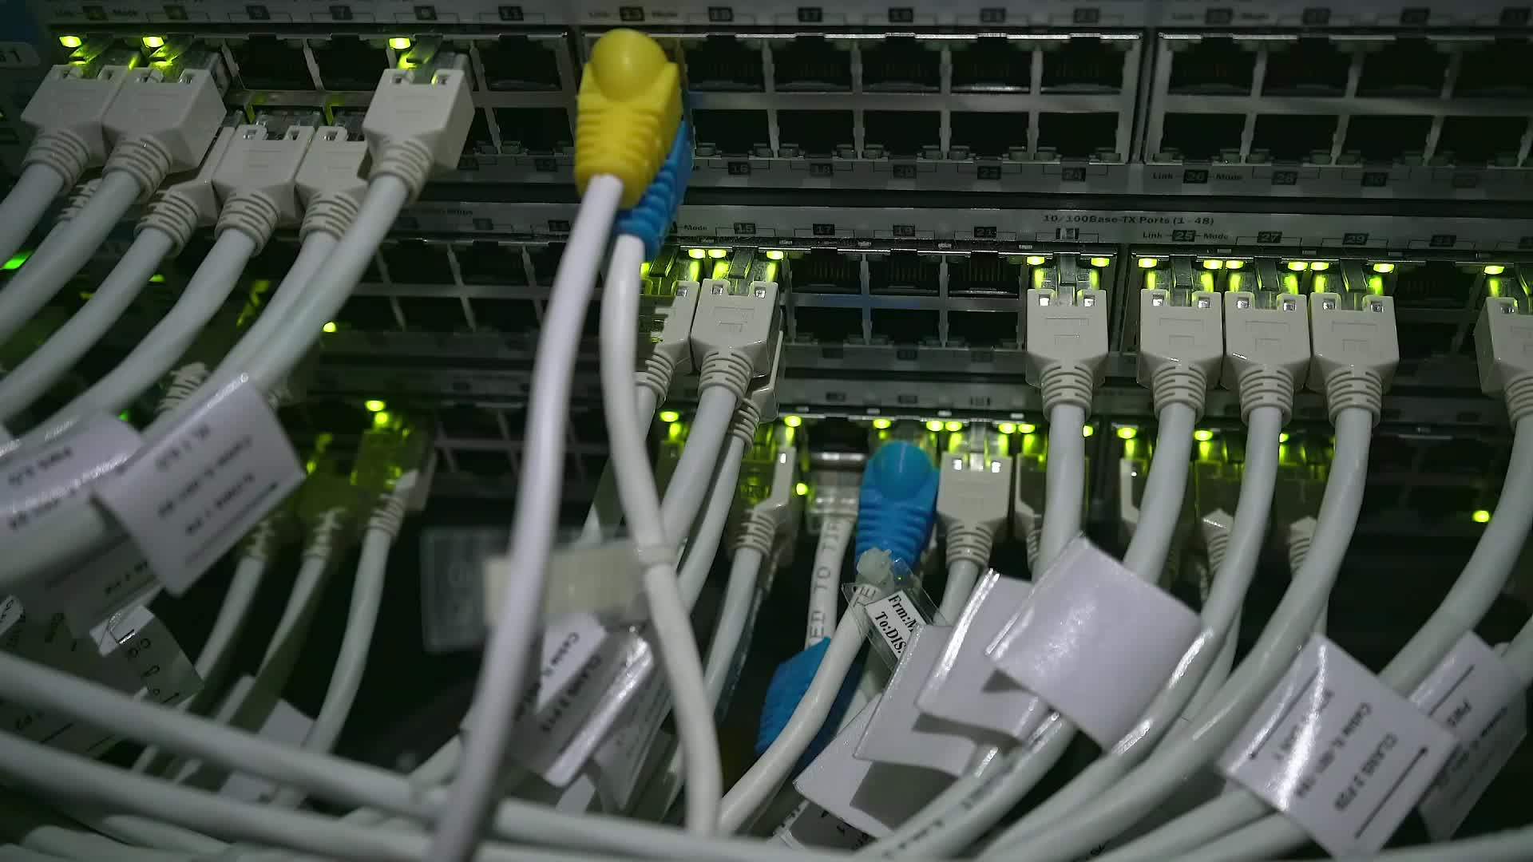
TCP/IP Protocol Suite
These slides are partially based on slides assembled by B. A. Forouzan, with grateful acknowledgement of the many others who made their course materials freely available online.

Slide 2
Outline
OSI Vs DoD Model
TCP/IP Model

Slide 3
Design Goals of TCP/IP
The TCP/IP reference model was developed prior to OSI model. The major design goals-
1. To connect multiple networks together so that they appear as a single network.
2. To survive after partial subnet hardware failures.
3. To provide a flexible architecture

Slide 4
Protocol and Its Elements
It is a set of rules that govern data communication.
Define What, How and When in terms of data communication
Syntax
Structure or format of the data
Indicates how to read the bits - field delineation
Semantics
Interprets the meaning of the bits
Knows which fields define what action
Timing
When data should be sent
Speed at which data should be sent or speed at which it is being received.

Slide 5
TCP/IP Protocol Suite
The Internet Protocol Suite (commonly known as TCP/IP) is the set of communications protocols used for the Internet and other similar networks.
Named from two of the most important protocols
  Transmission Control Protocol (TCP) and
  Internet Protocol (IP)
TCP/IP originated out of the investigative research into networking protocols that the Department of Defense (DoD) initiated in 1969.
In 1968, the DoD Advanced Research Projects Agency (ARPA) began researching the network technology that is now called packet switching.
The network that was initially constructed as a result of this research, then called ARPANET, gradually became known as the Internet.

Slide 6
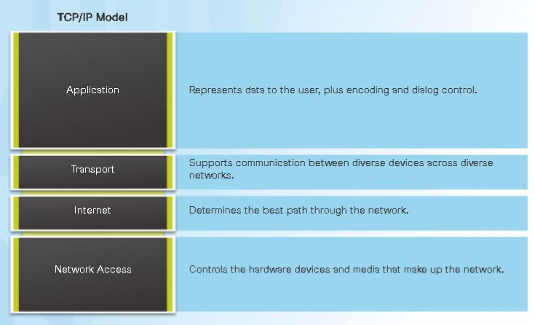
TCP/IP PROTOCOL SUITE
The layers in the TCP/IP protocol suite do not exactly match those in the OSI model.
The original TCP/IP protocol suite was defined as having four layers:
Host-to-network/Network access
Internet
Transport
Application.

Slide 7
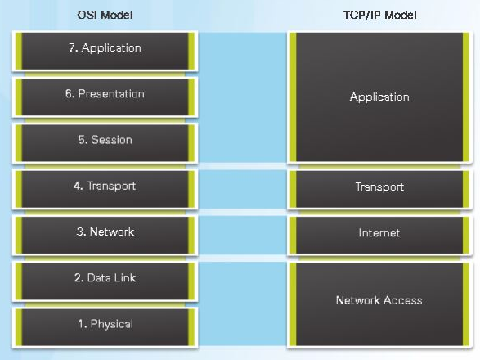
TCP/IP vs OSI

Slide 8

Physical + Data Link Layer
  The design of TCP/IP hides the function of this layer from users--it is concerned with getting data across a specific type of physical network (i.e., Ethernet, Token Ring, etc.).
  The functions are
    Encapsulating the IP datagrams into frames
    Maps the IP addresses to the physical addresses.

Slide 9

Network Layer
  Responsible for routing messages through internetworks.
  Two types of devices; gateway and router, are responsible for routing messages between networks.
  The internetwork layer protocols provide a datagram network service. Datagrams comprise of a header, data, and a trailer.
  Network layer protocols package the message in a datagram and send it off.
  A datagram service does not support session or connection. Once a message is sent or received, the service retains no memory of the entity with which it was communicating.

Slide 10

Transport/
Host-to-Host Layer
  It is responsible for providing end-to-end data integrity and provides a highly reliable communication service for entities that want to carry out an extended two-way conversation.
  It uses open and close commands to initiate and terminate the connection.
  This layer accepts information to be transmitted as a stream of characters, and it returns information to the recipient as a stream.
  The service employs the concept of a connection (or virtual circuit).

Slide 11

Application Layer
  This layer provides functions for users or their programs, and it is highly specific to the application being performed.
  This layer includes all applications protocols that use the host-to-host transport protocols to deliver data.
  Other functions that process user data, such as data encryption and decryption and compression and decompression, can also reside at the application layer.
  The application layer also manages the sessions (connections) between cooperating applications.
  Instead of using the term "session," TCP/IP uses the terms "socket" and "port" to describe the path (or virtual circuit) over which cooperating applications communicate.

Slide 12
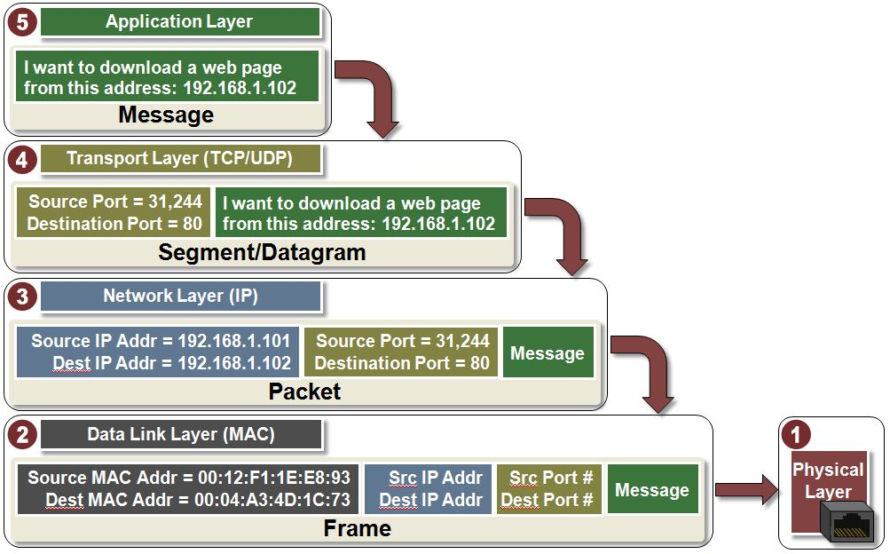
TCP/IP Reference Example (Layers)

Slide 13
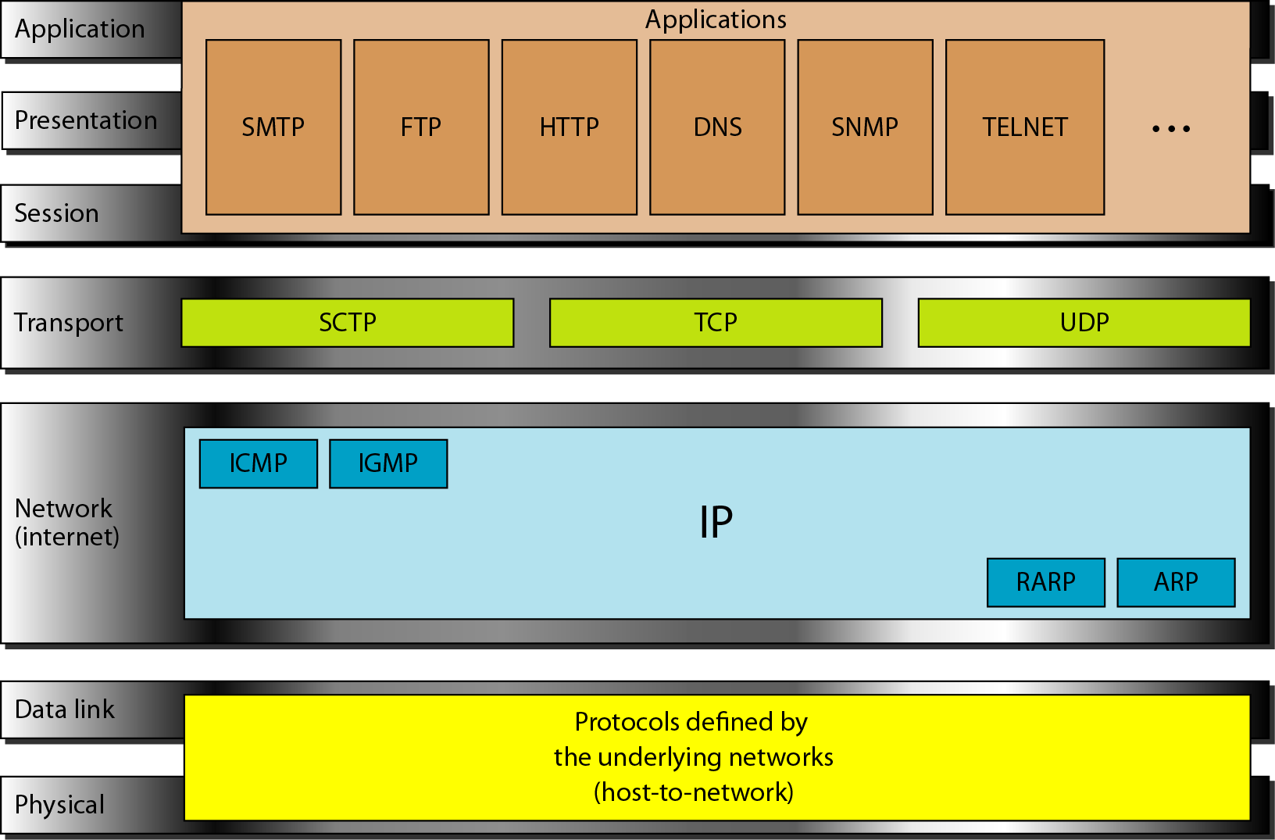
Protocols in TCP/IP Model
IP- Internet Protocol
ARP- Address Resolution Protocol
RARP- Reverse Address Resolution Protocol
ICMP- Internet Control Management Protocol
IGMP- Internet Group Management Protocol
SCTP- Stream Control Transmission Protocol
TCP- Transmission Control Protocol
UDP- User Datagram Protocol
SMTP- Simple Mail Transfer Protocol
FTP- File Transfer Protocol
HTTP- Hyper Text Transfer Protocol
DNS- Domain Name System
SNMP- Simple Network Management Protocol

