Slide 1

Physical Layer-Part-1 Signals and Its Properties and Network Performance Measures

Slide 2
Physical Layer: Services
Representation of Bits: Data in this layer consists of stream of bits. The bits must be encoded into signals for transmission. It defines the type of encoding i.e., how 0's and 1's are changed to signal.
Data Rate: This layer defines the rate of transmission which is the number of bits per second.
Synchronization: The sender and receiver are synchronized at bit level.
Interface: Transmission interface between devices and transmission medium.
Line Configuration: Point to Point configuration and Multipoint configuration.
Network topologies: Mesh, Star, Ring, Bus, Tree, and Hybrid.
Transmission Modes: Simplex, Half Duplex, Full Duplex.
Deals with baseband and broadband transmission.

Slide 3
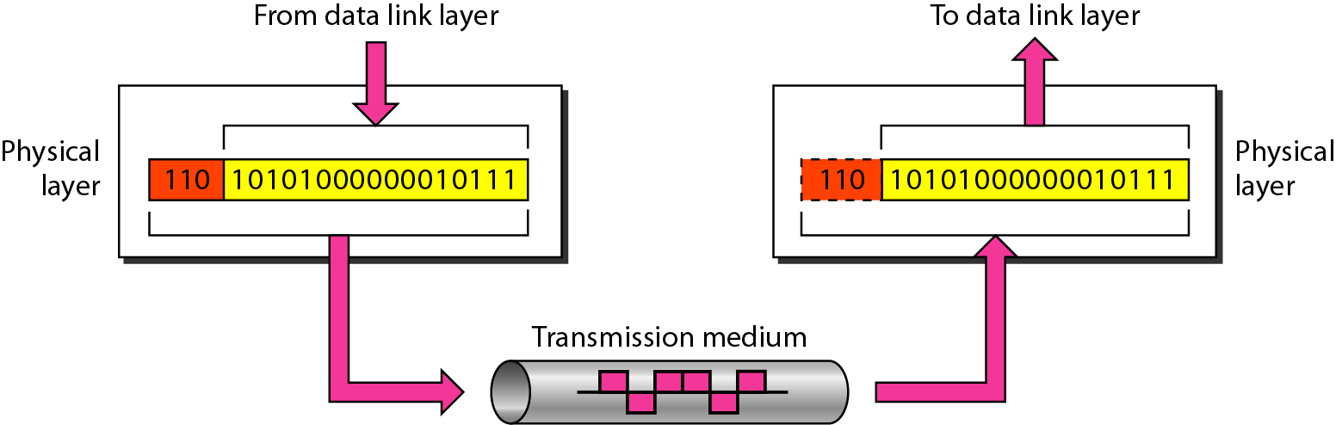
Physical layer
Data must be transformed to electromagnetic signals.

Slide 4
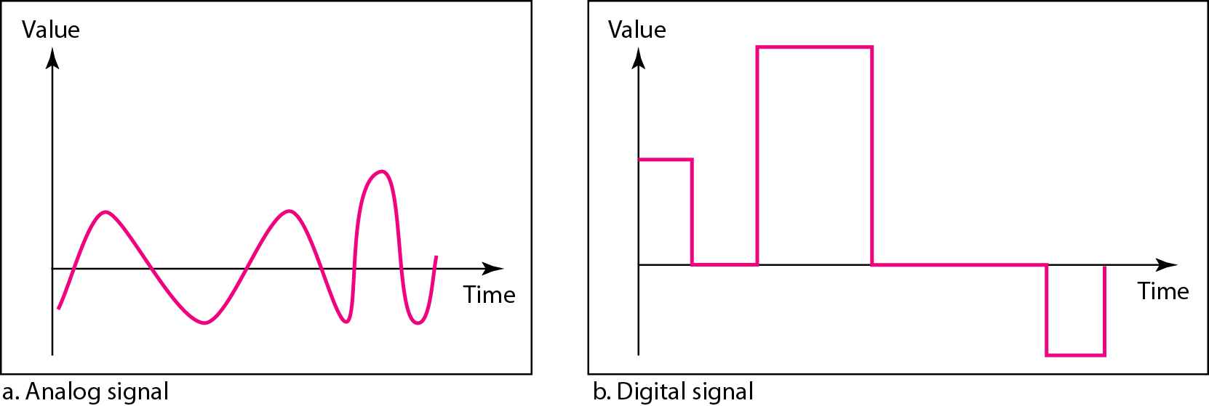
Comparison of analog and digital signals
Analog data refers to information that is continuous
Analog data take on continuous values
Analog signals can have an infinite number of values in a range
Digital data refers to information that has discrete states
Digital data take on discrete values
Digital signals can have only a limited number of values

Slide 5

Parameters to describe a signal
Peak Amplitude
Frequency
Phase

Slide 6
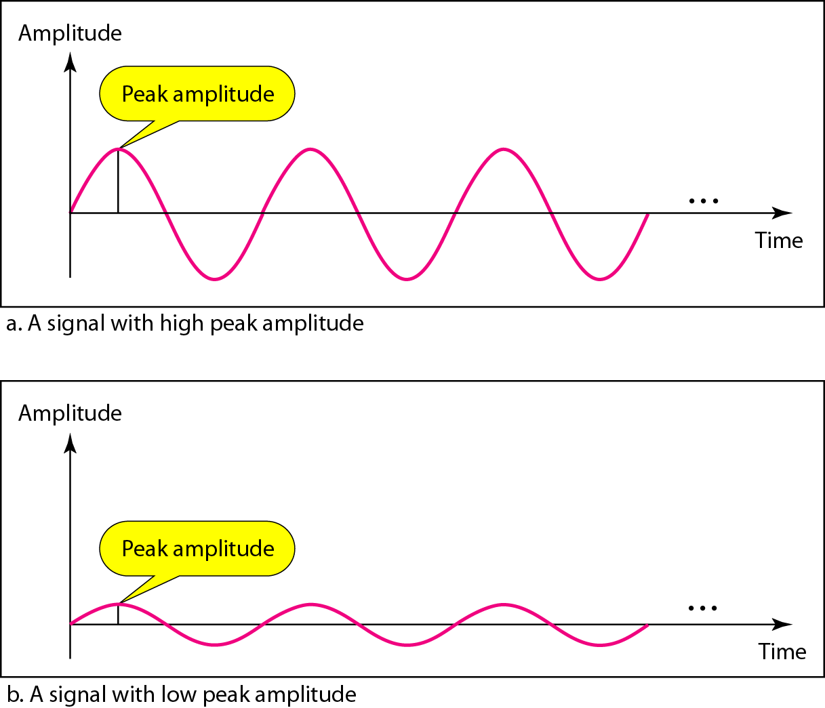
Signal amplitude and Frequency
Signal amplitude is a measure of a signal's strength or magnitude. It can be measured in volts, power, or as a ratio of the signal to noise.
Signal peak amplitude is the maximum value of a signal, either positive or negative. It is the absolute value of the distance from the signal's zero level to its peak

Slide 7

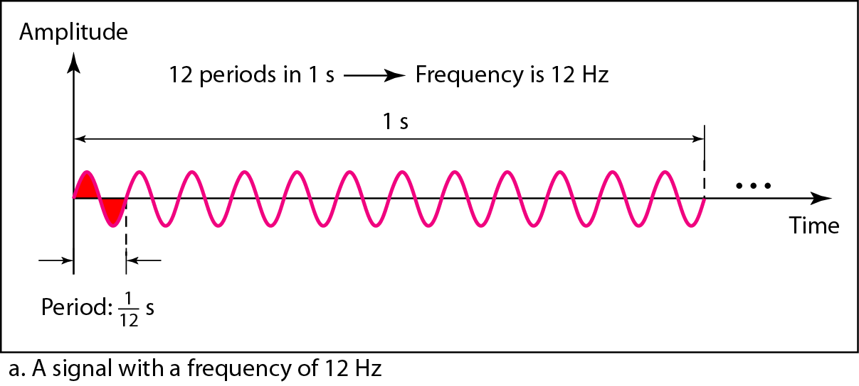
Signal amplitude and Frequency
Frequency is the rate of change with respect to time.
If a signal does not change at all, its frequency is zero
Frequency and period are the inverse of each other.

Slide 8
Signal amplitude and Frequency
The period of signal is 100ms. Find frequency in KHz

Slide 9
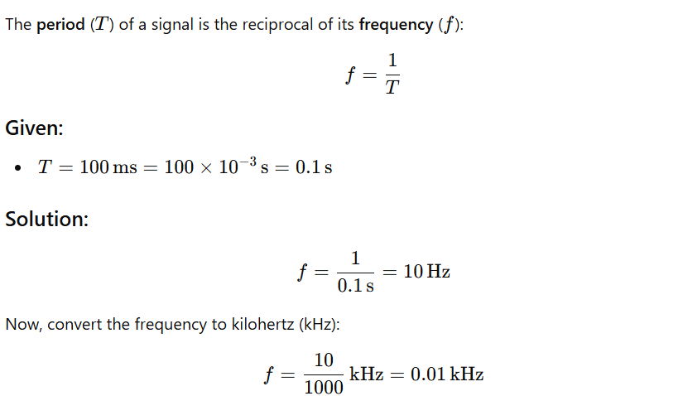
Signal amplitude and Frequency
The period of signal is 100ms. Find frequency in KHz

Slide 10
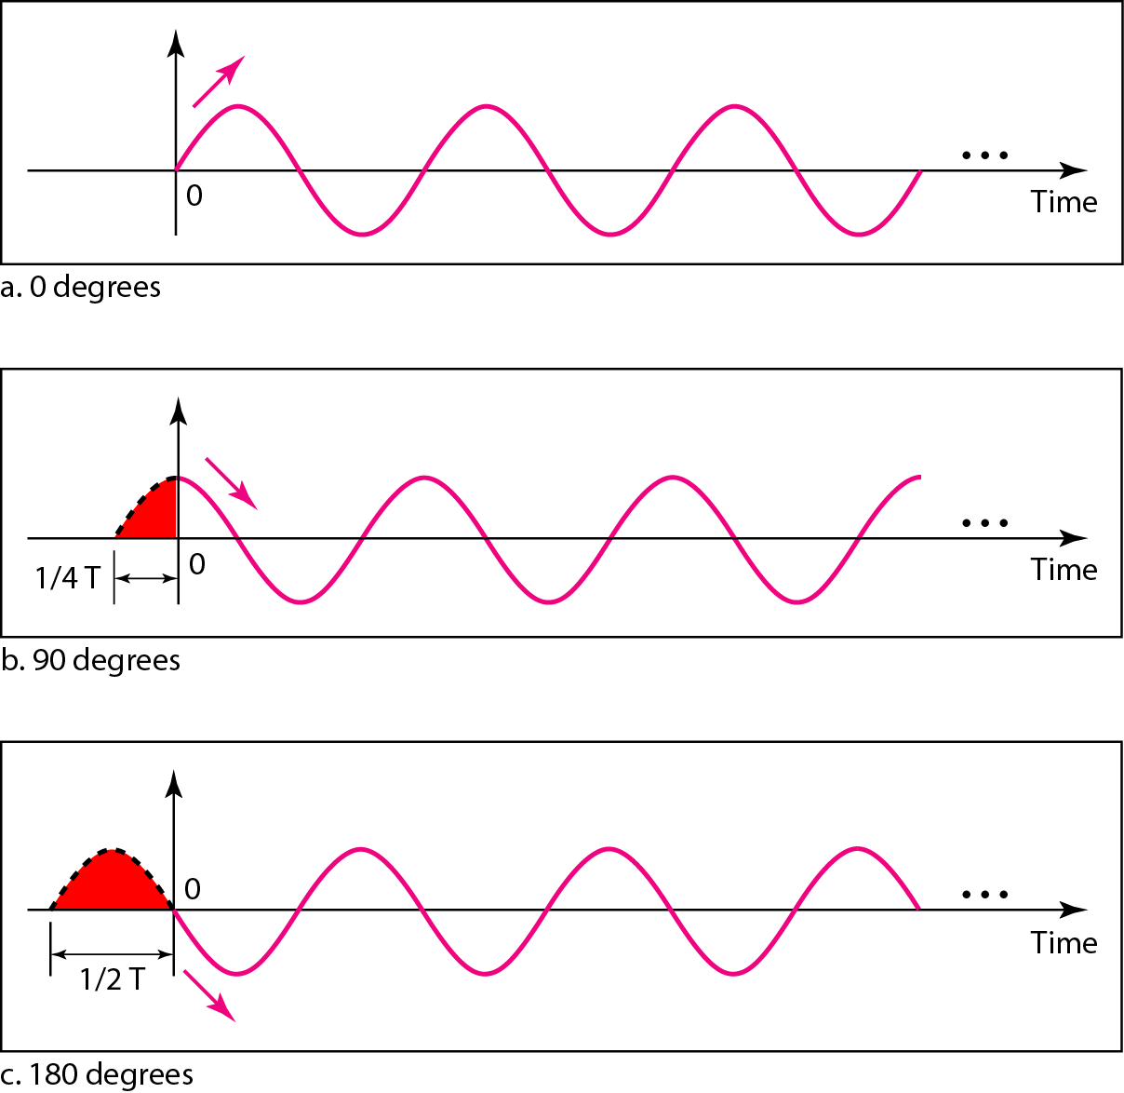
Phase
Phase describes the position of the waveform
relative to time 0
Three sine waves with the same amplitude and frequency, but different phases

Slide 11
Phase
Phase describes the position of the waveform
relative to time 0
A sine wave is offset 1/6 cycle with respect to time 0. What is its phase in degrees and radians?

Slide 12
Phase
Phase describes the position of the waveform
relative to time 0
A sine wave is offset 1/6 cycle with respect to time 0. What is its phase in degrees and radians?
1 cycle= 360°
1/6 cycle= 360x(1/6)
= 60°

Slide 13
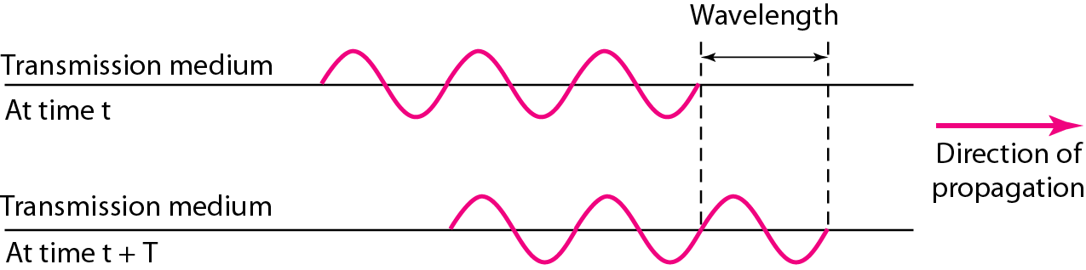
Wavelength and period
Wavelength binds the period or the frequency of a simple sine wave to the propagation speed of the medium
While the frequency of a signal is independent of the medium, the wavelength depends on both the frequency and the medium.
Wavelength = Propagation speed x Period
= Propagation speed / Frequency

Slide 14
in a vacuum, light is propagated with a speed of 3 x 10^8 ms.. The wavelength is normally measured in micrometers (microns) instead of meters. Find the wavelength of red light (frequency =4 x 10^14) in air is.

Slide 15
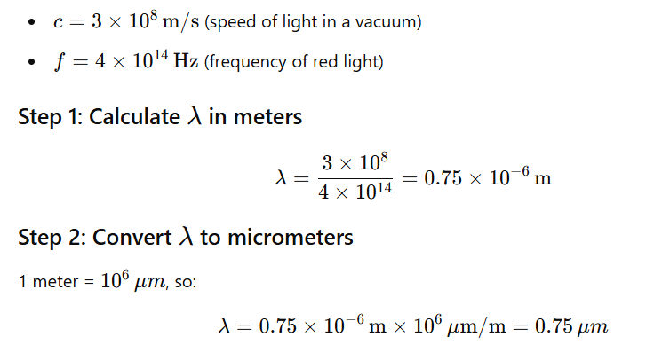
in a vacuum, light is propagated with a speed of 3 x 10^8 ms.. The wavelength is normally measured in micrometers (microns) instead of meters. Find the wavelength of red light (frequency =4 x 10^14) in air is.
That speed is lower in air and even lower in cable

Slide 16
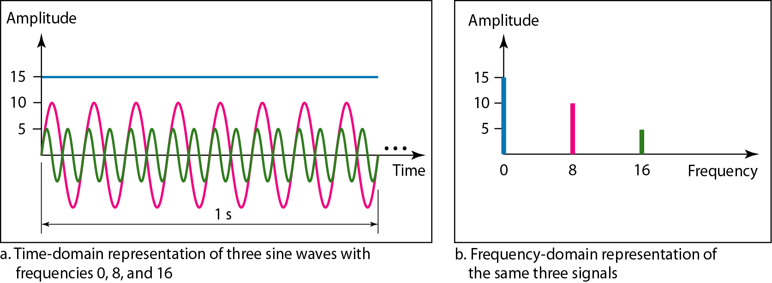
Frequency Domain
The frequency domain is more compact and useful when we are dealing with more than one sine wave.
A single-frequency sine wave is not useful in data communication
We need to send a composite signal, a signal made of many simple sine waves.

Slide 17
Fourier analysis
According to Fourier analysis,
any composite signal is a combination of simple sine waves with different frequencies, amplitudes, and phases.
If the composite signal is periodic, the decomposition gives a series of signals with discrete frequencies;
If the composite signal is nonperiodic, the decomposition gives a combination of sine waves with continuous frequencies.

Slide 18
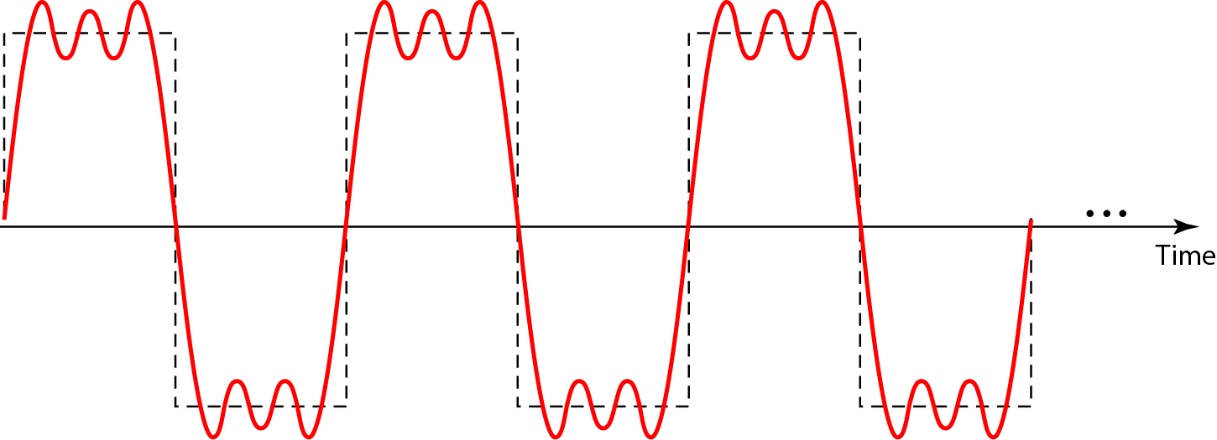
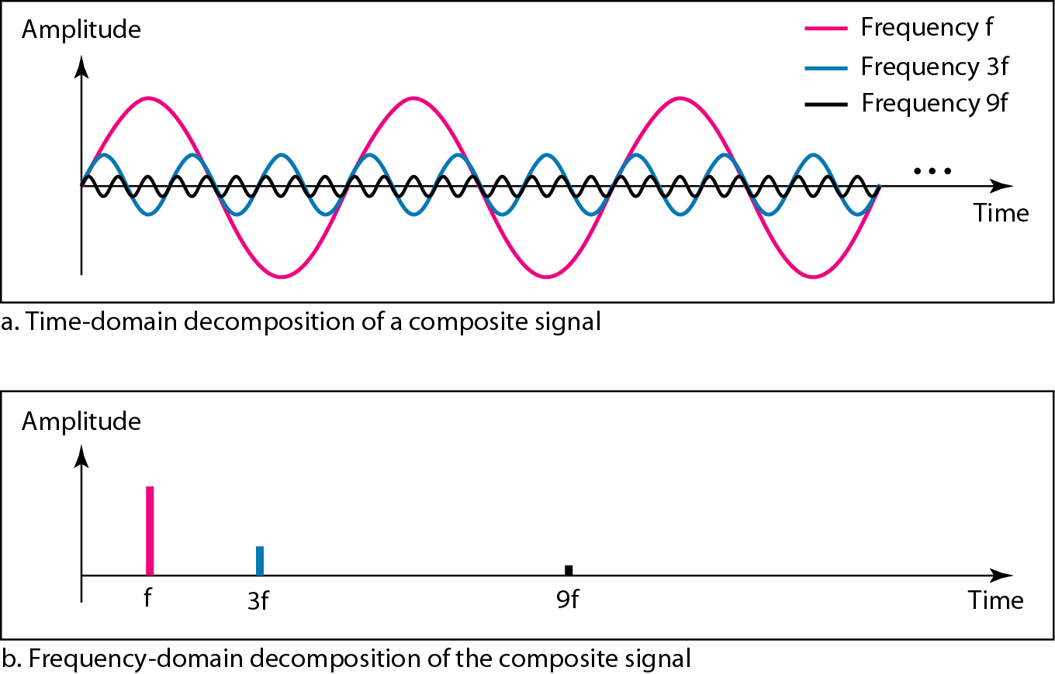
A composite periodic signal
Decomposition of the composite periodic signal in the time and frequency domains

Slide 19
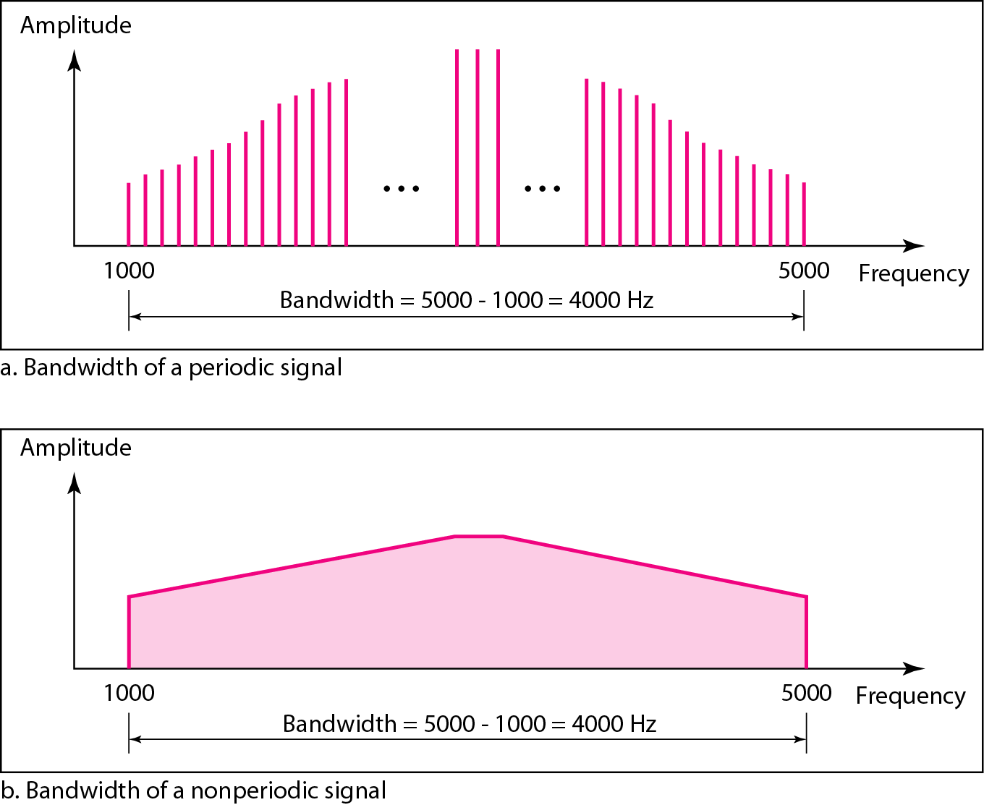

Bandwidth
The bandwidth of a composite signal is the difference between the highest and the lowest frequencies contained in that signal.

Slide 20
Question
A nonperiodic composite signal has a bandwidth of 200 kHz, with a middle frequency of 140 kHz and peak amplitude of 20 V. The two extreme frequencies have an amplitude of 0. Draw the frequency domain of the signal.

Slide 21
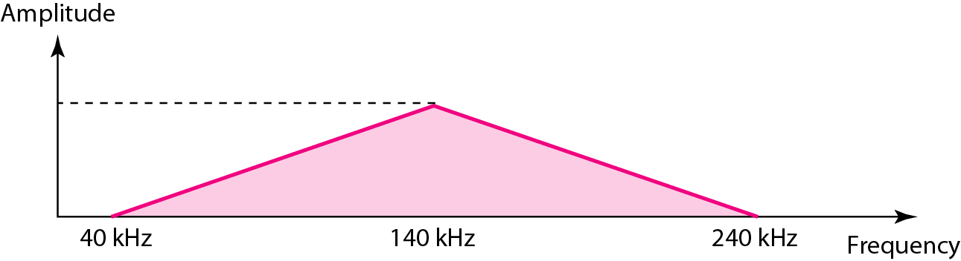
Question
A nonperiodic composite signal has a bandwidth of 200 kHz, with a middle frequency of 140 kHz and peak amplitude of 20 V. The two extreme frequencies have an amplitude of 0. Draw the frequency domain of the signal.
Solution
The lowest frequency must be at 40 kHz and the highest at 240 kHz.

Slide 22
Question
If a periodic signal is decomposed into five sine waves with frequencies of 100, 300, 500, 700, and 900 Hz, what is its bandwidth? Draw the spectrum, assuming all components have a maximum amplitude of 10 V.

Slide 23
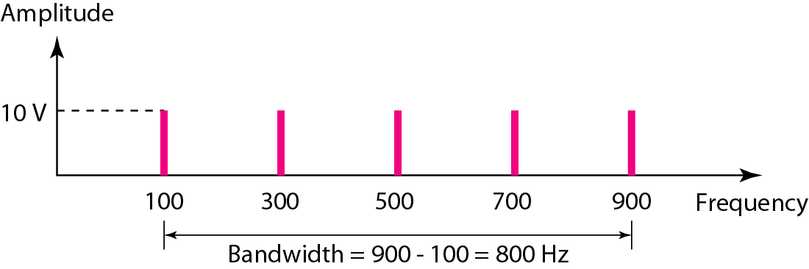
Question
If a periodic signal is decomposed into five sine waves with frequencies of 100, 300, 500, 700, and 900 Hz, what is its bandwidth? Draw the spectrum, assuming all components have a maximum amplitude of 10 V.
Solution

Slide 24
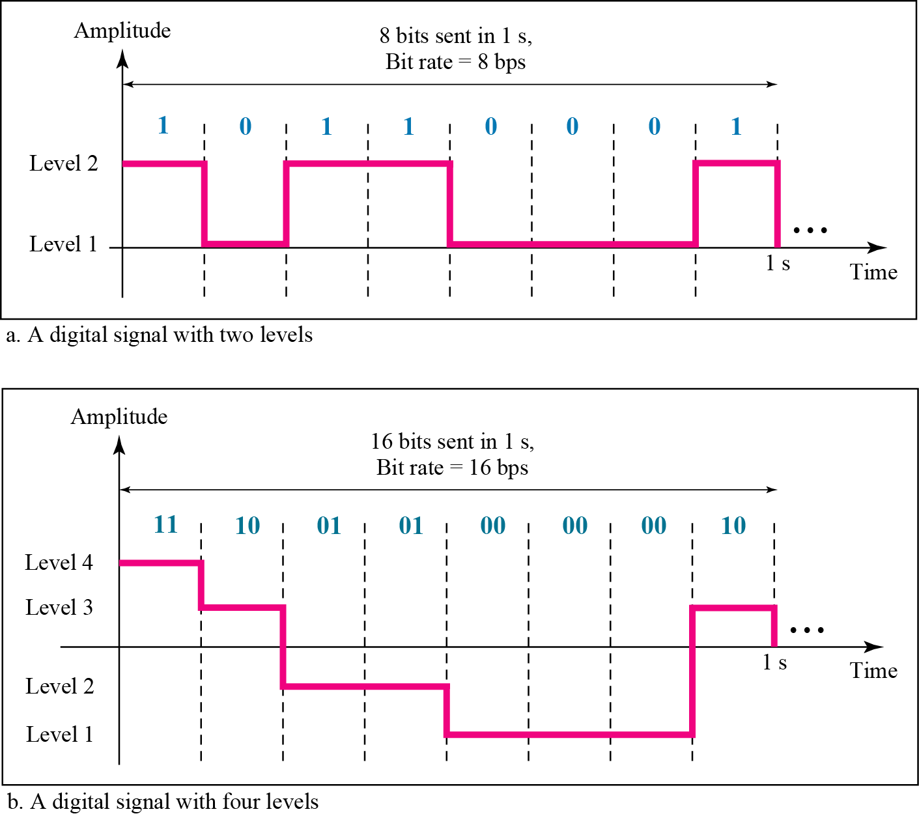
Digital signals with two different levels
Most digital signals used in data communication are non-periodic, another term ‘Bit rate’ is used to describe the digital signals
Bit rate- It is referred as number of bits sent in 1 sec. It is expressed in bits per second (bps).

Slide 25

Question
A digital signal has eight levels. How many bits are needed per level? We calculate the number of bits from the formula.
Each signal level is represented by 3 bits

Slide 26
Bit Rate
Most digital signals are nonperiodic, and thus period and frequency are not appropriate characteristics. Another term-bit rate (instead of frequency)-is used to describe digital signals
The bit rate is the number of bits sent in Is, expressed in bits per second (bps).

Slide 27
Question
Assume we need to download text documents at the rate of 100 pages per minute. What is the required bit rate of the channel?

Slide 28
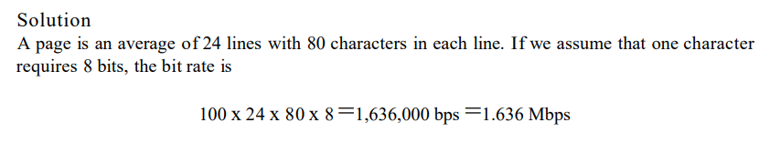
Question
Assume we need to download text documents at the rate of 100 pages per minute. What is the required bit rate of the channel?

Slide 29
Question
What is the bit rate for high-definition TV (HDTV)?

Slide 30
Question
What is the bit rate for high-definition TV (HDTV)?

Slide 31
Question
What is the bit rate for high-definition TV (HDTV)?
There are 1920 by 1080 pixels per screen, and the screen is renewed 30 times per second.

Slide 32

Question
What is the bit rate for high-definition TV (HDTV)?
There are 1920 by 1080 pixels per screen, and the screen is renewed 30 times per second.
Twenty-four bits represents one color pixel.

Slide 33
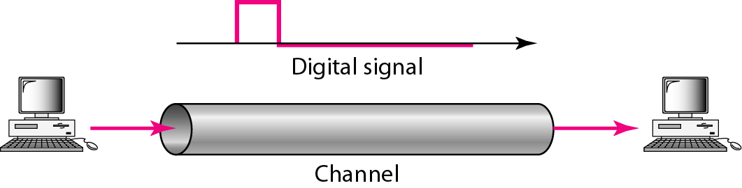
Digital Signal Transmission
Baseband Transmission
Communication technique in which digital signals are transmitted over a transmission medium without change in modulation.
Ethernet is an example of a baseband system found on many LANs
Broadband Transmission
Communication technique of transmitting large amount of data such as voice, videos over a long distance simultaneously by modulating each signal onto a different frequency.
Example - used in cable TV, and fiber optics media
More expensive than baseband
In baseband transmission, the required bandwidth is proportional to the bit rate;
if we need to send bits faster, we need more bandwidth.

Slide 34
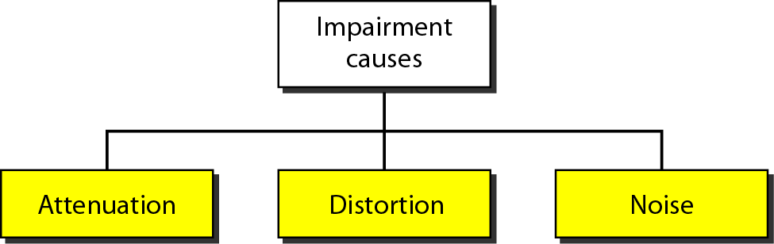
Imperfection in the transmission media causes impairment
Causes of Impairment

Slide 35
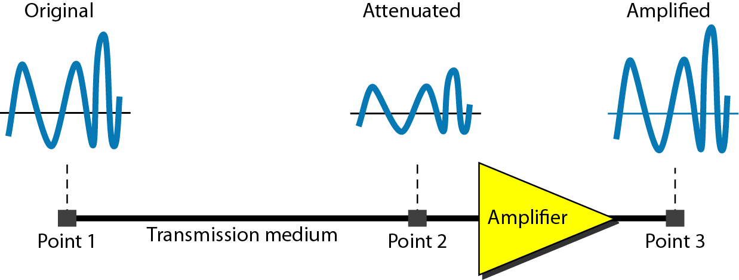

Attenuation, Distortion and Noise
Attenuation
Signal strength is expressed in decibel
dB =
where P= Power of signal

Slide 36
Attenuation, Distortion and Noise
Signal strength is expressed in decibel
dB =
where P= Power of signal
Attenuation
Question: Suppose a signal travels through a transmission medium and its power is reduced to one-half, calculate attenuation (loss of power)

Slide 37
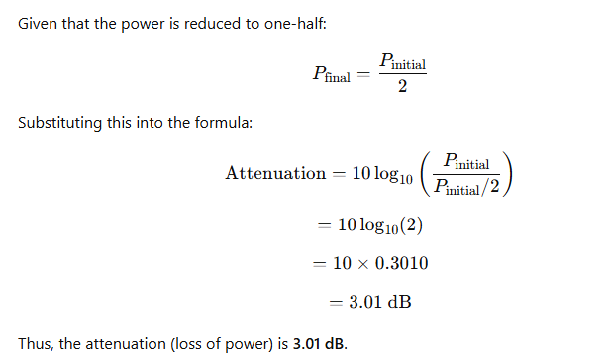
Attenuation, Distortion and Noise
Attenuation
Question: Suppose a signal travels through a transmission medium and its power is reduced to one-half, calculate attenuation (loss of power)

Slide 38
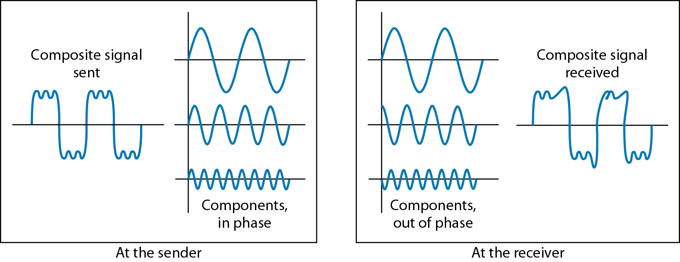
Attenuation, Distortion and Noise
Distortion : Distortion means that the signal changes its form or shape.
Distortion can occur in a composite signal made of different frequencies

Slide 39
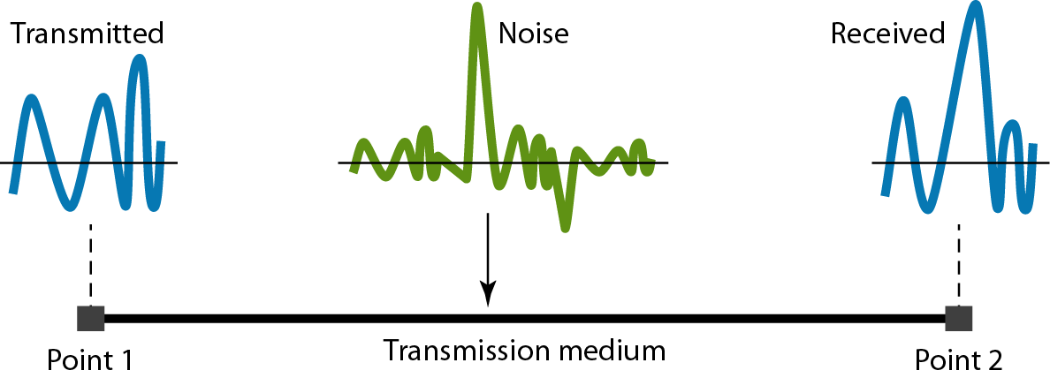
Attenuation, Distortion and Noise
Noise :
Several types of noise, such as
thermal noise,
induced noise,
crosstalk, and
impulse noise
Signal to Noise ratio (SNR) = (Average Signal Power/ Average Noise Power)
SNRdB= 10 log10(SNR)

Slide 40
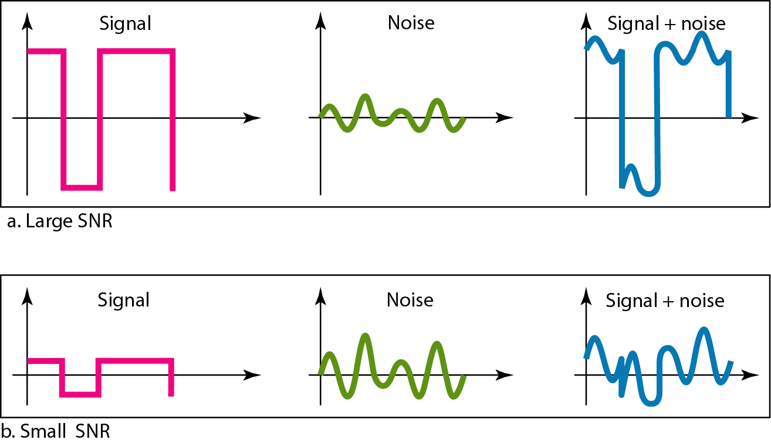
Two cases of SNR: a high SNR and a low SNR

Slide 41
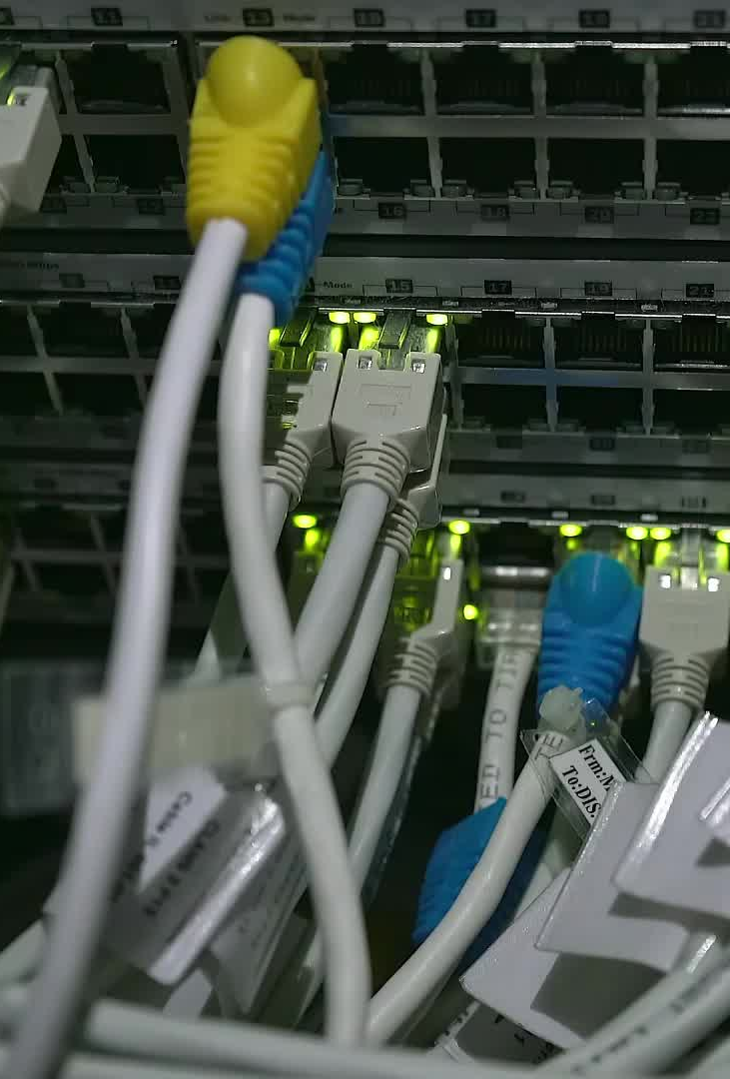
NETWORK PERFORMANCE
One important issue in networking is the performance of the network—how good is it?.
Performance Measures
Bandwidth
Channel Utilization
Throughput
Latency (Delay)
Bandwidth Delay Product
Jitter

Slide 42
Bandwidth
In networking, term bandwidth is used in two contexts.
The first, bandwidth in hertz, refers to the range of frequencies in a composite signal or the range of frequencies that a channel can pass.
The second, bandwidth in bits per second, refers to the speed of bit transmission in a channel or link.

Slide 43
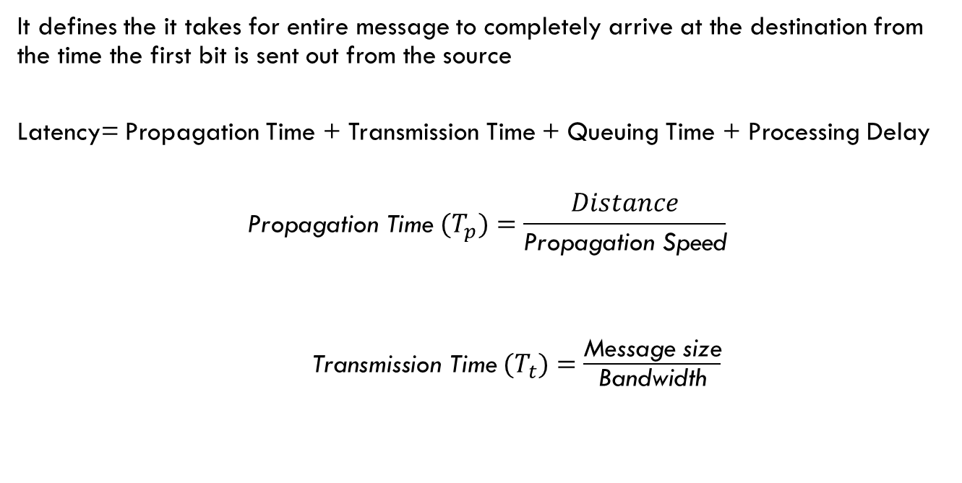
Latency (Delay)
It defines the it takes for entire message to completely arrive at the destination from the time the first bit is sent out from the source
Latency= Propagation Time + Transmission Time + Queuing Time + Processing Delay
$${\text{Propagation} \text{Time} (T}_{p})=\frac{Distance}{\text{Propagation} \text{Speed}}$$
${ \text{Transmission} \text{Time} (T}_{t})=$ $\frac{\text{Message} \text{size}}{\text{Bandwidth}}$

Slide 44
Latency (Delay)
Queuing Time:- It is the time needed for each intermediate or end device to hold the message before it can be processed
Processing Delay:- It is the time taken by routers to process the packet header.

Slide 45

Channel Utilisation
Channel Utilisation (U)$=\frac{\text{Active} \text{time} \text{of} \text{sender}}{\text{Cycle} \text{Time}}$
Cycle Time= ${(T}_{t}+2×$ $T_{p}$)
$$U=\frac{{(T}_{t})}{{(T}_{t}+2 T_{p}\text{)}}$$

Slide 46

Throughput
It is a measure of how fast data can be sent through a network
Throughput = $\frac{\text{Data} \text{send} \text{in} \text{1 }\text{cycle} \text{time}}{\text{Cycle} \text{Time}}$
$$T_{h}=\frac{(Frame size)}{{(T}_{t}+2×T_{p}\text{)}}$$

Slide 47
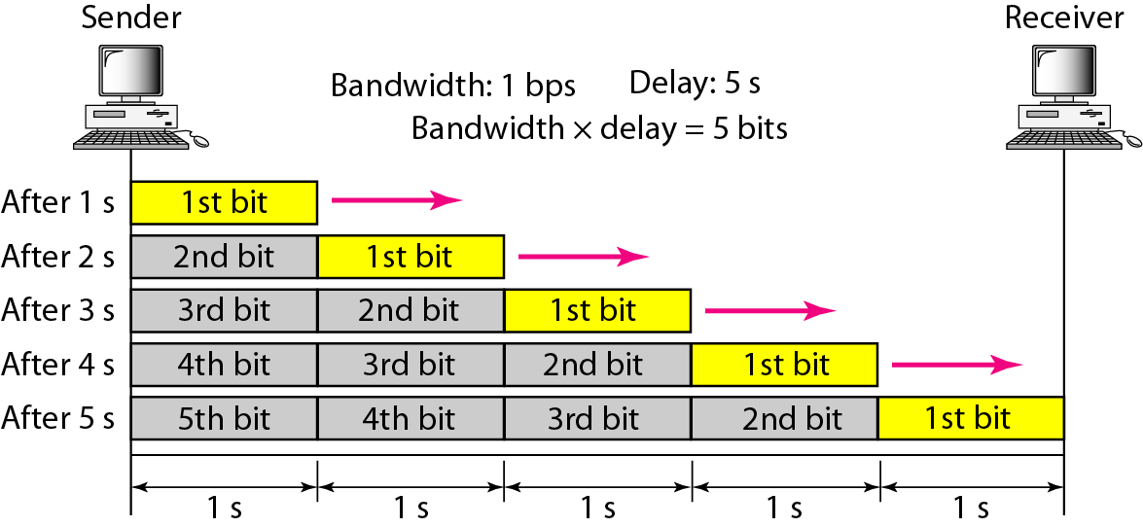

Bandwidth Delay Product
The bandwidth-delay product defines the number of bits that can fill the link

Slide 48
Jitter
Jitter is defined as the variation in the packet delay.
High jitter means the difference between delays is large; low jitter means the variation is small.

Slide 49
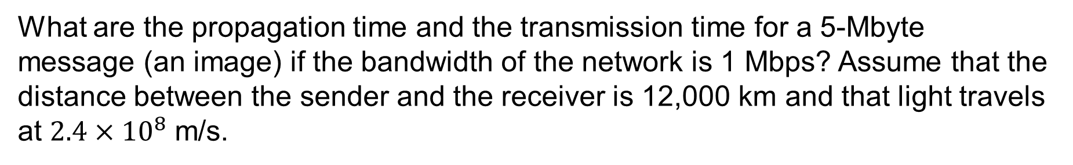
Question
What are the propagation time and the transmission time for a 5-Mbyte message (an image) if the bandwidth of the network is 1 Mbps? Assume that the distance between the sender and the receiver is 12,000 km and that light travels at $2.4×{10}^{8}$ m/s.
Solution
Message size= 5 Mbyte= 5x10,00000x8 bits
Transmission time= (5x10,00000x8)/(1x10,00000) sec
= 40 sec

Slide 50
Question
What are the propagation time and the transmission time for a 5-Mbyte message (an image) if the bandwidth of the network is 1 Mbps? Assume that the distance between the sender and the receiver is 12,000 km and that light travels at $2.4×{10}^{8}$ m/s.
Solution

Slide 51
Question
A network with bandwidth of 10 Mbps can pass only an average of 12,000 frames per minute with each frame carrying an average of 10,000 bits. What is the throughput of this network?
Solution

Slide 52

Question
A network with bandwidth of 10 Mbps can pass only an average of 12,000 frames per minute with each frame carrying an average of 10,000 bits. What is the throughput of this network?
Solution
Throughput of the network can be calculated as

