Slide 1
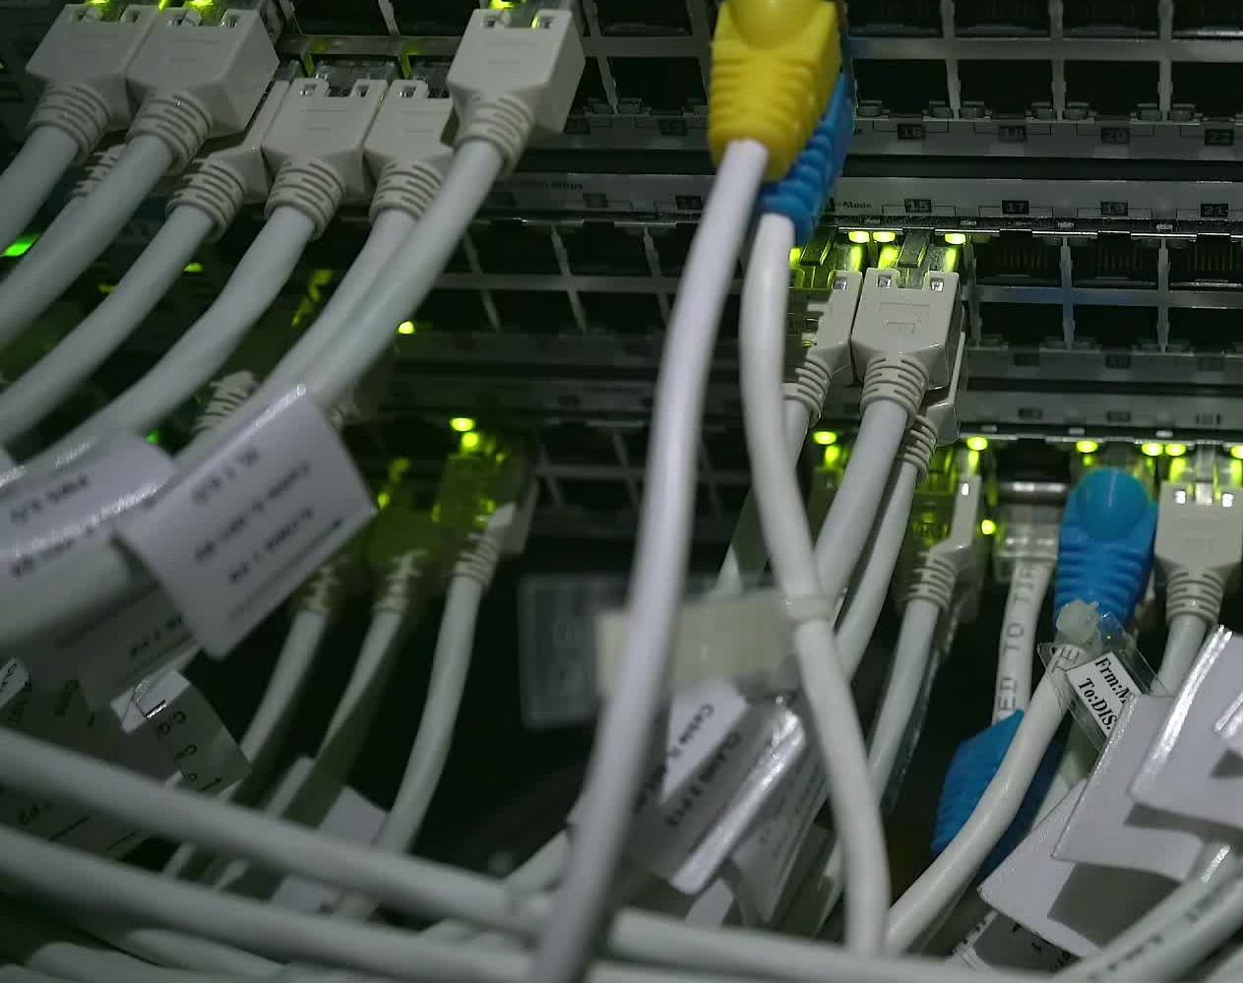
Physical Layer
Line coding Schemes
These slides are partially based on slides assembled by B. A. Forouzan, with grateful acknowledgement of the many others who made their course materials freely available online.

Slide 2

DIGITAL-TO-DIGITAL CONVERSION
How we can represent digital data by using digital signals?
The conversion involves three techniques:
Line coding
Block coding
Scrambling
Line coding is always needed; block coding and scrambling may or may not be needed.

Slide 3
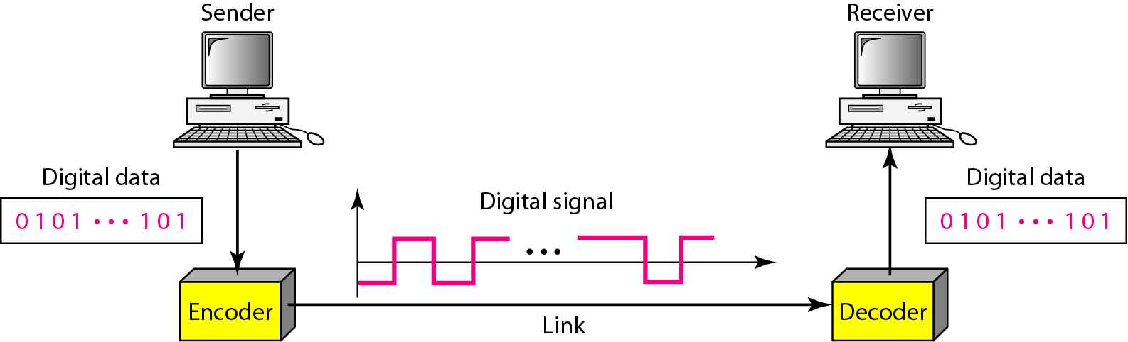
Line coding and Decoding

Slide 4
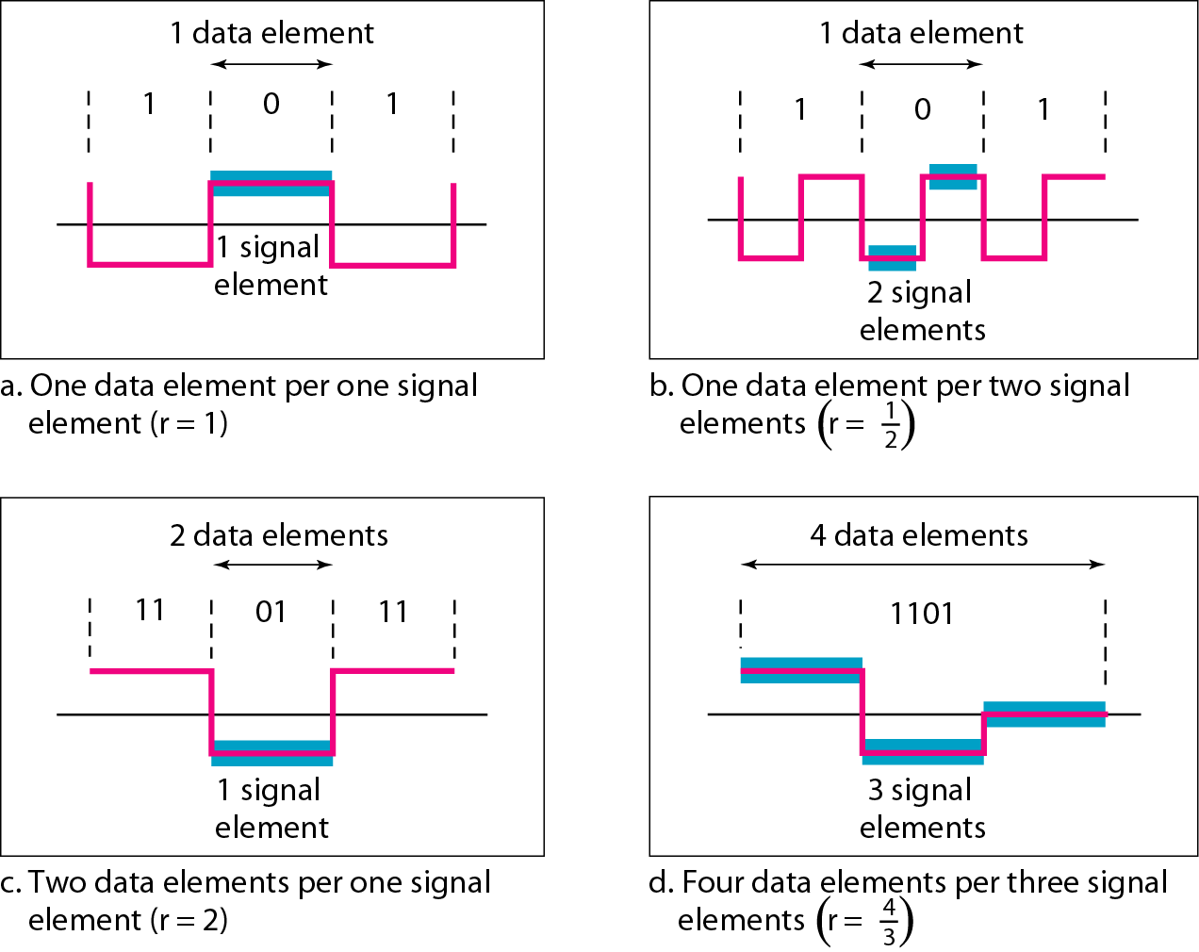
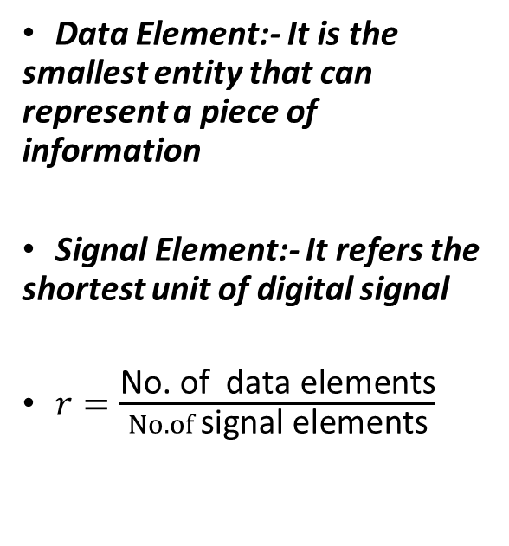
Signal element Vs Data element
Data Element:- It is the smallest entity that can represent a piece of information
Signal Element:- It refers the shortest unit of digital signal
$r=\frac{\text{No}\text{. }\text{of} \text{data} \text{elements}}{No. of \text{signal} \text{elements}}$

Slide 5

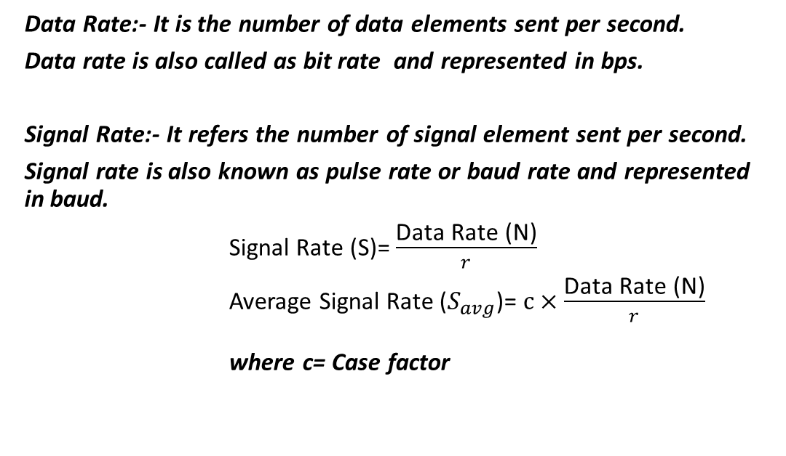
Data rate Vs Signal rate
Data Rate:- It is the number of data elements sent per second.
Data rate is also called as bit rate and represented in bps.
Signal Rate:- It refers the number of signal element sent per second.
Signal rate is also known as pulse rate or baud rate and represented in baud.
Signal Rate (S)= $\frac{\text{Data} \text{Rate}\text{ (}\text{N}\text{)}}{r}$
Average Signal Rate ($S_{avg}$)= $c×\frac{\text{Data} \text{Rate}\text{ (}\text{N}\text{)}}{r}$ where c= Case factor

Slide 6
Question
A signal is carrying data in which one data element is encoded as one signal element ( r = 1). If the bit rate is 100 kbps, what is the average value of the baud rate if c is between 0 and 1?
Solution

Slide 7
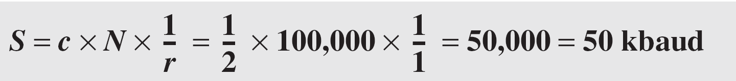
Question
A signal is carrying data in which one data element is encoded as one signal element ( r = 1). If the bit rate is 100 kbps, what is the average value of the baud rate if c is between 0 and 1?
Solution
Assuming that the average value of c is 1/2 . The baud rate is then

Slide 8
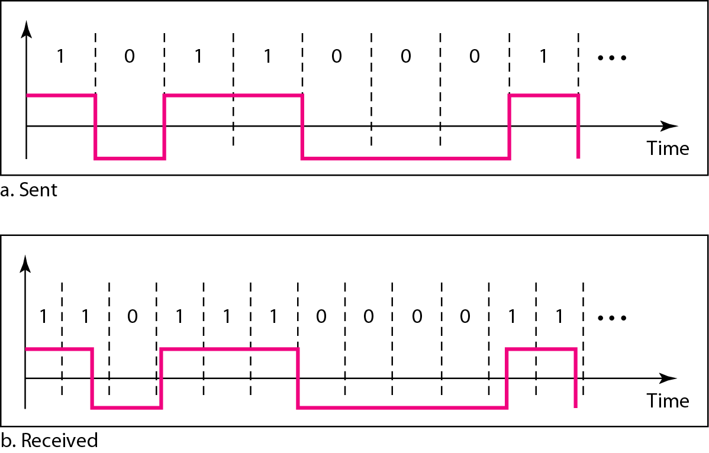
Signal Transmission Issues
DC Components:- When the voltage level in a digital signal is constant for a while, the spectrum creates very low frequencies. These frequencies around zero, called DC (direct-current) components. Creates problems for a system that cannot pass low frequencies
Effect of lack of synchronization
Self-Synchronization-: To correctly interpret the signals received from the sender, the receiver's bit intervals must correspond exactly to the sender's bit intervals.
If the receiver clock is faster or slower, the bit intervals are not matched and the receiver might misinterpret the signals.
The sender sends 10110001, while the receiver receives 110111000011

Slide 9
Question
In a digital transmission, the receiver clock is 0.1 percent faster than the sender clock.
How many extra bits per second does the receiver receive if the data rate is 1 kbps?
How many if the data rate is 1 Mbps?

Slide 10
Question
In a digital transmission, the receiver clock is 0.1 percent faster than the sender clock. How many extra bits per second does the receiver receive if the data rate is 1 kbps? How many if the data rate is 1 Mbps?
Solution
At 1 kbps, the receiver receives 1001 bps instead of 1000 bps.
At 1 Mbps, the receiver receives 1,001,000 bps instead of 1,000,000 bps.

Slide 11
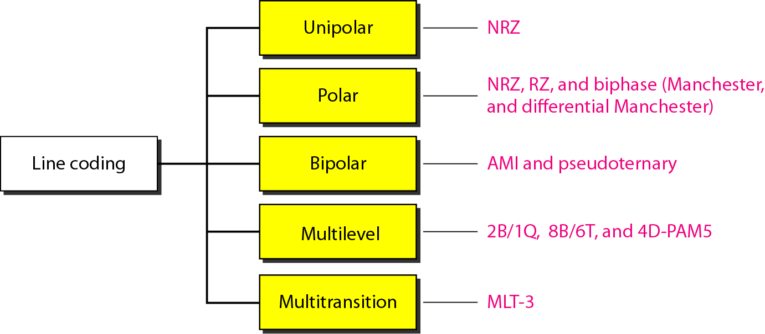
Line coding schemes
Line coding:- It is the process of converting digital data to digital signals

Slide 12
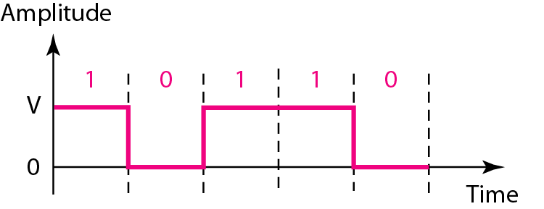
Unipolar NRZ scheme
Unipolar :-All signal levels are one side of time axis either below or above.
NRZ – Non- Return to Zero
Unipolar NRZ scheme is very
costly.

Slide 13
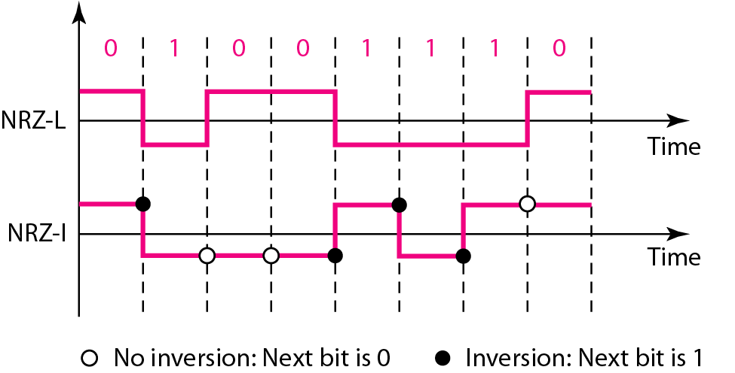
Polar NRZ-L and NRZ-I schemes
Polar :- Signal levels are on both side of time axis.
In NRZ-L the level of the voltage determines the value of the bit.
In NRZ-I the inversion or the lack of inversion determines the value of the bit.
NRZ-L and NRZ-I both have a DC component problem

Slide 14
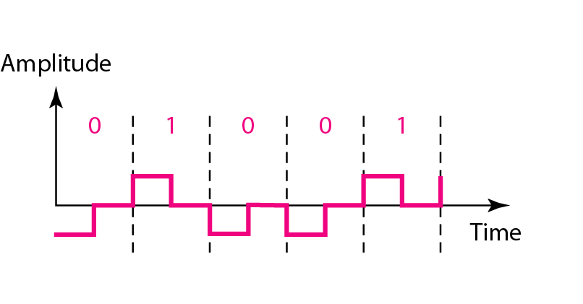
Polar RZ scheme
Polar RZ:- Return-to-zero (RZ) scheme uses three values: positive, negative, and zero.
In RZ, the signal changes not between bits but during the bit also.
No DC component problem.
It occupies greater bandwidth.
Complexity: RZ uses three levels of voltage, which is more complex to create and discern.

Slide 15
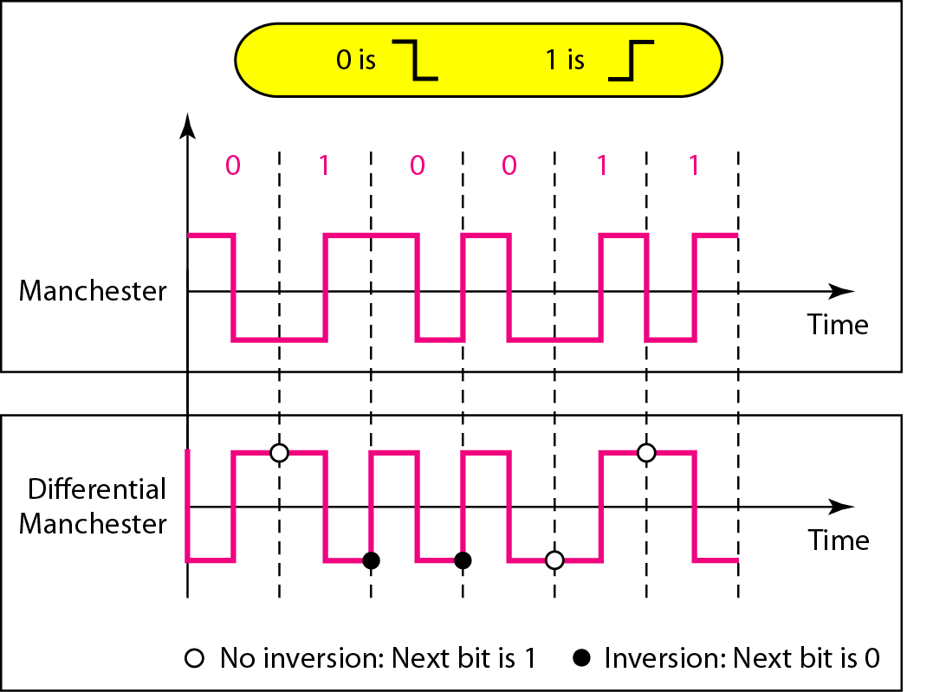
Polar Biphase: Manchester and
differential Manchester schemes
The idea of RZ (transition at the middle of the bit) and the idea of NRZ-L are combined into the Manchester scheme.
In Manchester encoding, the duration of the bit is divided into two halves.
Differential Manchester, on the other hand, combines the ideas of RZ and NRZ-I.
In both the encodings, the transition at the middle of the bit is used for synchronization

Slide 16
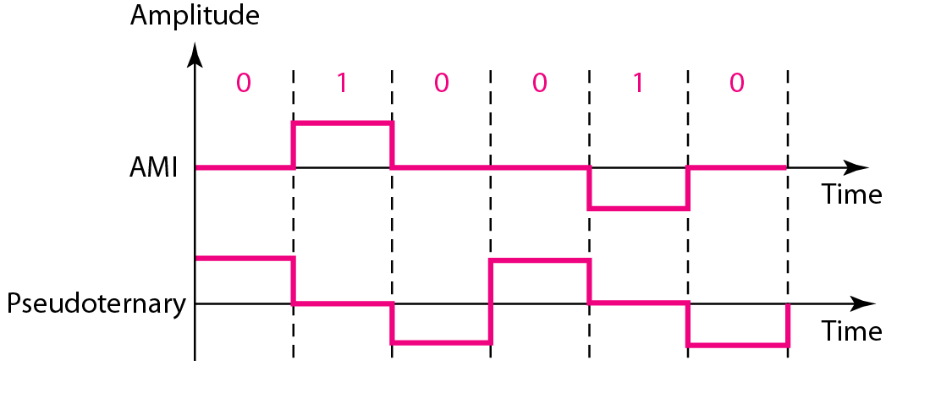
Bipolar schemes
In bipolar encoding, Three levels are used: positive, zero, and negative.
Two schemes: - AMI (Alternate Mark Inversion) and Pseudoternary
No DC component.
Commonly used for long-distance communication
Synchronization problem when a long sequence of 0s is present in the data.

