Slide 1
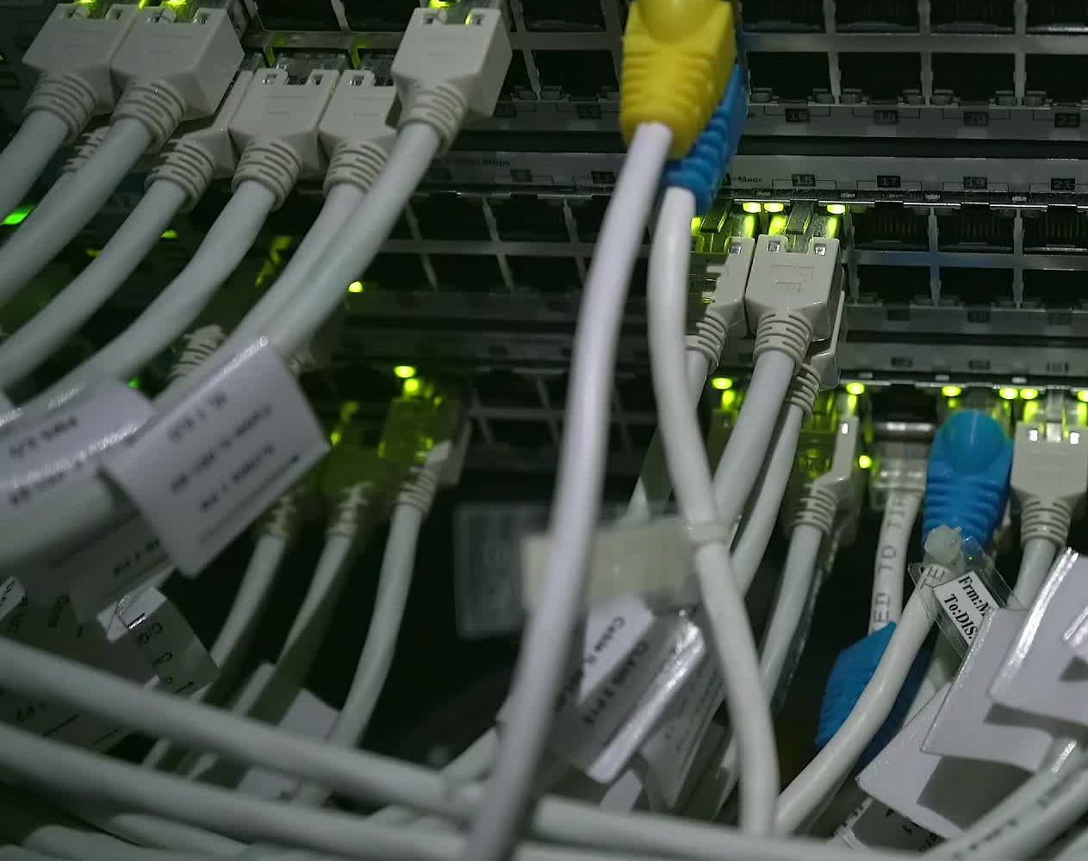
Physical Layer
Analog to Digital Conversion
These slides are partially based on slides assembled by B. A. Forouzan, with grateful acknowledgement of the many others who made their course materials freely available online.

Slide 2
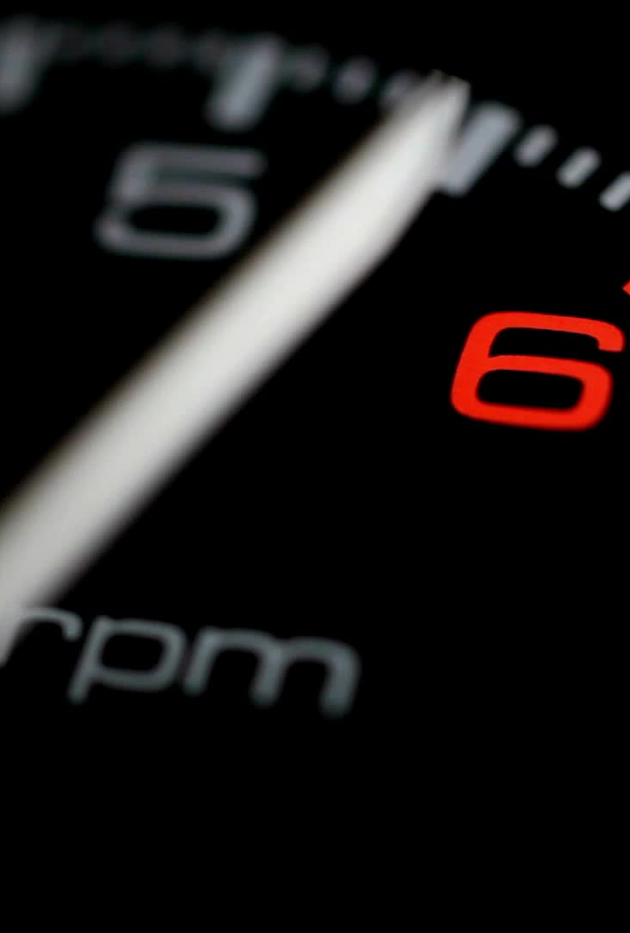
ANALOG-TO-DIGITAL CONVERSION
The tendency today is to change an analog signal to digital data.
Two techniques for analog to digital conversion
Pulse code modulation
Delta modulation.

Slide 3
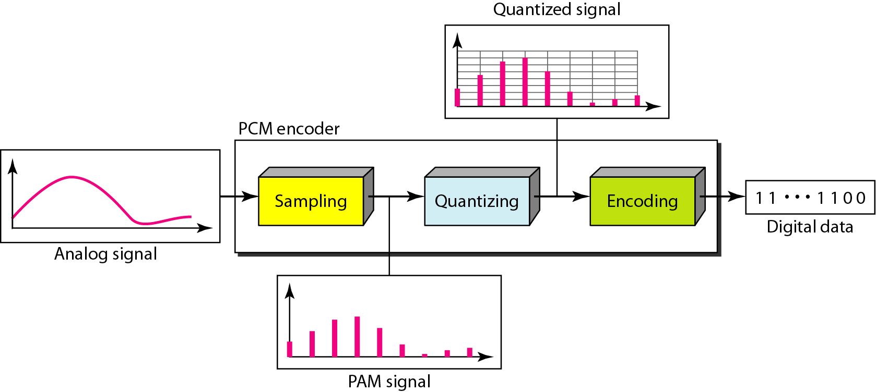
Pulse Code Modulation (PCM)
PCM:- The most common technique to change an analog signal to digital data
1. The analog signal is sampled. 2. The sampled signal is quantized. 3. The quantized values are encoded as streams of bits.
A PCM encoder has three components
Sampling
Quantizing
Encoding

Slide 4
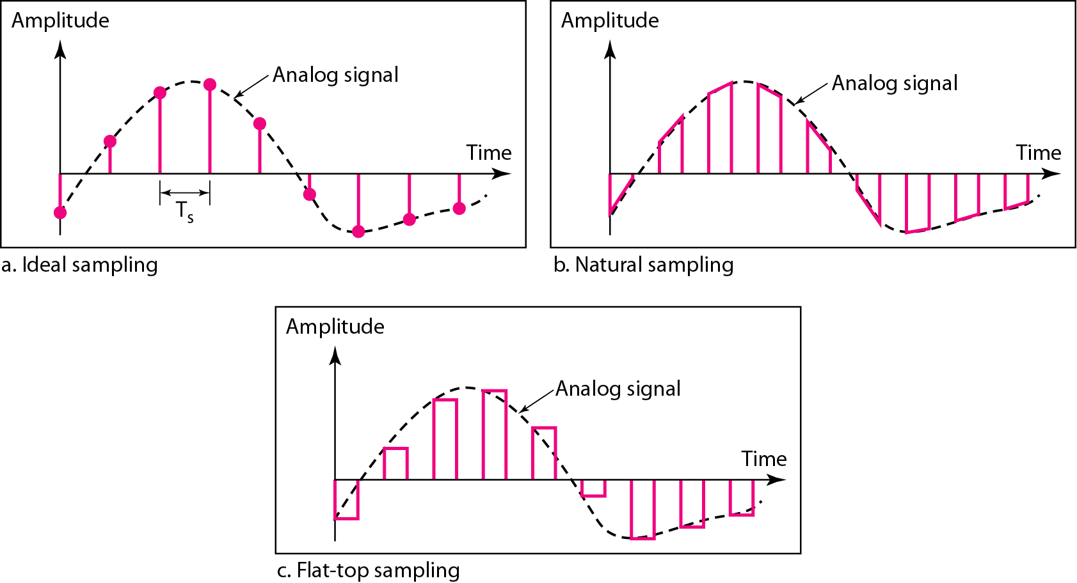
Three different sampling methods for PCM
Sample interval or period: The time interval at which analog signal is sampled ( e.g.- every Ts sec )
Sampling rate or sampling frequency:- Inverse of the sampling interval
Types of sampling methods:-
Ideal,
Natural,
Flat-top-

Slide 5
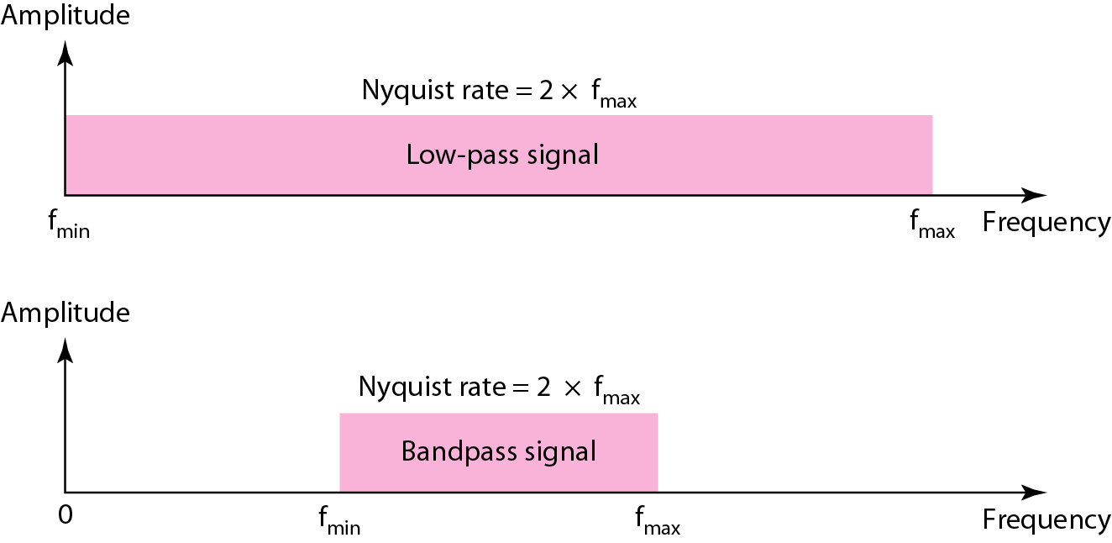
Nyquist theorem
According to the Nyquist theorem, the sampling rate must be at least 2 times the highest frequency contained in the signal.

Slide 6
Question
We want to digitize the human voice. What is the bit rate, assuming 8 bits per sample? Assuming that human voice contains frequencies from 0 to 4000 Hz

Slide 7
Question
We want to digitize the human voice. What is the bit rate, assuming 8 bits per sample? Assuming that human voice contains frequencies from 0 to 4000 Hz
Solution
The human voice normally contains frequencies from 0 to 4000 Hz. So the sampling rate and bit rate are calculated as follows:

Slide 8
Quantization and encoding of a sampled signal
Quantization: provides fixed pre-defined quantized levels (L)
The choice of number of levels, depends on the range of the amplitudes of the analog signal.
If the amplitude of a signal fluctuates between two values only, we need only two levels; if the signal, like voice, has many amplitude values, we need more quantization levels.
Encoding:- Process of converting the quantized values as streams of bits.
After quantization, number of bits per sample is decided, each sample can be changed to an bit code word

Slide 9
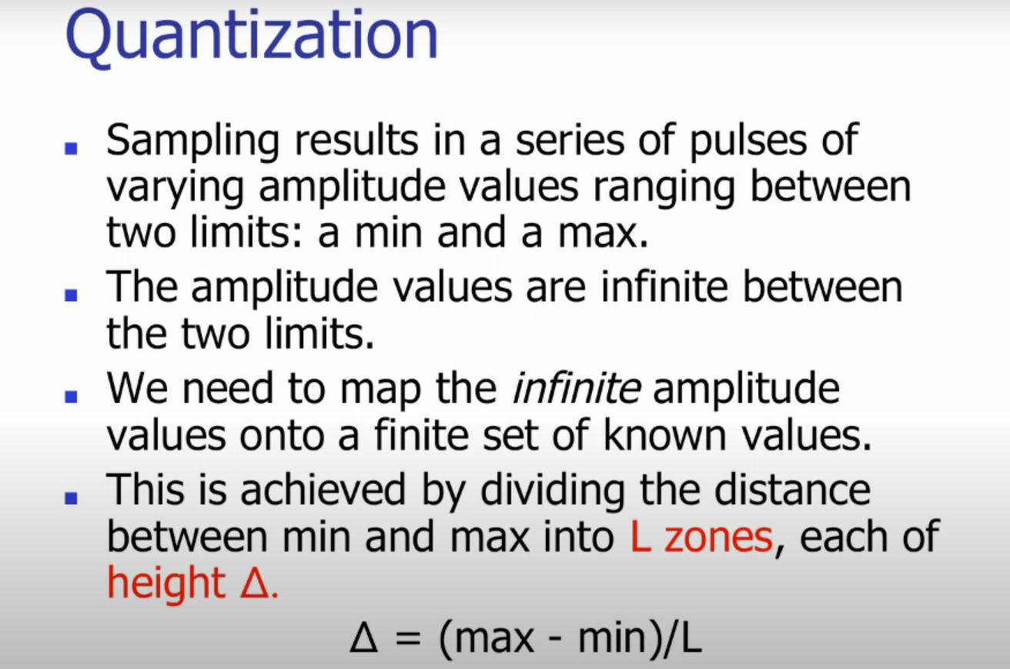

Slide 10
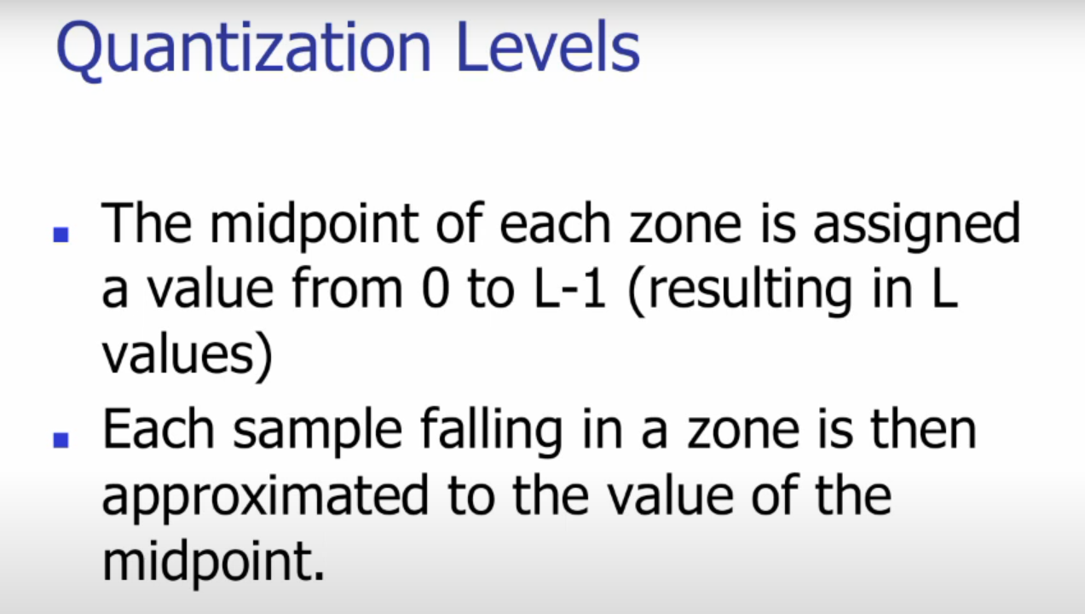

Slide 11
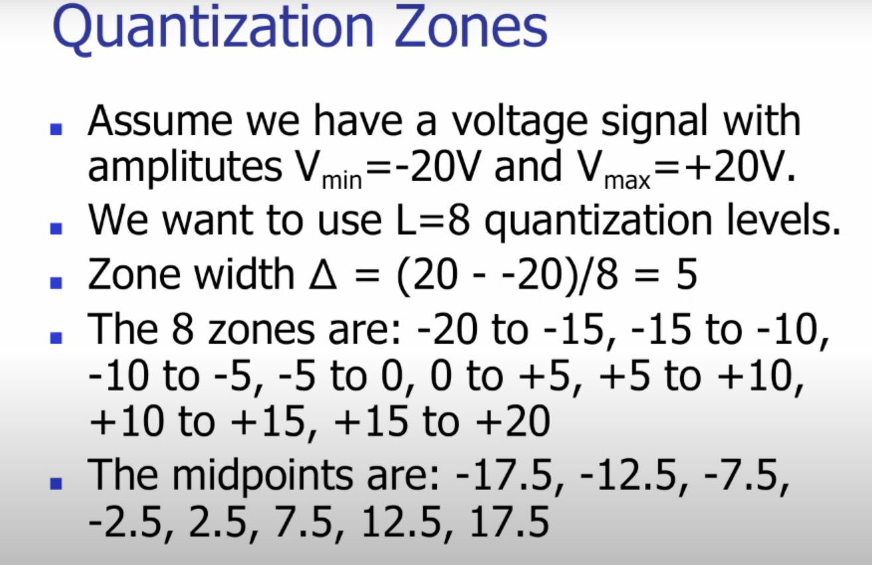

Slide 12
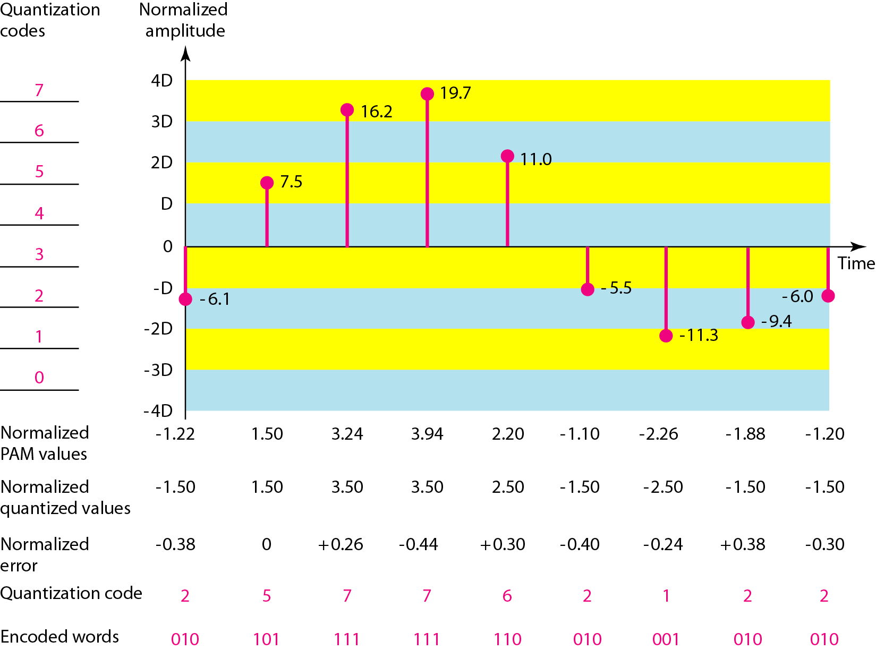
Quantization and encoding of a sampled signal

Slide 13
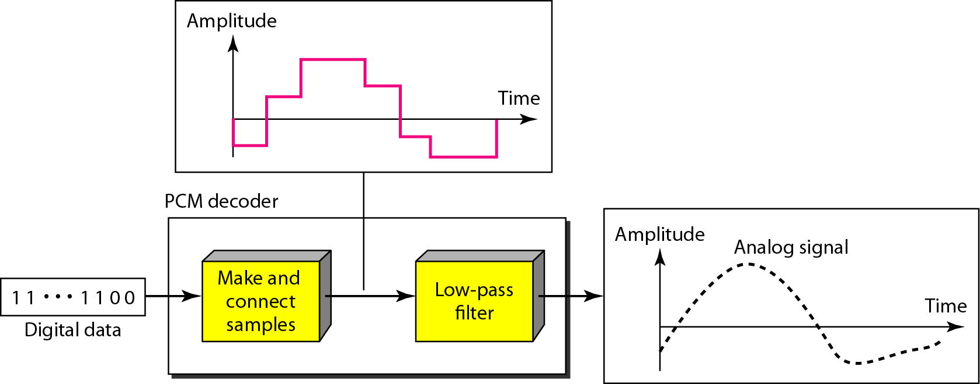
Components of a PCM decoder
The recovery of the original signal requires the PCM decoder.
The decoder first uses circuitry to convert the code words into a pulse that holds the amplitude until the next pulse.
After the staircase signal is completed, it is passed through a low-pass filter to smooth the staircase signal into an analog signal.

Slide 14
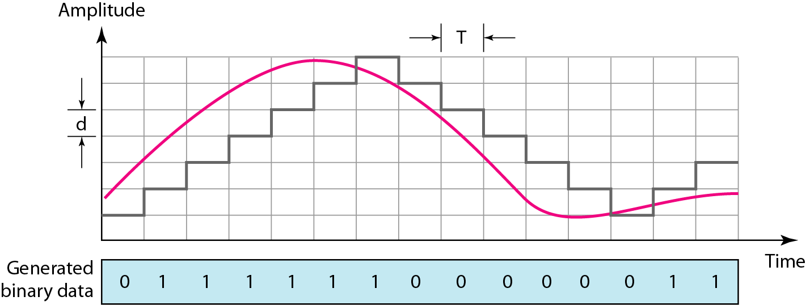
Delta Modulation
Delta Modulation (DM) have been developed to reduce the complexity of PCM.
PCM finds the value of the signal amplitude for each sample.
DM finds the change from the previous sample.

Slide 15
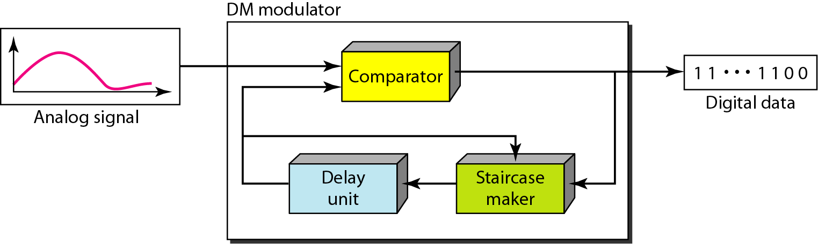
Delta modulation components
Modulator is used at the sender site to create a stream of bits from an analog signal.
The process records the small positive or negative changes, called delta.
Positive delta--→ recorded as 1; negative delta--→ recorded as 0
The modulator builds a second signal that resembles a staircase.
Finding the change is then reduced to comparing the input signal with the gradually made staircase signal
Delay unit is used to hold the staircase function for a period between two comparisons

Slide 16
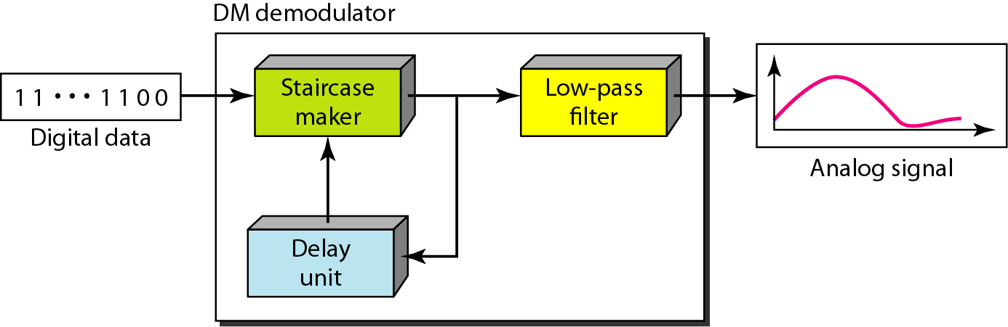
Delta demodulation components
The demodulator takes the digital data and, using the staircase maker and the delay unit, creates the analog signal.
The created analog signal, however, needs to pass through a low-pass filter for smoothing

Slide 17
TRANSMISSION MODES
The transmission of binary data across a link can be accomplished in either parallel or serial mode.
Parallel Transmission:- In parallel mode, multiple bits are sent with each clock tick. Serial Transmission:- In serial mode, 1 bit is sent with each clock tick.
there are three subclasses of serial transmission:
asynchronous
synchronous
isochronous

Slide 18
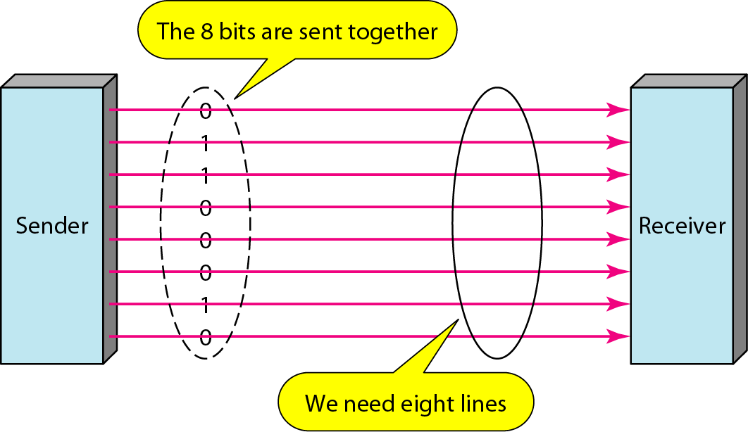
Parallel transmission

Slide 19
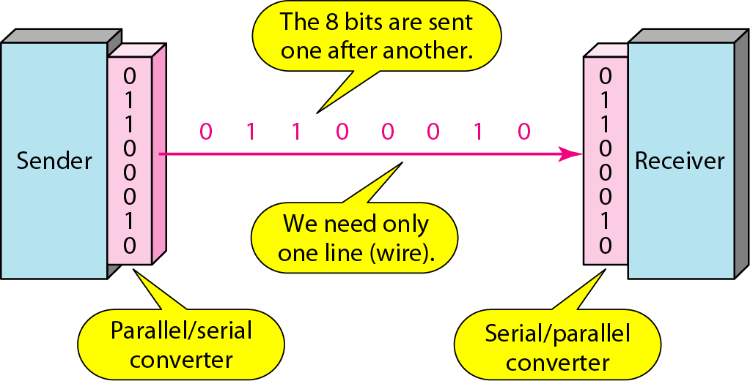
Serial transmission

Slide 20
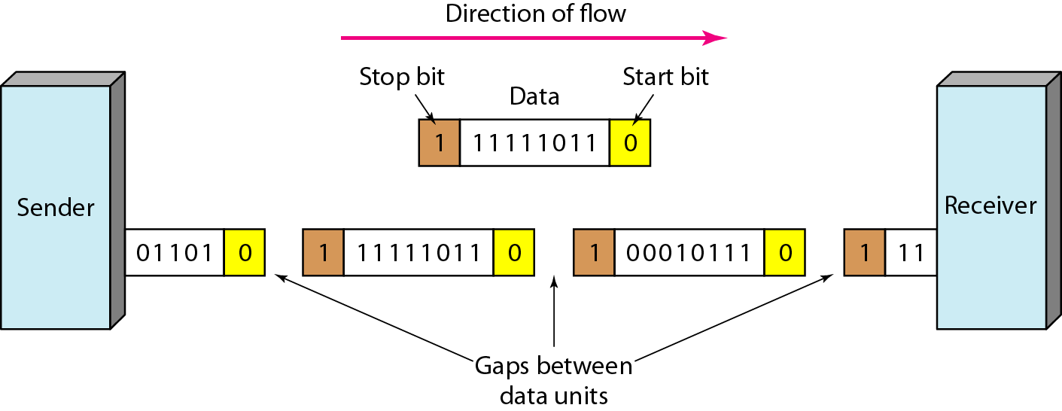
Asynchronous transmission
In asynchronous transmission, we send 1 start bit (0) at the beginning and 1 or more stop bits (1s) at the end of each byte. There may be a gap between each byte

Slide 21
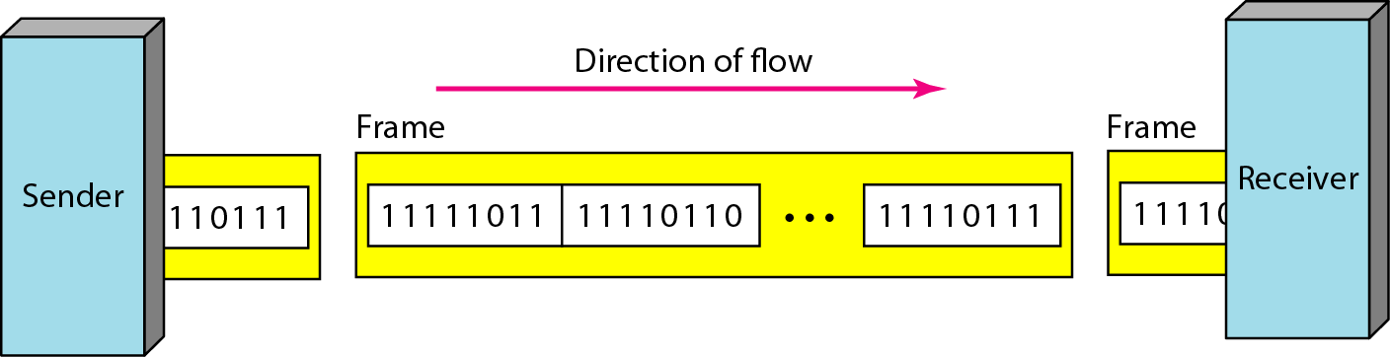
Synchronous transmission
In synchronous transmission, we send bits one after another without start or stop bits or gaps. It is the responsibility of the receiver to group the bits.

Slide 22
Isochronous transmission
Synchronization between characters is not enough; the entire stream of bits must be synchronized in case of isochronous transmission.
The isochronous transmission guarantees that the data arrive at a fixed rate.

