Slide 1
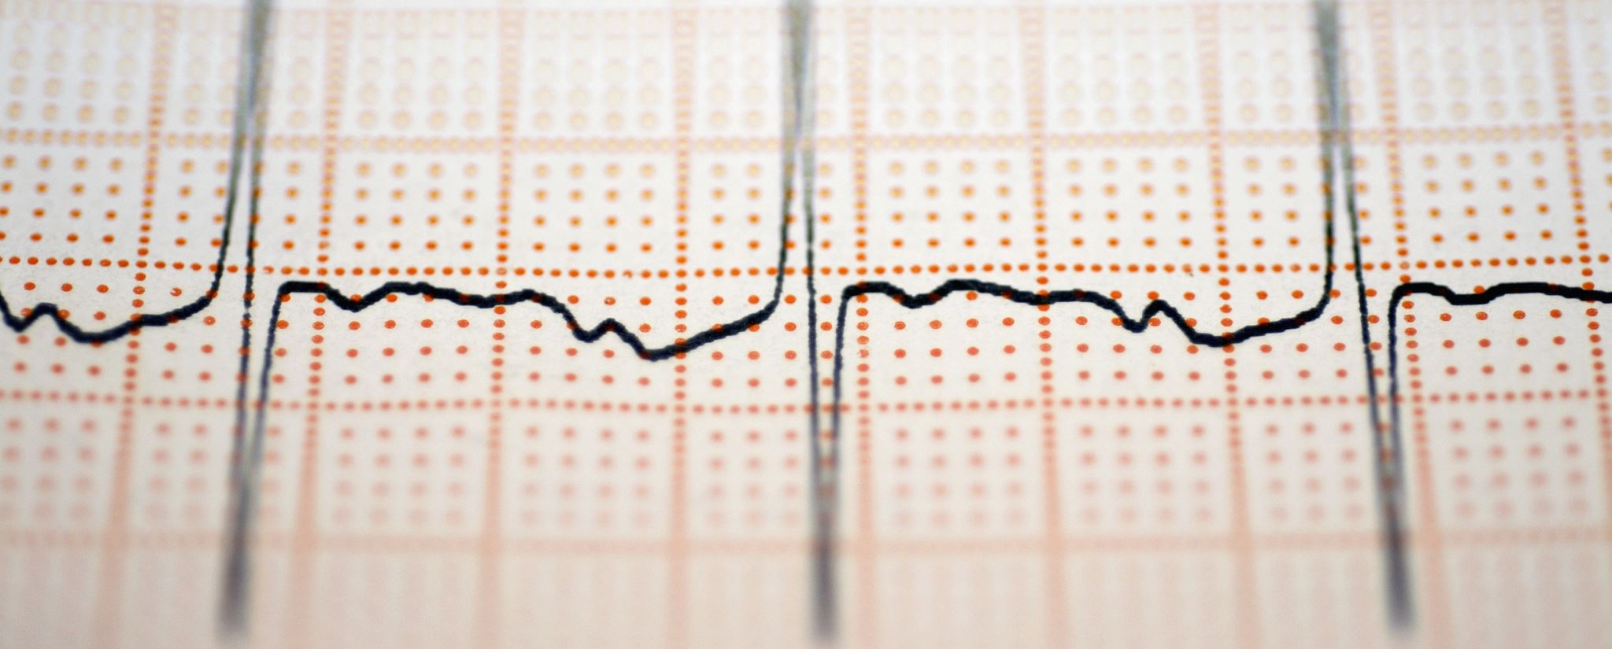
Physical Layer- Modulation, Multiplexing, Switching

Slide 2
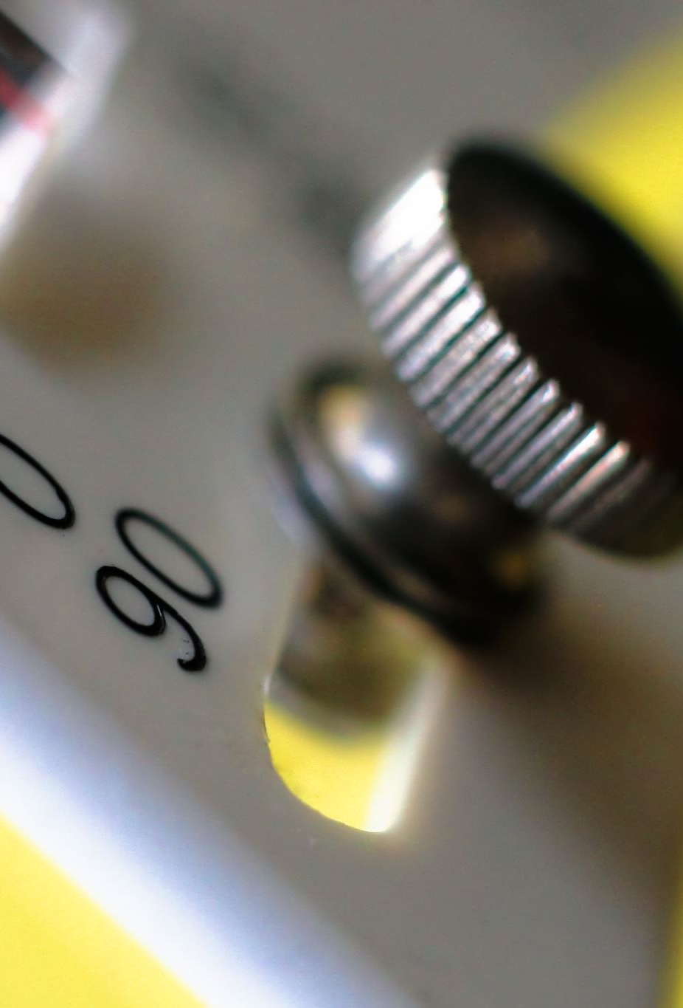
Outline
Modulation
Multiplexing
Switching

Slide 3
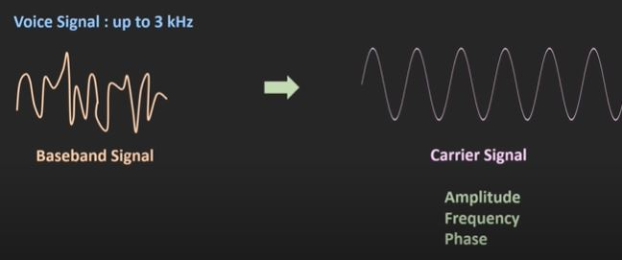
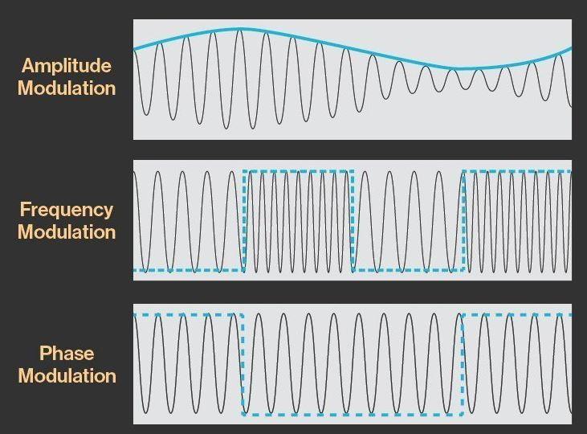
Modulation : Definition
The process of superimposing a low-frequency signal (message signal or baseband signal) on a high-frequency carrier signal (sinusoidal wave).
The process of varying RF carrier wave in accordance with the low-frequency signal information.
A higher frequency carrier wave is able to travel much farther than the baseband signal.
Modulation can be done based on the amplitude, frequency or phase of the signal.

Slide 4
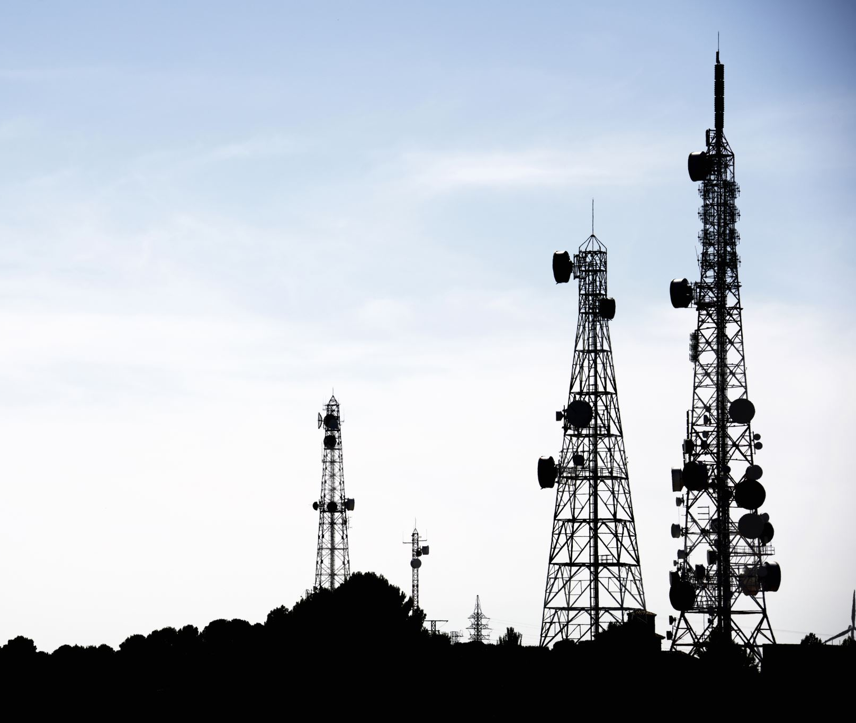
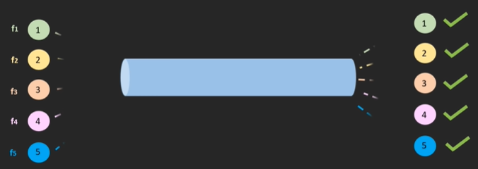
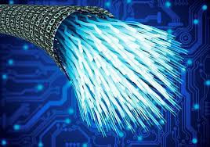
Why is modulation needed?
To reduce the antenna size
To reduce the interference
Wireless Communication

Slide 5
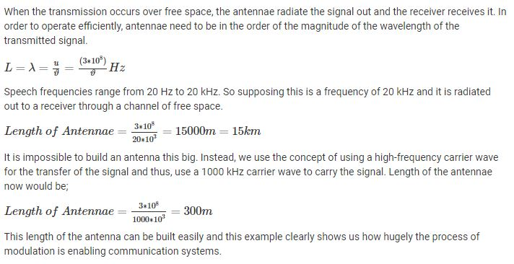
Modulation : Why is needed
Ease of Radiation (To reduce the antenna size)

Slide 6
Modulation : Why is needed
To reduce the interference: When thousands of devices want to transmit baseband signal with same frequency then those signals interfere with each other leading to a lot of noise in the system. By using a carrier wave of high frequencies and allotting a band of frequencies to each message, there is no mixing up of signals and the received signals are perfect.
Wireless Communication: Modulation helps to transmit the signals through space to long distances without using wires. The technique of modulation helped humans to use the wireless equipment in a big way in their lives. Telephones no longer had to remain plugged to a wall.

Slide 7
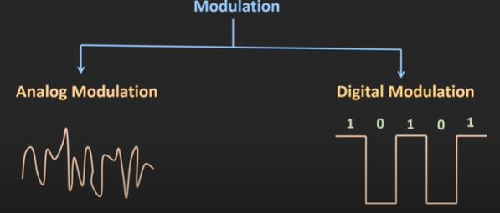
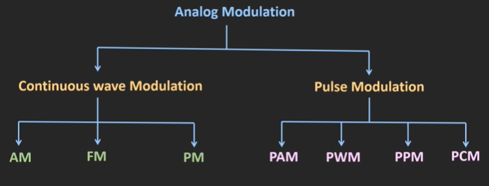
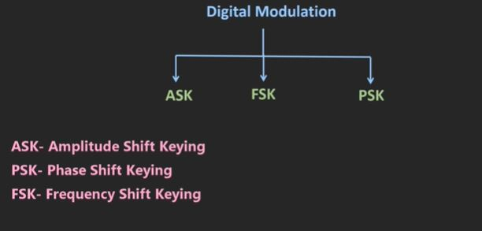
Modulation : Types

Slide 8
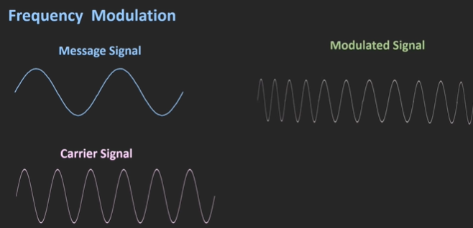
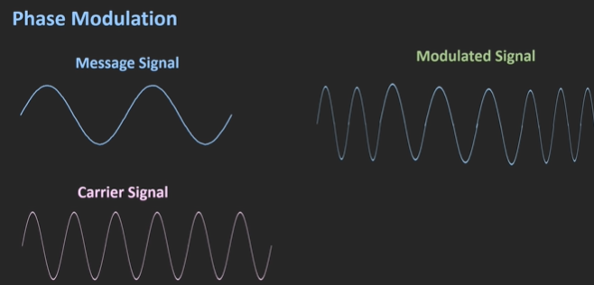
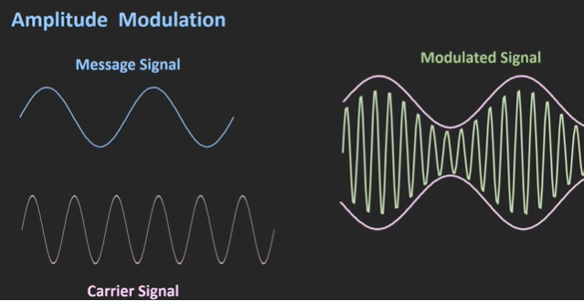
Analog Modulation: Continuous Wave Modulation

Slide 9
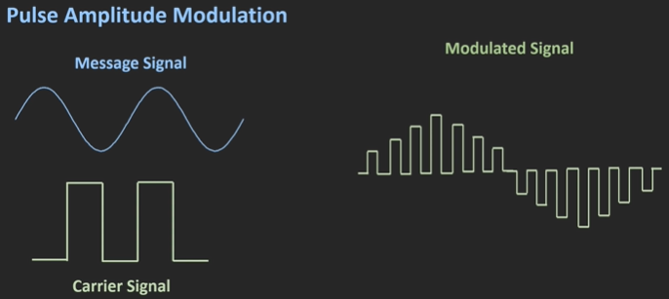
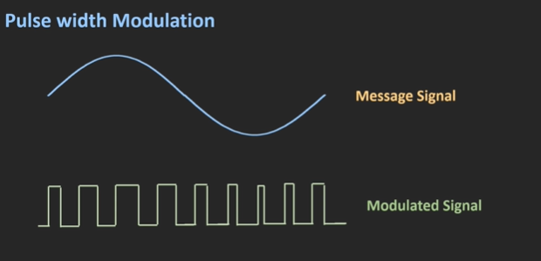
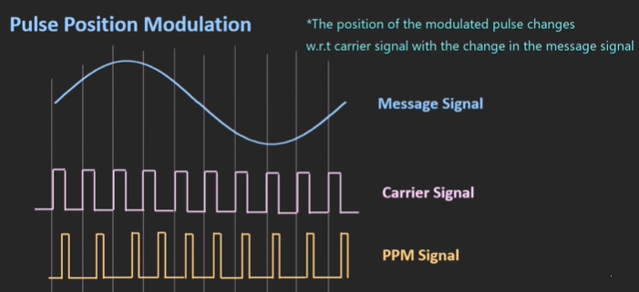
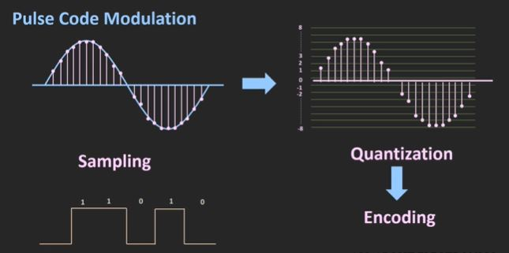
Analog Modulation: Pulse Modulation

Slide 10
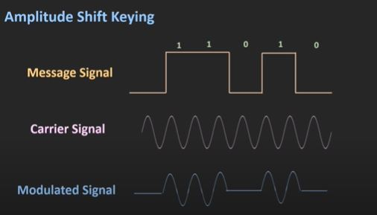
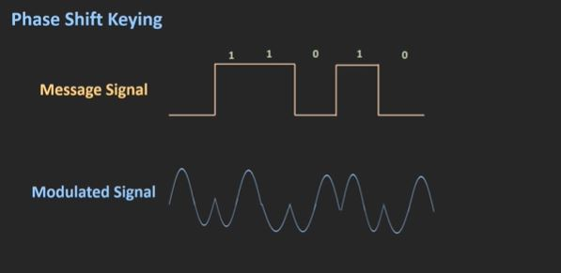
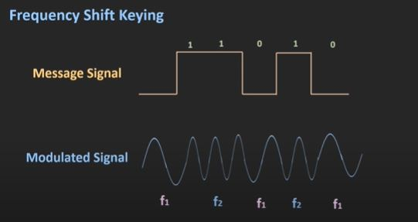
Modulation: Digital Modulation

Slide 11
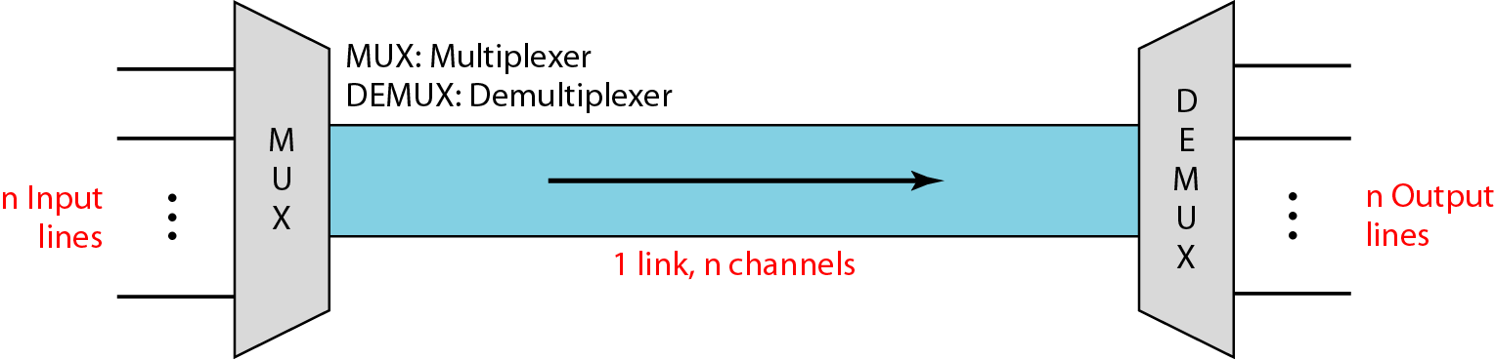
Multiplexing
A technique used to combine and send the multiple data streams over a single medium.
The process of combining the data streams is known as multiplexing and hardware used for multiplexing is known as a multiplexer.
Multiplexing follows many-to-one, i.e., n input lines and one output line.
Demultiplexing is achieved by using a device called Demultiplexer (DEMUX) available at the receiving end.
DEMUX separates a signal into its component signals (one input and n outputs).

Slide 12
Multiplexing
Why Multiplexing?
The transmission medium is shared among n users and can only have one signal at a time.
e.g. If there are 10 signals and bandwidth of medium is100 units, then the 10 unit is shared by each signal.
Multiplexing concept is used to avoid collision between signals.
Transmission services are very expensive.

Slide 13
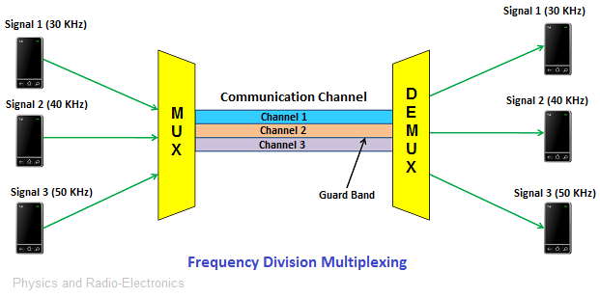
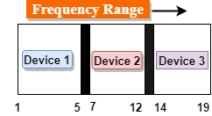
Multiplexing Techniques: Frequency division multiplexing (FDM)
It is an analog technique which is used extensively in TV and radio transmission.
The available bandwidth of a single transmission medium is subdivided into several channels.
The input signals are translated into frequency bands by using modulation techniques, and they are combined by a multiplexer to form a composite signal.

Slide 14
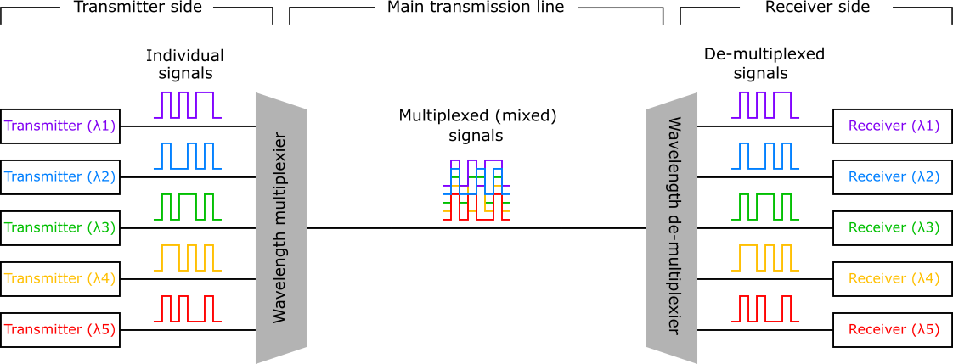
Multiplexing Techniques: Wavelength division multiplexing (WDM)
WDM is same as FDM except that the optical signals are transmitted through the fiber optic cable.
WDM is used on fiber optics to increase the capacity of a single fiber.
It is an analog multiplexing technique.
Optical signals from different source are combined to form a wider band of light using multiplexer.
Demultiplexer separates the signals to transmit them to their respective destinations.

Slide 15
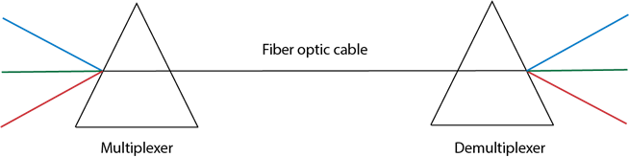
Multiplexing Techniques: Wavelength division multiplexing (WDM)
Multiplexing and Demultiplexing can be achieved by using a prism.
Prism can perform a role of multiplexer by combining the various optical signals to form a composite signal, and the composite signal is transmitted through a fiber optical cable.
Prism also performs a reverse operation, i.e., demultiplexing the signal.

Slide 16
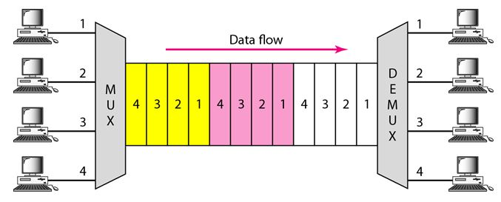
Multiplexing Techniques: Time division multiplexing (TDM)
A digital process that allows several connections to share the high bandwidth of a line instead of sharing a portion of the bandwidth as in FDM, time is shared.
Each connection occupies a portion of time in the link.

Slide 17

Multiplexing Techniques: Time division multiplexing (TDM)
A user takes control of the channel for a fixed amount of time (i.e., time slot).
Data is not transmitted simultaneously rather the data is transmitted one-by-one.
In TDM, the signal is transmitted in the form of frames.
Frames contain a cycle of time slots which contains one or more slots dedicated to each user.
There are two types of TDM:
Synchronous TDM: Time slot is preassigned to every device.
Asynchronous TDM: Time slots are not fixed and are allocated to only those devices which have the data to send.

Slide 18
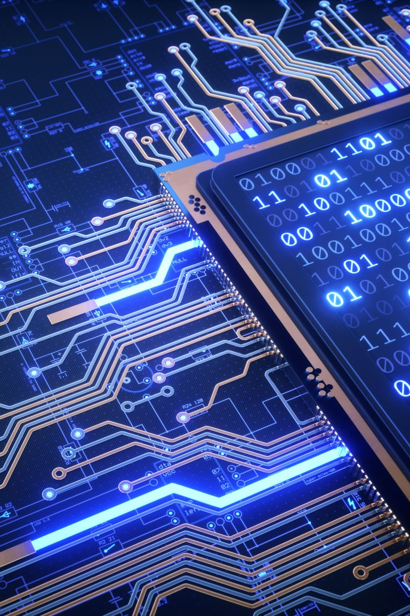
Switching
A process to forward packets coming in from one port to a port leading towards the destination.
Two terms used
Ingress – Data comes on a port
Egress – Data leaves a port or goes out
Switching can be divided into two categories:
Connectionless: Data is forwarded on behalf of forwarding table and no manual intervention. It is not secure
Connection-oriented: A circuit is pre-established along with the path between both endpoints. Data is forwarded on the circuit and the circuit can be kept for future use or can be turned down immediately.

Slide 19
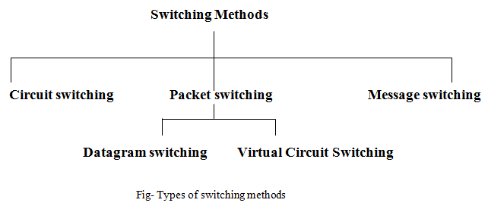
Switching : Techniques

Slide 20
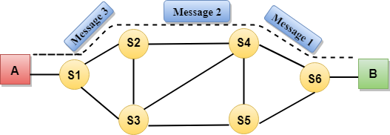
Switching : Circuit Switching
A dedicated path is established between sender and receiver and will remain to exist until the connection is terminated.
Circuit switching in a network operates in a similar way as the telephone works.
A complete end-to-end path must exist before the communication takes place.
Circuit switching has 3 phases:
Circuit establishment
Data transfer
Circuit Disconnect

Slide 21
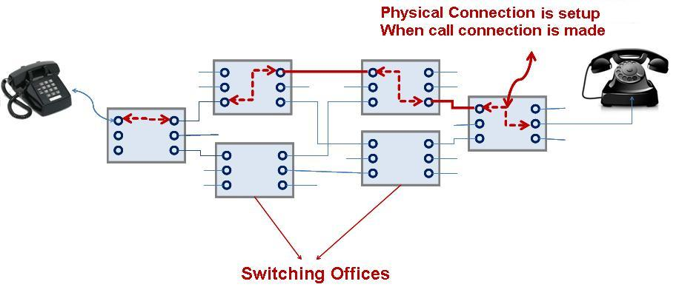
Switching : Circuit Switching
Advantage
Disadvantage
A committed transmission channel is established between the computers which give a guaranteed data rate.
No delay in data flow due to the dedicated transmission path.
It takes a long time to establish a connection.
More bandwidth is required in setting up dedicated channels.
It cannot be used to transmit any other data even if the channel is free as the connection is dedicated to circuit switching.

Slide 22
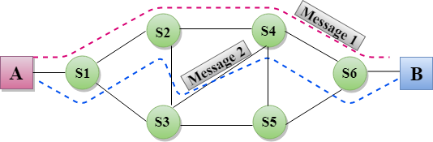
Switching : Message Switching
Message is transferred as a complete unit and forwarded using store and forward mechanism.
No dedicated path is established between the sender and receiver.
The destination address is appended to the message and is routed efficiently using dynamic path.
Each node stores the entire message and then forward it to the next node.
Not suited for streaming media and real-time application.
Application:
Telegraph message switching centers
Electronic mail systems

Slide 23
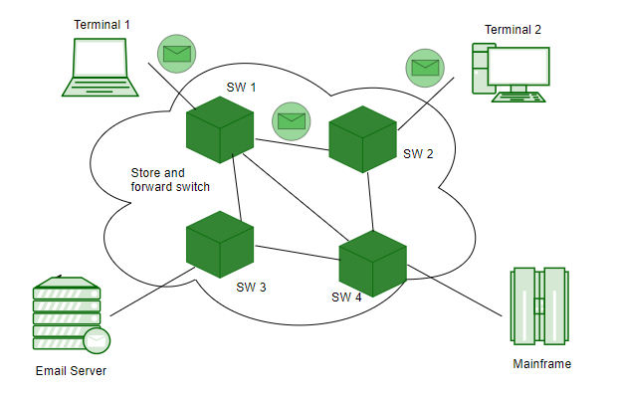
Switching : Message Switching
Advantage
It can store the message when channel is not available, it helps in reducing the traffic in the network.
The data channels are shared by the devices.
It makes traffic management efficient by assigning priorities to the messages.
Disadvantage
It cannot be used for real-time applications as storing messages causes delay.
The message must be stored for which every intermediate device in the network requires a large storing capacity.

Slide 24
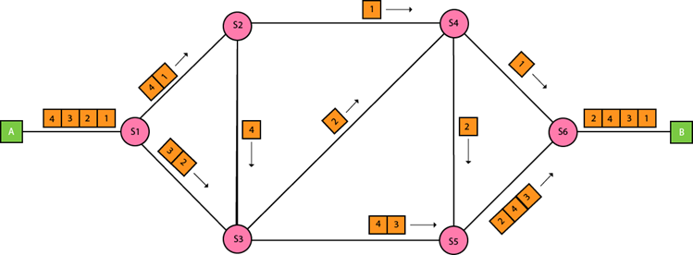
Switching : Packet Switching
Message is broken into individual chunk called as packets that is sent individually in the network.
Every packet contains some information in its headers such as source address, destination address and sequence number.
Packets will travel across the network, taking the shortest path as possible.
Sequence number helps the receiver to reorder the packets, detect missing packets, and send acknowledgement.
Application:
Ethernet
Frame Relay

Slide 25
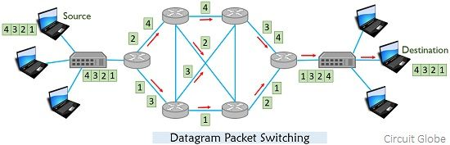
Switching : Packet Switching approaches
Datagram Packet switching:
Packet is known as a datagram and is considered as an independent entity.
Each packet contains the information about the destination and switch uses this information to forward the packet to the correct destination.
The packets are reassembled at the receiving end in correct order.
The routing path is not fixed where the routing decision is taken by the intermediate nodes.
It is also known as connectionless switching.

Slide 26
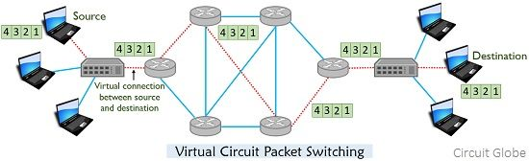
Switching : Packet Switching approaches
Virtual circuit switching:
It is also known as connection-oriented switching.
A preplanned route is established before the messages are sent.
Call request and call accept packets are used to establish connection between sender and receiver.
In this case, the path is fixed for the duration of a logical connection.

Slide 27
Switching : Packet Switching approaches
Advantage
Disadvantage
More efficient in terms of bandwidth, since the concept of reserving circuit is not there.
Minimal transmission latency.
More reliable as a destination can detect the missing packet.
More fault tolerant because packets may follow a different path in case any link is down, Unlike Circuit Switching.
Cost-effective and comparatively cheaper to implement.
It doesn’t send packets in order.
Since the packets are unordered, we need to provide sequence numbers for each packet.
Complexity is more at each node because of the facility to follow multiple paths.
Transmission delay is more because of rerouting.
Packet Switching is beneficial only for small messages, but for bursty data (large messages) Circuit Switching is better.

