Slide 1
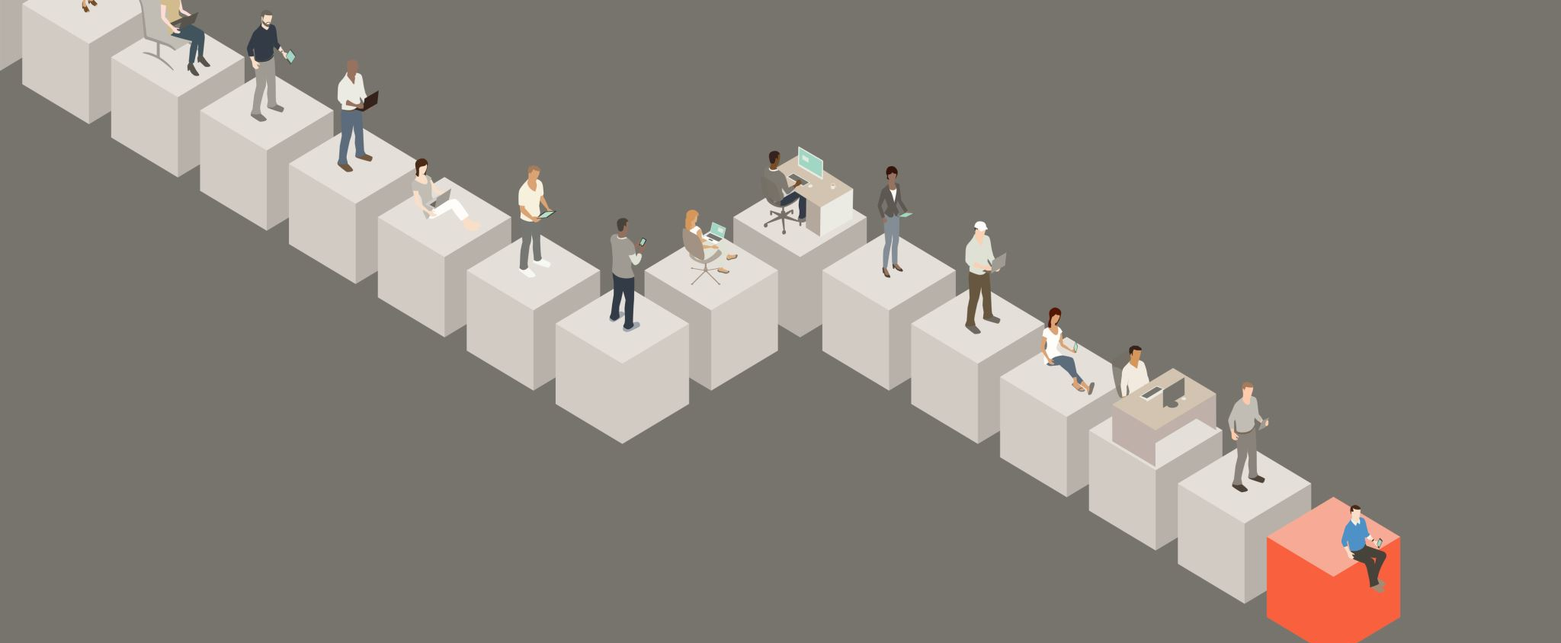
Brief overview of Session & Presentation Layers

Slide 2
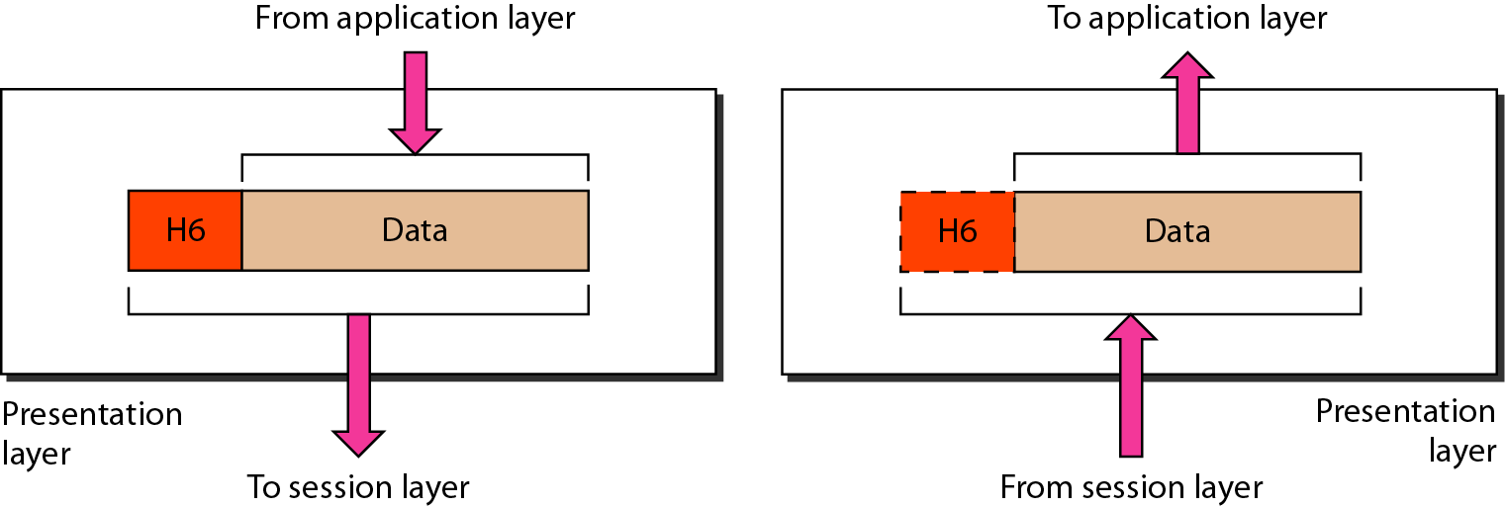
Presentation layer
The presentation layer is responsible for translation, compression, and encryption

Slide 3
Presentation Layer
Translates data
Responsible for encrypting data
Manages data compression

Slide 4
Data translation
A sending computer receiving data from the application layer will need to convert data from the receiving format(eg ASCII) to a format understood and accepted by other layers of the OSI model to ensure smooth file transfer
The receiving computer is responsible for the conversion of “the external format” with which data is received from the sending computer to one accepted by the other layers in the host computer
Data formats include postscript, ASCII, or BINARY such as EBCDIC (Extended Binary Coded Decimal Interchange Code)

Slide 5
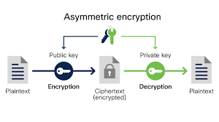
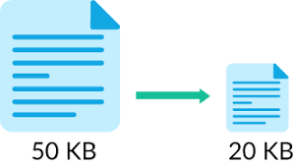
Encryption & Compression
The process of transforming information (plaintext) using an algorithm (called cipher) to make it unreadable to anyone except those possessing special knowledge, usually referred to as a key.
The goal of data compression is to represent an information source (a data file, an image) as accurately as possible using the fewest number of bits
For example, 25.888888888
  This string can be compressed as: 25.[9]8
Interpreted as, "twenty five point 9 eights", the original string is perfectly recreated, just written in a smaller form

Slide 6
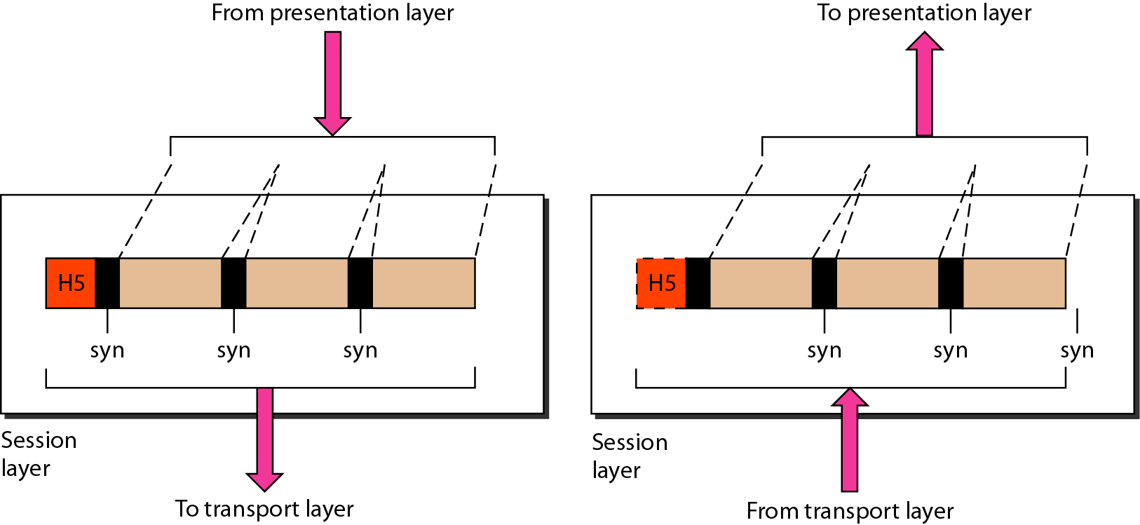
Session Layer
The session layer is responsible for dialog control and synchronization
Sender
Receiver

Slide 7
Session Layer
The session layer defines how to start, control and end conversations (called sessions) between applications.
This includes the control and management of multiple bi-directional messages using dialogue control.
It also synchronizes dialogue between two hosts' and manages their data exchange.
The session layer offers provisions for efficient data transfer.

Slide 8
Basic Functions for the Session Layer Protocols
Managing multiple sessions
  A computer can establish multiple sessions with several other computers
    e.g., session 1: exchanging information over the World Wide Web with www.yahoo.com
    session 2: exchanging information over the World Wide Web with www.google.com
    session 3: exchanging information over the World Wide Web with www.espn.com
  Two computers can also establish multiple sessions,
    e.g., function 1: exchanging information over the World Wide Web;
    function 2: exchanging information over the FTP
    function 3: exchanging information over the email

Slide 9
Question
The ……… layer allows two systems to enter into dialog.
Network
Session
Presentation
Transport

