Slide 1
Decision Trees
Lecture 16

Slide 2
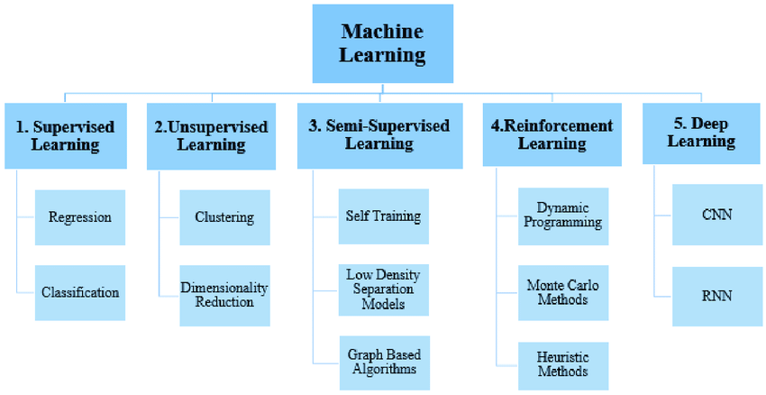

Slide 3
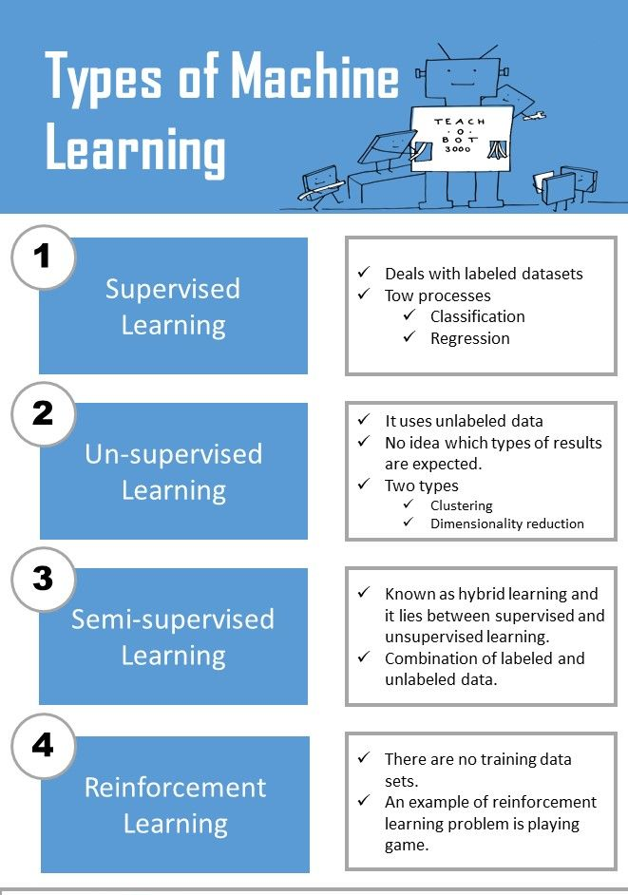

Slide 4
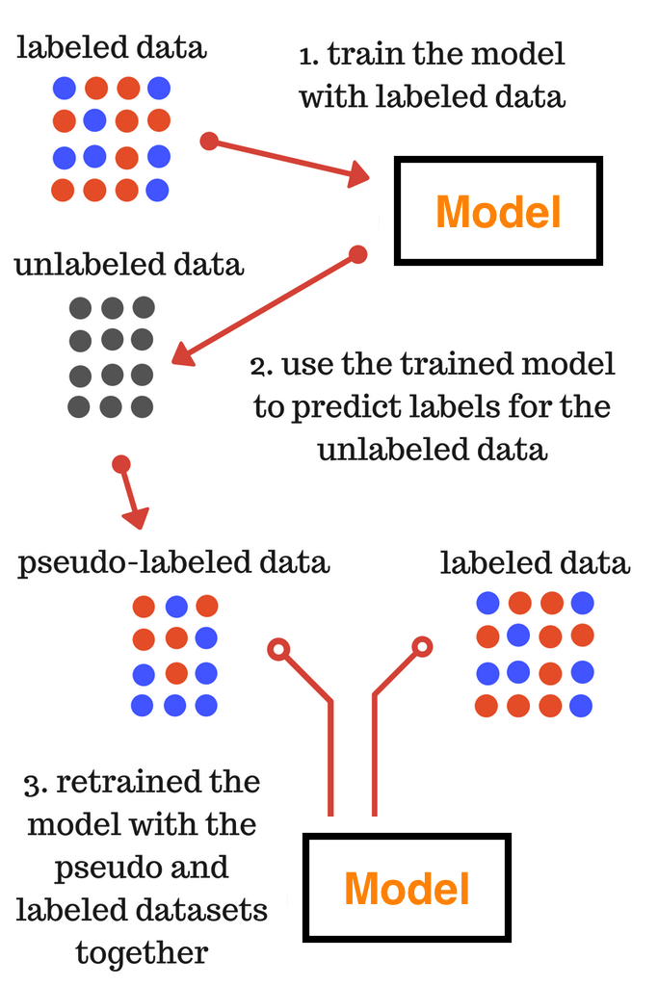
Techniques Used in Semi-Supervised Learning
Pseudo-labeling

Slide 5
Feature Extraction: PCA, TF-IDF
Supervised: K-NN, Linear Regression, Logistic Regression, Decision Tree
Unsupervised: K-Mean

Slide 6
Decision Tree Classifier
Simplest, yet successful form of machine learning algorithm.
Goal: build a model using the training set to classify examples as positive or negative instances of concept .
Decision Tree algorithm constructs a tree consisting of two types of nodes: internal nodes and leaf nodes .
Notes:
Each leaf node has a class label, determined by majority vote of training examples reaching that leaf. 2. Each internal node is a question on features. It branches out according to the answers.

Slide 7
Splitting Attributes
categorical
categorical
continuous
class
Refund
Yes
No
NO
MarSt
Single, Divorced
Married
TaxInc
NO
< 80K
> 80K
NO
YES
Training Data
Model: Decision Tree
Notes:
Each leaf node has a class label, determined by majority vote of training examples reaching that leaf. 2. Each internal node is a question on features. It branches out according to the answers.

Slide 8
Notes:
Decision tree classification task

Slide 9
Apply Model to Test Data
Start from the root of tree.
Test Data
Refund
Yes
No
NO
MarSt
Single, Divorced
Married
TaxInc
NO
< 80K
> 80K
NO
YES

Slide 10
Apply Model to Test Data
Refund
Test Data
Yes
No
NO
MarSt
Single, Divorced
Married
TaxInc
NO
< 80K
> 80K
NO
YES

Slide 11
Apply Model to Test Data
Refund
Test Data
Yes
No
NO
MarSt
Single, Divorced
Married
TaxInc
NO
< 80K
> 80K
NO
YES

Slide 12
Apply Model to Test Data
Refund
Test Data
Yes
No
NO
MarSt
Single, Divorced
Married
TaxInc
NO
< 80K
> 80K
NO
YES

Slide 13
Apply Model to Test Data
Refund
Test Data
Yes
No
NO
MarSt
Single, Divorced
Married
TaxInc
NO
Assign Cheat to “No”
< 80K
> 80K
NO
YES

Slide 14
Decision Tree Algorithms
  ID3 (1986 ; Ross Quinlan)
  C4.5 (1993; Ross Quinlan)
  CART (1984; Breimanetal)

Slide 15
Decision Tree Induction
Greedy strategy: Split the records based on an attribute test that optimizes certain criterion.
Issues
  Determine how to split the records
    How to specify the attribute test condition?
    How to determine the best split?
  Determine when to stop splitting

Slide 16
Specify Test Condition in Decision Tree

Slide 17
Decision Tree Induction
Greedy strategy: Split the records based on an attribute test that optimizes certain criterion.
Issues
  Determine how to split the records
    How to specify the attribute test condition?
    How to determine the best split?
  Determine when to stop splitting

Slide 18
How to Specify Test Condition?
Depends on attribute types
  Nominal
  Ordinal
  Continuous
Depends on number of ways to split
  2-way split
  Multi-way split

Slide 19
Splitting based on Nominal Attributes
Multi-way split: Use as many partitions as distinct values.
Binary split: Divides values into two subsets.
CarType
Family
Luxury
Sports
CarType
CarType
{Sports, Luxury}
{Family,
Luxury}
{Family}
OR
{Sports}

Slide 20
Splitting based on Odinal Attributes
Multi-way split: Use as many partitions as distinct values.
Binary split: Divides values into two subsets
Size
Small
Large
Medium
Size
Size
{Medium,
Large}
{Small, Medium}
{Small}
{Large}
OR

Slide 21
Splitting based on Continuous Attributes
  Discretization to form an ordinal categorical attribute
    ranges can be found by equal interval bucketing, or clustering.
    Binary Decision: (A < v) or (A ≥ v)
    consider all possible splits and finds the best cut
    can be more compute intensive

Slide 22
Splitting based on Continuous Attributes

Slide 23
Determine the Best Split

Slide 24
Decision Tree Induction
Greedy strategy: Split the records based on an attribute test that optimizes certain criterion.
Issues
  Determine how to split the records
    How to specify the attribute test condition?
    How to determine the best split?
  Determine when to stop splitting

Slide 25
How to Determine the Best Split?
Before Splitting: Assume10 records of class 0, 10 records of class 1.
Which test condition is the best?

Slide 26
How to Determine the Best Split?
Greedy approach:
  Nodes with homogeneous class distribution are preferred
Need a measure of node impurity:
Non-homogeneous,
High degree of impurity
Homogeneous,
Low degree of impurity

Slide 27
Measures for Node Impurity
Information Gain
Gini Index

Slide 28
Information Gain
Which split is more informative?
Less than 50k Equal to or over 50k
Employed Unemployed

Slide 29
Information Gain
Impurity or Entropy: measures the level of impurity in a group.

Slide 30
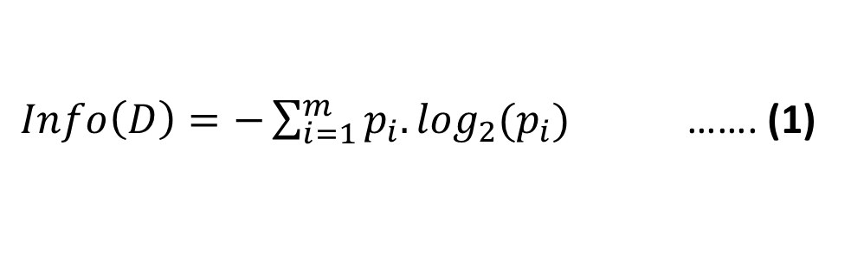
Information Gain
Entropy for Dataset ‘D’ is defined as:
$Info\left(D\right)=−\sum_{i=1}^{m}{p_{i}.\log_{2}(p_{i})}$ ……. (1)
Here, p_{i} is non-zero probability that a tuple in D belongs to class c_{i} and m denotes the number of distinct classes in D.

Slide 31
Information Gain
What is the entropy of a group in which all examples belong to the same class?
entropy = - 1 log₂(1) = 0 Minimum impurity
What is the entropy of a group with 50% in either class?
entropy = -0.5 log₂(0.5) – 0.5 log₂(0.5) =1 Max. impurity

Slide 32
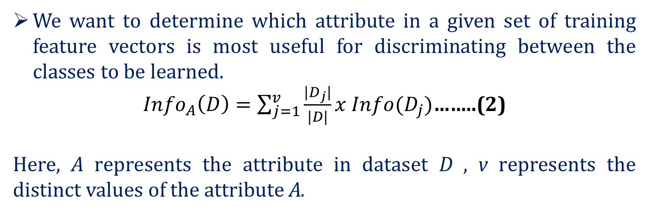
Information Gain (for an Attribute)
We want to determine which attribute in a given set of training feature vectors is most useful for discriminating between the classes to be learned.
${Info}_{A}\left(D\right)=\sum_{j=1}^{v}{\frac{{|D}_{j}|}{|D|}}x Info(D_{j})$……..(2)
Here, A represents the attribute in dataset D , v represents the distinct values of the attribute A.

Slide 33
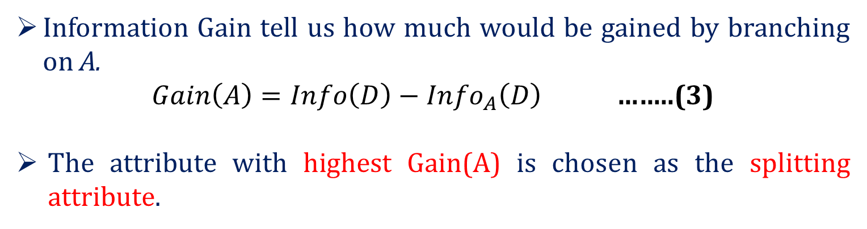
Information Gain
Information Gain tell us how much would be gained by branching on A.
$Gain\left(A\right)={Info\left(D\right)−Info}_{A}\left(D\right)$……..(3)
The attribute with highest Gain(A) is chosen as the splitting attribute.

Slide 34

ID | Age | Income | Student | Credit_Rating | Buys_computer
1 | youth | high | no | fair | NO
2 | youth | high | no | excellent | NO
3 | middle | high | no | fair | YES
4 | senior | medium | no | fair | YES
5 | senior | low | yes | fair | YES
6 | senior | low | yes | excellent | NO
7 | middle | low | yes | excellent | YES
8 | youth | medium | no | fair | NO
9 | youth | low | yes | fair | YES
10 | senior | medium | yes | fair | YES
11 | youth | medium | yes | excellent | YES
12 | middle | medium | no | excellent | YES
13 | middle | high | yes | fair | YES
14 | senior | medium | no | excellent | NO

Slide 35
Calculating Information Gain
Calculate Info(D) using eq. (1):
Info(D)=-9/14.log₂(9/14) - 5/14.log₂(5/14) = 0.940 bits
Calculate Info_{Age}(D) using eq. (2):
Info_{Age}(D)=5/14x(-2/5.log₂(2/5)-3/5.log₂(3/5)) + 4/14x(-4/4.log₂(4/4)- 0) + 5/14x(-3/5.log₂(3/5)-2/5.log₂(2/5)) = 0.694 bits
youth
senior
middle

Slide 36
Calculating Information Gain
Calculate Gain(Age) using eq. (3):
Gain(Age) = Info(D) - Info_{Age}(D)= 0.940 - 0.694 = 0.246 bits
Similarly,
Gain(Income) = 0.029 bits
Gain(Student)= 0.151 bits
Gain (Credit-rating)=0.048 bits

Slide 37
Calculating Information Gain
Since, Age has the highest Info. Gain, so Age will be the splitting attribute.
Age
Income | Student | Credit-Rating | Buys-computer
High | No | Fair | No
High | No | Excellent | No
Medium | No | Fair | No
Low | Yes | Fair | Yes
Medium | Yes | Excellent | Yes
youth
senior
Income | Student | Credit-Rating | Buys-computer
Medium | No | Fair | Yes
Low | Yes | Fair | Yes
Low | Yes | Excellent | no
Medium | Yes | Fair | yes
Medium | No | Excellent | No
middle
YES
Leaf node (4 records)

Slide 38
Gini Index
The other way of splitting a decision tree is the Gini Index.
It is specifically for balanced dataset.
The Gini Index is also known as Gini impurity.
It is a measure of how mixed or impure a dataset is.
The Gini impurity ranges between 0 and 1, where 0 represents a pure dataset and 1 represents a completely impure dataset
(In a pure dataset, all the samples belong to the same class or category.

Slide 39
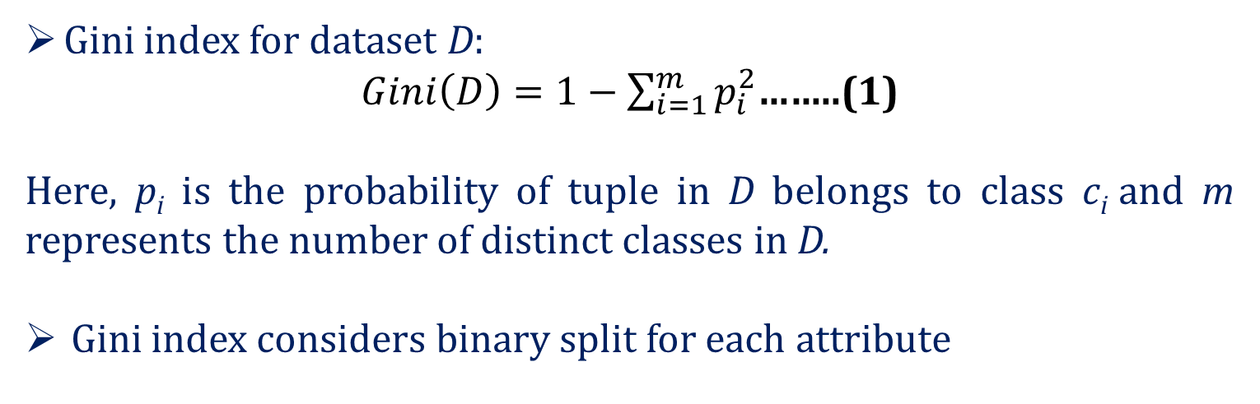
Gini Index
Gini index for dataset D:
$Gini\left(D\right)=1−\sum_{i=1}^{m}{p_{i}^{2}}$……..(1)
Here, p_{i}is the probability of tuple in D belongs to class c_{i} and m represents the number of distinct classes in D.
Gini index considers binary split for each attribute

Slide 40
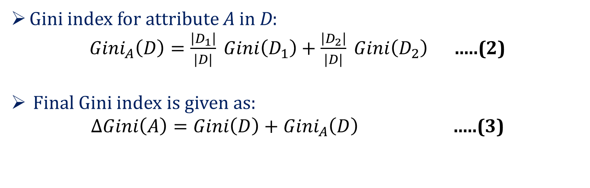
Gini Index
Gini index for attribute A in D:
${Gini}_{A}\left(D\right)=\frac{\left|D_{1}\right|}{|D|} Gini\left(D_{1}\right)+\frac{\left|D_{2}\right|}{|D|} Gini\left(D_{2}\right)$ …..(2)
Final Gini index is given as:
$ΔGini\left(A\right)=Gini\left(D\right)+{Gini}_{A}\left(D\right)$ …..(3)

Slide 41
Gain Ratio
Gain Ratio is an alternative to Information Gain that is used to select the attribute for splitting in a decision tree.
It is used to overcome the problem of bias towards the attribute with many outcomes.
For example, Suppose we have two features, “Color” and “Size” and we want to build a decision tree to predict the type of fruit based on these two features. The “Color” feature has three outcomes (red, green, yellow) and the
“Size” feature has two outcomes (small, large).
Using the information gain method, the “Color” feature would be chosen as the best feature to split on because it has the highest information gain. However, this could be a problem because the “Size” feature could be a better feature to split on because it is less ambiguous and has fewer outcomes.

Slide 42
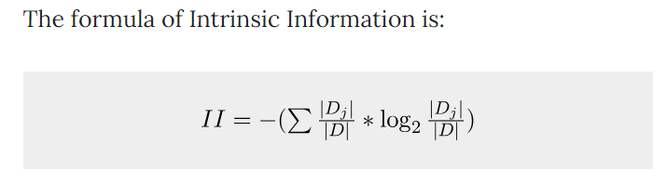
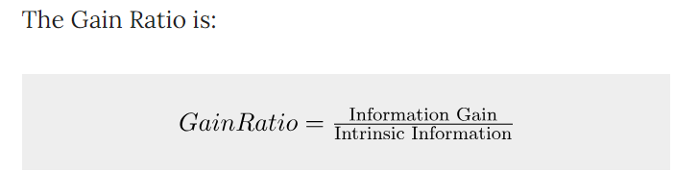
Gain Ratio attempts to lessen the bias of Information Gain on highly branched predictors by introducing a normalizing term called the Intrinsic Information.

Slide 43
Decision Tree Algorithms
  ID3 (1986 ; Ross Quinlan): Information Gain
  C4.5 (1993; Ross Quinlan): Gain Ratio
  CART (1984; Breimanetal): Gini Index

Slide 44
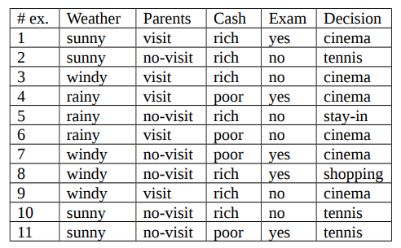
Question

Slide 45
Stopping Criteria for DT Algorithm

Slide 46
Decision Tree Induction
Greedy strategy: Split the records based on an attribute test that optimizes certain criterion.
Issues
  Determine how to split the records
    How to specify the attribute test condition?
    How to determine the best split?
  Determine when to stop splitting

Slide 47
Stopping Criteria for Decision Tree
Stop expanding a node when all the records belong to the same class.
Stop expanding a node when all the records have similar attribute values.
Early termination.

Slide 48
Overfitting and Underfitting

Slide 49
Model Overfitting
Errors of classification model: Training Errors , Generalization Errors
Training Errors: Number of misclassification errors of the model on training set.
Generalization Errors: Expected error of the model on the previously unseen data.

Slide 50
Model Overfitting
Good model: Low training error as well as low generalization error.
Model that fits too well on the training data can have a poorer generalization error than a model with higher training error, leading to model overfitting.

Slide 51
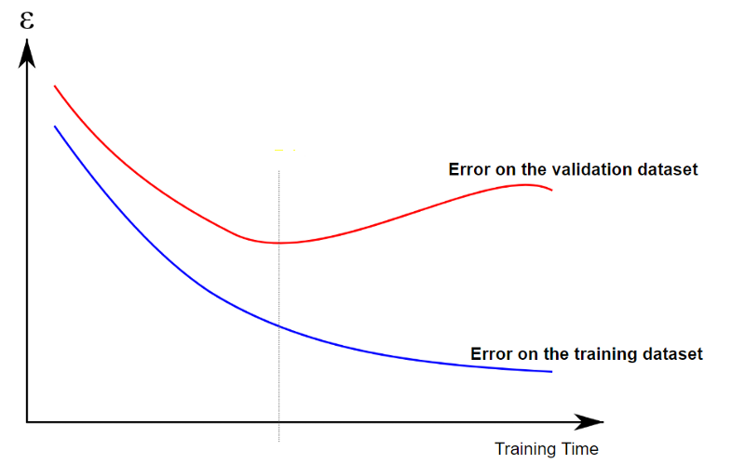
Model Overfitting
Underfitting: training and testing error rates will be high when the size of tree is very small.
As the number of nodes increases, fewer training and testing errors
When the tree becomes too large, the testing error starts increasing whereas training error continue to decrease.
Underfitting
Overfitting

Slide 52
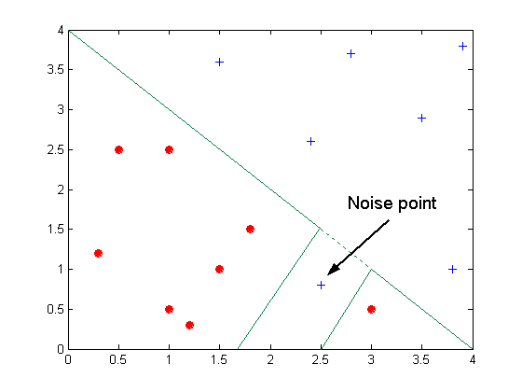
Overfitting due to Noise
Decision boundary is distorted due to noise.

Slide 53
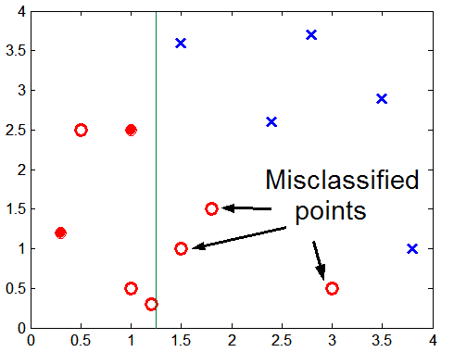
Overfitting due to Insufficient Samples
Lack of data points in the lower half of the diagram makes it difficult to predict correctly the class labels of that region.
Notes:
Lack of data points in the lower half of the diagram makes it difficult to predict correctly the class labels of that region
- Insufficient number of training records in the region causes the decision tree to predict the test examples using other training records that are irrelevant to the classification task

Slide 54
Occam’s Razor
Given two models of similar generalization errors, prefer the simpler model over the more complex model.
For complex models, there is a greater chance that it fitted accidentally by errors in data.
Therefore, model complexity should be considered when evaluating a model.

Slide 55
How to Control Overfitting?
Pre-Pruning (Early Stopping Rule)
  Stop the algorithm before it becomes a fully-grown tree
  Stop if number of instances is less than some user-specified threshold
  Stop if class distribution of instances are independent of the available features
  Stop if expanding the current node does not improve impurity
  measures (e.g., Gini or information gain).

Slide 56
How to Control Overfitting?
Post-pruning
  Grow decision tree to its entirety
  Trim the nodes of the decision tree in a bottom-up fashion
  If generalization error improves after trimming, replace sub-tree by a leaf node.
  Class label of leaf node is determined from majority class of instances in the sub-tree

Slide 57
Thank You

