Slide 1
Support Vector Machine (SVM)

Slide 2
SVM
An extremely powerful machine learning technique known as the Support Vector Machine (SVM).
It is one of the best "out of the box" classification techniques.
It is a supervised binary classification technique

Slide 3
Introduction
A Support Vector Machine (SVM) is a discriminative classifier formally defined by a separating hyperplane.
In other words, given labeled training data (supervised learning), the algorithm outputs an optimal hyperplane that categorizes new examples. In two-dimensional space, this hyperplane is a line dividing a plane into two parts where each class lies on either side.
The goal of the SVM algorithm is to create the best line or decision boundary that can segregate n-dimensional space into classes so that we can easily put the new data point in the correct category in the future. This best decision boundary is called a hyperplane.

Slide 4
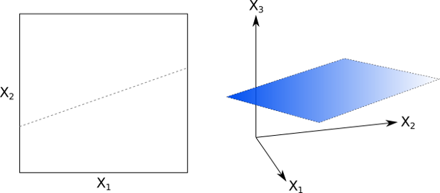
Hyperplane

Slide 5
Hyperplane and Support Vectors in the SVM algorithm:
Hyperplane:
There can be multiple lines/decision boundaries to segregate the classes in n-dimensional space, but we need to find out the best decision boundary that helps to classify the data points. This best boundary is known as the hyperplane of SVM.
The dimensions of the hyperplane depend on the features present in the dataset, which means if there are 2 features, then the hyperplane will be a straight line. And if there are 3 features, then the hyperplane will be a 2-dimension plane.
We always create a hyperplane that has a maximum margin, which means the maximum distance between the data points.
Support Vectors:
The data points that are the closest to the hyperplane and which affect the position of the hyperplane are termed as Support Vector. Since these vectors support the hyperplane, hence called a Support vector.

Slide 6
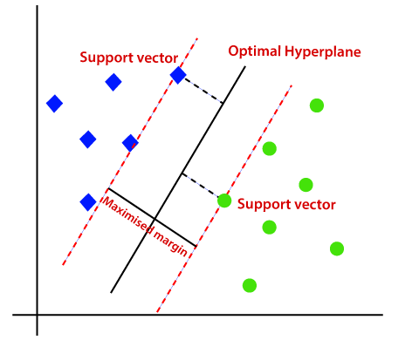
The distance between the support vectors and the hyperplane is called as margin.
The goal of SVM is to maximize this margin.
The hyperplane with maximum margin is called the optimal hyperplane.

Slide 7
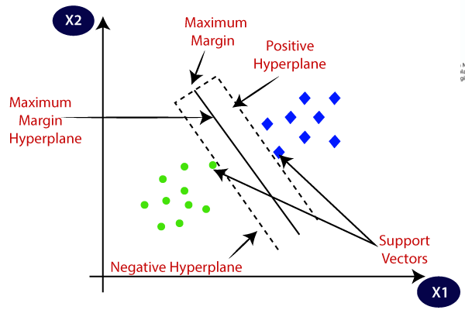
Consider the below diagram in which two different categories are classified using a decision boundary or hyperplane:

Slide 8
Using the dataset the algorithm finds a hyperplane which should ideally have the following properties:
It creates separation between examples of two classes with a maximum margin
Its equation (w.x + b = 0) yields a value ≥ 1 for examples from +ve class and ≤-1 for examples from -ve class
w is the normal direction of the plane and b is a form of threshold/bias.
Given a data point w, if w⋅x is evaluated to be bigger than b, it belongs to a +ve class. If it is evaluated to be less than b, then it belongs to another class.

Slide 9
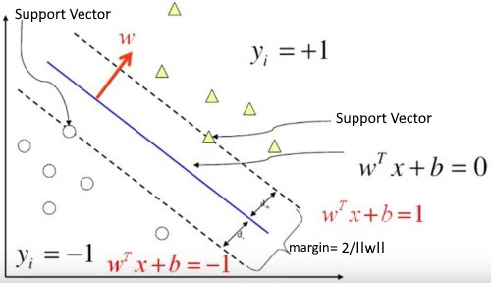

Slide 10
Constructing the classifier

Slide 11
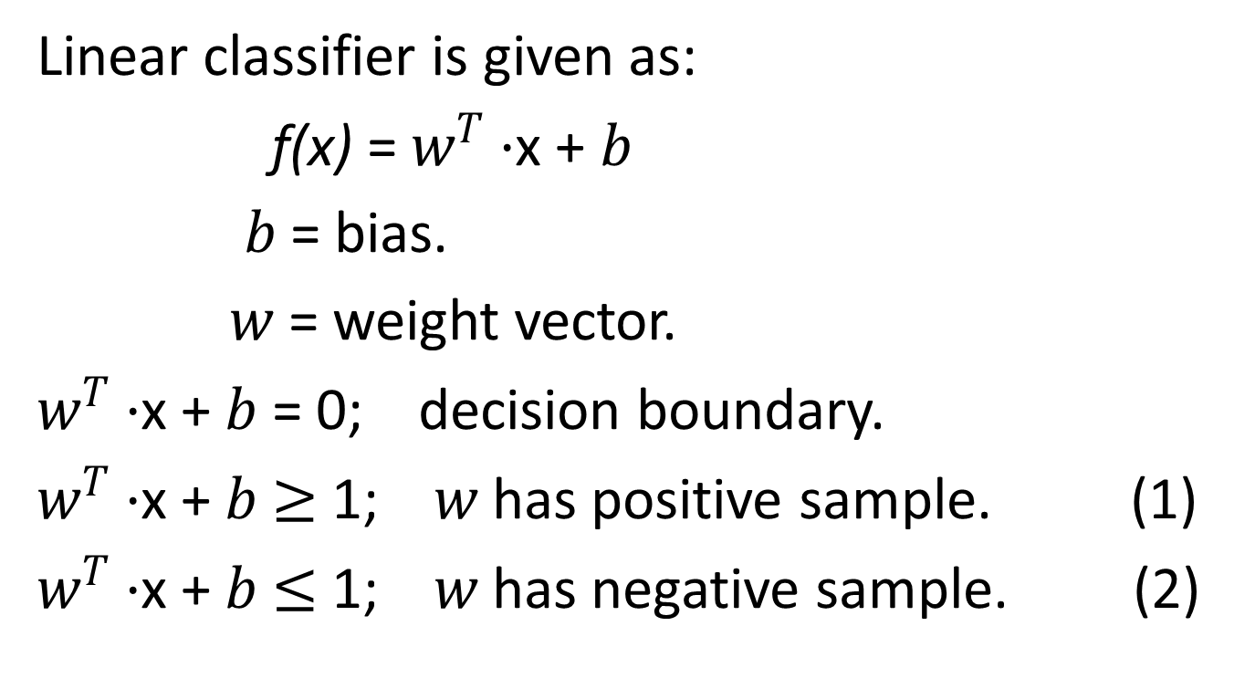
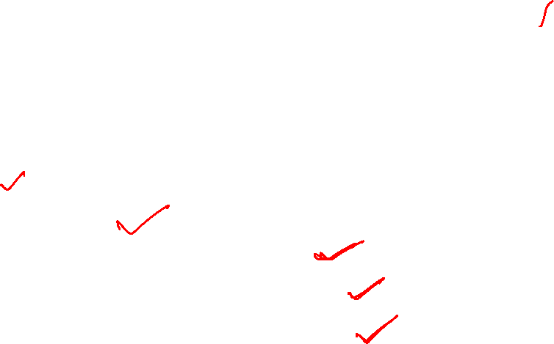
Constructing the classifier
Linear classifier is given as:
f(x) = $w^{T}·$x + $b$
$b$ = bias.
$w$ = weight vector.
$w^{T}·$x + $b$ = 0; decision boundary.
$w^{T}·$x + $b≥$ 1; $w$ has positive sample. (1)
$w^{T}·$x + $b≤$ 1; $w$ has negative sample. (2)

Slide 12
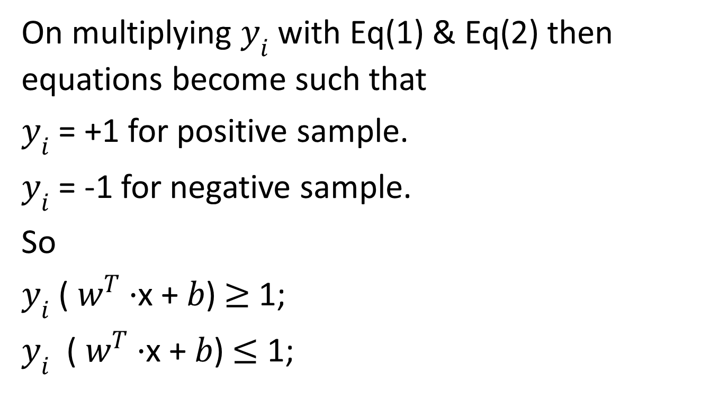
Constructing the classifier

Slide 13
Recall the distance from a point(x0,y0) to a line: Ax+By+c = 0 is:
|Ax +By +c| / sqrt(A2+B2),
so, The distance between H0 and H1 is then:
|w•x+b| / ||w||= 1 / ||w||,
so The total distance between H1 and H2 is thus: 2 / ||w||

Slide 14
Types of SVM
SVM can be of two types:
Linear SVM: Linear SVM is used for linearly separable data, which means if a dataset can be classified into two classes by using a single straight line, then such data is termed as linearly separable data, and classifier is used called as Linear SVM classifier.
Non-linear SVM: Non-Linear SVM is used for non-linearly separated data, which means if a dataset cannot be classified by using a straight line, then such data is termed as non-linear data and classifier used is called as Non-linear SVM classifier.

Slide 15
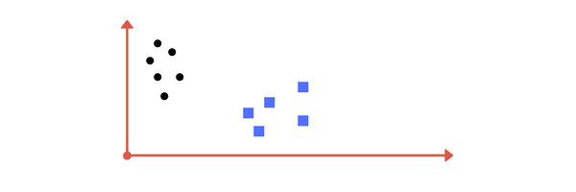
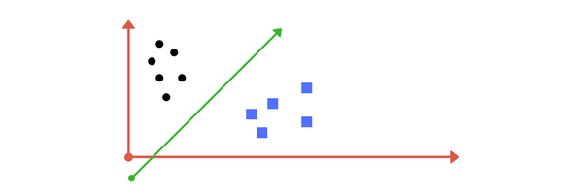
Suppose you are given plot of two label classes on graph as shown in image A. Can you decide a separating line for the classes?
        (A)
You might have come up with something similar to following image (b).
(b)
It fairly separates the two classes.

Slide 16
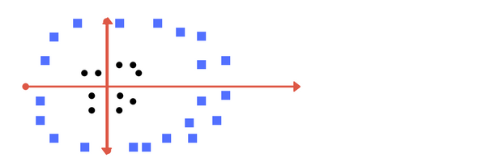
If any point that is left of line falls into black circle class and on right falls into blue square class.
Separation of classes?
That’s what SVM does. It finds out a line/ hyper-plane.
Now consider what if we had data as shown in image below?
Clearly, there is no line that can separate the two classes in this x-y plane. So what do we do?

Slide 17
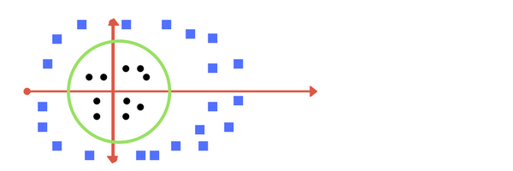
We apply transformation and add one more dimension as we call it z-axis. Let's assume value of points on z plane, w = x² + y².
In this case we can manipulate it as distance of point from z-origin. Now if we plot in z-axis, a clear separation is visible, and a line can be drawn .
It maps to circular boundary as shown in image.
These transformations are called kernels.

Slide 18
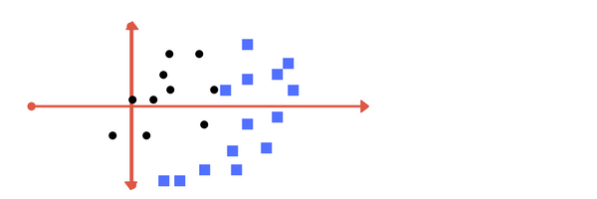
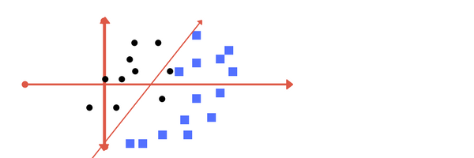
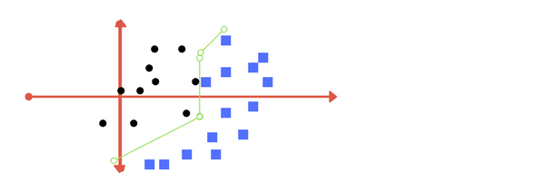
What if data plot overlaps? Or, what in case some of the black points are inside the blue ones?
Which line among 1 or 2?should we draw?
(1) (2)

Slide 19
Which one do you think? Well, both the answers are correct. The first one tolerates some outlier points. The second one is trying to achieve 0 tolerance with perfect partition.
But, there is trade off. In real world application, finding perfect class for millions of training data set takes lot of time.
There are tuning parameters in SVM classifier.
Kernel, Regularization, Gamma and Margin.

Slide 20
Advantages
High-Dimensionality - The SVM is an effective tool in high-dimensional spaces, which is particularly applicable to document classification and sentiment analysis where the dimensionality can be extremely large (≥10⁶).
Memory Efficiency - Since only a subset of the training points are used in the actual decision process of assigning new members, only these points need to be stored in memory (and calculated upon) when making decisions.
Versatility - Class separation is often highly non-linear. The ability to apply new kernels allows substantial flexibility for the decision boundaries, leading to greater classification performance.

Slide 21
Disadvantages
p>n - In situations where the number of features for each object (p) exceeds the number of training data samples (n), SVMs can perform poorly. This can be seen intuitively as if the high-dimensional feature space is much larger than the samples, then there are less effective support vectors on which to support the optimal linear hyperplanes, leading to poorer classification performance as new unseen samples are added.
Non-Probabilistic - Since the classifier works by placing objects above and below a classifying hyperplane, there is no direct probabilistic interpretation for group membership. However, one potential metric to determine the "effectiveness" of the classification is how far from the decision boundary the new point is.

Slide 22
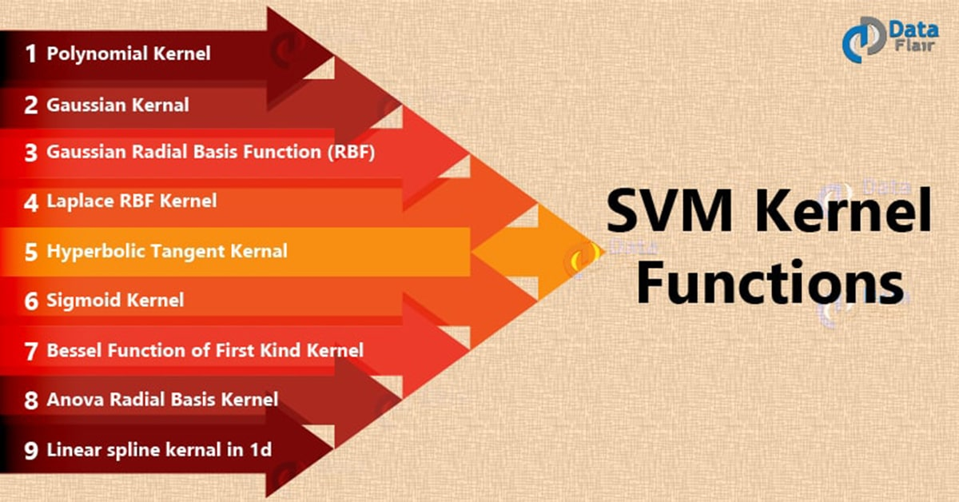
Kernel

Slide 23
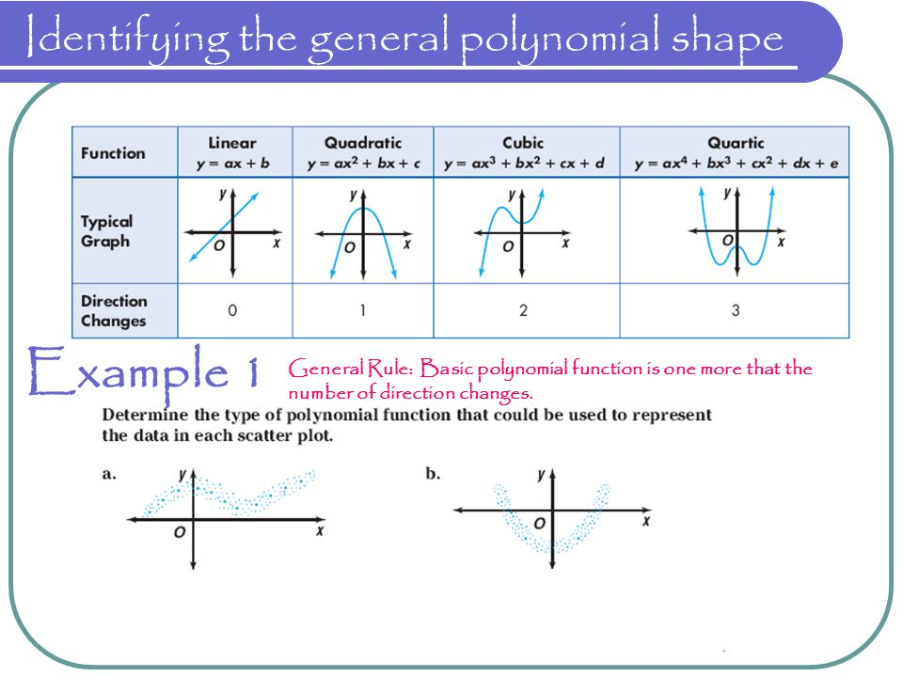
Shape of kernel functions

Slide 24
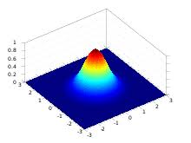
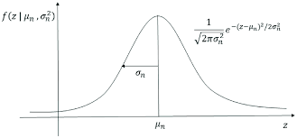
Gaussian Kernel (RBF)

Slide 25
Sigmoid Kernel
The Sigmoid Kernel comes from the Neural Networks field, where the bipolar sigmoid function is often used as an activation function for artificial neurons. It is interesting to note that a SVM model using a sigmoid kernel function is equivalent to a two-layer, perceptron neural network.
It is also known as The Hyperbolic Tangent Kernel
the slope alpha and the intercept constant c. A common value for alpha is 1/N, where N is the data dimension.

Slide 26
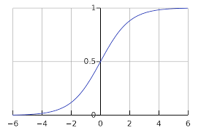
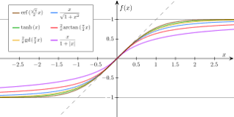
Sigmoid Kernel (activation in Neural Network)

Slide 27
Regularization
The Regularization parameter (often termed as C parameter in python’s sklearn library) tells the SVM optimization how much you want to avoid misclassifying each training example.
For large values of C: the optimization will choose a smaller-margin hyperplane if that hyperplane does a better job of getting all the training points classified correctly.
a very small value of C will cause the optimizer to look for a larger-margin separating hyperplane, even if that hyperplane misclassifies more points.

Slide 28
The images below (same as image 1 and image 2) are example of two different regularization parameter. Right one has some misclassification due to lower regularization value. Higher value leads to results like left one.
high regularization value low regularization value

Slide 29
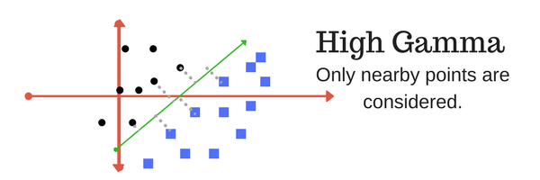
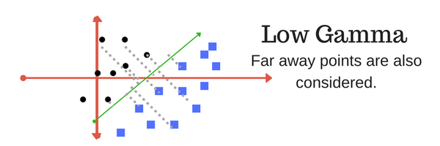
Gamma
The gamma parameter defines how far the influence of a single training example reaches, with low values meaning ‘far’ and high values meaning ‘close’. In other words, with low gamma, points far away from plausible seperation line are considered in calculation for the seperation line. Where as high gamma means the points close to plausible line are considered in calculation.

Slide 30
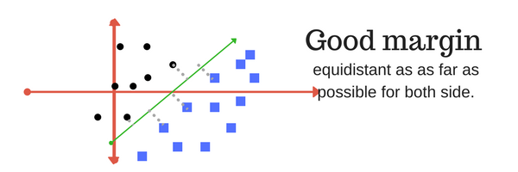
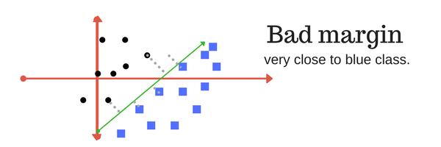
Margin
And finally last but very important characteristic of SVM classifier. SVM to core tries to achieve a good margin.
A margin is a separation of line to the closest class points.
A good margin is one where this separation is larger for both the classes. Images below gives to visual example of good and bad margin. A good margin allows the points to be in their respective classes without crossing to other class.

Slide 31
Applications of SVM in Real World
Face detection – SVM classify parts of the image as a face and non-face and create a square boundary around the face.
Text and hypertext categorization – SVMs allow Text and hypertext categorization for both inductive and transductive models. They use training data to classify documents into different categories. It categorizes on the basis of the score generated and then compares with the threshold value.
Classification of images – Use of SVMs provides better search accuracy for image classification. It provides better accuracy in comparison to the traditional query-based searching techniques.
Bioinformatics – It includes protein classification and cancer classification. We use SVM for identifying the classification of genes, patients on the basis of genes and other biological problems.
Protein fold and remote homology detection – Apply SVM algorithms for protein remote homology detection.
Handwriting recognition – We use SVMs to recognize handwritten characters used widely.

Slide 32
Python Code
# import support vector classifier
# "Support Vector Classifier"
from sklearn.svm import SVC
clf = SVC(kernel='linear')
# fitting x samples and y classes
clf.fit(x, y)

