Slide 1
Outlier Analysis

Slide 2
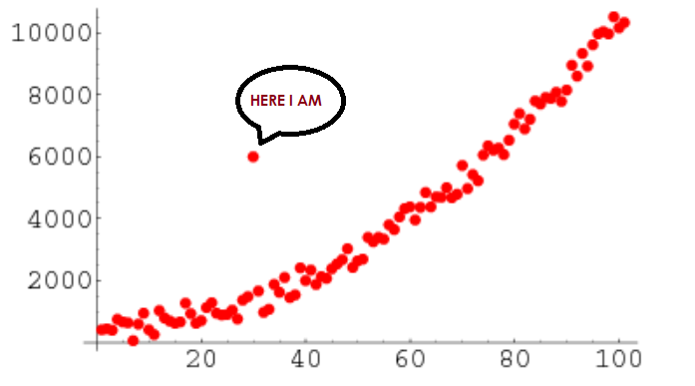
Outlier in data mining
“An Outlier is that observation which is significantly different from all other observations.”.
If you're going to analyze data sets for any task, you'll have to make some assumptions about how the data was generated.
If you locate certain data points that appear to be prone to error, these are unquestionably outliers, and depending on the context, you'll want to eliminate those errors.

Slide 3
Difference between outlier and Noise
An actual data point significantly outside a distribution’s mean or median is an outlier.
A Noise is a false data point made by a different process than the rest of the data.
An outlier is a valid data point, and can’t be ignored, whereas noise is garbage that needs removal. Let’s take another example to understand noise.
Suppose you wanted to take the average salary of employees and in data added the pay of Ratan Tata or Bill Gate, all the employer’s salary averages will show an increase which is incorrect data.

Slide 4

Z-Scores to detect outlier
We can calculate Z – Scores by the given formula where x is a random variable, μ is the mean, and σ is the standard deviation.
Why do we need Z-Scores to be calculated?
It helps to know how a single or individual value lies in the entire distribution.
For example, if the maths subject scores mean is given to us 82, the standard deviation σ is 4. We have a value of x as 75. Now Z-Scores will be calculated as 82-75/4 = 1.75.
It shows the value 75 with a z-score of 1.75 lies below the mean. It helps to determine whether values are higher, lower, or equal to the mean and how far.
DBSCAN
As the name indicates, the DBSCAN is on clustering. In this method, we calculate the distance between points.

Slide 5

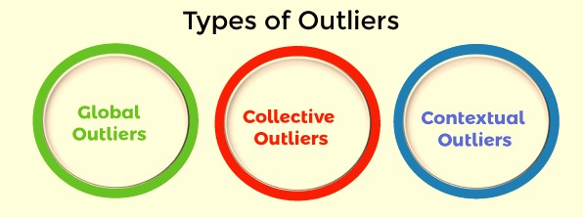
Types of Outlier
Outliers are divided into three different types

Slide 6
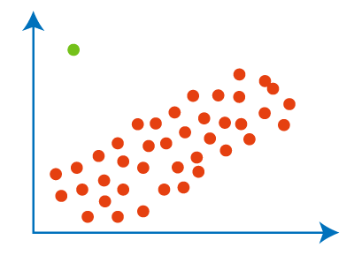
Global Outliers
Point outliers are another name for global
outliers.
Global outliers are the most basic type of outlier.
The global outlier is a data point that deviates from the rest of the data points in a given data set.
In the vast majority of circumstances, all outlier identification algorithms are aimed at identifying global outliers.
The global outlier is the green data point.

Slide 7
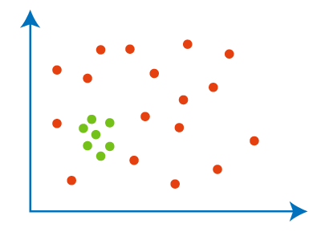
Collective Outlier
When a group of data points deviates from the rest of the data set, this is referred to as collective outliers.
The individual group of data objects may not be outliers in this case, but they may act like outliers when viewed as a whole.
To determine the different forms of outliers, you must first review background knowledge on the relationship between the behaviour of outliers displayed by various data objects.

Slide 8
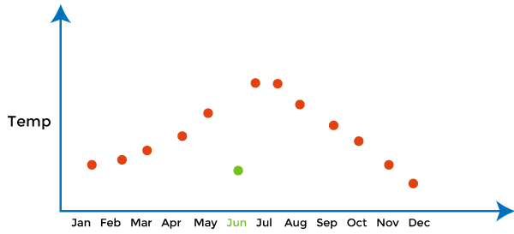
Contextual Outlier
The term "contextual" refers to the fact that this outlier was brought into a context.
The single background noise, for example, in the speech recognition approach.
Conditional outliers are another name for contextual outliers.
Outliers occur when a data object deviates from the other data points in a particular data set due to a specific condition.

Slide 9
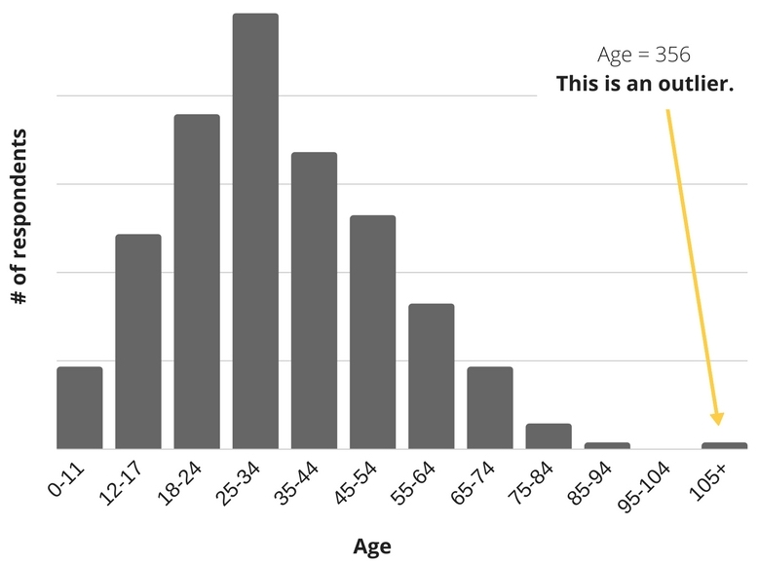
An analogy of Outliers in Real-life Examples,
Example-1: In a class, we have 100 students and one student who always scores marks on the higher side concerning other students; its score is not much dependent on the Difficulty level of the exam. So, here we consider that guy as an outlier.
Example-2: let’s have to find the average salary of a group of people and accidentally Bill Gates or Elon Musk-like people entered the group. So, think now about the average salary of new groups of people. Here average salary is not a true representation due to outliers.

Slide 10
How to Detect Outliers?
1. For Normal Distributions
Use empirical relations of Normal distribution.
The data points that fall below mean-3*(sigma) or above mean+3*(sigma) are outliers, where mean and sigma are the average value and standard deviation of a particular column.
2. For Skewed Distributions
Use Inter-Quartile Range (IQR) proximity rule.
The data points that fall below Q1 – 1.5 IQR or above the third quartile Q3 + 1.5 IQR are outliers, where Q1 and Q3 are the 25th and 75th percentile of the dataset, respectively. IQR represents the inter-quartile range and is given by Q3 – Q1.
3. For Other Distributions
Use a percentile-based approach.
For Example, data points that are far from the 99% percentile and less than 1 percentile are considered an outlier.

Slide 11
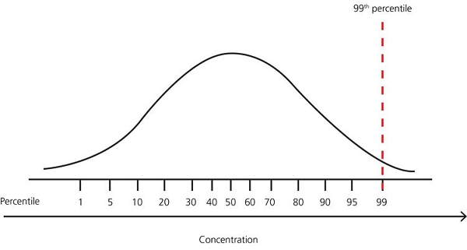

Slide 12
What is the advantage of removing outliers?
The benefit of removing outliers is to enhance the accuracy and stability of statistical models and ML algorithms by reducing their impact on results.
Outliers can distort statistical analyses and skew results as they are extreme values that differ from the rest of the data.
Removing outliers makes the results more robust and accurate by eliminating their influence. It reduces overfitting in ML algorithms by avoiding fitting to extreme values instead of the underlying data pattern.

