Slide 1
REGRESSION
Linear Regression and Logistic Regression

Slide 2
Regression
Regression model provides a target prediction value based on independent variables.
It is mostly used for finding out the relationship between variables and forecasting.
Different regression models differ based on – the kind of relationship between the dependent and independent variables, they are considering, and the number of independent variables being used.

Slide 3
Linear Regression vs Logistic Regression
Linear Regression and Logistic Regression are the two famous Machine Learning Algorithms which come under supervised learning technique.
Since both the algorithms are of supervised in nature hence these algorithms use labeled dataset to make the predictions. But the main difference between them is how they are being used.
Linear Regression is used for solving Regression problems
Logistic regression is basically used for solving classification problem, the target variable(or output), y, can take only discrete values for a given set of features(or inputs), X.

Slide 4
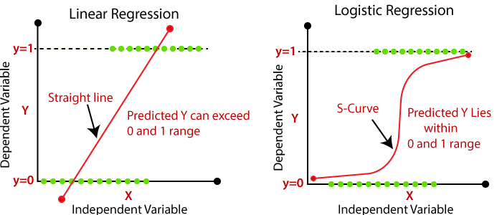

Slide 5
Linear Regression
It is used for predicting the continuous dependent variable with the help of independent variables.
The goal of the Linear regression is to find the best fit line that can accurately predict the output for the continuous dependent variable.
If single independent variable is used for prediction, then it is called Simple Linear Regression and if there are more than two independent variables then such regression is called as Multiple Linear Regression.
By finding the best fit line, algorithm establish the relationship between dependent variable and independent variable. And the relationship should be of linear nature.
The output for Linear regression should only be the continuous values such as price, age, salary, etc. The relationship between the dependent variable and independent variable can be shown in image.

Slide 6
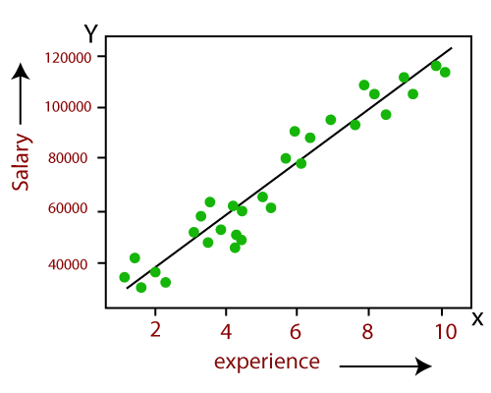
In image the dependent variable is on Y-axis (salary) and independent variable is on x-axis(experience). The regression line can be written as:
y= b0+b1x+ ε
x: input training data (univariate – one input variable(parameter))
y: labels to data (supervised learning)
When training the model – it fits the best line to predict the value of y for a given value of x.
The model gets the best regression fit line by finding the best a0 and a1 values.
b0: intercept
b1: coefficient of x
ε is the error term.

Slide 7
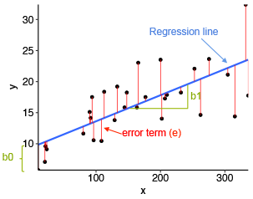

Slide 8
Hypothesis
Here, we plug θ^{T}x into the linear function where θ are the weights and x is the input and h_{θ}(x) is the hypothesis function.
Linear regression hypothesis.
Formula Y=b0+b1x
b1 = Σ [ (x_{i} - x’)(y_{i} - y’) ] / Σ [ (x_{i} - x’)²] = 69/9 / 114/9 = 23/38
b0 = y’ - b1 * x’ = (2/3) – (23/38) * (2/3) = 0.26
Y= 0.26 + 0.60 X y at x=5? Y=0.26 +0.60 * 5 = 3.26

Slide 9
R square or coefficient of determination
R-squared is a statistical measure of how close the data are to the fitted regression line.
This correlation, known as the "goodness of fit," is represented as a value between 0.0 and 1.0.
0% indicates poor data fitness.
If we can predict our y variable correctly then we would have R square of 1.
Usually the R square of . 70 is considered good.

Slide 10
How well does the regression equation fit the data?
Coefficient of Determination
One way to assess fit is to check the coefficient of determination, which can be computed from the following formula.
R² = { ( 1 / N ) * Σ [ (x_{i} - x’) * (y_{i} - y’) ] / (σ_{x} * σ_{y} ) }²
standard deviation of x (σ_{x}):
σ_{x} = sqrt [ Σ ( x_{i} - x’)² / N ]
Next, we find the standard deviation of y, (σ_{y}):
σ_{y} = sqrt [ Σ ( y_{i} - y’)² / N ]

Slide 11
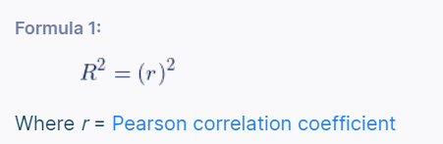
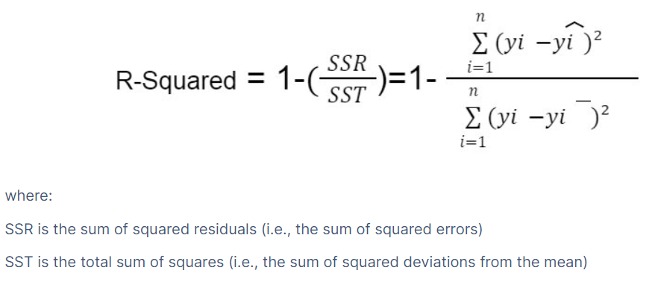
Formula 1: Using the correlation coefficient
Formula 2: Using the regression outputs
y_{i}^ represents Predicted value
yi– represents the average(mean)
yi represents the actual value.

Slide 12
An R2 of 0 means that the dependent variable cannot be predicted from the independent variable.
An R2 of 1 means the dependent variable can be predicted without error from the independent variable.
An R2 between 0 and 1 indicates the extent to which the dependent variable is predictable.
An R2 of 0.10 means that 10 percent is predictable from X;
an R2 of 0.20 means that 20 percent is predictable; and so on.

Slide 13
Question 1
Last year, five randomly selected students took a math aptitude test before they began their statistics course. The Statistics Department has three questions.
What linear regression equation best predicts statistics
performance, based on math aptitude scores?
If a student made an 80 on the aptitude test, what grade
would we expect her to make in statistics?
How well does the regression equation fit the data?
In the table below, the x_{i} column shows scores on the aptitude test. Similarly, the y_{i} column shows
statistics grades.
Student | x_{i} | y_{i}
1 | 95 | 85
2 | 85 | 95
3 | 80 | 70
4 | 70 | 65
5 | 60 | 70

Slide 14
Student | x_{i} | y_{i} | (x_{i}-x) | (y_{i}-y) | (x_{i}-x)² | (y_{i}-y)² | (x_{i}-x)(y_{i}-y)
1 | 95 | 85 | 17 | 8 | 289 | 64 | 136
2 | 85 | 95 | 7 | 18 | 49 | 324 | 126
3 | 80 | 70 | 2 | -7 | 4 | 49 | -14
4 | 70 | 65 | -8 | -12 | 64 | 144 | 96
5 | 60 | 70 | -18 | -7 | 324 | 49 | 126
Sum | 390 | 385 |  |  | 730 | 630 | 470
Mean | X=78 | Y=77

Slide 15
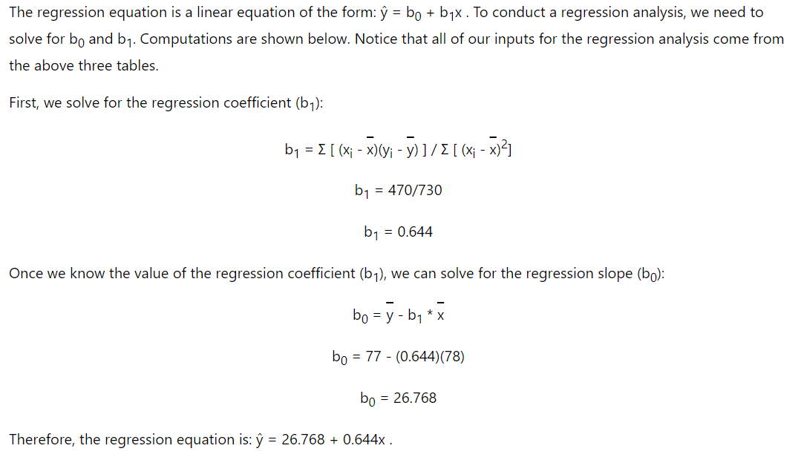

Slide 16
If a student made an 80 on the aptitude test, the estimated statistics grade (Y) would be:
Y = b₀ + b₁x
Y = 26.768 + 0.644x = 26.768 + 0.644 * 80
Y = 26.768 + 51.52 = 78.288
Coefficient of Determination
R² = { ( 1 / N ) * Σ [ (x_{i} - x) * (y_{i} - y) ] / (σ_{x} * σ_{y} ) }²
Computations for the sample problem of this lesson are shown below. We begin by computing the standard deviation of x (σ_{x}):
σ_{x} = sqrt [ Σ ( x_{i} - x )² / N ]
σ_{x} = sqrt( 730/5 ) = sqrt(146) = 12.083
Next, we find the standard deviation of y, (σ_{y}):
σ_{y} = sqrt [ Σ ( y_{i} - y )² / N ]
σ_{y} = sqrt( 630/5 ) = sqrt(126) = 11.225

Slide 17
And finally, we compute the coefficient of determination (R²):
R² = { ( 1 / N ) * Σ [ (x_{i} - x) * (y_{i} - y) ] / (σ_{x} * σ_{y} ) }²
R² = [ ( 1/5 ) * 470 / ( 12.083 * 11.225 ) ]²
R² = ( 94 / 135.632 )² = ( 0.693 )² = 0.48
A coefficient of determination equal to 0.48 indicates that about 48% of the variation in statistics grades (the dependent variable) can be explained by the relationship to math aptitude scores (the independent variable).

Slide 18
Question 2
Consider the following set of points: {(-2 , -1) , (1 , 1) , (3 , 2)}
a) Find the regression line for the given data points.
b) Plot the given points and the regression line in the same rectangular system of axes.
Question 3
Find the regression line for the following set of data
{(2 , 3),(4 , 7),(6 , 5),(8 , 10)}
b) Plot the given points and the regression line in the same rectangular system of axes.

Slide 19
Why Logistic Regression in Classification?
Using Linear Regression, all predictions >= 0.5 can be considered as 1 and the rest all < 0.5 can be considered as 0. But then the question arises as to why classification can’t be performed using it?
Problem –
Suppose we are classifying a mail as spam or not spam and our output is y, it can be 0(spam) or 1(not spam). In case of Linear Regression, h_{θ}(x) can be > 1 or < 0. Although our prediction should be in between 0 and 1, the model will predict value out of the range i.e. maybe > 1 or < 0.
So, that’s why for a Classification task, Logistic/Sigmoid Regression plays its role.

Slide 20
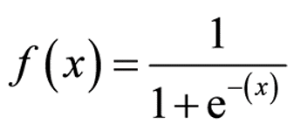
Sigmoid Function
Earlier we spoke about mapping values to probabilities. This can be achieved by calling the sigmoid function, which will map any real value into another value between 0 and 1. Machine learning uses this function to map predictions to probabilities.
Mathematically,
Where, f(x) = output between 0 and 1 (probability estimate)

Slide 21
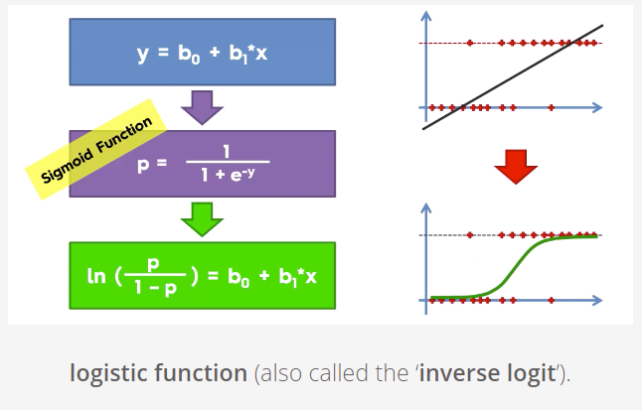

Slide 22
Logistic Regression:
Logistic regression is used to predict the categorical dependent variable with the help of independent variables.
Logistic regression can be used where the probabilities between two classes is required. Such as whether it will rain today or not, either 0 or 1, true or false etc.
Logistic regression is based on the concept of Maximum Likelihood estimation. According to this estimation, the observed data should be most probable.
In logistic regression, we pass the weighted sum of inputs through an activation function that can map values in between 0 and 1. Such activation function is known as sigmoid function and the curve obtained is called as sigmoid curve or S-curve. Consider the below image:

Slide 23
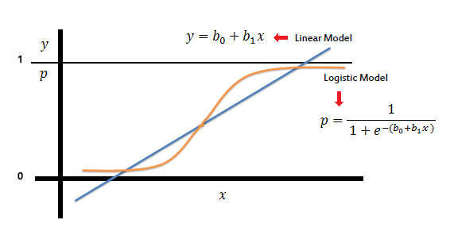

Slide 24



In the logistic regression the constant (b₀) moves the curve left and right and the slope (b₁) defines the steepness of the curve. By simple transformation, the logistic regression equation can be written in terms of an odds ratio.
Finally, taking the natural log of both sides, we can write the equation in terms of log-odds (logit) which is a linear function of the predictors. The coefficient (b₁) is the amount the logit (log-odds)
changes with a one-unit change in x.

Slide 25
As mentioned before, logistic regression can handle any number of numerical and/or categorical variables.

Slide 26
Linear Regression | Logistic Regression
Linear regression is used to predict the continuous dependent variable using a given set of independent variables. | Logistic Regression is used to predict the categorical dependent variable using a given set of independent variables.
Linear Regression is used for solving Regression problem. | Logistic regression is used for solving Classification problems.
In Linear regression, we predict the value of continuous variables. | In logistic Regression, we predict the values of categorical variables.
In linear regression, we find the best fit line, by which we can easily predict the output. | In Logistic Regression, we find the S-curve by which we can classify the samples.
Least square estimation method is used for estimation of accuracy. | Maximum likelihood estimation method is used for estimation of accuracy.
The output for Linear Regression must be a continuous value, such as price, age, etc. | The output of Logistic Regression must be a Categorical value such as 0 or 1, Yes or No, etc.
In Linear regression, it is required that relationship between dependent variable and independent variable must be linear. | In Logistic regression, it is not required to have the linear relationship between the dependent and independent variable.
In linear regression, there may be collinearity between the independent variables. | In logistic regression, there should not be collinearity between the independent variable.

