Slide 1
Model Selection and Assessment Lecture 10

Slide 2
Goal
Model Selection
Model Assessment

Slide 3
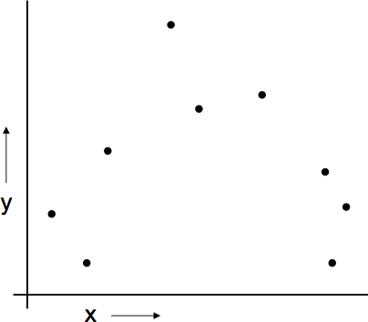
A Regression Problem
y = f(x) + noise
Can we learn f from this data?
Let’s consider three methods...
3

Slide 4
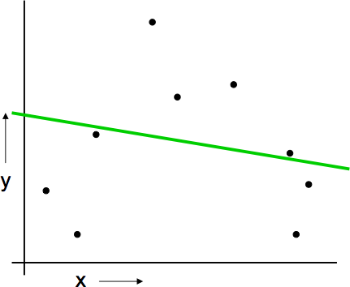
Linear Regression

Slide 5
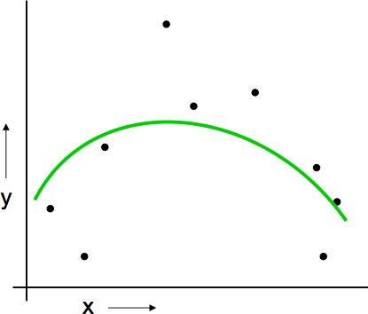
Quadratic Regression

Slide 6
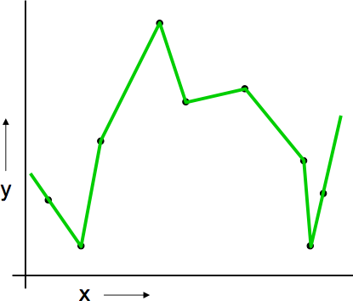
Joining the dots

Slide 7
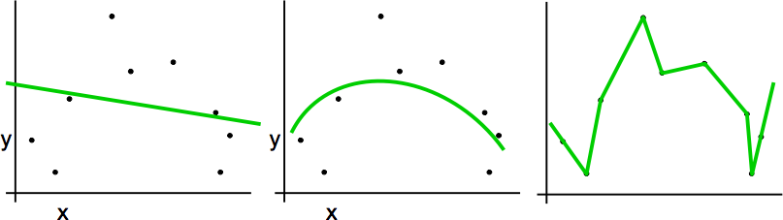
Which is best?
Why not choose the method with the best fit to the data?
“How well are you going to predict future data drawn from the same distribution?”
7

Slide 8
Model Selection and Assessment
Model Selection: Estimating performances of different models to choose the best one (produces the minimum of the test error).
Model Assessment: Having chosen a model, estimating the prediction error on new data.

Slide 9
Why Errors
Why do we want to study errors?
In a data-rich situation split the data:
Train | Validation | Test
Model Selection Model assessment
But, that’s not usually the case

Slide 10
Overall Motivation
Errors
Measurement of errors (Loss functions)
Decomposing Test Error into Bias & Variance
Estimating the true error
Estimating in-sample error (analytically )
Estimating extra-sample error (efficient sample reuse)
Cross Validation
Bootstrapping

Slide 11
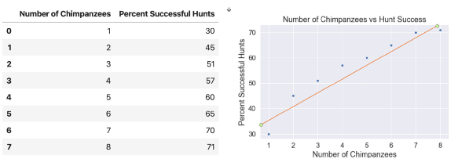
Principles of Linear Regression
Linear regression is a method for predicting y from x. In our case, y is the dependent variable, and x is the independent variable.
We want to predict the value of y for a given value of x. Now, if the data were perfectly linear, we could simply calculate the slope-intercept form of the line in terms y = mx+ b.
To predict y, we would just plug in the given values of x and b.

Slide 12
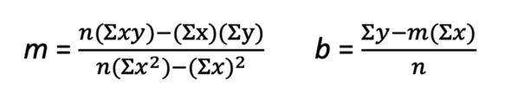
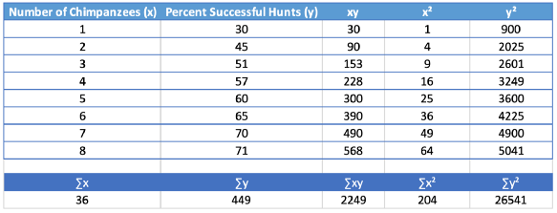

Slide 13
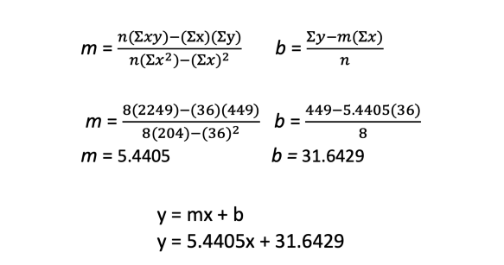
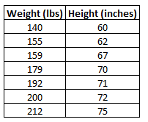

Slide 14
Solution:
How to Interpret a Simple Linear Regression Equation
Here is how to interpret this estimated linear regression equation:
ŷ = 0.2001x + 32.783
b₀ = 32.7830. When weight is zero pounds, the predicted height is 32.783 inches.

Slide 15


Measuring Errors: Loss Functions
Typical regression loss functions
Squared error:
Absolute error:

Slide 16
Overfitting - Underfitting
If the model does much better on the training dataset than on the test dataset, then it is likely a situation of overfitting.
For example, any model performed with a 99% accuracy on the training dataset but only 50-55% accuracy on the test dataset. It is Overfitting the model and did not perform well on unseen dataset.
If the model does much better on the test dataset than on the training dataset, then it is likely underfitting.

Slide 17
Cross Validation
Cross-validation is a powerful preventative measure against overfitting.
Use the initial training data to generate multiple mini train-test splits. Use these splits to tune the model.
In standard k-fold cross-validation, the data is partitioned into k subsets, called folds.
Then, we iteratively train the algorithm on k-1 folds while using the remaining fold as the test set (called the “holdout fold”).
Cross-validation allows you to tune hyperparameters with only your original training dataset. This allows you to keep your test dataset as a truly unseen dataset for selecting your final model.

Slide 18
Cross-Validation
test
train
K-fold
……
1
N
( i
, f (x_{i},α))
CV (α) =
∑
i=1
ˆ −κ (i)
L y
N

Slide 19
How many folds?
Computation increases
Variance decreases
bias decreases
k fold
Leave-one-out
k increases

Slide 20
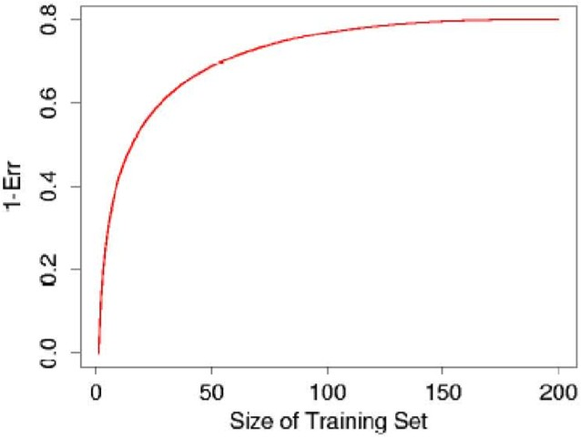
Cross-Validation: Choosing K
Popular choices for K: 5,10,N
18

Slide 21
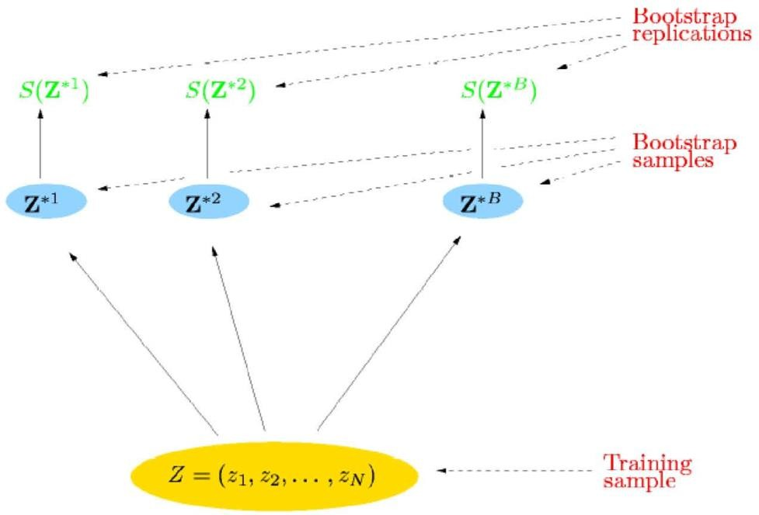
Bootstrap: Main Concept
“The bootstrap is a computer-based method
of statistical inference that can answer many real
statistical questions without formulas”
(An Introduction to the Bootstrap, Efron and Tibshirani, 1993)
Step 2: Calculate the
statistic
Step 1: Draw samples with replacement

Slide 22
Bootstrap
Allows to calculate the standard errors when no formula is available.
Allows to calculate the standard errors when assumptions are not met.

Slide 23
Why Bootstrap
The bootstrap uses computer simulation.
But, unlike the simulations that drew observations from a
hypothetical world, the bootstrap:
draws observations only from the own sample (not a hypothetical world)
makes no assumptions about the underlying distribution in the
population.

Slide 24
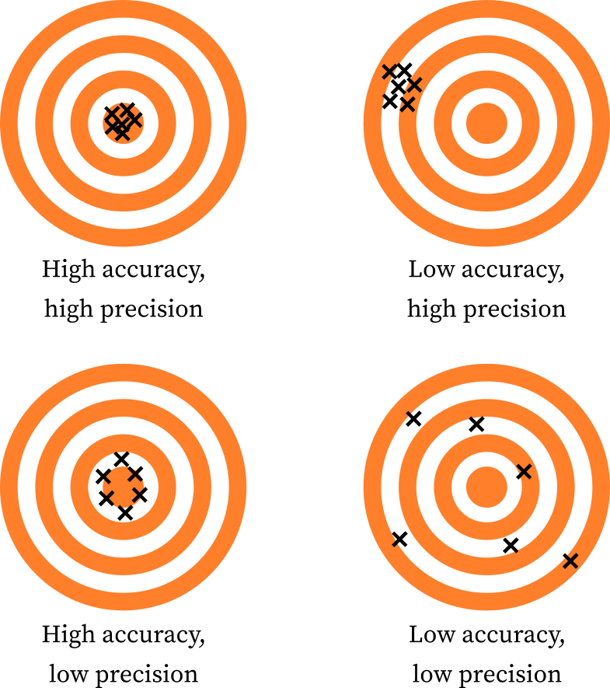
Accuracy & Precision

Slide 25
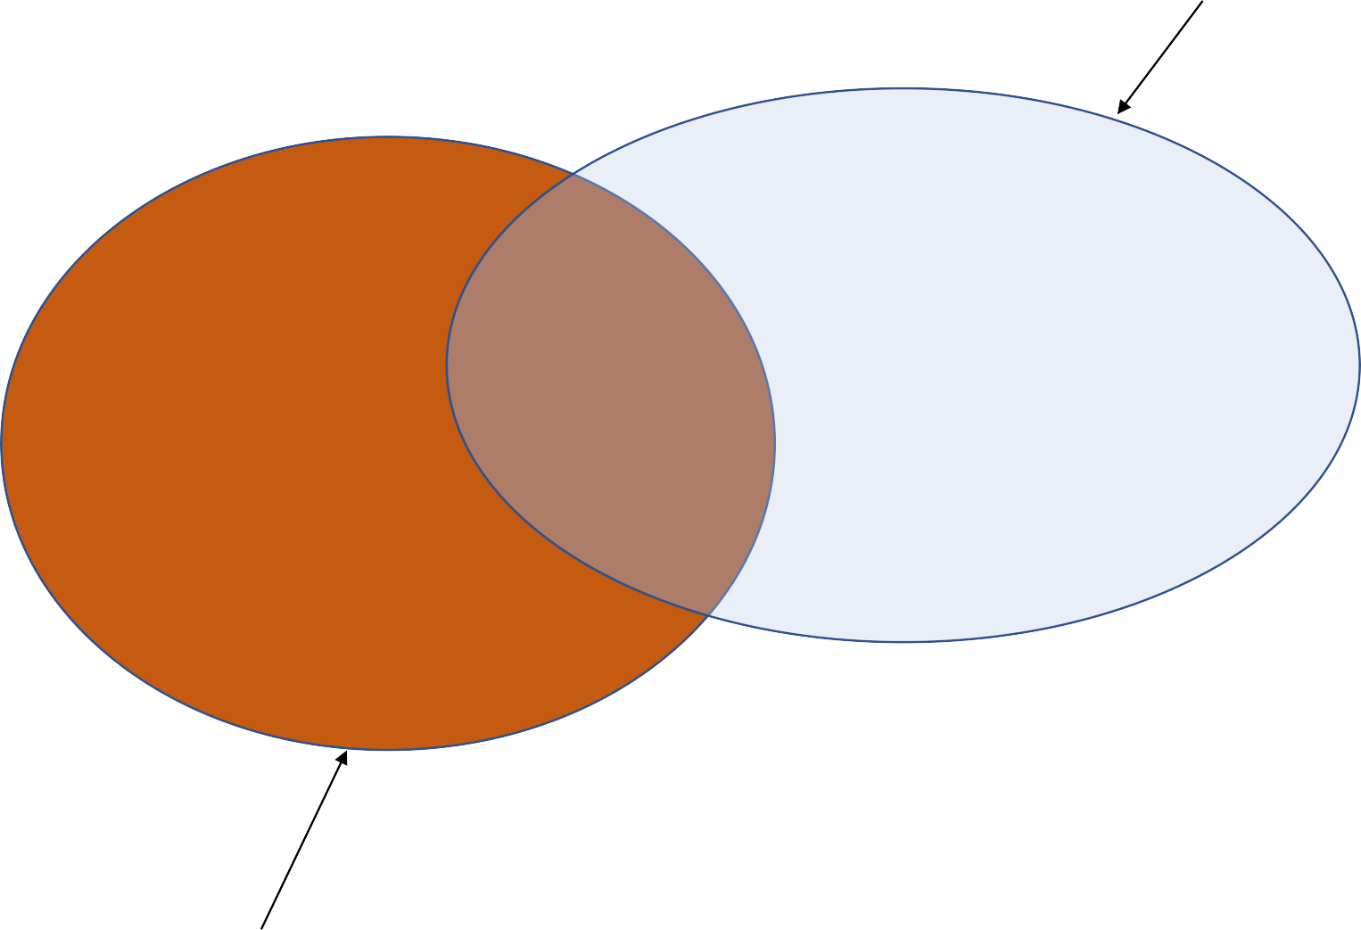
Precision & Recall
The set of items retrieved
The set of relevant items in the dataset

Slide 26

Precision & Recall
The set of items retrieved
The set of relevant items that is retrieved
The set of relevant items in the dataset

Slide 27
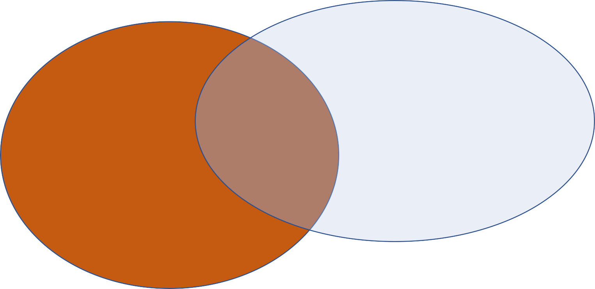
Precision & Recall
C
A
B
Precision = [A / (A+C)]
Recall = [A / (A+B)]
F-Score = the harmonic mean of precession and recall
= 2 * Recall * Precision / (Precision + Recall)
25

Slide 28
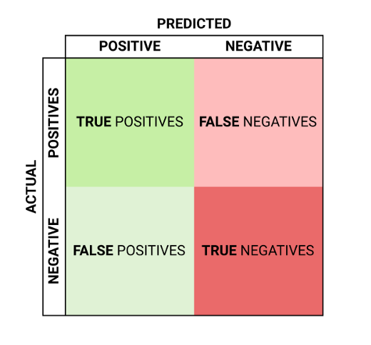
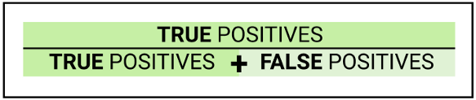
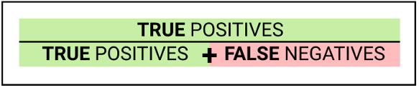
Precision
Precision is calculated by dividing the true positives by anything that was predicted as a positive.
Recall
Recall (or True Positive Rate) is calculated by dividing the true positives by anything that should have been predicted as positive.
Confusion Matrix
Accuracy=TP+TN/(TP+TN+FP+FN)

Slide 29
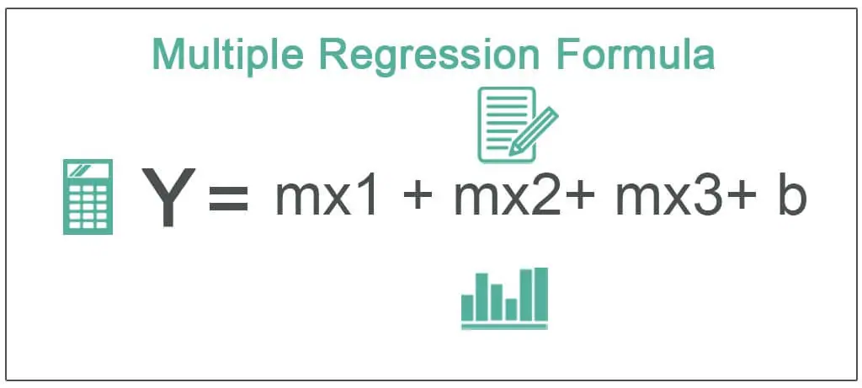
Multiple Regression

