Slide 1
Data Mining and Predictive Modelling
Lecture 4: Data Pre-Processing

Slide 2
Data Preprocessing
Data Quality
Tasks in Data Preprocessing
- Data Cleaning
- Data Integration
- Data Reduction
- Data Transformation and Data Discretization

Slide 3
Data Quality (Measures)
Accuracy: correct or wrong, accurate or not
Completeness: not recorded, unavailable, …
Consistency: some modified but some not, dangling, …
Timeliness: timely update?
Believability: how trustable the data are correct?
Interpretability: how easily the data can be understood?

Slide 4
Tasks in Data Preprocessing
Data Cleaning
Fill in missing values, smooth noisy data, identify or remove outliers, and resolve inconsistencies
Data Integration
Integration of multiple databases, data cubes, or files
Data reduction
Dimensionality reduction
Numerosity reduction
Data compression
Data transformation and data discretization
Normalization
Concept hierarchy generation

Slide 5
Data Cleaning
The real-world data is highly dirty such as:
Incomplete: lacking attribute values, lacking certain attributes of interest, or containing only
aggregate data
E.g., Profession=“ ” (missing data)
Noisy: containing noise, errors, or outliers
E.g., salary= ‘-10’ (an error)
Inconsistent: containing discrepancies in codes or names, e.g.,
Discrepancy between duplicate records
Was rating “1,2,3”, given rating “A,B,C”
Intentional (e.g., disguised missing data)
Jan. 1 as everyone’s birthday?

Slide 6
Incomplete (Missing) Data
Data is not always available
E.g., many tuples have no recorded value for several attributes, such as customer income in sales data
Missing data may be due to
Equipment malfunction
Inconsistent with other recorded data and thus deleted
Data not entered due to misunderstanding
Certain data my not be considered important at the time of entry
Not register history or changes of the data
Missing data may need to be inferred

Slide 7
Handling missing data
Ignore the tuple, usually done when class label is missing (when doing classification)— not effective when the % of missing values per attribute varies considerably
Fill in the missing value manually: tedious + infeasible?
Fill in it automatically with
a global constant : e.g., “unknown”, a new class?!
the attribute mean
the attribute mean for all samples belonging to the same class: smarter
the most probable value: inference-based such as Bayesian formula or decision tree

Slide 8
Noise: random error or variance in a measured variable
Incorrect attribute values may be due to
faulty data collection instruments
data entry problems
data transmission problems
technology limitation
inconsistency in naming convention
Noisy Data
Other data problems which require data cleaning
duplicate records
incomplete data
inconsistent data

Slide 9
Binning
first sort data and partition it into (equal-frequency) bins
then one can smooth by bin means, smooth by bin median, smooth by bin boundaries, etc.
Regression
smooth by fitting the data into regression functions
Clustering
detect and remove outliers
Combined computer and human inspection
detect suspicious values and check by human (e.g., deal with possible outliers)
Handling Noisy Data

Slide 10
Data discrepancy detection
Use metadata (e.g., domain, range, dependency, distribution)
Check field overloading
Check the uniqueness rule, consecutive rule, and null rule
Use commercial tools-
Data scrubbing: use simple domain knowledge (e.g., postal code, spell-check) to detect errors and make corrections
Data auditing: by analyzing data to discover rules and relationships to detect violators (e.g., correlation and clustering to find outliers)
Data migration and integration
Data migration tools: allow transformations to be specified
ETL (Extraction/Transformation/Loading) tools: allow users to
specify transformations through a graphical user interface
Data Cleaning as a Process
Integration of the two processes
Iterative and interactive

Slide 11
Data Integration

Slide 12
Data integration:
Combines data from multiple sources into a coherent store
Schema integration: e.g., A.cust-id ≡ B.cust-#
Integrate metadata from different sources
Entity identification problem:
Identify real world entities from multiple data sources
Detecting and resolving data value conflicts
For the same real world entity, attribute values from different sources are different
Possible reasons: different representations,
different scales, e.g., metric vs. British units
Data Integration

Slide 13
multiple databases
Redundant data occur often when integration of
Handling Redundancy in Data Integration
Object identification: The same attribute or object may have different names in different databases
Derivable data: One attribute may be a “derived” attribute in another table, e.g., annual revenue
Redundant attributes may be able to be detected by correlation analysis and covariance analysis
Careful integration of the data from multiple sources may help reduce/avoid redundancies and inconsistencies and improve mining speed and quality

Slide 14
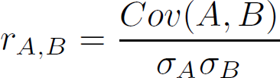
Covariance (Numeric Data)
Covariance is similar to correlation
Correlation coefficient:
where n is the number of tuples, $\overline{A}$ and $\overline{B}$are the respective mean or expected values of A and B, σ_{A} and σ_{B} are the respective standard deviation of A and B.
Positive covariance: If Cov_{A,B} > 0, then A and B both tend to be larger than their expected values.
Negative covariance: If Cov_{A,B} < 0 then if A is larger than its expected value, B is likely to be
smaller than its expected value.
Independence -> Cov_{A,B} = 0 but the converse is not true:
Some pairs of random variables may have a covariance of 0 but are not independent. Only under some additional assumptions (e.g., the data follow multivariate normal distributions) does a covariance of 0 imply independence
16

Slide 15
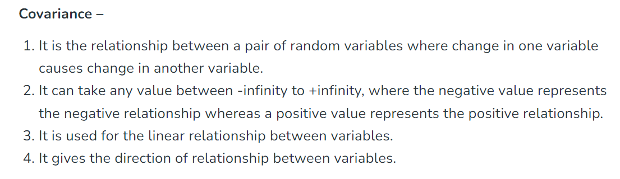
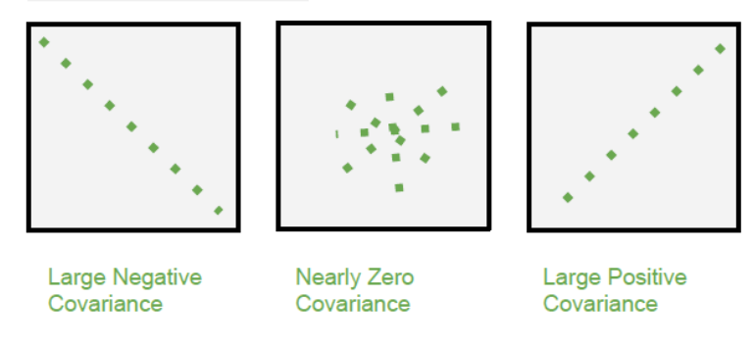
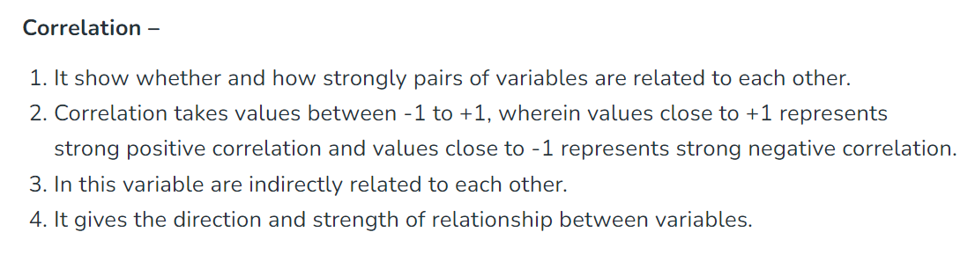
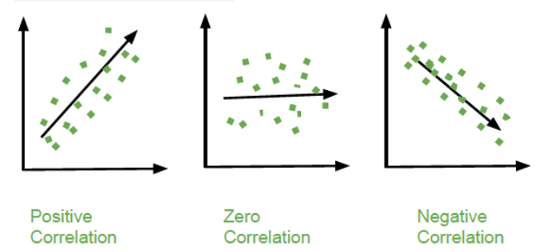
Correlation and Covariance Difference

Slide 16
Correlation Analysis
Correlation analysis is a statistical technique for determining the strength of a relationship between two variables.
It is used to detect patterns and trends in data and to forecast future occurrences.
Correlation explains how these variables are dependent on each other.
Correlation quantifies how strong the relationship between two variables is. A higher value of the correlation coefficient implies a stronger association.
The sign of the correlation coefficient indicates the direction of the relationship between variables. It can be either positive, negative, or zero.

Slide 17
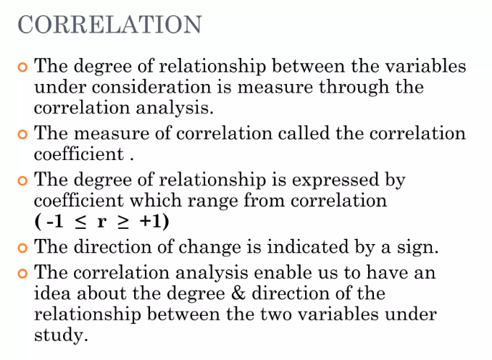

Slide 18
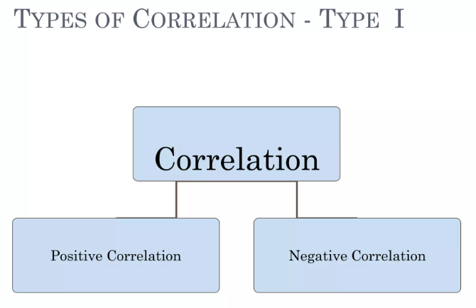

Slide 19
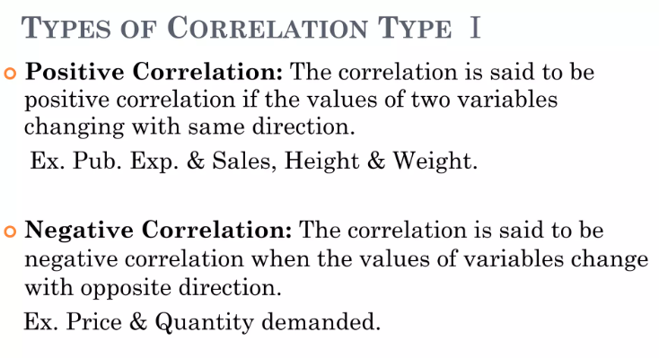

Slide 20
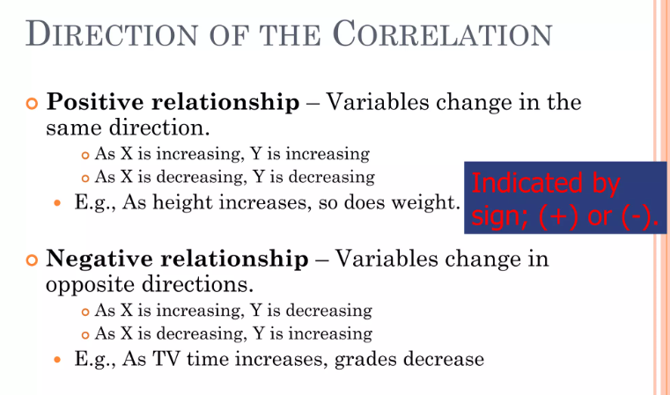

Slide 21
Example
Water consumption and Temperature
Alcohol consumption and Driving ability
Study time and grades
Price and Quantity Demanded

Slide 22
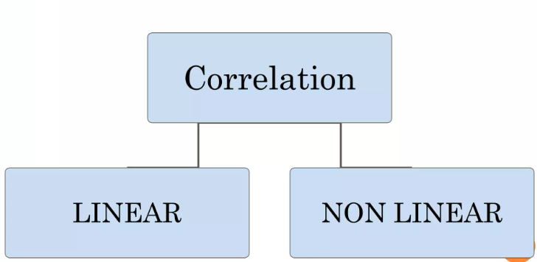
Types of Correlation – Type II

Slide 23
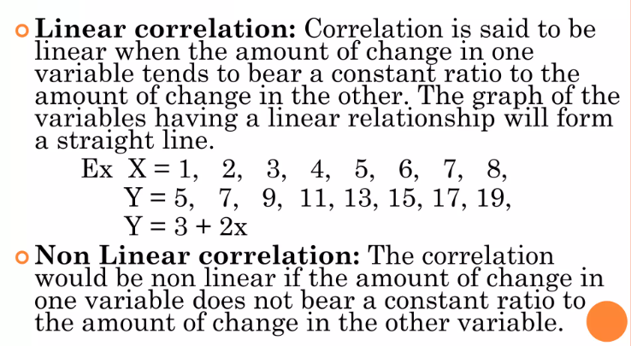

Slide 24
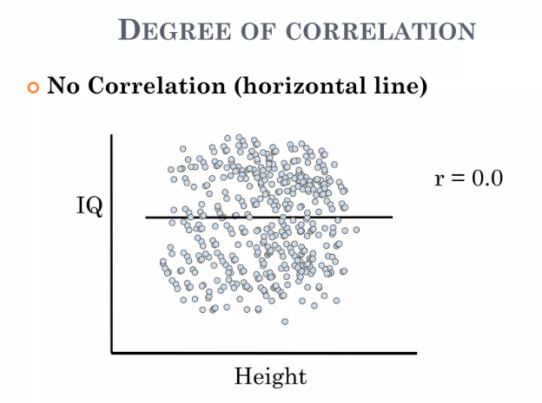
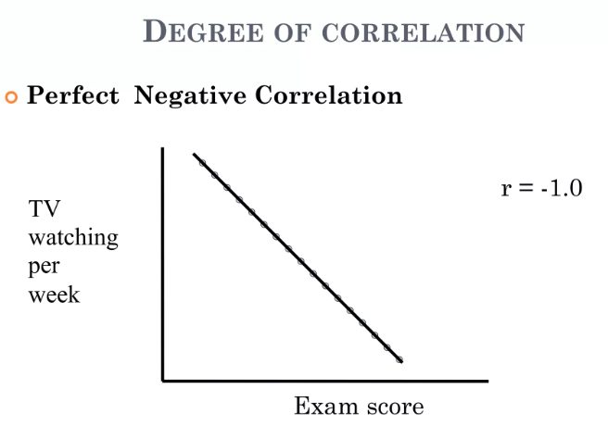
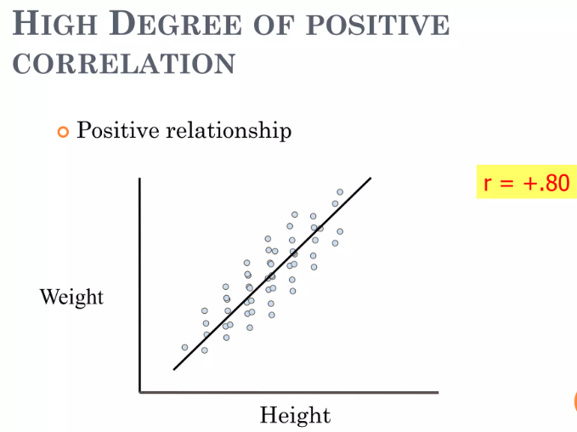
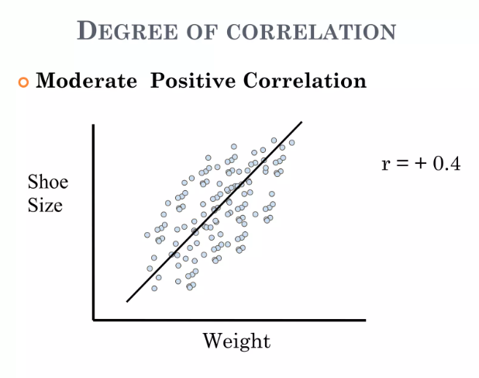

Slide 25
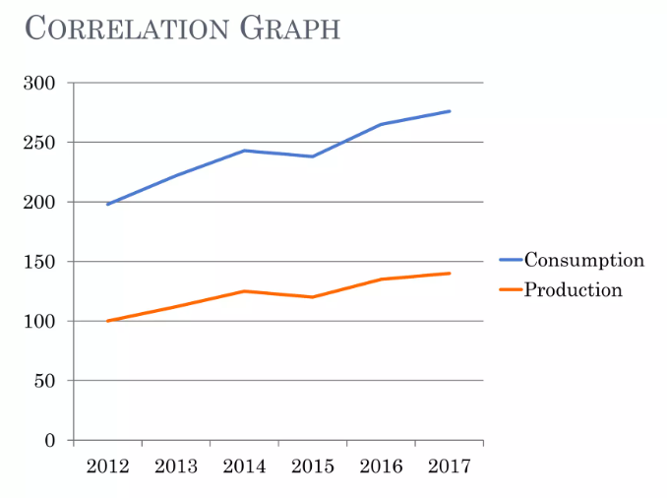

Slide 26
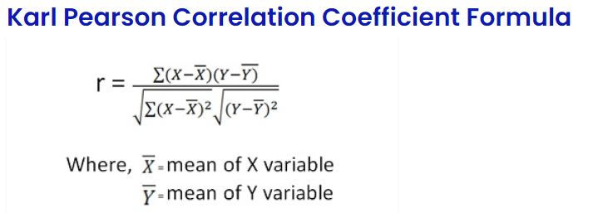
Karl Pearson’s Coefficient Correlation
Karl Pearson’s Coefficient of Correlation is a mathematical approach in which the numerical expression determines the range and the direction of the relationship between two linearly related variables.
Karl Pearson’s Coefficient is a quantitative method often used in statistics.
It is also known as Pearson’s Coefficient of Correlation and It is a widely accepted and widely used method.

Slide 27
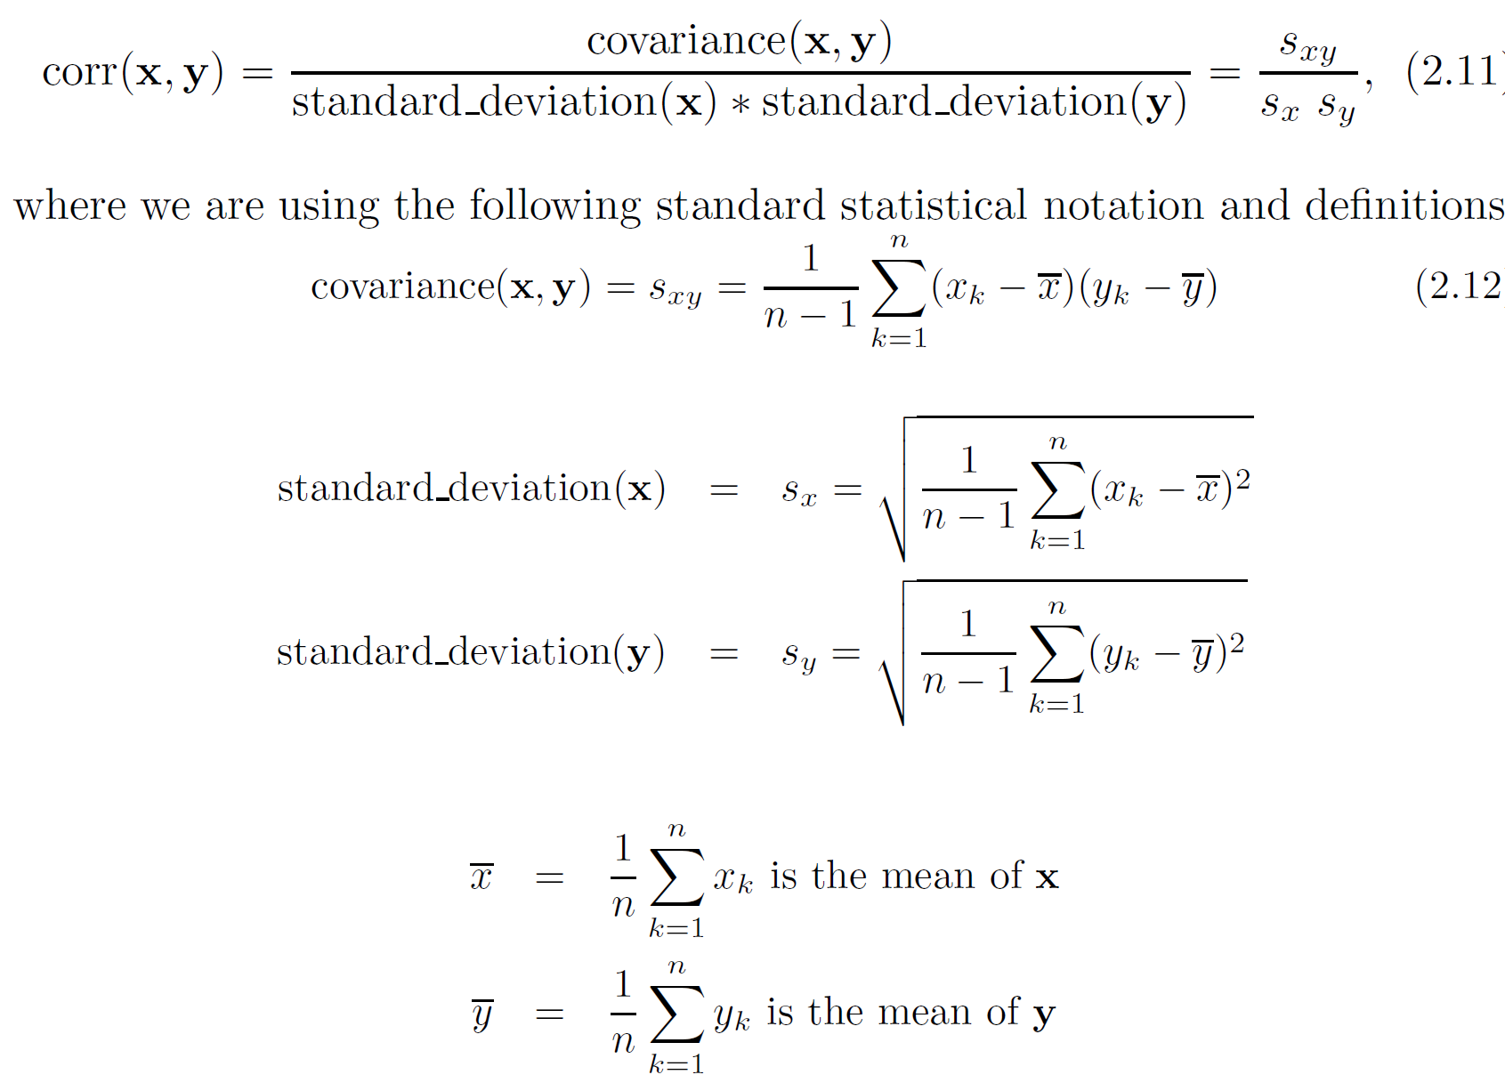
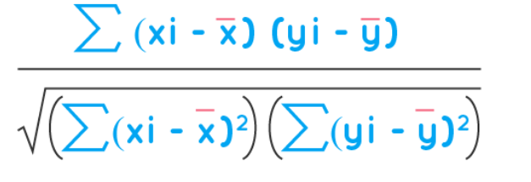
Correlation Analysis (Numeric Data)
Correlation coefficient (also called Pearson’s product moment coefficient , ‘r’)
If r_{A,B} > 0, A and B are positively correlated (A’s values increase as B’s). The higher, the stronger correlation.
r_{A,B} = 0: independent
r_{AB} < 0: negatively correlated

Slide 28
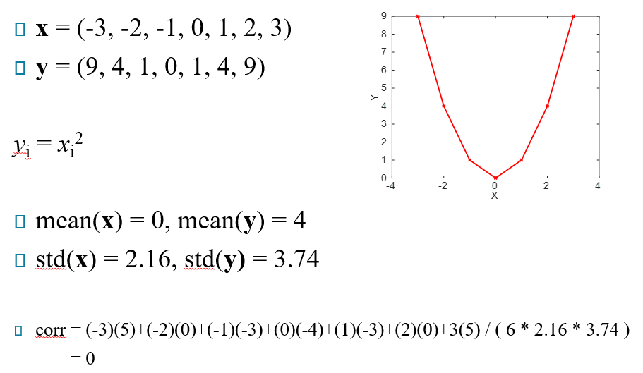
Limitation of Correlation Analysis
Correlation measures the linear relationship between objects!

Slide 29
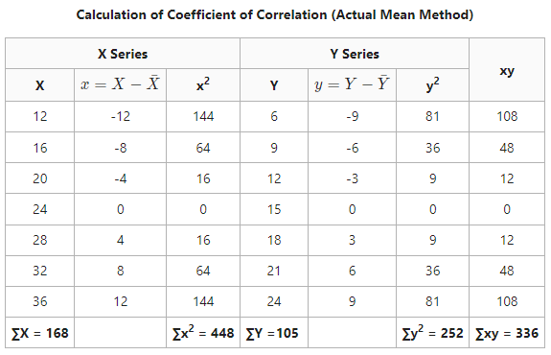

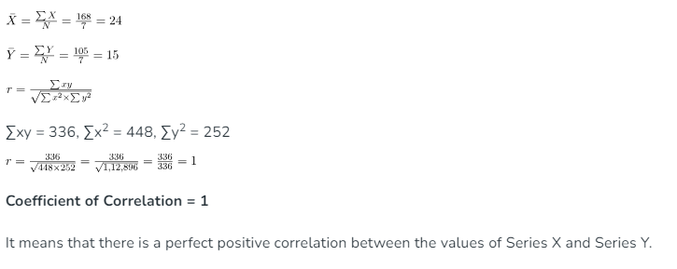
Question

Slide 30
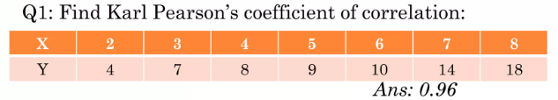
Test Yourself

Slide 31
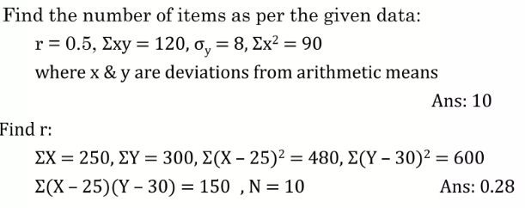

Slide 32
Data reduction: Obtain a reduced representation of the data set that is much smaller in volume but yet produces the same (or almost the same) analytical results
Why data reduction? — A database/data warehouse may store terabytes of data. Complex data analysis may take a very long time to run on the complete data set.
Data reduction strategies
Dimensionality reduction, e.g., remove unimportant attributes
Data Reduction
Wavelet transforms
Principal Components Analysis (PCA)
Feature subset selection, feature creation
Numerosity reduction (some simply call it: Data Reduction)
Regression and Log-Linear Models
Histograms, clustering, sampling
Data cube aggregation
Data compression

Slide 33
Curse of dimensionality
When dimensionality increases, data becomes increasingly sparse
Density and distance between points, which is critical to clustering,
outlier analysis, becomes less meaningful
The possible combinations of subspaces will grow exponentially
Dimensionality reduction
Avoid the curse of dimensionality
Help eliminate irrelevant features and reduce noise
Reduce time and space required in data mining
Allow easier visualization
Dimensionality reduction techniques
Wavelet transforms
Principal Component Analysis
Supervised and nonlinear techniques (e.g., feature selection)
Data Reduction: Dimensionality Reduction

Slide 34
Data Reduction: Principal Component Analysis
x₂
e
Find a projection that captures the largest amount of variation in data
The original data are projected onto a much smaller space, resulting in dimensionality reduction. We find the eigenvectors of the covariance matrix, and these eigenvectors define the new space
x₁

Slide 35
Data Reduction: Attribute Subset Selection
Another way to reduce dimensionality of data
Redundant attributes
Duplicate much or all of the information contained in
one or more other attributes
E.g., purchase price of a product and the amount of sales tax paid
Irrelevant attributes
Contain no information that is useful for the data mining task at hand
E.g., students' ID is often irrelevant to the task of
predicting students' GPA

Slide 36
Thank You

