Slide 1
Data Mining and Predictive Modelling
Lecture 5: Principal Component Analysis

Slide 2
Data reduction: Obtain a reduced representation of the data set that is much smaller in volume but yet produces the same (or almost the same) analytical results
Why data reduction? — A database/data warehouse may store terabytes of data. Complex data analysis may take a very long time to run on the complete data set.
Data reduction strategies
Dimensionality reduction, e.g., remove unimportant attributes
Data Reduction
Wavelet transforms
Principal Components Analysis (PCA)
Feature subset selection, feature creation
Numerosity reduction (some simply call it: Data Reduction)
Regression and Log-Linear Models
Histograms, clustering, sampling
Data cube aggregation
Data compression

Slide 3
Curse of dimensionality
When dimensionality increases, data becomes increasingly sparse
Density and distance between points, which is critical to clustering,
outlier analysis, becomes less meaningful
The possible combinations of subspaces will grow exponentially
Dimensionality reduction
Avoid the curse of dimensionality
Help eliminate irrelevant features and reduce noise
Reduce time and space required in data mining
Allow easier visualization
Dimensionality reduction techniques
Wavelet transforms
Principal Component Analysis
Supervised and nonlinear techniques (e.g., feature selection)
Data Reduction: Dimensionality Reduction

Slide 4
Dimensionality Reduction
Feature Elimination
Feature Extraction

Slide 5
Feature Elimination: reduce the feature space by eliminating features.
Feature Extraction: We transform the original set of features into another set of features. The idea is to pack the most important information into as few derived features as possible. But we don't lose complete information from the original features. Derived features are a linear combination of the original features.
We create these new independent variables in a specific way and order these new variables by how well they predict our dependent variable.

Slide 6
Feature Extraction
Uncorrelated features Extraction
Uncorrelated features are extracted
Linear Methods
PCA
LDA
SVD
Non-Linear Methods
Kernel – PCA
MDS (Multidimensional Scaling)

Slide 7

Principal Component Analysis

Slide 8
Principal Component Analysis, or PCA, is a dimensionality-reduction method that is often used to reduce the dimensionality of large data sets. It is a technique for feature extraction.
It extracts the features by transforming a large set of variables into a smaller one that still contains most of the information in the large set.
The algorithm of Principal Component Analysis is based on a few mathematical ideas namely:
- Variance and Covariance - Eigen Vectors and Eigenvalues
It combines our input variables in a specific way so that we can drop the “least important” variables while still retaining the most valuable parts of all of the variables.
Each of the “new” variables after PCA are all independent of one another.

Slide 9
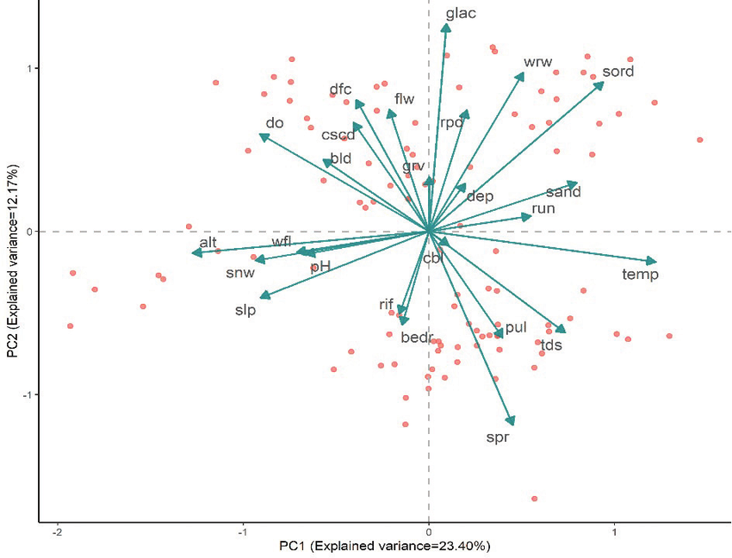

Slide 10

Steps for Computing PCA
Standardization of the data
1
Computing the covariance matrix
2
Calculating the eigenvectors and eigenvalues
3
Computing the Principal Components
4
Reducing the dimensions of the data set
5

Slide 11
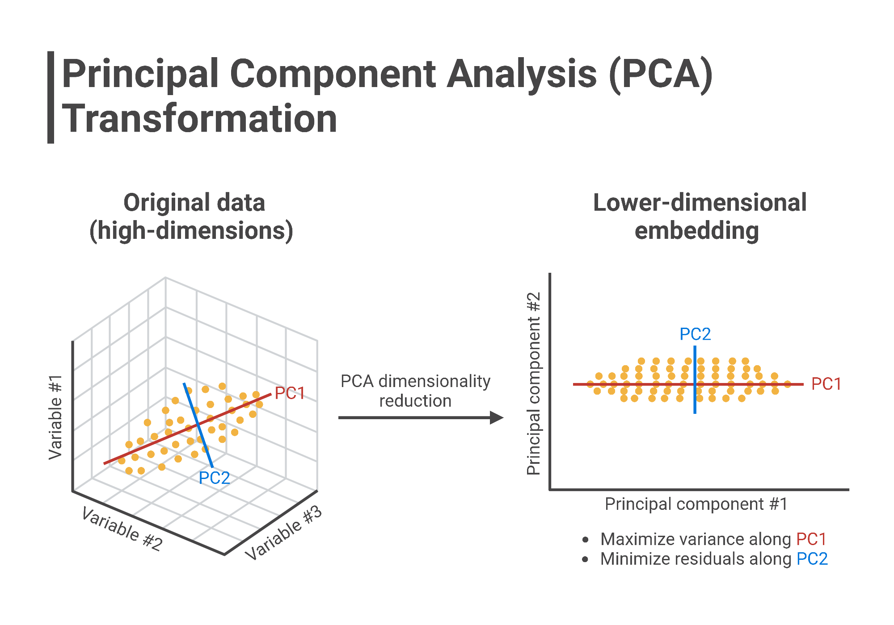

Slide 12

Assumptions
PCA is based on the Pearson correlation coefficient framework and inherits similar assumptions.
Sample size: Minimum of 150 observations and ideally a 5:1 ratio of observation to features (Pallant, 2010)
Correlations: The feature set is correlated, so the reduced feature set effectively represents the original data space.
Linearity: All variables exhibit a constant multivariate normal relationship, and principal components are a linear combination of the original features.
Outliers: No significant outliers in the data as these can have a disproportionate influence on the results.
Large variance implies more structure: high variance axes are treated as principal components, while low variance axes are treated as noise and discarded.

Slide 13
Principal components represent the directions of the data that explain a maximal amount of variance, that is to say, the lines that capture most information of the data.

Slide 14
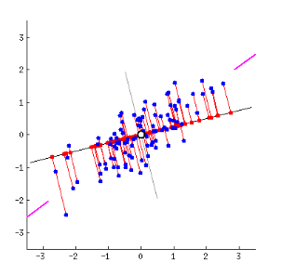
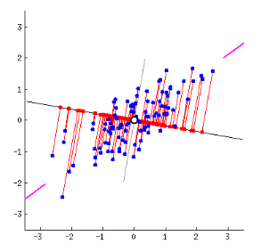
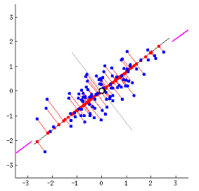
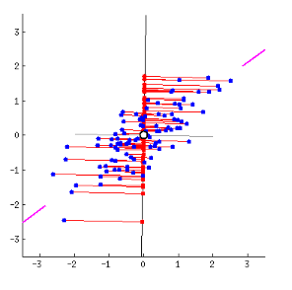
As there are as many principal components as there are variables in the data, principal components are constructed in such a manner that the first principal component accounts for the largest possible variance in the data set.

Slide 15
First Principal Component
The first principal component is approximately the line that matches the purple marks because it goes through the origin and it’s the line in which the projection of the points (red dots) is the most spread out.
Mathematically, it’s the line that maximizes the variance (the average of the squared distances from the projected points (red dots) to the origin).

Slide 16
Second Principal Component
The second principal component is calculated in the same way, with the condition that it is uncorrelated with (i.e., perpendicular to) the first principal component and that it accounts for the next highest variance.
This continues until a total of p principal components have been calculated, equal to the original number of variables.

Slide 17
Mathematics Behind PCA
PCA can be thought of as an unsupervised learning problem. The whole process of obtaining principal components from a raw dataset can be simplified in six parts :
Take the whole dataset consisting of d+1 dimensions and ignore the labels such that our new dataset becomes d dimensional.
Compute the mean for every dimension of the whole dataset.
Compute the covariance matrix of the whole dataset.
Compute eigenvectors and the corresponding eigenvalues.
Sort the eigenvectors by decreasing eigenvalues and choose k eigenvectors (Feature Vector) with the largest eigenvalues to form a d × k dimensional matrix W.
Use this d × k eigenvector matrix to transform the samples onto the new subspace.

Slide 18


Step1: Standardization of data
Scaling the data in such a way that all the features and their values lie within a similar range.
It is calculated as:
$$Z=\frac{feature value −mean}{standard deviation}$$

Slide 19
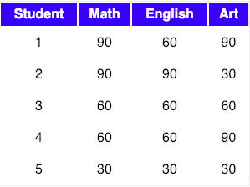
Take the whole dataset consisting of d+1 dimensions and ignore the labels such that our new dataset becomes d dimensional.
Let’s say we have a dataset which is d+1 dimensional. Where d could be thought as X_train and 1 could be thought as y_train (labels) in modern machine learning paradigm.
Let data matrix X be the score of
three subjects :

Slide 20
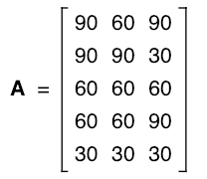

2. Compute the mean of every dimension of the whole dataset.
The data from the above table can be represented in matrix A, where each column in the matrix shows scores on a test and each row shows the score of a student.
So, The mean of matrix A would be
Mean of Matrix A

Slide 21

3. Compute the covariance matrix of the whole dataset ( sometimes also called as the variance-covariance matrix)
So, we can compute the covariance of two variables X and Y using the following formula
Using the above formula, we can find the covariance matrix of A. Also, the result would be a square matrix of d ×d dimensions.
Positive covariance: If Cov_{A,B} > 0, then A and B both tend to be larger than their expected values.
Negative covariance: If Cov_{A,B} < 0 then if A is larger than its expected value, B is likely to be
smaller than its expected value.
Independence: Cov_{A,B} = 0 but the converse is not true:

Slide 22
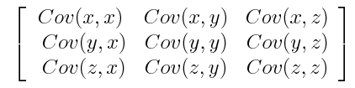
Covariance Matrix Computation
The aim of this step is to understand how the variables of the input data set are varying from the mean with respect to each other, or in other words, to see if there is any relationship between them.
Sometimes, variables are highly correlated in such a way that they contain redundant information. So, to identify these correlations covariance matrix is computed.

Slide 23
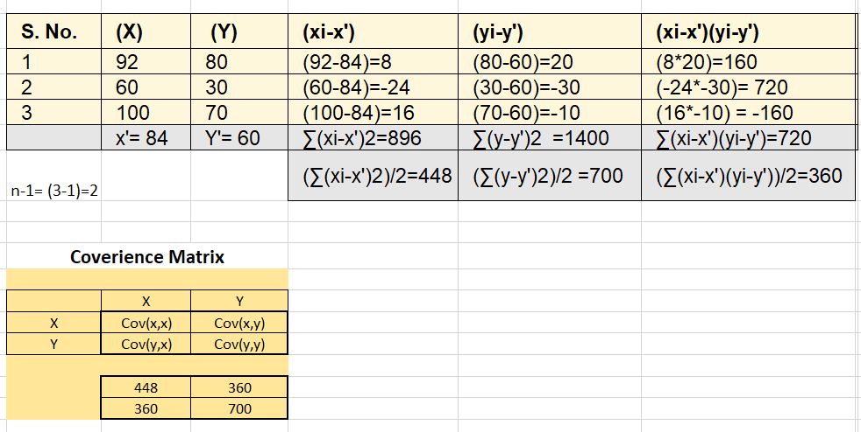

Slide 24
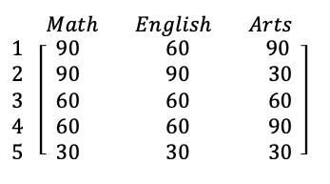
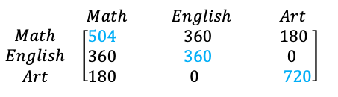
Original data Its covariance matrix would be
A few points that can be noted here is :
Shown in Blue along the diagonal, we see the variance of scores for each test. The art test has the biggest variance (720); and the English test, the smallest (360). So we can say that art test scores have more variability than English test scores.
The covariance is displayed in black in the off-diagonal elements of the matrix A
a) The covariance between math and English is positive (360), and the covariance between math and art is positive (180).
b) The covariance between English and art, however, is zero. This means there tends to be no predictable relationship between the movement of English and art scores.

Slide 25
4. Compute Eigenvectors and corresponding Eigenvalues
Eigenvectors of the Covariance matrix are the directions of the axes where there is the most variance(most information) and that we call Principal Components.
Eigenvalues are simply the coefficients attached to eigenvectors, which give the amount of variance carried in each Principal Component.
By ranking your eigenvectors in order of their eigenvalues, highest to lowest, you get the principal components in order of significance.
And their number is equal to the number of dimensions of the data. For example, for a 3-dimensional data set, there are 3 variables, therefore there are 3 eigenvectors with 3 corresponding eigenvalues.

Slide 26
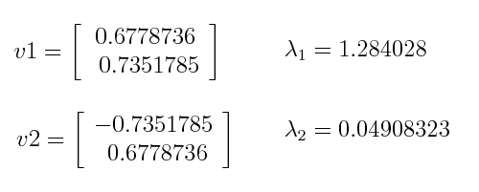
Example
λ1>λ2
Eigenvector that corresponds to the first principal component (PC1) is v1 and the one that corresponds to the second component (PC2) isv2.

Slide 27
Percentage of Variance
Divide the eigenvalue of each component by the sum of eigenvalues.
PC1 and PC2 carry respectively 96% and 4% of the variance of the data.

Slide 28


An eigenvector is a vector whose direction remains unchanged when a linear transformation is applied to it.
Now, we can easily compute eigenvalue and eigenvectors from the covariance matrix that we have above.
Let A be a square matrix, ν a vector and λ a scalar that satisfies
Aν = λν, then λ is called eigenvalue associated with eigenvector ν of A.
The eigenvalues of A are roots of the characteristic equation
Calculating det(A-λI) first, I is an identity matrix :

Slide 29


We now have the equation and we need to solve for λ, so as to get the eigenvalue of the matrix. So, equating the above equation to zero :
After solving this equation for the value of λ, we get the following value
Now, we can calculate the eigenvectors corresponding to the above eigenvalues.

Slide 30

5. Sort the eigenvectors by decreasing eigenvalues and choose k eigenvectors with the largest eigenvalues to form a d × k dimensional matrix W.
the eigenvectors with the lowest eigenvalues bear the least information about the distribution of the data, and those are the ones we want to drop.
The common approach is to rank the eigenvectors from highest to lowest corresponding eigenvalue and choose the top k eigenvectors.
So, after sorting the eigenvalues in decreasing order, we have
https://metric.ma.ic.ac.uk/metric_public/matrices/eigenvalues_and_eigenvectors/eigenvalues2.html

Slide 31
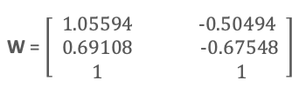
For our simple example, where we are reducing a 3-dimensional feature space to a 2-dimensional feature subspace, we are combining the two eigenvectors with the highest eigenvalues to construct d×k dimensional eigenvector matrix W.
So, eigenvectors corresponding to two maximum eigenvalues are:
6. Transform the samples onto the new subspace
In the last step, we use the 2×3-dimensional matrix W that we just computed to transform our samples onto the new subspace via the equation
y = W′ × x’
where W′ is the transpose of the matrix W.
Where X’ is the original data that we wish to project and y is the projection of X. So lastly, we have computed our two principal components and projected the data points onto the new subspace.
$$Reconstrcucted Dataset=Feature Vector\text{T} X Standardized original dataset$$

Slide 32
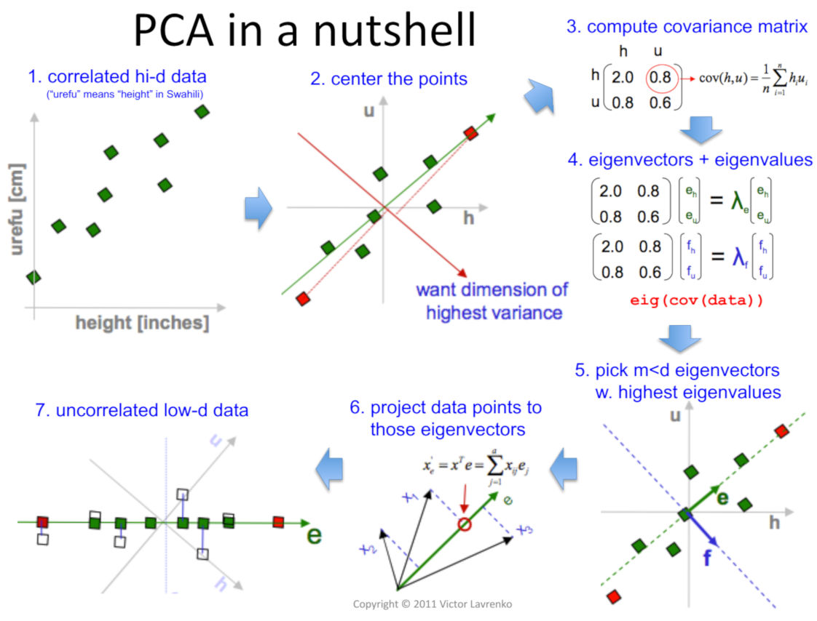

Slide 33
Numerical Example
Consider the two-dimensional patterns (2, 1), (3, 5), (4, 3), (5, 6), (6, 7), (7, 8).
Compute the principal component using the PCA Algorithm.

Slide 34
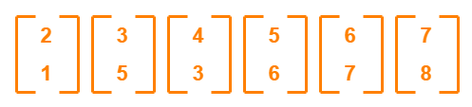
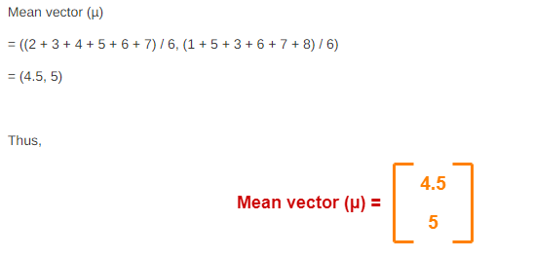

Slide 35
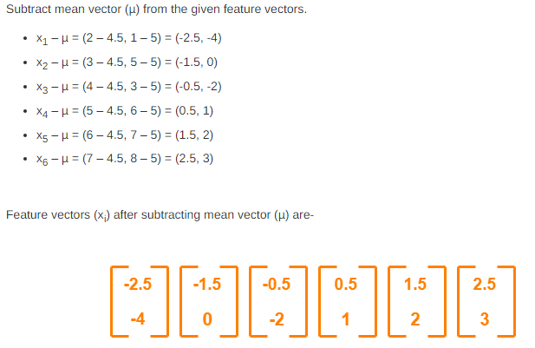

Slide 36
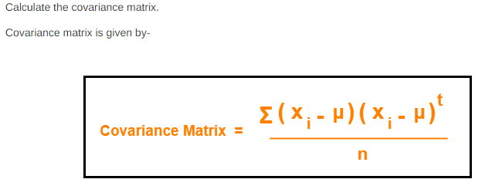

Slide 37
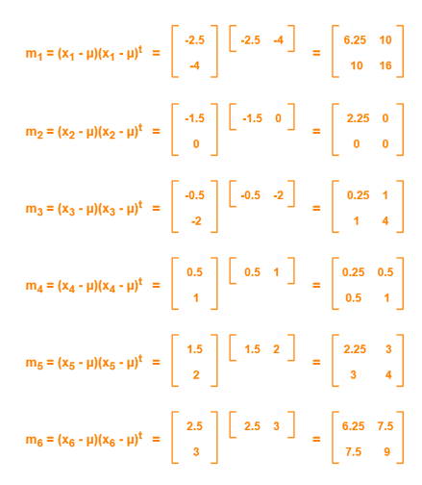

Slide 38
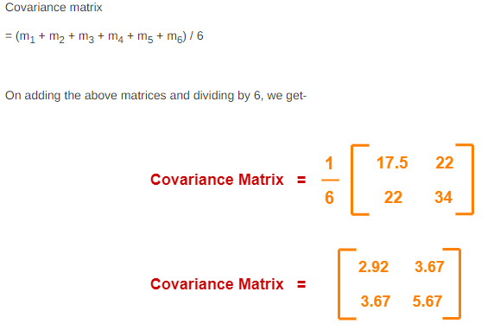

Slide 39
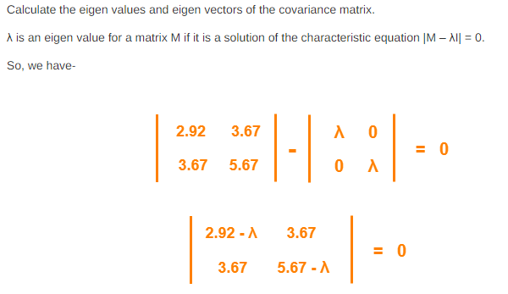

Slide 40
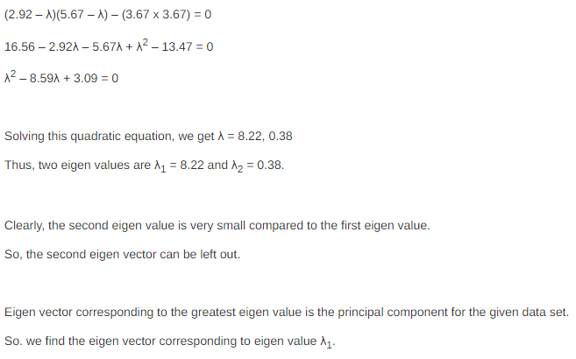

Slide 41
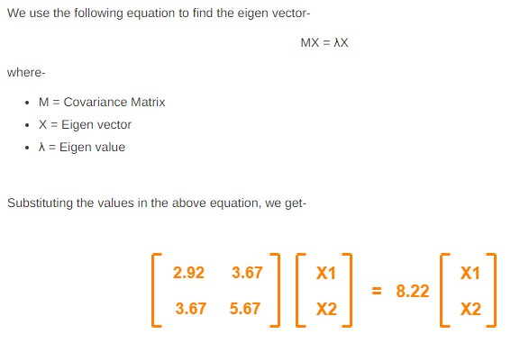

Slide 42
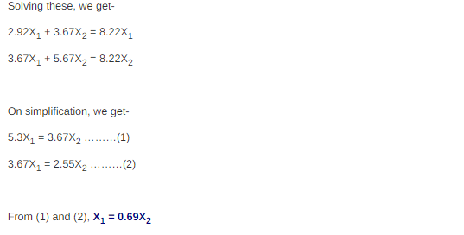

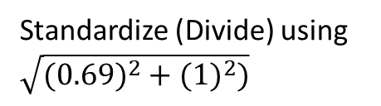
The vector is:$\left[\begin{matrix}0.69 \\ 1\end{matrix}\right]$
And the Eigen vector is: $\left[\begin{matrix}\begin{aligned}0.567 \\ 0.8230\end{aligned} \\ \end{matrix}\right]$
Therefore, PC1 = $\left[\begin{matrix}\begin{aligned}0.567 \\ 0.8230\end{aligned} \\ \end{matrix}\right]$
Standardize (Divide) using $\sqrt{({0.69)}^{2}+({1)}^{2})}$

Slide 43
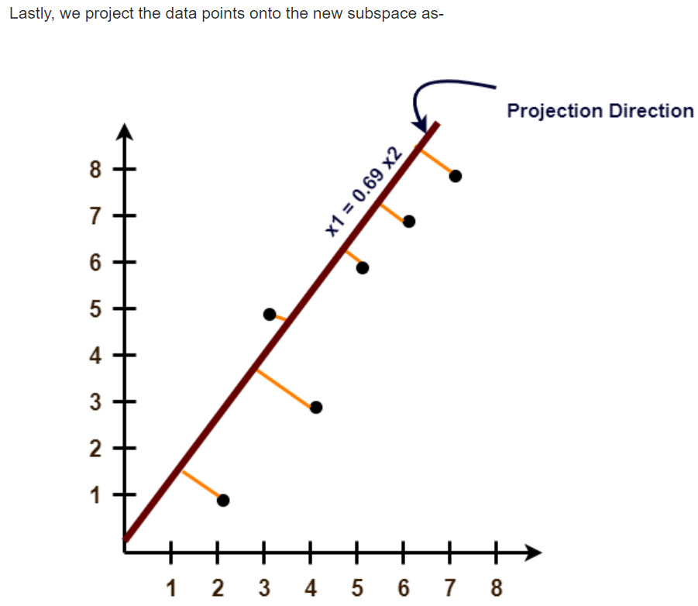
$$Reconstrcucted Dataset=Feature Vector\text{T} X Standardized original dataset$$

Slide 44
Customer ID | Total Spent (USD) | Visited Page (Times) | Browse Time (Minutes) | Purchased (Yes/No)
1 | 235 | 4 | 17 | Yes
2 | 78 | 1 | 5 | No
3 | 140 | 3 | 12 | Yes
4 | 125 | 2 | 8 | No
5 | 210 | 5 | 20 | Yes
6 | 42 | 1 | 3 | No
7 | 380 | 6 | 25 | Yes
8 | 35 | 1 | 2 | No
9 | 172 | 4 | 15 | No
10 | 90 | 2 | 7 | Yes

Slide 45
To solve the PCA (Principal Component Analysis) algorithm on the given dataset, we need to follow these steps:
Preprocess the data by standardizing the numerical features.
Calculate the covariance matrix of the standardized data.
Compute the eigenvalues and eigenvectors of the covariance matrix.
Sort the eigenvalues in descending order and select the top k eigenvectors corresponding to the largest eigenvalues to form the principal components.
Transform the original data into the new feature space defined by the selected principal components.

Slide 46
Data Point | Principal Components
1 | [84.49473068 -0.42693724]
2 | [-72.99360936 -1.39005696]
3 | [-10.62368736 1.39319365]
4 | [-25.8896456 -1.65147778]
5 | [59.78268824 4.5134805 ]

Slide 47
To apply PCA (Principal Component Analysis) on the given dataset without considering the 'Purchased (Yes/No)' column, we can follow these steps:
Preprocess the data by standardizing the numerical features.
Apply PCA to reduce the dimensionality of the dataset.
Here's the Python code to achieve this using the pandas and sklearn libraries:

Slide 48

This code will output a DataFrame principal_df containing the two principal components obtained from PCA for the given dataset. You can further analyze or visualize these
principal components to understand the data distribution and reduce the dimensionality of the dataset.

Slide 49
Thank You

