Slide 1
Data Mining and Predictive Modeling
Lecture 7: Measuring Data Similarity

Slide 2
Similarity
Numerical measure of how alike two data objects are
Value is higher when objects are more alike
Often falls in the range [0,1]
Dissimilarity
Numerical measure of how different two data objects are
Lower when objects are more alike
Minimum dissimilarity is often 0
Upper limit varies
Proximity refers to a similarity or dissimilarity
Data Similarity
and Dissimilarity

Slide 3
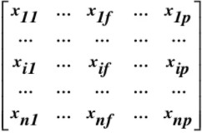
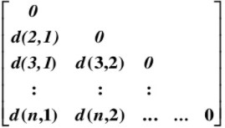
Data Matrix and Dissimilarity Matrix
Data Matrix
  N data points with p dimensions
  Two modes
Dissimilarity Matrix
  N data points, but registers only the distance
  A triangular matrix
  Single mode

Slide 4
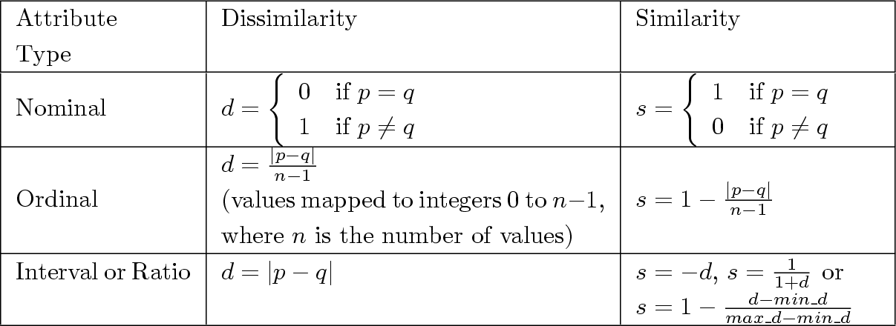
Similarity/Dissimilarity for Simple Attributes
p and q are the attribute values for two data objects.

Slide 5
Similarity is a measure of how similar two attributes or objects are.
Distance is a typical measure of dissimilarity between two attributes or objects.
Similarity
Cosine Similarity
Jaccard Similarity
Sørensen-Dice Coefficient
Pearson Correlation Coefficient
Dissimilarity
Euclidean Distance
Manhattan Distance
Minkowski Distance
Hamming Distance

Slide 6
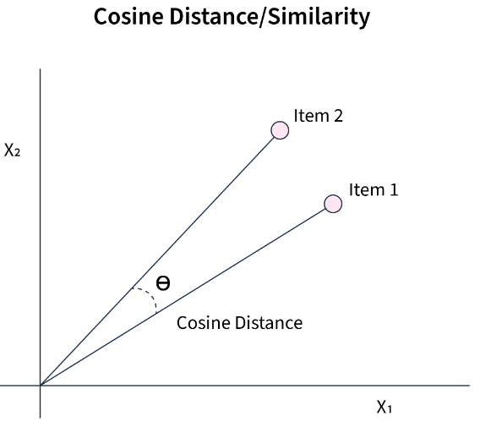
Cosine Similarity
It measures the cosine of the angle between two non-zero vectors in a multi-dimensional space. In the context of data mining, these vectors represent the feature vectors of two data points. The cosine similarity score ranges from 0 to 1, with 0 indicating no similarity and 1 indicating perfect similarity.
If d₁ and d₂ are two document vectors, then
cos( d₁, d₂ ) = (d₁ • d₂) / ||d₁|| ||d₂|| ,
where • indicates vector dot product and || d || is the length of vector d.
Example:
d₁ = 3 2 0 5 0 0 0 2 0 0
d₂ = 1 0 0 0 0 0 0 1 0 2
d₁ • d₂= 3*1 + 2*0 + 0*0 + 5*0 + 0*0 + 0*0 + 0*0 + 2*1 + 0*0 + 0*2 = 5
||d₁|| = (3*3+2*2+0*0+5*5+0*0+0*0+0*0+2*2+0*0+0*0)^{0.5} = (42) ^{0.5} = 6.481
||d₂|| = (1*1+0*0+0*0+0*0+0*0+0*0+0*0+1*1+0*0+2*2) ^{0.5} = (6) ^{0.5} = 2.245
cos( d₁, d₂ ) = .3150

Slide 7
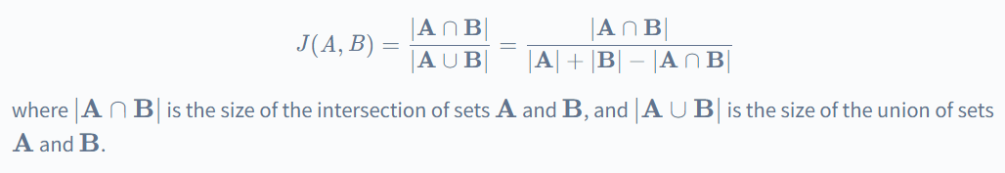
Jaccard Similarity
Jaccard Similarity is a common proximity measurement used to compute the similarity between two objects, such as two text documents.
Jaccard similarity can be used to find the similarity between two asymmetric binary vectors or to find the similarity between two sets.
The Jaccard similarity score ranges from 0 to 1, with 0 indicating no similarity and 1 indicating perfect similarity.
The Jaccard similarity between two sets A and B is calculated as follows -

Slide 8
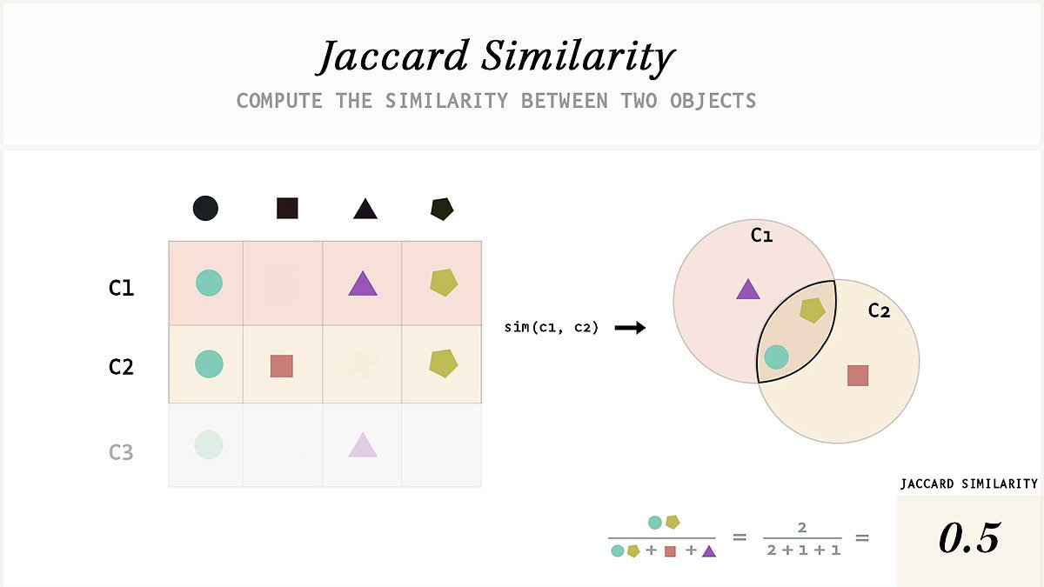

Slide 9
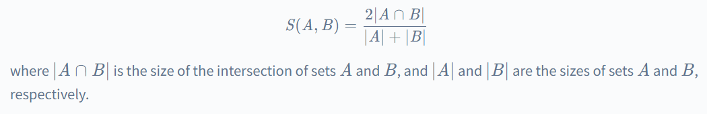
Sørensen-Dice Coefficient
The Sørensen-Dice coefficient, also known as the Dice similarity index, is a similarity measure used to compare the similarity between two sets of data, typically used in the context of text or image analysis.
The coefficient ranges from 0 to 1, with 0 indicating no similarity and 1 indicating perfect similarity.
The Sørensen-Dice coefficient is commonly used in text analysis to compare the similarity between two documents based on the set of words or terms they contain.
It is also used in image analysis to compare the similarity between two images based on the set of pixels they contain.
The Sørensen-Dice coefficient between two sets, A and B, is calculated as follows -

Slide 10
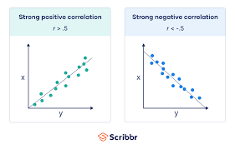
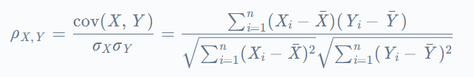
Pearson Correlation Coefficient
The Pearson correlation coefficient is a widely used similarity measure in data mining and statistical analysis. It measures the linear correlation between two continuous variables, X and Y. The Pearson correlation coefficient ranges from -1 to +1, with -1 indicating a perfect negative correlation, 0 indicating no correlation, and +1 indicating a perfect positive correlation.
The Pearson correlation coefficient between two variables, X and Y,
is calculated as follows -

Slide 11
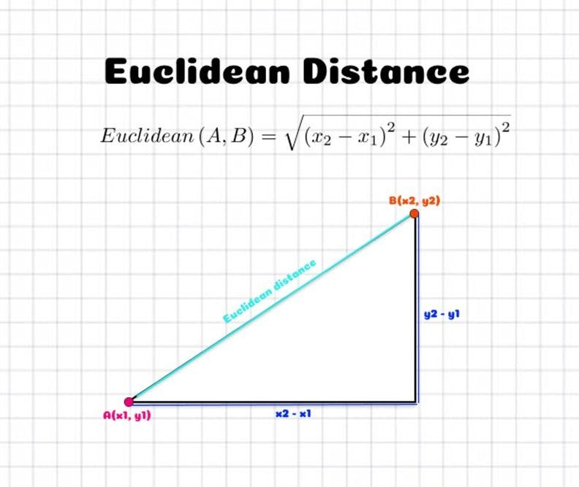
Euclidean Distance
Euclidean distance is a commonly used dissimilarity measure that quantifies the distance between two points in a multidimensional space. It is named after the ancient Greek mathematician Euclid, who first studied its properties.
The Euclidean distance between two points X and Y in
an n-dimensional space is defined as

Slide 12
Euclidean Distance
3
2
p1
point x y
p1 0 2
p2 2 0
p3 3 1
p4 5 1
p3
p4
1
p2
0
0 1
2 3 4
5 6
 | p1 | p2 | p3 | p4
p1 | 0 | 2.828 | 3.162 | 5.099
p2 | 2.828 | 0 | 1.414 | 3.162
p3 | 3.162 | 1.414 | 0 | 2
p4 | 5.099 | 3.162 | 2 | 0
Distance Matrix

Slide 13
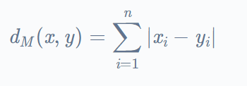
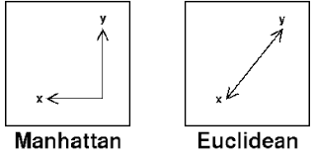
Manhattan Distance
Manhattan distance, also known as city block distance, is a dissimilarity measure that quantifies the distance between two points in a multidimensional space.
The distance between two points is measured by the number of blocks one has to walk horizontally and vertically to reach the other point.
The Manhattan distance between two points x and y in an n-dimensional space is defined as-

Slide 14
Minkowski Distance
Minkowski distance is a generalization of Euclidean Distance.
1
n
dist = ( ∑| X_{k} − Y_{k} |^{r} ) ^{r}
k =1
Where r is a parameter,
n is the number of dimensions (attributes)
X_{k} and Y_{k} are, respectively, the kth attributes (components) or data objects X and Y.

Slide 15
Minkowski Distance Examples
r = 1. City block (Manhattan, taxicab, L₁ norm) distance.
  A common example of this is the Hamming distance, which is just the number of
bits that are different between two binary vectors
r = 2. Euclidean distance
r → ∞. “supremum” (L_{max} norm, L∞ norm) distance.
  This is the maximum difference between any component of the vectors
Do not confuse r with n, i.e., all these distances are defined for all numbers of dimensions.

Slide 16
Hamming Distance
Hamming distance is a distance metric used to measure the dissimilarity between two strings of equal length.
It is defined as the number of positions at which the corresponding symbols in the two strings are different.
For example, consider the strings "101010" and "111000".
The Hamming distance between these two strings is three since there are three positions at which the corresponding symbols are different: the second, fourth, and sixth positions.
Hamming distance is often used in error-correcting codes and cryptography, where it is important to detect and correct errors in data transmission.

Slide 17
Common Properties of a Distance
Distances, such as the Euclidean distance, have some well known properties.
1. d(p, q) ≥ 0
for all p and q and d(p, q) = 0 only if
p = q. (Positive definiteness)
d(p, q) = d(q, p) for all p and q. (Symmetry)
d(p, r) ≤ d(p, q) + d(q, r)
(Triangle Inequality)
for all points p, q, and r.
where d(p, q) is the distance (dissimilarity) between points (data objects), p
and q.
A distance that satisfies these properties is a metric

Slide 18
Question
Calculate the distance between the points (4,1) and (3,0).

Slide 19
