Slide 1
Data Mining and Predictive Modelling
Lecture 8: Vectorization

Slide 2
Vectorization
It is an approach of converting input data from its raw format (i.e., text) into vector of real
numbers.
In Data Mining/Machine Learning, vectorization is a step in feature extraction.
The idea is to get some distinct features out of the text for the model to train on, by converting text to numerical vectors.
e.g.: Classify some tweets for positive and negative sentiments.

Slide 3
What is a Vector?
An array of floating point numbers.
Represents data
Text
Audio
Image
Video
Example
-[ 1.0, 0.0, 1.0, 0.5]

Slide 4
Vector Space Model
Common way of vectorizing text
Every possible word is mapped to a specific integer
If we have a large enough array then every word fits into a unique slot in the array
Value at that index is the number of the times the word occurs
Generally, the array size is less than our corpus vocabulary
So, we have to have a vectorization strategy to deal with this

Slide 5
Process of Vectorization
Sentence Segmentation
of dividing a string of written language into its component sentences.
Tokenization
Find individual words
Lemmatization
Finding the base or stem of words
Removing Stop words
“the”, “and” etc.
Vectorization

Slide 6
Bag of Words
TF-IDF
N-Grams
Vector Embedding
Techniques

Slide 7
Bag of Words
A group of words or a document is represented as a bag
Bag of words is a list of words and their word counts
Simplest vector model
Can end up using a lot of columns due to number of words involved.
Grammar and word ordering is ignored
But we still track how many time the word occurs in the document
Has been used most frequently in the document classification
And information retrieval domains

Slide 8
Bag of Words-Example
Unique words
it
was
the
best
of
times
worst
age
wisdom
foolishness
It was the best of times, It was the worst of times, It was the age of wisdom,
It was the age of foolishness,
Design the vocabulary

Slide 9
Bag of Words: Create Document Vectors
The next step is to score the words in each document.
The objective is to turn each document of free text into vector.
Since the vocabulary has 10 words, we can use a fixed-length document representation of 10, with one position in the vector to score each word.
The simplest scoring method is to mark the presence of words as a Boolean value, 0 for absent and 1 for present.
Using the arbitrary ordering of words listed above in our vocabulary,
we can step through the first document(“It was the best of times”).

Slide 10
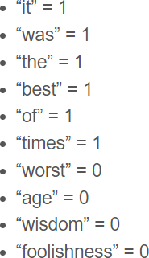
Bag of Words: Create Document Vectors
“it was the best of times”
[1, 1, 1, 1, 1, 1, 0, 0, 0, 0 ]
“it was the worst of times”
[1, 1, 1, 0, 1, 1, 1, 0, 0, 0 ]
“it was the age of wisdom”
[1, 1, 1, 0, 1, 0, 0, 1, 1, 0 ]

Slide 11
Term Frequency – Inverse Document Frequency
The problem with scoring word frequency is that highly frequent words start to dominate the document.
But they may not contain as much “informational content” to the
model.
One solution could be to rescale the frequency of words by how often they appear in all documents, so that the scores for frequent words across all documents are penalized.
This scoring is called Term Frequency – Inverse Document Frequency.

Slide 12
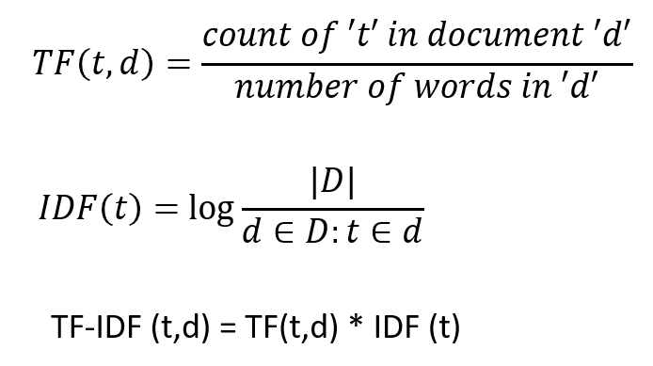
TF-IDF
Term Frequency: is a scoring of the frequency of word in the current document.
Inverse Document Frequency: is a scoring of how rare the word is across documents.
TF = (Number of repetitions of t word in a document) / (# of words in a document)
IDF =Log[(Number of documents) / (Number of documents containing the word)]

Slide 13
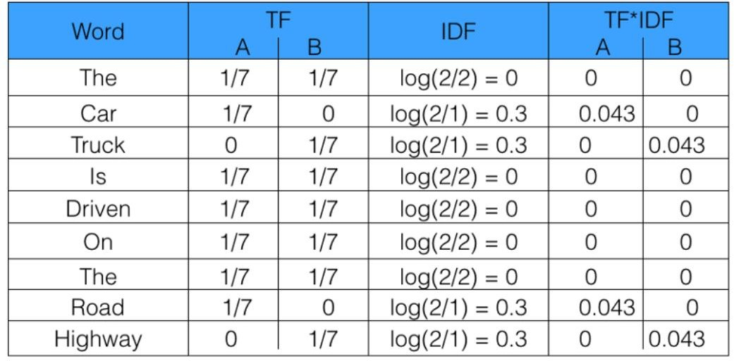
TF-IDF
Sentence 1: The car is driven on this road. Sentence 2: The truck is driven on this highway.

Slide 14
Question:
Document 1 It is going to rain today.
Document 2 Today I am not going outside.
Document 3 I am going to watch the season premiere.

Slide 15
Vocab:
'am’,
'going’,
'is’,
'it’,
'not’,
'outside’,
'premiere’,
'rain’,
'season’,
'the’,
'to’,
'today’,
'watch'

Slide 16
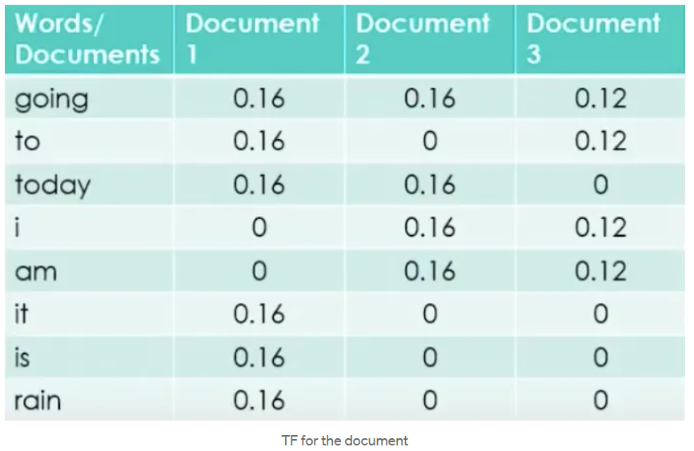

Slide 17
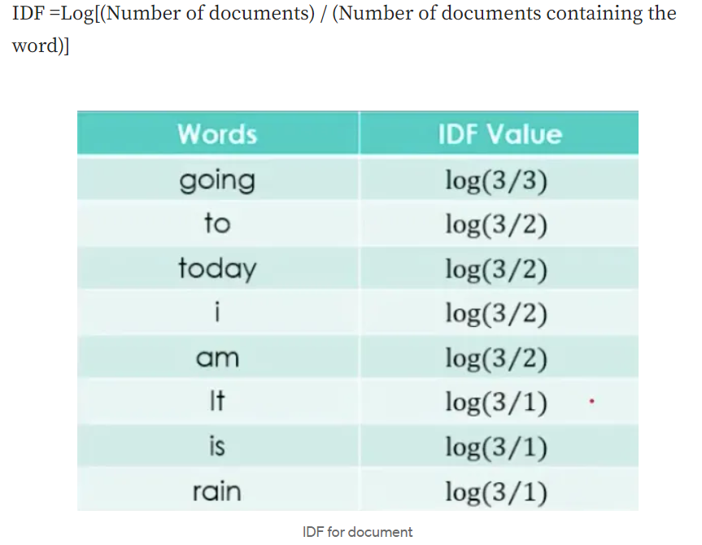

Slide 18
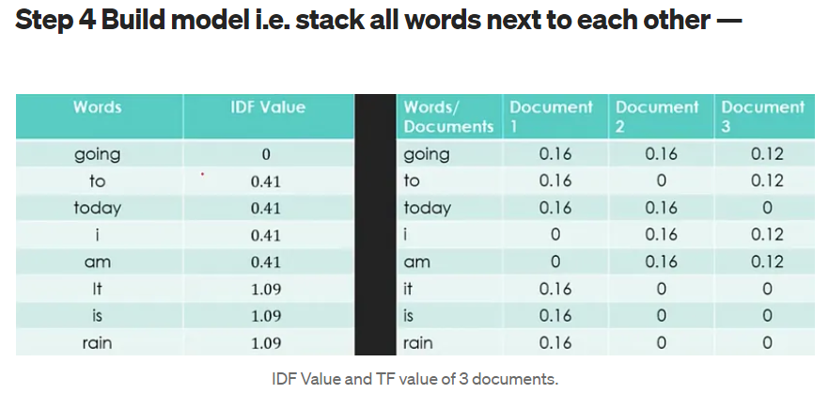

Slide 19
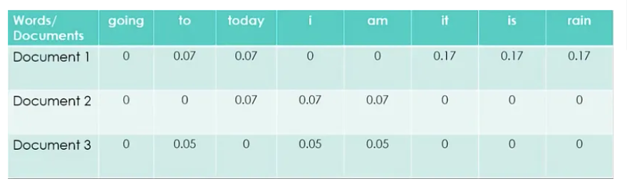
The final equation = TF-IDF = TF * IDF

Slide 20
Thank You

