Slide 1

Data Mining and Predictive Modeling Lecture 8

Slide 2
Association Rule Mining
It is an important unsupervised data mining model
Assume all data are categorical.
Initially used for market basket analysis to find how items purchased by customers are related.
Bread → Milk
[sup = 5%, conf = 100%]

Slide 3
Frequent Pattern Analysis
Frequent pattern: a pattern (a set of items, subsequences, substructures, etc.) that occurs frequently in a data set.
First proposed by Rakesh Agrawal, Tomasz, and Arun Swami (1993) [1] in the context of frequent itemsets and association rule mining.
Motivation: Finding inherent regularities in data
What products were often purchased together?
What are the subsequent purchases after buying a PC?
Applications:
Market Basket analysis, cross-marketing, catalog design, sale campaign analysis.
Notes:
[1] Agrawal, R.; Imieliński, T.; Swami, A. (1993). "Mining association rules between sets of items in large databases". Proceedings of the 1993 ACM SIGMOD international conference on Management of data - SIGMOD '93. p. 207.

Slide 4
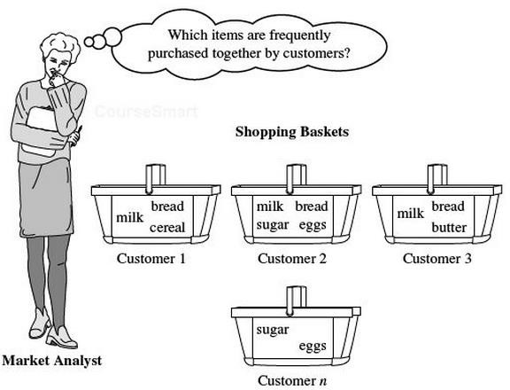
Market Basket Analysis

Slide 5
Why Frequent Pattern Mining?
Frequent pattern: An inherent and important property of datasets
Foundation for many essential data mining tasks
Association, correlation, and causality analysis
Sequential, structural (e.g., sub-graph) patterns
Pattern analysis in spatiotemporal, multimedia, time-series, and stream data
Classification: frequent pattern analysis
Cluster analysis: frequent pattern-based clustering
Broad applications

Slide 6

Basic Concepts: Frequent Patterns
I = {i₁, i₂, …, i_{m}}: a set of items.
Transaction t :
t a set of items, and t ⊆ I.
Transaction Database T: a set of transactions T = {t₁, t₂, …, t_{n}}.

Slide 7
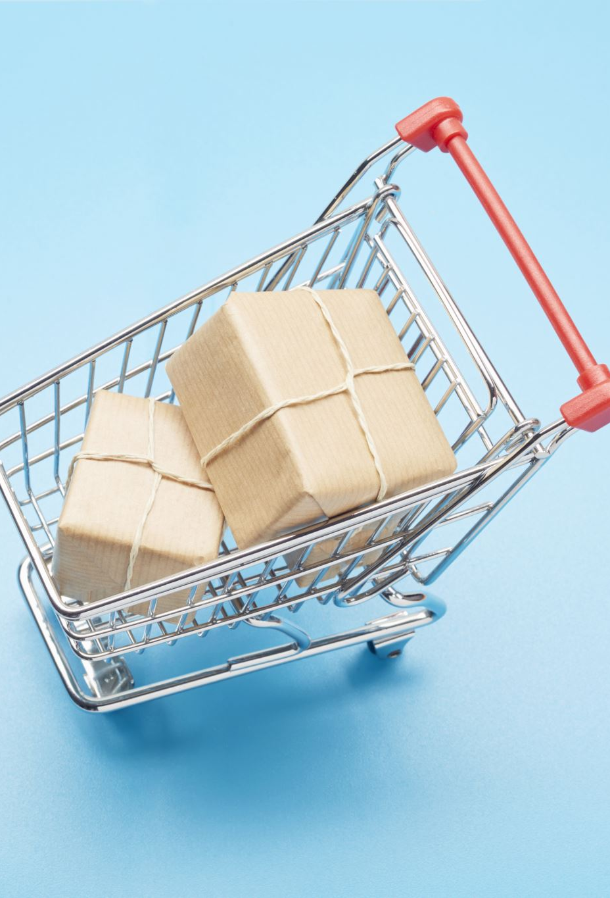
Transaction Data: Supermarket
Market basket transactions:
t1: {bread, cheese, milk}
t2: {apple, eggs, salt, yogurt}
… …
tn: {biscuit, eggs, milk}
Concepts:
An item: an article in a basket
I: the set of all items sold in the store
A transaction: items purchased in a basket; it may have TID (transaction ID)
A transactional dataset: A set of transactions

Slide 8
The Model: rules
A transaction t contains X, a set of items (itemset) in I,
An association rule is an implication of the form:
X → Y, where X, Y ⊂ I, and X ∩Y = ∅
An itemset is a set of items.
E.g., X = {milk, bread, cereal} is an itemset.
A k-itemset is an itemset with k items.
E.g., {milk, bread, cereal} is a 3-itemset

Slide 9
Example
Tid | Items bought
10 | Beer, Nuts, Diaper
20 | Beer, Coffee, Diaper
30 | Beer, Diaper, Eggs
40 | Nuts, Eggs, Milk
50 | Nuts, Coffee, Diaper, Eggs, Milk
itemset: A set of one or more items
k-itemset X = {x₁, …, x_{k}}
support count of X: Frequency of an itemset X
support, s, refers to the relative frequency of an item set in a dataset. For example, if an itemset occurs in 5% of the transactions in a dataset, it has a support of 5%.
An itemset X is frequent if X’s support is no less than a minsup threshold
Customer buys both
Customer buys diaper
Customer
buys beer

Slide 10
Association Rules
Find all the rules X → Y with
minimum support and confidence
Tid | Items bought
10 | Beer, Nuts, Diaper
20 | Beer, Coffee, Diaper
30 | Beer, Diaper, Eggs
40 | Nuts, Eggs, Milk
50 | Nuts, Coffee, Diaper, Eggs, Milk
support, s, the probability that a transaction contains X ∪ Y
Support(X) = (Number of transactions containing X) /
(Total number of transactions)
Ex. Support({milk, bread}) = Number of transactions containing
{milk, bread} / Total number of transactions
confidence, c, conditional probability that a transaction having X also contains Y
Ex. Confidence(milk -> bread)
= Number of transactions containing {milk, bread} / Number of transactions containing {milk}
Customer
buys both
Customer buys diaper
Customer buys beer
10

Slide 11
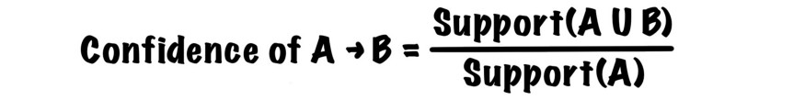
Association Rules
Tid | Items bought
10 | Beer, Nuts, Diaper
20 | Beer, Coffee, Diaper
30 | Beer, Diaper, Eggs
40 | Nuts, Eggs, Milk
50 | Nuts, Coffee, Diaper, Eggs, Milk
⚡ The support of rule A → B is the same as rule B → A, but the confidence of them is often different!
Support= (A U B)/Total
Customer
buys both
Customer buys diaper
Let minsup = 50%, minconf = 50%
Freq. Pat.: Beer:3, Nuts:3, Diaper:4, Eggs:3, {Beer,
Diaper}:3
Customer buys beer
Association rules: (many more!)
Beer → Diaper (60%, 100%) 3/5, 3/3
Diaper → Beer (60%, 75%) 3/5, 3/4
10

Slide 12
Frequent Itemset Mining Methods

Slide 13

Frequent Itemset Mining Methods
Apriori: A Candidate Generation-and-Test Approach
FPGrowth: A Frequent Pattern-Growth Approach
Frequent Pattern Mining with Vertical Data Format

Slide 14
Apriori Algorithm
Proposed by R. Agrawal and R. Srikanth in 1994.
The name of this algorithm is based on the fact that the algorithm uses prior knowledge of the frequent itemset properties.
Apriori employs an iterative approach known as a level-wise search where k-itemsets are used to explore (k+1) itemsets.

Slide 15
Apriori Method
Method:
Initially, scan DB once to get frequent 1-itemset
Generate length (k+1) candidate itemsets from length k frequent itemsets
Terminate when no frequent or candidate set can be generated
To improve the efficiency of the level-wise generation of frequent itemsets, the apriori property is used to reduce the search space
All non-empty subsets of a frequent itemset must also be frequent
If {beer, diaper, nuts} is frequent, so is {beer, diaper}

Slide 16
Apriori -Example
Sup_{min} = 2
Database TDB
Itemset | sup
{A} | 2
{B} | 3
{C} | 3
{D} | 1
{E} | 3
Itemset | sup
{A} | 2
{B} | 3
{C} | 3
{E} | 3
C₁
1st scan
L
Tid | Items
10 | A, C, D
20 | B, C, E
30 | A, B, C, E
40 | B, E
1
C₂
Itemset | sup
{A, B} | 1
{A, C} | 2
{A, E} | 1
{B, C} | 2
{B, E} | 3
{C, E} | 2
C₂
2nd scan
Itemset
{A, B}
{A, C}
{A, E}
{B, C}
{B, E}
{C, E}
L
Itemset | sup
{A, C} | 2
{B, C} | 2
{B, E} | 3
{C, E} | 2
2
C₃
Itemset
{B, C, E}
3rd scan
L₃
Itemset | sup
{B, C, E} | 2

Slide 17
Apriori - Algorithm
C_{k}: Candidate itemset of size k
L_{k} : frequent itemset of size k
L₁ = {frequent items};
for (k = 1; L_{k} !=∅; k++) do begin
C_{k+1} = candidates generated from L_{k};
for each transaction t in database do
increment the count of all candidates in C_{k+1} that are contained in t
^{L}k+1
end
= candidates in C_{k+1} with min_support
return ∪_{k} L_{k};

Slide 18
Apriori - Implementation
How to generate candidates?
Step 1: self-joining L_{k}
Step 2: pruning
Example of Candidate-generation
L₃={abc, abd, acd, ace, bcd}
Self-joining: L₃*L₃
abcd from abc and abd
acde from acd and ace
Pruning:
acde is removed because ade is not in L₃
C₄ = {abcd}

Slide 19
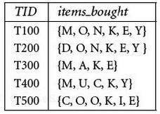
Example
Consider the following database with five transactions. Let min_sup = 60% and min_conf = 80%.
Find all the frequent itemsets using Apriori method
List all the strong association rules matching the following metarule

Slide 20

Generating Association Rules from Frequent Itemsets
Method
For each frequent itemset l, generate all nonempty subsets of l
For every nonempty subset of l, output the rule
s -> (l - s) if
(support_coutn(l) / support_count(s)) >=min_conf
Because the rules are generated from frequent itemsets, each one automatically satisfies the minimum support

Slide 21
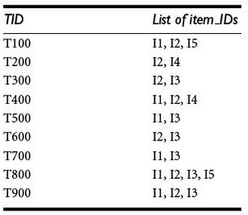
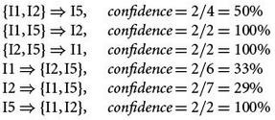
Generating Association Rules Example
Example: Given the following table and the frequent itemset X = {I1, I2, I5}, generate the association rules.
The nonempty subsets of X are:
{I1, I2}, {I1, I5}, {I2, I5}, {I1}, {I2}, {I5}
The resulting association rules are:
If the minimum confidence threshold is, say, 70%, then only the second, third, and last rules are output, because these are the only ones generated that are strong

Slide 22
Improving the Efficiency of Apriori
Major computational challenges
Multiple scans of transaction database
Huge number of candidates
Tedious workload of support counting for candidates
Improving Apriori: general ideas
Reduce passes of transaction database scans
Shrink number of candidates
Facilitate support counting of candidates

Slide 23
Scan Database only Twice
Scan 1: partition database and find local frequent patterns.
Scan 2: consolidate global frequent patterns.

Slide 24
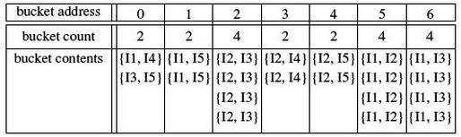
Hash-based Technique: Reduce the Number of candidates
A k-itemset whose corresponding hashing bucket count is below the threshold
cannot be frequent

Slide 25

Thank You

