Slide 1

Time Series Analysis

Slide 2
What is Time Series ??
Time series is a unique type of problem in machine learning where the time component
plays a critical role in the model predictions.
As observations are dependent on adjacent observations, this violates the assumption that
observations are independent to each other followed by most conventional machine learning models.
Common use cases of time series analysis are forecasting future numeric values,
e.g. stock pricing, revenue, temperature, which falls under the category of regression models.
However, time series models can also be applied in classification problems, for instance, pattern recognition in brain wave monitoring, or failure identification in the production process are
common applications of time series classifiers.

Slide 3
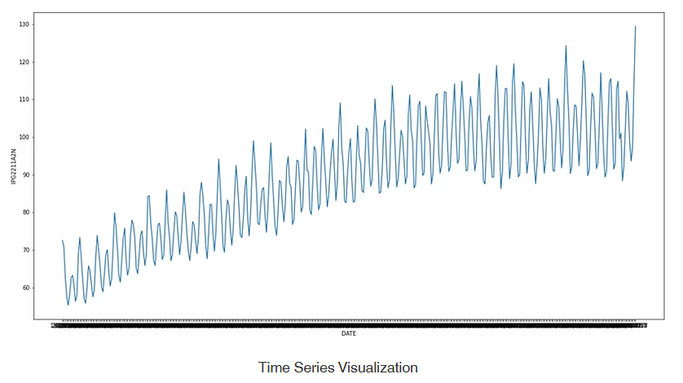
Electric Production time series data

Slide 4
Time-Series Components
Trend
Cyclical
Time-Series
Seasonal
Random

Slide 5

Trend Component
Overall Upward or Downward Movement
Data Taken Over a Period of Years
Sales
Time
© 1999 Prentice-Hall, Inc.
Chap. 15- 5

Slide 6
Cyclical Component
Upward or Downward Swings
May Vary in Length
Usually Lasts 2 - 10 Years
Sales
Time

Slide 7
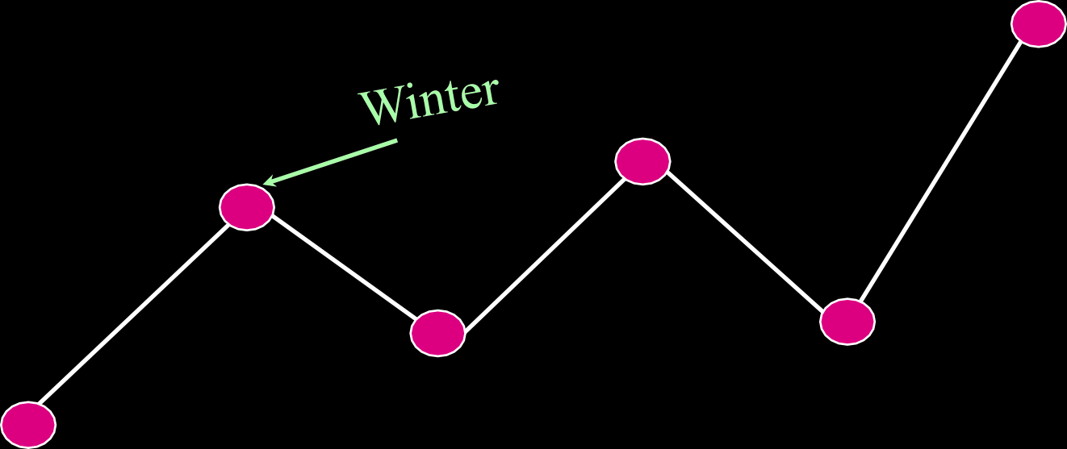
Seasonal Component
Upward or Downward Swings
Regular Patterns
Observed Within 1 Year
Sales
Time (Monthly or Quarterly)

Slide 8
Erratic, Nonsystematic, Random, ‘Residual’ Fluctuations
Due to Random Variations of
Nature
Accidents
Short Duration and Non-repeating
Random or Irregular Component

Slide 9
Multiplicative Time-Series Model
Used Primarily for Forecasting
Observed Value in Time Series is the product of Components
For Annual Data: _{Yi}
= T_{i} × C_{i} × I_{i}
For Quarterly or Monthly Data: _{Yi}
= T_{i} × S_{i} × C_{i} × I_{i}
T_{i} = Trend C_{i} = Cyclical I_{i} = Irregular
S_{i} = Seasonal

Slide 10
Moving Averages
Used for Smoothing
Series of Arithmetic Means Over Time
Result Dependent Upon Choice of L, Length of Period for Computing Means
For Annual Time-Series, L Should be Odd
Example: 3-year Moving Average
First Average:
+ Y₂ + Y₃
MA ( 3 ) = ^{Y1}
3
Y₂ + Y₃ + Y₄
Second Average: MA ( 3 ) =
3

Slide 11

Moving Average Example
John is a building contractor with a record of a total of 24 single family homes constructed over a 6-year period. Provide John with a Moving Average Graph.
Year | Units | Moving Ave
1994 | 2 | NA
1995 | 5 | 3
1996 | 2 | 3
1997 | 2 | 3.67
1998 | 7 | 5
1999 | 6 | NA

Slide 12

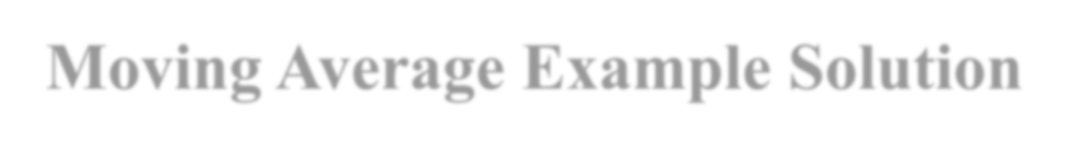


Moving Average Example Solution
Year | Response | Moving Ave
1994 | 2 | NA
1995 | 5 | 3
1996 | 2 | 3
1997 | 2 | 3.67
1998 | 7 | 5
1999 | 6 | NA
Sales
8
6
4
2
0
94 95 96 97 98 99

Slide 13
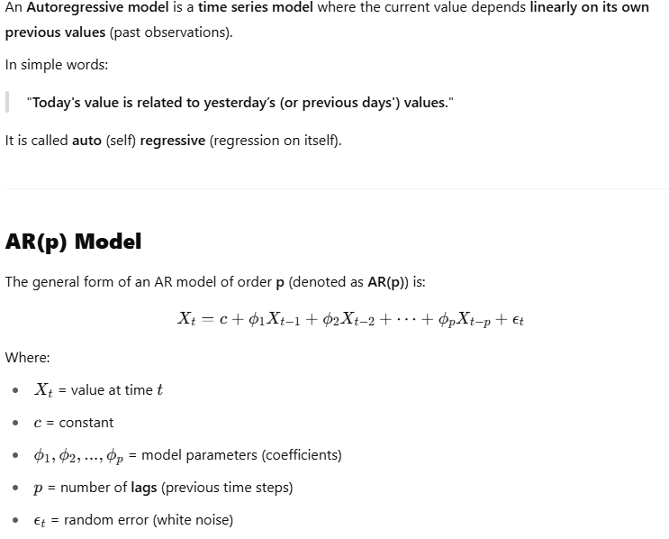
Autoregressive (AR) Modeling in Time Series

Slide 14
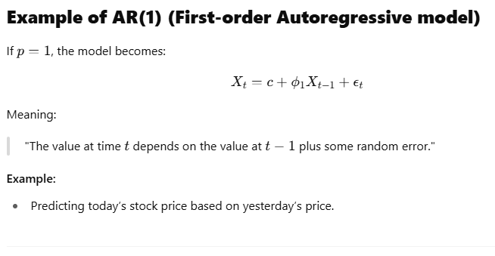
Real-World Examples
Predicting tomorrow's temperature based on today's temperature.
Modeling electricity load based on past loads.
Forecasting sales based on previous months’ sales.

Slide 15
Stationarity
Time series data can be classified into stationary and non-stationary. Stationarity is an important property, as some models work well when the data is stationary.
However, time series data often possesses the non-stationary property. Therefore, we need to understand how to identify non-stationary time series and how to transform it through various techniques, e.g. differencing.
Stationary data is defined as not depending on the time component and possesses the following characteristics, constant mean, constant variance overtime and constant autocorrelation structure (i.e., the pattern of autocorrelation does not change over time), without periodic or seasonal component.
Use ARMA for stationary series.
Use ARIMA when the series is non-stationary and needs differencing.

Slide 16
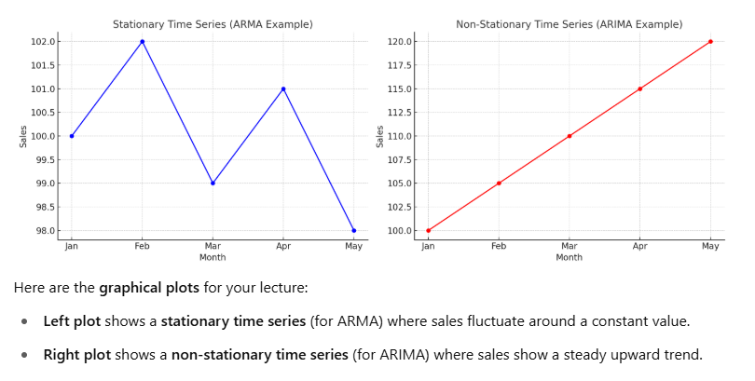

Slide 17
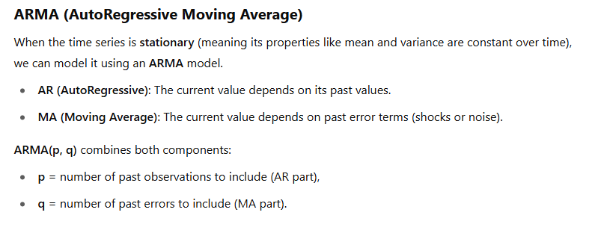

Slide 18
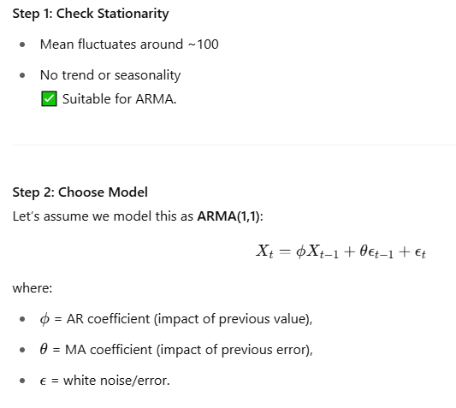
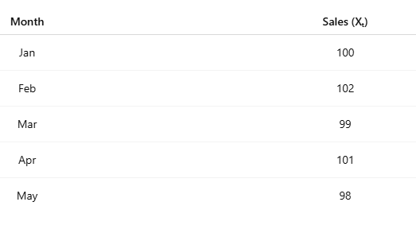
ARMA example

Slide 19
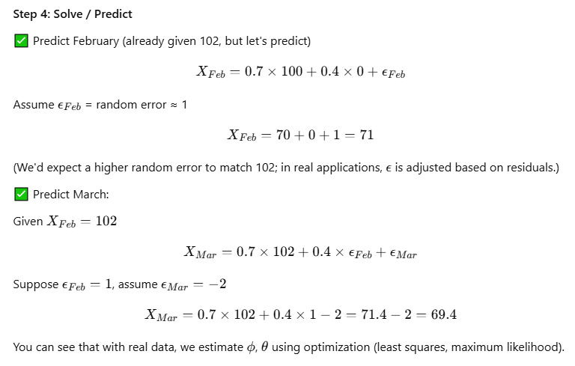

Slide 20
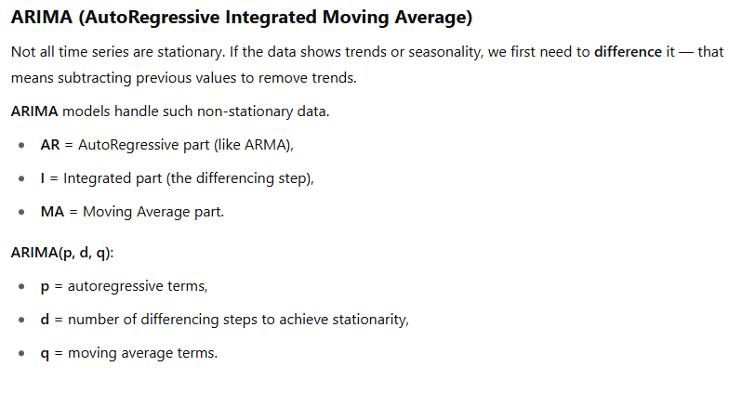

Slide 21
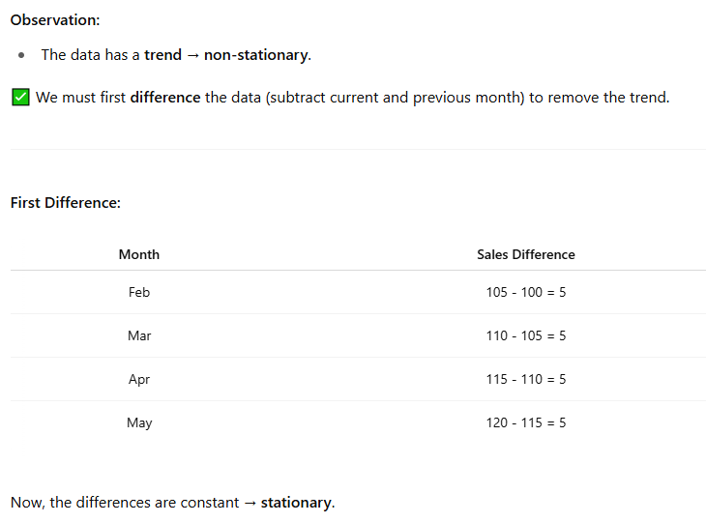
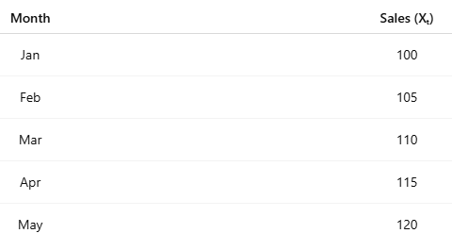
ARIMA Example

Slide 22
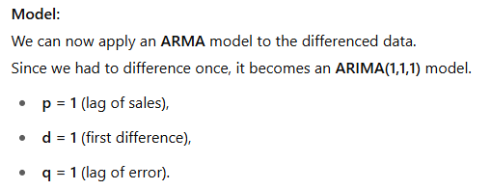
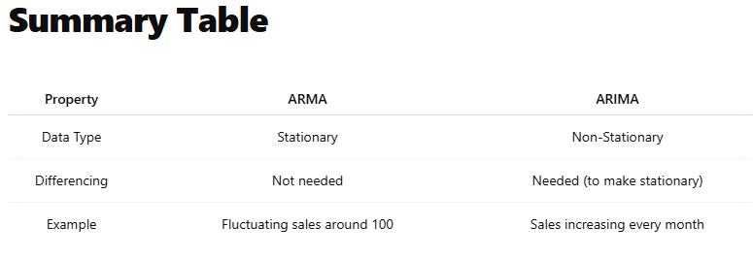

Slide 23





Residual Analysis
e
e
0
0
T
T
Random errors
Cyclical effects
e
e
0
0
T
T
Trend
Seasonal effects

Slide 24

Measuring Errors
Sum Square Error (SSE)
n
SSE =
∑
(Y − Y^{ˆ} )²
i i
i =1
Mean Absolute Deviation (MAD)
n
∑
Y − Y^{ˆ}
i i
_{MAD =} i =1
n

