Slide 1

Operating system: cset209

Slide 2
Outline
Distributed Systems
Network vs Distributed OS
RPC its structure and working
Sun RPC and XDR

Slide 3
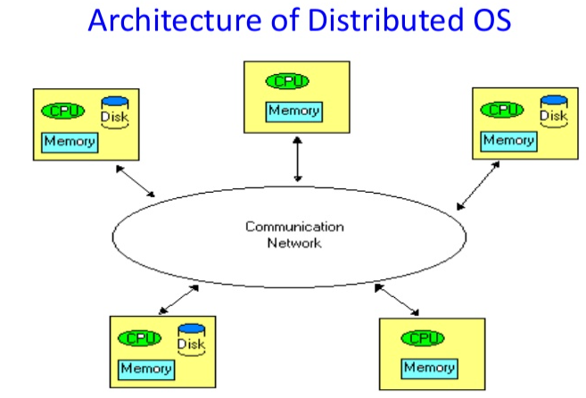
1. Distributed Operating System
S
A distributed operating system is system software over a collection of independent, networked, communicating, and physically separate computational nodes.
The distributed operating system manages a set of independent, networked, communicating computers and makes them look like an ordinary centralized operating system. Its main objective is to manage hardware resources.
Few examples of a distributed OS are as follows: AIX operating system for IBM RS/6000 computers. Solaris operating system for SUN multiprocessor workstations

Slide 4
Distributed Operating System
S
Advantages of Distributed OS
The distributed operating system provides sharing of resources.
This type of system is fault-tolerant.
Disadvantages of Distributed OS
Protocol overhead can dominate computation cost.

Slide 5
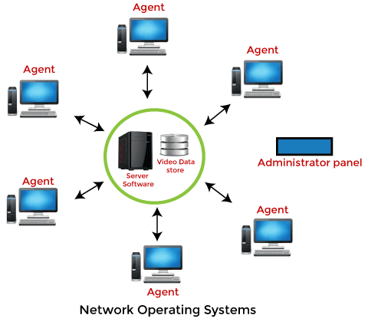
2. Network Operating System
S
Network operating systems are server-based operating systems that provide networking-related functionality. Its primary objective is to give local services to remote users. It's all nodes can have a different operating system.
Examples of Network Operating System are: Microsoft Windows Server 2003, Microsoft Windows Server 2008, UNIX, Linux
It can be used for providing file server, email server etc. services over the network.

Slide 6
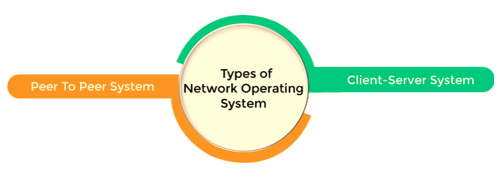
Network Operating System
S
Advantages of Network OS
In this type of operating system, network traffic reduces due to the division between clients and the server.
This type of system is less expensive to set up and maintain.
Disadvantages of Network OS
In this type of operating system, the failure of any node in a system affects the whole system.
Security and performance are important issues. So trained network administrators are required for network administration.

Slide 7
Network vs Distributed Operating System
S.NO | Network Operating System | Distributed Operating System
1. | Network Operating System’s main objective is to provide the local services to remote client. | Distributed Operating System’s main objective is to manage the hardware resources.
2. | In Network Operating System, Communication takes place on the basis of files. | In Distributed Operating System, Communication takes place on the basis of messages and shared memory.
3. | Network Operating System is more scalable than Distributed Operating System. | Distributed Operating System is less scalable than Network Operating System.
4. | In Network Operating System, fault tolerance is less. | While in Distributed Operating System, fault tolerance is high.
5. | Ease of implementation in Network Operating System is also high. | While in Distributed Operating System Ease of implementation is less.
6. | In Network Operating System, All nodes can have different operating system. | While in Distributed Operating System, All nodes have same operating system.

Slide 8
NOS vs DOS in terms of system design and user experience.
System Design
Feature | Network Operating System (NOS) | Distributed Operating System (DOS)
Architecture | Loosely coupled; each node has its own OS. | Tightly integrated; appears as one system.
Resource Management | Each system manages its own resources independently. | Centralized/global resource management across nodes.
Communication | Users or applications explicitly manage communication (e.g., file sharing, remote login). | Communication is handled transparently by the system.
Scalability | Easier to scale by adding new independent systems. | More complex to scale due to coordination overhead.
Fault Tolerance | Failures affect only the affected system. | Can provide higher fault tolerance via redundancy and replication.

Slide 9
NOS vs DOS in terms of system design and user experience.
User Experience
Feature | Network Operating System (NOS) | Distributed Operating System (DOS)
Transparency | Low; users are aware of multiple systems (e.g., accessing remote resources manually). | High; users see the system as a single cohesive unit.
File System | Separate file systems per machine; user must specify remote access paths. | Unified file system; files can be accessed without knowing their physical location.
Process Management | Users manage processes on individual systems. | System can schedule and migrate processes transparently across machines.
Ease of Use | More effort needed to interact with remote resources. | Easier, as all resources seem local.

Slide 10
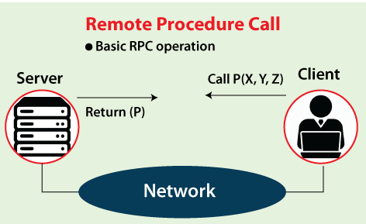
3. Remote Procedure Call (RPC) Protocol in Distributed System
Remote Procedure Call is a software communication protocol that one program can use to request a service from a program located in another computer on a network without having to understand the network's details.
RPC uses the client-server model.
NOTE: RPC is especially well suited for client-server (e.g. query-response) interaction in which the flow of control alternates between the caller and callee.
Example Applications: Remote file and database access, remote monitoring program control, remote error logging etc.

Slide 11
Types of Parameter Passing in RPC
Call-by-Value: A copy of the data is sent to the remote server. Changes made on the server do not affect the original variable on the client.
Call-by-Reference: Instead of copying, a reference to the data is passed. However, true call-by-reference is not feasible across networks, so it’s usually simulated using handles or additional communication.
Call-by-Result: Only the output result is returned to the caller.
Call-by-Value-Result: Combines call-by-value and call-by-result—parameters are sent and updated values are returned.

Slide 12
Importance of Parameter Passing in RPC
Transparency:
Goal: RPC aims to make remote calls as similar to local calls as possible.
Proper parameter passing ensures interface transparency, hiding the complexities of data transmission from the developer.
Issues like data marshalling (converting parameters to a transmittable format) and unmarshalling are handled by the RPC mechanism to preserve this abstraction.
Correctness:
Incorrect parameter handling (e.g., not considering differences in data representation or endianness) can lead to bugs or crashes.
Ensures that input/output semantics are preserved across different systems.
Efficiency:
Large or complex parameters can cause performance bottlenecks due to serialization overhead and network latency.
Efficient marshalling, minimizing data transfer, and avoiding unnecessary parameter copies are critical for performance.

Slide 13
Effects on Transparency and Efficiency
Aspect | Impact of Parameter Passing
Transparency | Makes the remote procedure call appear like a local one; poor parameter handling breaks this illusion.
Efficiency | Affects serialization/deserialization cost, network usage, and processing time on both client and server sides.
Robustness | Impacts error handling and fault tolerance in case of transmission or format mismatches.

Slide 14
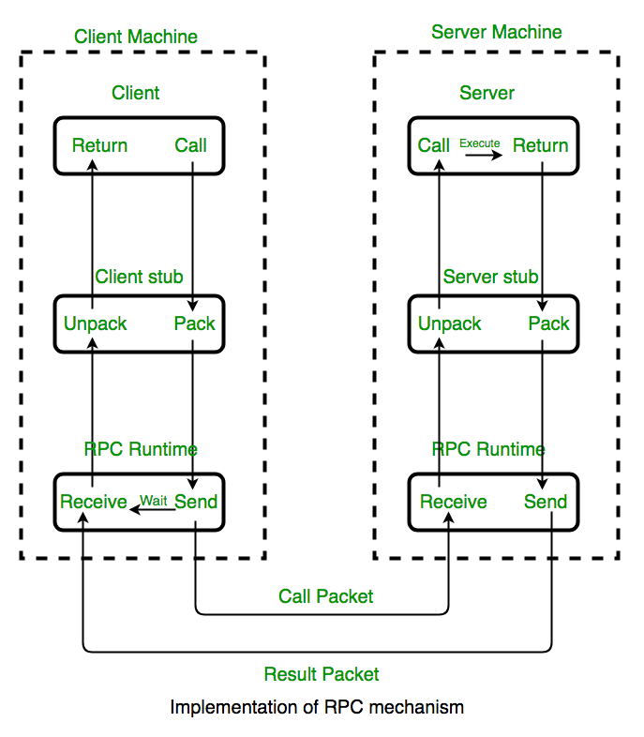
How to Make a Remote Procedure Call?
The following steps take place during a RPC :
A client invokes a client stub procedure, passing parameters in the usual way. The client stub resides within the client’s own address space.
The client stub marshalls(pack) the parameters into a message. Marshalling includes converting the representation of the parameters into a standard format, and copying each parameter into the message.
The client stub passes the message to the transport layer, which sends it to the remote server machine.
On the server, the transport layer passes the message to a server stub, which demarshalls(unpack) the parameters and calls the desired server routine using the regular procedure call mechanism.
When the server procedure completes, it returns to the server stub (e.g., via a normal procedure call return), which marshalls the return values into a message. The server stub then hands the message to the transport layer.
The transport layer sends the result message back to the client transport layer, which hands the message back to the client stub.
The client stub demarshalls the return parameters and execution returns to the caller.

Slide 15
ISSUES and challenges in rpc
1. RPC Runtime: RPC run-time system is a library of routines and a set of services that handle the network communications that underlie the RPC mechanism. In the course of an RPC call, client-side and server-side run-time systems’ code handle binding, establish communications over an appropriate protocol, pass call data between the client and server, and handle communications errors.
2. Stub: The function of the stub is to provide transparency to the programmer-written application code.
On the client side, the stub handles the interface between the client’s local procedure call and the run-time system, marshaling and unmarshalling data, invoking the RPC run-time protocol, and if requested, carrying out some of the binding steps.
On the server side, the stub provides a similar interface between the run-time system and the local manager procedures that are executed by the server.
3. Binding: How does the client know who to call, and where the service resides? The most flexible solution is to use dynamic binding and find the server at run time when the RPC is first made.

Slide 16
Features of RPC
In an operating system, remote procedure call (RPC) has the following features, such as:
RPC hides the complexity of the message passing process from the user.
RPC only uses specific layers of the OSI model like the transport layer.
Clients can communicate with the server by using higher-level languages.
RPC works well with both local environments and remote environments.

Slide 17
4 Sun RPC and ROLE of XDR
The first popular implementation of RPC on Unix was Sun's RPC (now called ONC RPC), used as the basis for Network File System (NFS).
Role of XDR in Sun RPC: RPC package uses XDR (eXternal Data Representation) to represent data sent between client and server stubs.
In Sun RPC The XDR (eXternal Data Routines) are responsible for marshalling/unmarshalling procedure parameters onto/from XDR streams.

Slide 18
Thank You ?

