Slide 1
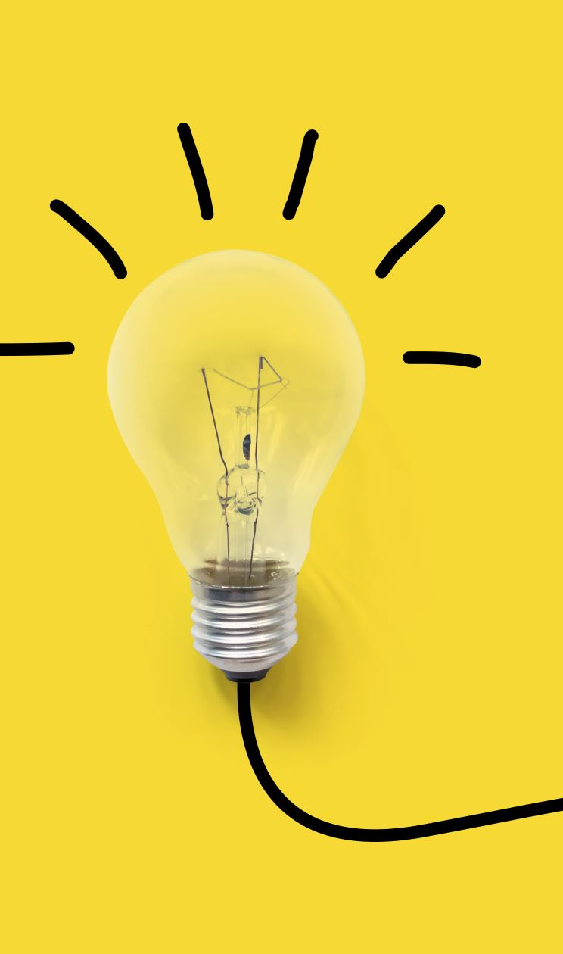
Operating system: cset209

Slide 2
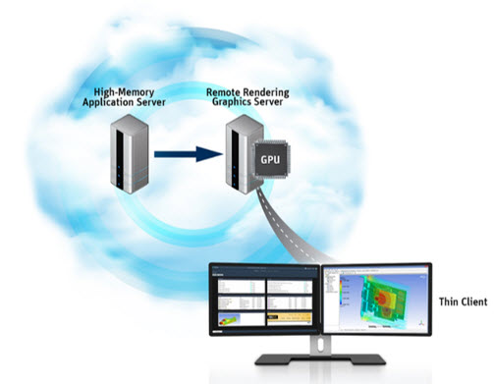

Internal Working and Virtualization
in
Cloud Computing

Slide 3
Cloud Computing Working Architecture

Slide 4
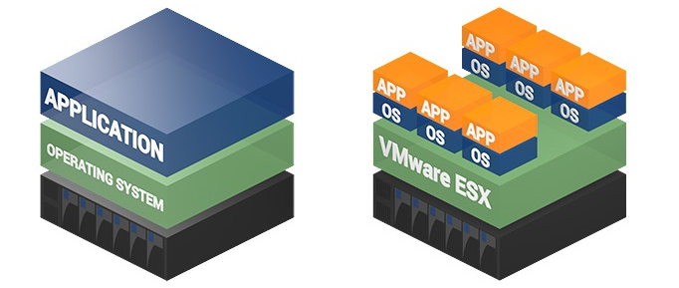
Cloud Computing -Virtualization
Without virtualization, single OS owns all hardware resources, so only 10% of the server resources are utilized and 90% is wasted.
However, virtualization allows increase in hardware utilization by running multiple operating systems to run on the same physical hardware.
(a) Traditional architecture
(b) Virtualization architecture
Figure 1: Traditional vs. Cloud Virtualization architecture
VirtualBox, VMware, KVM, and Citrix XenServer are the popular tools to implement virtualization environment.
In a cloud platform, when a user request for services, resources are allocated in the form of Virtual Machines (VMs).

Slide 5
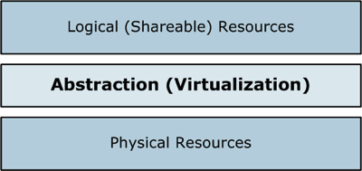
Virtualization
Virtualization is nothing more than an abstraction over physical resources to make them shareable by a number of physical users.
Virtualization allows multiple operating system instances to run concurrently on a single computer, it is a means of separating hardware from a single operating system.

Slide 6
Benefits of Virtualization
Resource Pooling (thus maximum resource utilization)
Server Consolidation (thus saving energy and cost)
VM Migration (Refers to moving a server environment from one place to another)
Load balancing
Maintenance
Failover
Redundancy
Isolated machines (Useful for testing operating systems and new applications)
Notes:
Server virtualization conserves space through consolidation. It's common practice to dedicate each server to a single application. If several applications only use a small amount of processing power, the network administrator can consolidate several machines into one server running multiple virtual environments. For companies that have hundreds or thousands of servers, the need for physical space can decrease significantly.
Server virtualization provides a way for companies to practice redundancy without purchasing additional hardware. Redundancy refers to running the same application on multiple servers. It's a safety measure -- if a server fails for any reason, another server running the same application can take its place. This minimizes any interruption in service. It wouldn't make sense to build two virtual servers performing the same application on the same physical server. If the physical server were to crash, both virtual servers would also fail. In most cases, network administrators will create redundant virtual servers on different physical machines.
Virtual servers offer programmers isolated, independent systems in which they can test new applications or operating systems. Rather than buying a dedicated physical machine, the network administrator can create a virtual server on an existing machine. Because each virtual server is independent in relation to all the other servers, programmers can run software without worrying about affecting other applications.
Server hardware will eventually become obsolete, and switching from one system to another can be difficult. In order to continue offering the services provided by these outdated systems -- sometimes called legacy systems -- a network administrator could create a virtual version of the hardware on modern servers. From an application perspective, nothing has changed. The programs perform as if they were still running on the old hardware. This can give the company time to transition to new processes without worrying about hardware failures, particularly if the company that produced the legacy hardware no longer exists and can't fix broken equipment.
An emerging trend in server virtualization is called migration. Migration refers to moving a server environment from one place to another. With the right hardware and software, it's possible to move a virtual server from one physical machine in a network to another. Originally, this was possible only if both physical machines ran on the same hardware, operating system and processor. It's possible now to migrate virtual servers from one physical machine to another even if both machines have different processors, but only if the processors come from the same manufacturer.

Slide 7
Characteristic of Virtualization
Partitioning: In virtualization, many applications and operating systems (OSes) are supported in a single physical system by partitioning (separating) the available resources.
Isolation: Each virtual machine is isolated from its host physical system and other virtualized machines. Because of this isolation, if one virtual-instance crashes, it doesn’t affect the other virtual machines. In addition, data isn’t shared between one virtual container and another.
Encapsulation: A virtual machine can be represented (and even stored) as a single file, so you can identify it easily based on the service it provides.
Sharing – Virtualization allows the creation of a separate computing environments within the same host. This basic feature is used to reduce the number of active servers and limit power consumption.
Notes:
Server virtualization conserves space through consolidation. It's common practice to dedicate each server to a single application. If several applications only use a small amount of processing power, the network administrator can consolidate several machines into one server running multiple virtual environments. For companies that have hundreds or thousands of servers, the need for physical space can decrease significantly.
Server virtualization provides a way for companies to practice redundancy without purchasing additional hardware. Redundancy refers to running the same application on multiple servers. It's a safety measure -- if a server fails for any reason, another server running the same application can take its place. This minimizes any interruption in service. It wouldn't make sense to build two virtual servers performing the same application on the same physical server. If the physical server were to crash, both virtual servers would also fail. In most cases, network administrators will create redundant virtual servers on different physical machines.
Virtual servers offer programmers isolated, independent systems in which they can test new applications or operating systems. Rather than buying a dedicated physical machine, the network administrator can create a virtual server on an existing machine. Because each virtual server is independent in relation to all the other servers, programmers can run software without worrying about affecting other applications.
Server hardware will eventually become obsolete, and switching from one system to another can be difficult. In order to continue offering the services provided by these outdated systems -- sometimes called legacy systems -- a network administrator could create a virtual version of the hardware on modern servers. From an application perspective, nothing has changed. The programs perform as if they were still running on the old hardware. This can give the company time to transition to new processes without worrying about hardware failures, particularly if the company that produced the legacy hardware no longer exists and can't fix broken equipment.
An emerging trend in server virtualization is called migration. Migration refers to moving a server environment from one place to another. With the right hardware and software, it's possible to move a virtual server from one physical machine in a network to another. Originally, this was possible only if both physical machines ran on the same hardware, operating system and processor. It's possible now to migrate virtual servers from one physical machine to another even if both machines have different processors, but only if the processors come from the same manufacturer.

Slide 8
Advantages of Virtualization
Using Virtualization to Increase Availability
Virtualization platforms offer a number of advanced features that are not found on physical servers, which increase uptime and availability.
Disaster Recovery
Disaster recovery is very easy when your servers are virtualized. With up-to-date snapshots of your virtual machines, you can quickly get back up and running.
Save Energy
Moving physical servers to virtual machines and consolidating them onto far fewer physical servers’ means lowering monthly power and cooling costs in the data center. It reduces carbon footprint and helps to clean up the air we breathe. Consumers want to see companies reducing their output of pollution and taking responsibility.

Slide 9
Advantages of Virtualization
Deploying Servers too fast
You can quickly clone an image, master template or existing virtual machine to get a server up and running within minutes
Save Space in your Server Room or Datacenter
Imagine a simple example: you have two racks with 30 physical servers and 4 switches. By virtualizing your servers, it will help you to reduce half the space used by the physical servers. The result can be two physical servers in a rack with one switch, where each physical server holds 15 virtualized servers.
Possibility to Divide Services
If you have a single server, holding different applications this can increase the possibility of the services to crash with each other and increasing the fail rate of the server

Slide 10
Disadvantages of Virtualization
Extra Costs
May be you have to invest in the virtualization software and possibly additional hardware might be required to make the virtualization possible. This depends on your existing network. Many businesses have sufficient capacity to accommodate the virtualization without requiring much cash.
Software Licensing
This is becoming less of a problem as more software vendors adapt to the increased adoption of virtualization. However, it is important to check with your vendors to understand how they view software use in a virtualized environment.
Learn the new Infrastructure
Implementing and managing a virtualized environment will require IT staff with expertise in virtualization. On the user side, a typical virtual environment will operate similarly to the non-virtual environment. There are some applications that do not adapt well to the virtualized environment.

Slide 11
Basic Terminology
A physical server on which one or more virtual machines are running is defined as host.
The virtual machines are called guests.
A hypervisor is a program that would enable you to host several different virtual machines on a single hardware.

Slide 12
Non-virtualized Data Centers
Too many servers for too little work
High costs and infrastructure needs
Maintenance
Networking
Floor space
Cooling
Power
Disaster Recovery

Slide 13
Different types of Virtualization
Full Virtualization
Para-Virtualization

Slide 14
Full Virtualization
The hypervisor interacts directly with the physical server's CPU and disk space.
The hypervisor keeps each virtual server completely independent and unaware of the other virtual servers running on the physical machine.
Each guest server runs on its own OS -- you can even have one guest running on Linux and another on Windows.

Slide 15
Full Virtualization (Contd..)
As virtual servers run applications, the hypervisor relays resources from the physical machine to the appropriate virtual server.
Hypervisors have their own processing needs, which means that the physical server must reserve some processing power and resources to run the hypervisor application.
This can impact overall server performance and slow down applications.

Slide 16
Full Virtualization
Full virtualization provides a complete simulation of the underlying hardware and is a technique used to provide support for unmodified guest operating systems.
The term unmodified refers to operating system kernels which have not been altered to run on a hypervisor.
While full virtualization comes with a performance penalty, the technique permits running unmodified operating system, which is ideal, particularly when source is unavailable such as with proprietary operating systems.
Notes:
A hardware emulator presents a simulated hardware interface to guest operating systems. In hardware emulation, the virtualization software (usually referred to as a hypervisor) actually creates an artificial hardware device with everything it needs to run an operating system and presents an emulated hardware environment that guest operating systems operate upon. This emulated hardware environment is typically referred to as a Virtual Machine Monitor or VMM. Hardware emulation supports actual guest operating systems; the applications running in each guest operating system are running in truly isolated operating environments. This way, we can have multiple servers running on a single box, each completely independent of the other. The VMM provides the guest OS with a complete emulation of the underlying hardware and for this reason, this kind of virtualization is also referred to as Full Virtualization. Thus, full virtualization provides a complete simulation of the underlying hardware and is a technique used to provide support for unmodified guest operating systems. This means that all software, operating systems and applications, which can run natively on the hardware can also be run in the virtual machine. The term unmodified refers to operating system kernels which have not been altered to run on a hypervisor and therefore still execute privileged operations as though running in ring 0 of the CPU. Full virtualization uses the hypervisor to coordinate the CPU of the server and the host machine's system resources in order to manage the running of guest operating systems without any modification. In this scenario, the hypervisor provides CPU emulation to handle and modify privileged and protected CPU operations made by unmodified guest operating system kernels. The guest operating system makes system calls to the emulated hardware. These calls, which would actually interact with underlying hardware, are intercepted by the virtualization hypervisor which maps them onto the real underlying hardware. The hypervisor provides complete independence and autonomy of each virtual server to other virtual servers running on the same physical machine. Each guest server has its own operating system and it may even happen that one guest server is running Linux and the other is running Windows. The hypervisor also monitors and controls the physical server resources, allocating what is needed to each operating system and making sure that the guest operating systems (the virtual machines) cannot disrupt each other. With full virtualization, the guest OS is not aware it is being virtualized and thus requires no modification.

Slide 17
Full Virtualization
The guest operating system makes system calls to the emulated hardware.
These calls, which would actually interact with underlying hardware, are intercepted by the virtualization hypervisor which maps them onto the real underlying hardware.
The hypervisor also monitors and controls the physical server resources.

Slide 18
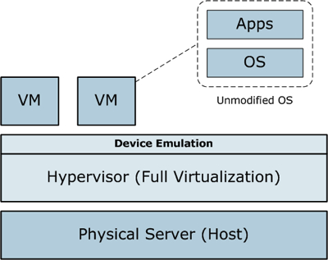
Full Virtualization

Slide 19
Para-Virtualization
The fundamental issue with full virtualization is the emulation of devices within the hypervisor.
A solution to this problem is to make the guest operating system aware that it's being virtualized.
With this knowledge, the guest OS can short circuit its drivers to minimize the overhead of communicating with physical devices.
In this way, the guest OS drivers and hypervisor drivers integrate with one another to efficiently enable and share physical device access.
Low-level emulation of devices is removed, replaced with cooperating guest and hypervisor drivers.

Slide 20
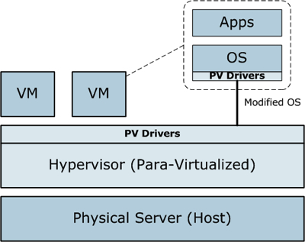
Para-Virtualization

Slide 21
Para virtualization
Pros
Improved Performance
Cons
The downside of para-virtualization is that the guest must be modified to integrate hypervisor awareness

Slide 22
Different Types of Hypervisors
Type 1
Type 2

Slide 23
Type 1 Hypervisor
A hypervisor running on bare metal is called Type 1 Hypervisor or native Hypervisor.
No host operating system is required, they are installed on bare metal.
Bare metal hypervisors are faster and more efficient as they do not need to go through the operating system and other layers that usually make hosted hypervisors slower.
Examples
KVM
Citrix XenServer
Notes:
Study How to Install VMWare ESXi 5.1 on Server – Type-1 Hypervisor

Slide 24
Type 2 Hypervisor
Installed over an operating System and are referred to as Type 2 Hypervisor or hosted Hypervisor.
Hosted hypervisors are much easier to set up than bare metal hypervisors because you have an OS to work with.
These are also compatible with a broad range of hardware.
Examples
Microsoft Hyper-V (run over Windows Server)
VirtualBox
Vmware Workstation
Notes:
Type 2 desktop hypervisors are typically used by IT in test and development, rather than for business-wide virtual desktop deployments, Burton Group analyst Chris Wolf says.

Slide 25
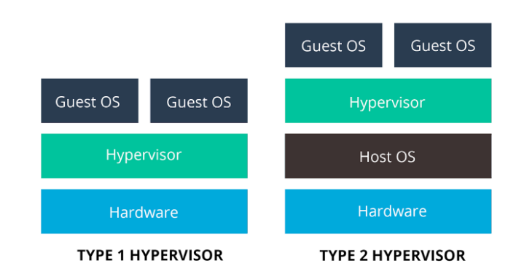
Type 1 Hypervisor vs. Type 2 Hypervisor
Type 1 vs. Type 2 Hypervisor
According to IBM, Type 1 hypervisors provide higher performance, availability, and security than Type 2 hypervisors.

Slide 26
Key Roles of Virtualization
Resource Abstraction and Isolation: Enables multiple tenants to share the same physical resources securely and efficiently.
Efficient Resource Utilization: Physical hardware is used more effectively by running multiple VMs or containers on a single server.
Scalability and Flexibility: Easily spin up or tear down virtual machines or containers based on demand.
Disaster Recovery and High Availability: VMs can be quickly backed up, migrated, or restored in case of hardware failures.
Cost Savings: Reduces the need for physical servers, lowering hardware, power, and maintenance costs.
Simplified Management and Automation: Tools like hypervisors, orchestration platforms (e.g., Kubernetes), and Infrastructure as Code (IaC) enhance automation and manageability.

Slide 27
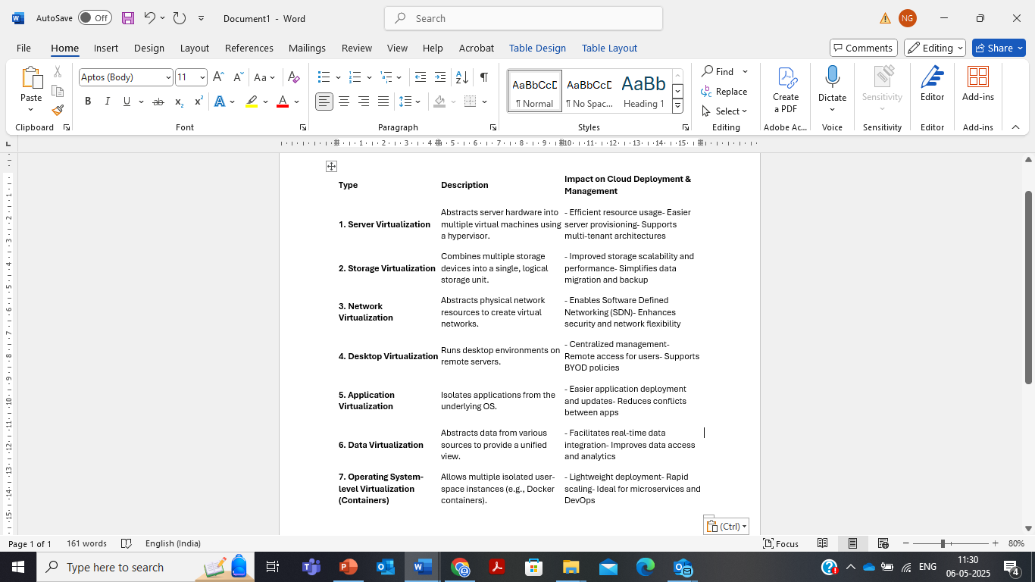
Types of Virtualization and Their Impact

Slide 28

Cloud Computing Challenges: Dealing with too many issues
Pricing
Virtualization
Scalability
Resource Metering
QoS
Reliability
Service Level
Agreements
Billing
Energy Efficiency
Provisioning
on Demand
Utility & Risk Management
Security
Legal & Regulatory
Privacy
Programming Env. & Application Dev.
Uhm, I am not quite
clear…Yet another
complex IT paradigm?
Trust
Software Eng. Complexity

Slide 29
Biggest Cloud Computing Challenges in 2022
1. Security of Data
In terms of security concerns of cloud technology, we don’t find answers to some questions. Mysterious threats like website hacking and virus attack are the biggest problems of cloud computing data security.
2. Insufficiency of Resources and Expertise
The inadequacy of resources and expertise is one of the cloud migration challenges this year. As per the report by RightScale, almost 75% of the respondent marked it as a challenge while 23% said that it was a serious challenge.
3. Complete Governance over IT Services
IT always doesn’t have full control over provisioning, infrastructure delivery, and operation in this cloud-based world. This has raised the complicacy of IT to offer important compliance, governance, data quality, and risk management.
4. Cloud Cost Management
The RightScale report revealed that for a few companies, handling cloud spending has passed security as the biggest cloud computing challenge. As per their anticipations, organizations are ruining nearly 30% of the money they invest in the cloud.

Slide 30
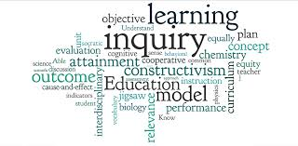
Thanks Note
THANKS
tungal/presentations/ad2012

