Slide 1

MODULE-2
DESIGN OF COMBINATIONAL
LOGIC CIRCUITS
CSET105 – DIGITAL DESIGN
Bennett University

Slide 2

MODULE-4
Design of Combinational Logic Circuits
Design Procedure, Binary Adder-Subtractor, Parallel Adder, Binary Multiplier, MagnitudeComparator-4 bit, Decoders, Encoders, Multiplexers, De-multiplexer, Parity generator and checker. Application of Mux and Demux.
MODULE- 2
CSET-105: Digital Design
2

Slide 3
INTRODUCTION TO COMBINATIONAL LOGIC CIRCUITS
MODULE- 2
CSET-105: Digital Design
3

Slide 4
INTRODUCTION TO COMBINATIONAL LOGIC
The digital system consists of two types of circuits,
Combinational circuit:
  consists of logic gates
  output at any time is determined from the present combination of inputs.
Sequential circuit:
  comprises both logic gates and the state of storage elements such as flip-flops.
  The output of a sequential circuit depends not only on present value of inputs but also on past state of inputs.
MODULE- 2
CSET-105: Digital Design
4

Slide 5
INTRODUCTION TO COMBINATIONAL LOGIC
A combinational circuit consists of input variables, logic gates, and output variables.
The logic gates accept signals from inputs and output signals are generated according to the logic circuits employed in it.
Binary information from the given data transforms to desired output data in this process.
Both input and output are obviously the binary signals, i.e., either logic 1 or logic 0.
MODULE- 2
CSET-105: Digital Design
6

Slide 6
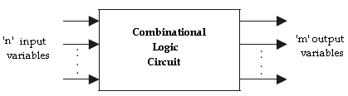
INTRODUCTION TO COMBINATIONAL LOGIC
Block diagram of a combinational logic circuit
MODULE- 2
CSET-105: Digital Design
7

Slide 7
INTRODUCTION TO COMBINATIONAL LOGIC
For n number of input variables to a combinational circuit, 2^{n} possible combinations of binary input states are possible.
For each possible combination, there is one and only one possible output combination.
A combinational logic circuit can be described by m Boolean functions and each output can be expressed in terms of n input variables.
MODULE- 2
CSET-105: Digital Design
8

Slide 8
DESIGN
PROCEDURE
MODULE- 2
CSET-105: Digital Design
23

Slide 9
DESIGN PROCEDURE
Any combinational circuit can be designed by the following steps of design procedure.
The problem statement.
Identify the number of input and output variables.
The input and output variables are assign with letter symbols.
Construction of a truth table for the given logic.
The simplified Boolean expression is obtained by any method of minimization—algebraic method, Karnaugh map method.
A logic diagram is realized from the simplified Boolean expression using logic gates.
MODULE- 2
CSET105: Digital Design
24

Slide 10
DESIGN PROCEDURE
EXAMPLE-1:
Design a combinational circuits with three input variables that will produce a logic-1 output when more than one input variables are HIGH state.
Solution:
STEP1: The problem statement.
Design a combinational circuits with three input variables that will produce a logic-1 Output when more than one input variables are HIGH.
STEP2: Identify the input and output variables
No. of inputs required: 3
No. of output required: 1
MODULE- 2
CSET105: Digital Design
25

Slide 11
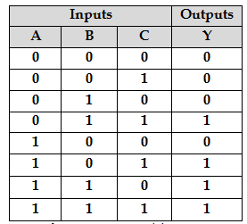
DESIGN PROCEDURE
STEP3: The input & outputs are assign with letter symbols
Letter symbol for inputs: A, B, C
Letter symbol for output: Y
STEP4: Construction of a truth table for the given logic
MODULE- 2
CSET105: Digital Design
26

Slide 12
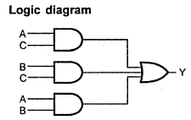
DESIGN PROCEDURE
STEP5: obtain the simplified expression for output variable using K-map simplification
STEP6: A logic diagram is realized from the simplified Boolean expression using logic gates
C
0
1
AB
00
01
11
10
0 | 0
0 | 1
1 | 1
0 | 1
Y = (AB)+(AC)+(BC)
MODULE- 2
CSET105: Digital Design
27

Slide 13
DESIGN PROCEDURE
EXERCISES
Design a circuit with 4 inputs that has outputs with a binary value equal to the number of inputs that are HIGH.
A logic circuit accepts two 3-bit numbers and generates a logic output only when the two 3-bit numbers applied to the circuit are equal. Design the logic circuit.
Design a logic circuit that will produce a 1 only when the number of 1’s in a set of four inputs variables, A, B, and C, D are even (i.e. an even parity checker).
MODULE- 2
CSET105: Digital Design
31

Slide 14
BINARY
ADDER
MODULE- 2
CSET105: Digital Design
32

Slide 15

BINARY ADDER
HALF ADDER
A half-adder is a combinational circuit that can be used to add two binary bits.
It has two inputs that represent the two bits to be added and two outputs, with one producing the SUM output and the other producing the CARRY.
Inputs |  | Outputs
A | B | Carry (C) | Sum (S)
0 | 0 | 0 | 0
0 | 1 | 0 | 1
1 | 0 | 0 | 1
1 | 1 | 1 | 0
BLOCK DIAGRAM
TRUTH TABLE
MODULE- 2
CSET105: Digital Design
33

Slide 16
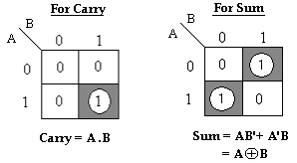
BINARY ADDER
HALF ADDER
The Boolean expressions for the SUM and CARRY outputs are given by the equations,
Sum, S = A’B+ AB’= A⊕B
Carry, C = A . B
MODULE- 2
CSET105: Digital Design
34

Slide 17
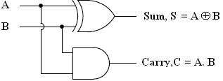
BINARY ADDER
HALF ADDER
The first one representing the SUM output is that of an EX-OR gate, the second one representing the CARRY output is that of an AND gate.
LOGIC DIAGRAM
MODULE- 2
CSET105: Digital Design
35

Slide 18
BINARY ADDER
FULL ADDER
The full adder circuit overcomes the limitation of the half-adder, which can be used to add two bits only.
A full adder is a combinational circuit that forms the arithmetic sum of three input bits.
It consists of 3 inputs and 2 outputs. Two of the input variables, represent the significant bits to be added.
The third input represents carry from previous lower significant position.
MODULE- 2
CSET105: Digital Design
36

Slide 19
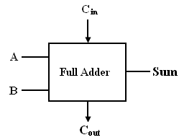
BINARY ADDER
FULL ADDER
Inputs |  |  | Outputs
A | B | C_{in} | Sum (S) | Carry (C_{out})
0 | 0 | 0 | 0 | 0
0 | 0 | 1 | 1 | 0
0 | 1 | 0 | 1 | 0
0 | 1 | 1 | 0 | 1
1 | 0 | 0 | 1 | 0
1 | 0 | 1 | 0 | 1
1 | 1 | 0 | 0 | 1
1 | 1 | 1 | 1 | 1
LOGIC DIAGRAM
TRUTH TABLE
MODULE- 2
CSET105: Digital Design
37

Slide 20
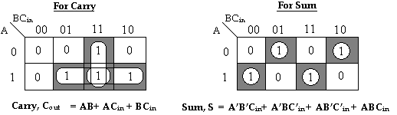
BINARY ADDER
FULL ADDER
K-MAP
The Boolean expressions for the SUM and CARRY outputs are given by the equations,
Sum, S= A’B’C_{in}+ A’BC’_{in} + AB’C’_{in} + ABC_{in}
Carry, C_{out} = AB+ AC_{in} + BC_{in .}
MODULE- 2
CSET105: Digital Design
38

Slide 21
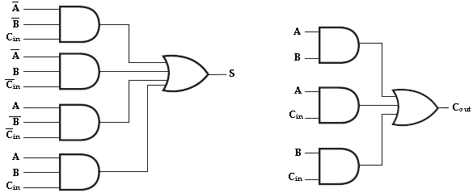
BINARY ADDER
FULL ADDER
The logic diagram for the above functions is shown as,
Implementation of full-adder in Sum of Products
MODULE- 2
CSET105: Digital Design
39

Slide 22
BINARY ADDER
FULL ADDER
The logic diagram of the full adder can also be implemented with two half-adders and one OR gate.
The S output from the second half adder is the exclusive-OR of C_{in} and the output of the first half-adder, giving
Sum = A’BC’_{in} + AB’C’_{in} + ABC_{in} + A’B’C_{in .}
= C’_{in} (A’B+AB’) + C_{in} (AB+A’B’)
= C’_{in} (A’B+AB’) + C_{in} (A’B+AB’)’
= C_{in} ⊕ (A’B+AB’)
= C_{in} ⊕ (A ⊕ B) [x ⊕ y = x’y+ xy’]
MODULE- 2
CSET105: Digital Design
40

Slide 23
BINARY ADDER
FULL ADDER
Carry, C_{out} = AB+ AC_{in}+ BC_{in.}
= AB+ AC_{in}+ BC_{in} (A +A’)
= ABC_{in}+ AB+ AC_{in}+ A’BC_{in}
= AB (C_{in}+1) + AC_{in}+ A’BC_{in} [C_{in}+1= 1]
= AB+ AC_{in}+ A’BC_{in}
= AB+ AC_{in} (B+B’) + A’BC_{in}
= ABC_{in}+ AB+ A’BC_{in}+ AB’C_{in}
= AB (C_{in}+1) + A’BC_{in}+ AB’C_{in} [C_{in}+1= 1]
= AB+ A’BC_{in}+ AB’C_{in}
= AB+ C_{in} (A’B+AB’)
MODULE- 2
CSET105: Digital Design
41

Slide 24
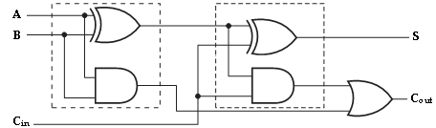
BINARY ADDER
FULL ADDER
Implementation of full adder with two half-adders and an OR gate
MODULE- 2
CSET105: Digital Design
42

Slide 25
BINARY
SUBTRACTOR
MODULE- 2
CSET105: Digital Design
43

Slide 26

BINARY SUBTRACTOR
HALF SUBTRACTOR
A half Subtractor is a combinational circuit that can be used to subtract one binary digit from another to produce a DIFFERENCE output and a BORROW output.
The BORROW output here specifies whether a ‘1’ has been borrowed to perform the subtraction.
Block schematic of half Subtractor
MODULE- 2
CSET105: Digital Design
44

Slide 27
BINARY SUBTRACTOR
HALF SUBTRACTOR
The truth table of half Subtractor, showing all possible input combinations and the corresponding outputs are shown below.
Input |  | Output
A | B | Difference (D) | Borrow (B_{out})
0 | 0 | 0 | 0
0 | 1 | 1 | 1
1 | 0 | 1 | 0
1 | 1 | 0 | 0
MODULE- 2
CSET105: Digital Design
45

Slide 28
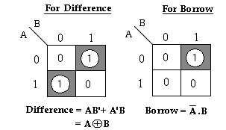
BINARY SUBTRACTOR
HALF SUBTRACTOR
K-map simplification for half Subtractor:
The Boolean expressions for the DIFFERENCE and BORROW outputs are given by the equations,
Difference, D = A’B+ AB’= A ⊕ B
Borrow, B_{out} = A’ . B
MODULE- 2
CSET105: Digital Design
46

Slide 29
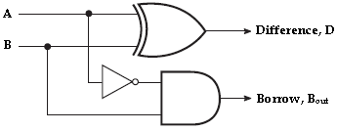
BINARY SUBTRACTOR
HALF SUBTRACTOR
Logic Implementation of Half-Subtractor
MODULE- 2
CSET105: Digital Design
47

Slide 30
BINARY SUBTRACTOR
HALF SUBTRACTOR
Comparing a half Subtractor with a half-adder, we find that the expressions for the SUM and DIFFERENCE outputs are just the same.
The expression for BORROW in the case of the half-Subtractor is also similar to what we have for CARRY in the case of the half-adder.
If the input A i.e. the minuend is complemented, an AND gate can be used to implement the BORROW output.
MODULE- 2
CSET105: Digital Design
48

Slide 31
BINARY SUBTRACTOR
FULL SUBTRACTOR
A full Subtractor performs subtraction operation on two bits, a minuend and a subtrahend, and also takes into consideration whether a ‘1’ has already been borrowed by the previous adjacent lower minuend bit or not.
As a result, there are three bits to be handled at the input of a full Subtractor, namely the two bits to be subtracted and a borrow bit designated as B_{in}.
MODULE- 2
CSET105: Digital Design
49

Slide 32
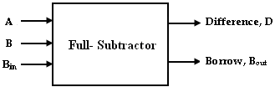
BINARY SUBTRACTOR
FULL SUBTRACTOR
There are two outputs, namely the DIFFERENCE output D and the BORROW output B_{o}. The BORROW output bit tells whether the minuend bit needs to borrow a ‘1’ from the next possible higher minuend bit.
Block schematic of full Subtractor
MODULE- 2
CSET105: Digital Design
50

Slide 33
BINARY SUBTRACTOR
FULL SUBTRACTOR
Inputs |  |  | Outputs
A | B | B_{in} | Difference(D) | Borrow(B_{out})
0 | 0 | 0 | 0 | 0
0 | 0 | 1 | 1 | 1
0 | 1 | 0 | 1 | 1
0 | 1 | 1 | 0 | 1
1 | 0 | 0 | 1 | 0
1 | 0 | 1 | 0 | 0
1 | 1 | 0 | 0 | 0
1 | 1 | 1 | 1 | 1
Truth Table
MODULE- 2
CSET105: Digital Design
51

Slide 34
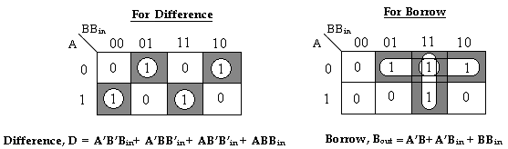
BINARY SUBTRACTOR
FULL SUBTRACTOR
K-map simplification for full Subtractor:
The Boolean expressions for the DIFFERENCE and BORROW outputs are given by the equations,
Difference, D = A’B’B_{in}+ A’BB’_{in} + AB’B’_{in} + ABB_{in}
Borrow, B_{out} = A’B+ A’C_{in} + BB_{in .}
MODULE- 2
CSET105: Digital Design
52

Slide 35
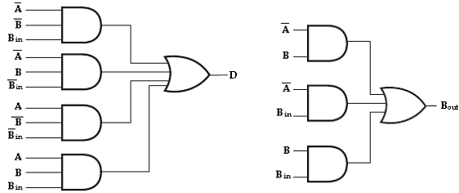
BINARY SUBTRACTOR
FULL SUBTRACTOR
Implementation of full Subtractor
MODULE- 2
CSET105: Digital Design
53

Slide 36
BINARY SUBTRACTOR
FULL SUBTRACTOR
The logic diagram of the full Subtractor can also be implemented with two half Subtractor and one OR gate.
The difference, D output from the second half Subtractor is the exclusive-OR of B_{in} and the output of the first half Subtractor, giving
Difference, D = A’BB’_{in} + AB’B’_{in} + ABB_{in} + A’B’B_{in .}
= B’_{in} (A’B+AB’) + B_{in} (AB+A’B’)
= B’_{in} (A’B+AB’) + B_{in} (A’B+AB’)’ [(x’y+xy’)’= (xy+x’y’)]
= B_{in} ⊕ (A’B+AB’)
= B_{in} ⊕ (A ⊕ B) [x ⊕ y = x’y+ xy’]
MODULE- 2
CSET105: Digital Design
54

Slide 37
BINARY SUBTRACTOR
FULL SUBTRACTOR
Borrow, B_{out} = A’B+ BB_{in}+ A’B_{in.}
= A’B+ BB_{in}+ A’B_{in} (B +B’)
= A’BB_{in}+ A’B+ BB_{in}+ A’B’B_{in}
= A’B (B_{in}+1) + BB_{in}+ A’B’B_{in} [B_{in}+1= 1]
= A’B+ BB_{in}+ A’B’B_{in}
= A’B+ BB_{in} (A+A’) + A’B’B_{in} [A+A’= 1]
= A’BB_{in}+ A’B+ ABB_{in}+ A’B’B_{in}
= A’B (B_{in}+1) + ABB_{in}+ A’B’B_{in} [B_{in}+1= 1]
= A’B+ ABB_{in}+ A’B’B_{in}
= A’B+ B_{in} (AB+A’B’)
= A’B+ B_{in} (A’B+AB’)’ [(x’y+xy’)’=(xy+x’y’)]
MODULE- 2
CSET105: Digital Design
55

Slide 38
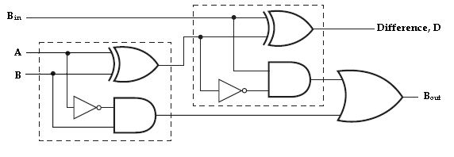
BINARY SUBTRACTOR
FULL SUBTRACTOR
Therefore, we can implement full Subtractor using two half Subtractor and OR gate as,
Implementation of full Subtractor with two half Subtractor and an OR gate
MODULE- 2
CSET105: Digital Design
56

Slide 39
BINARY ADDER & SUBTRACTOR
APPLICATIONS
Adders & Subtractors are wildly used in in computer’s ALU (Arithmetic logic unit) to compute addition as well as CPU (Central Processing unit) and GPU (Graphics Processing unit) for graphics applications to reduce the circuit complexity.
Adder and subtractor are basically used for performing arithmetical functions like addition, subtraction, multiplication and division in electronic calculators and digital instruments.
MODULE- 2
CSET105: Digital Design
56

Slide 40
BINARY ADDER & SUBTRACTOR
APPLICATIONS
Microcontrollers use adders for arithmetic additions, PC (program counter) and timers.
It is also used in microprocessors to calculate address, table indices, increment and decrement operators and slimier operations
It is also used in networking and DSP (Digital signal processor) oriented system
MODULE- 2
CSET105: Digital Design
56

Slide 41
PARALLEL ADDER
MODULE- 2
CSET105: Digital Design
57

Slide 42
PARALLEL ADDER
A single full adder is capable of adding two one bit numbers and an input carry. In order to add a binary number with more than one bit an additional full adders must be employed.
The n-bit parallel adder can be constructed using “n” number of full adder circuits in parallel.
The block diagram of n-bit parallel adder using number of full adder circuits connected in cascade i.e. the carry output of each adder is connected to the carry input of the next higher order adder is shown in figure.
MODULE- 2
CSET105: Digital Design
58

Slide 43
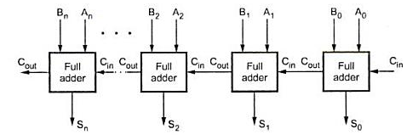
PARALLEL ADDER
n-bit parallel Adder
MODULE- 2
CSET105: Digital Design
59

Slide 44
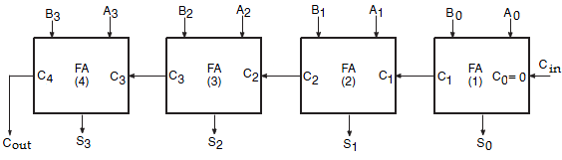
PARALLEL ADDER
The 4-bit binary adder using full adder circuits is capable of adding two 4-bit numbers resulting in a 4-bit sum and a carry output as shown in figure below.
4-bit binary parallel Adder
MODULE- 2
CSET105: Digital Design
60

Slide 45
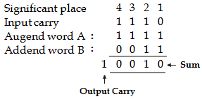
PARALLEL ADDER
Since all the bits of augend and addend are fed into the adder circuits simultaneously and the additions in each position are taking place at the same time, this circuit is known as parallel adder.
Let the 4-bit words to be added be represented by, A₃ A₂ A₁ A₀= 1 1 1 1 and B₃ B₂ B₁ B₀= 0 0 1 1.
MODULE- 2
CSET105: Digital Design
61

Slide 46
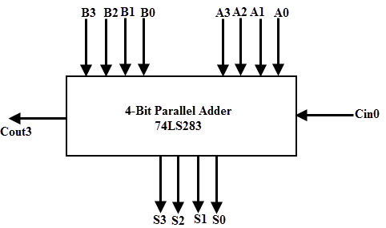
PARALLEL ADDER
Logic diagram of 4-bit parallel adder
MODULE- 2
CSET105: Digital Design
62

Slide 47
PARALLEL ADDER
The bits are added with full adders, starting from the least significant position, to form the sum bit and carry bit.
The input carry C₀ in the least significant position must be 0. The carry output of the lower order stage is connected to the carry input of the next higher order stage.
Hence this type of adder is called ripple-carry adder.
MODULE- 2
CSET105: Digital Design
63

Slide 48
PARALLEL ADDER
In the least significant stage, A₀, B₀ and C₀ (which is 0) are added resulting in sum S₀ and carry C₁. This carry C₁ becomes the carry input to the second stage.
Similarly in the second stage, A₁, B₁ and C₁ are added resulting in sum S₁ and carry C_{2,} in the third stage, A₂, B₂ and C₂ are added resulting in sum S₂ and carry C_{3,} in the third stage, A₃, B₃ and C₃ are added resulting in sum S₃ and C_{4,} which is the output carry.
Thus the circuit results in a sum (S₃ S₂ S₁ S₀) and a carry output (C_{out}).
MODULE- 2
CSET105: Digital Design
64

Slide 49
BINARY
MULTIPLIER
MODULE- 2
CSET105: Digital Design
79

Slide 50
BINARY MULTIPLIER
Multiplication of binary numbers is performed in the same way as in decimal numbers.
The multiplicand is multiplied by each bit of the multiplier starting from the least significant bit.
Each such multiplication forms a partial product. Such partial products are shifted one position to left.
The final product is obtained from the sum of partial products.
MODULE- 2
CSET105: Digital Design
80

Slide 51
BINARY MULTIPLIER
2-Bit by 2-Bit Multiplier
Consider the multiplication of two 2-bit numbers. The multiplicand bits are B₁ and B₀, the multiplier bits are A₁ and A₀, and the product is P₃, P₂, P₁ and P₀.
The first partial product is formed by multiplying B₀ by A₁A₀. The multiplication of two bits such as A₀ and B₀ produces a 1 if both bits are 1; otherwise, it produces a 0.
This is identical to an AND operation. Therefore the partial product can be implemented with AND gates as shown in the diagram.
MODULE- 2
CSET105: Digital Design
81

Slide 52
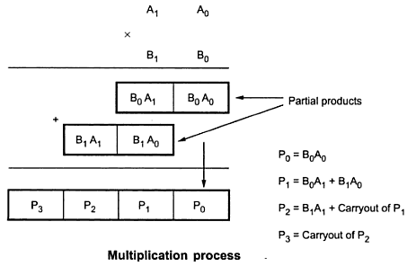
BINARY MULTIPLIER
2-Bit by 2-Bit Multiplier
The second partial product is formed by multiplying A₁ by B₁B₀ and shifted one position to the left. The two partial products are added with two half adder (HA) circuits.
MODULE- 2
CSET105: Digital Design
82

Slide 53
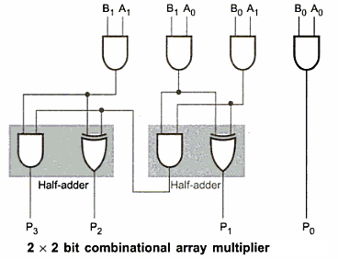
BINARY MULTIPLIER
2-Bit by 2-Bit Multiplier
MODULE- 2
CSET105: Digital Design
83

Slide 54
BINARY MULTIPLIER
2-Bit by 2-Bit Multiplier
Usually there are more bits in the partial products and it is necessary to use full adders to produce the sum of the partial products.
The least significant bit of the product does not have to go through an adder since it is formed by the output of the first AND gate.
A combinational circuit binary multiplier with more bits can be constructed in a similar fashion. A bit of the multiplier is ANDed with each bit of the multiplicand in as many levels as there are bits in the multiplier.
MODULE- 2
CSET105: Digital Design
84

Slide 55
BINARY MULTIPLIER
4-Bit by 4-Bit Multiplier
The binary output in each level of AND gates are added with the partial product of the previous level to form a new partial product. The last level produces the final product result.
Consider a multiplier circuit that multiplies a binary number of four bits by a number of four bits.
Let the multiplicand be represented by B₃, B₂, B₁, B₀ and the multiplier by A₃, A₂, A₁, and A₀.
MODULE- 2
CSET105: Digital Design
85

Slide 56
BINARY MULTIPLIER
4-Bit by 4-Bit Multiplier
Since 4x4 multiplication process we need 16 AND gates and three 4-bit parallel adders to produce a product of eight bits.
As shown in figure each shifted multiplicand which is multiplied by either 0 or 1 depending on the corresponding, multiplier bit is called partial product.
The final 8-bit product is obtained by adding all partial products.
MODULE- 2
CSET105: Digital Design
86

Slide 57
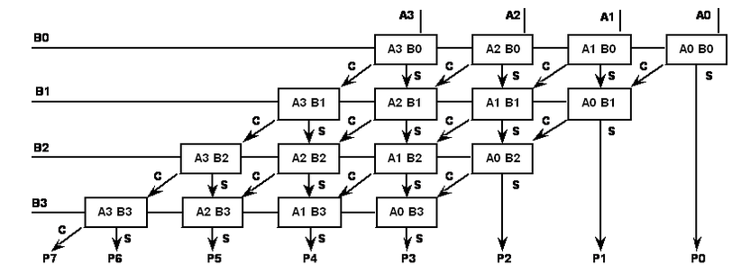
BINARY MULTIPLIER
4-Bit by 4-Bit Multiplier
MODULE- 2
CSET105: Digital Design
87

Slide 58
BINARY MULTIPLIER
4-Bit by 4-Bit Multiplier
The multiplication of B₀ and A₀ produces a 1 if both bits are 1; otherwise it produces 0. This is identical to AND gates operation. Therefore the partial products can be implemented with AND gates.
The 4-bit partial products are added using 4-bit parallel adder. During addition of first partial product three most significant bits of it are added to the second partial product.
As we take only three bits from the partial product, the fourth bit (MSB) is considered as 0.
MODULE- 2
CSET105: Digital Design
88

Slide 59
BINARY MULTIPLIER
4-Bit by 4-Bit Multiplier
The three most significant bits and carry out of first partial sum are then added to the third partial product.
Finally the three most significant bits and carry out of second partial sum are added to the fourth partial product the carryout and third sum represents the five most significant bits of the product.
Least significant bits of first and second partial sum represent P₁ and P₂ respectively & product B₀A₀ represents P₀.
MODULE- 2
CSET105: Digital Design
89

Slide 60
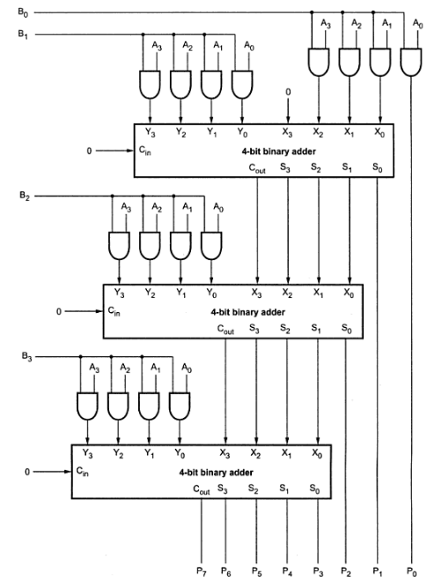
BINARY MULTIPLIER
4-Bit by 4-Bit Multiplier
MODULE- 2
CSET105: Digital Design
90

