Slide 1

MODULE-2
DESIGN OF COMBINATIONAL
LOGIC CIRCUITS
CSET105 – DIGITAL DESIGN
Bennett University

Slide 2

MODULE-4
Design of Combinational Logic Circuits
Design Procedure, Binary Adder-Subtractor, Parallel Adder, Binary Multiplier, MagnitudeComparator-4 bit, Decoders, Encoders, Multiplexers, De-multiplexer, Parity generator and checker. Application of Mux and Demux.
MODULE- 2
CSET-105: Digital Design
2

Slide 3
INTRODUCTION TO COMBINATIONAL LOGIC CIRCUITS
MODULE- 2
CSET-105: Digital Design
3

Slide 4
INTRODUCTION TO COMBINATIONAL LOGIC
The digital system consists of two types of circuits,
Combinational circuit:
  consists of logic gates
  output at any time is determined from the present combination of inputs.
Sequential circuit:
  comprises both logic gates and the state of storage elements such as flip-flops.
  The output of a sequential circuit depends not only on present value of inputs but also on past state of inputs.
MODULE- 2
CSET-105: Digital Design
4

Slide 5
INTRODUCTION TO COMBINATIONAL LOGIC
A combinational circuit consists of input variables, logic gates, and output variables.
The logic gates accept signals from inputs and output signals are generated according to the logic circuits employed in it.
Binary information from the given data transforms to desired output data in this process.
Both input and output are obviously the binary signals, i.e., either logic 1 or logic 0.
MODULE- 2
CSET-105: Digital Design
6

Slide 6
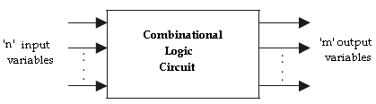
INTRODUCTION TO COMBINATIONAL LOGIC
Block diagram of a combinational logic circuit
MODULE- 2
CSET-105: Digital Design
7

Slide 7
INTRODUCTION TO COMBINATIONAL LOGIC
For n number of input variables to a combinational circuit, 2^{n} possible combinations of binary input states are possible.
For each possible combination, there is one and only one possible output combination.
A combinational logic circuit can be described by m Boolean functions and each output can be expressed in terms of n input variables.
MODULE- 2
CSET-105: Digital Design
8

Slide 8
DESIGN
PROCEDURE
MODULE- 2
CSET-105: Digital Design
23

Slide 9
DESIGN PROCEDURE
Any combinational circuit can be designed by the following steps of design procedure.
The problem statement.
Identify the number of input and output variables.
The input and output variables are assign with letter symbols.
Construction of a truth table for the given logic.
The simplified Boolean expression is obtained by any method of minimization—algebraic method, Karnaugh map method.
A logic diagram is realized from the simplified Boolean expression using logic gates.
MODULE- 2
CSET105: Digital Design
24

Slide 10
DESIGN PROCEDURE
EXAMPLE-1:
Design a combinational circuits with three input variables that will produce a logic-1 output when more than one input variables are HIGH state.
Solution:
STEP1: The problem statement.
Design a combinational circuits with three input variables that will produce a logic-1 Output when more than one input variables are HIGH.
STEP2: Identify the input and output variables
No. of inputs required: 3
No. of output required: 1
MODULE- 2
CSET105: Digital Design
25

Slide 11
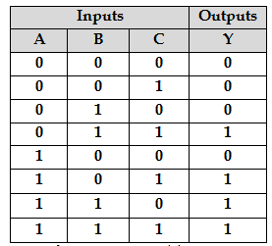
DESIGN PROCEDURE
STEP3: The input & outputs are assign with letter symbols
Letter symbol for inputs: A, B, C
Letter symbol for output: Y
STEP4: Construction of a truth table for the given logic
MODULE- 2
CSET105: Digital Design
26

Slide 12
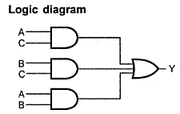
DESIGN PROCEDURE
STEP5: obtain the simplified expression for output variable using K-map simplification
STEP6: A logic diagram is realized from the simplified Boolean expression using logic gates
C
0
1
AB
00
01
11
10
0 | 0
0 | 1
1 | 1
0 | 1
Y = (AB)+(AC)+(BC)
MODULE- 2
CSET105: Digital Design
27

Slide 13
DESIGN PROCEDURE
EXERCISES
Design a circuit with 4 inputs that has outputs with a binary value equal to the number of inputs that are HIGH.
A logic circuit accepts two 3-bit numbers and generates a logic output only when the two 3-bit numbers applied to the circuit are equal. Design the logic circuit.
Design a logic circuit that will produce a 1 only when the number of 1’s in a set of four inputs variables, A, B, and C, D are even (i.e. an even parity checker).
MODULE- 2
CSET105: Digital Design
31

Slide 14
BINARY
ADDER
MODULE- 2
CSET105: Digital Design
32

Slide 15

BINARY ADDER
HALF ADDER
A half-adder is a combinational circuit that can be used to add two binary bits.
It has two inputs that represent the two bits to be added and two outputs, with one producing the SUM output and the other producing the CARRY.
Inputs |  | Outputs
A | B | Carry (C) | Sum (S)
0 | 0 | 0 | 0
0 | 1 | 0 | 1
1 | 0 | 0 | 1
1 | 1 | 1 | 0
BLOCK DIAGRAM
TRUTH TABLE
MODULE- 2
CSET105: Digital Design
33

Slide 16
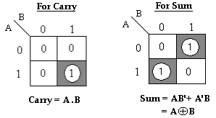
BINARY ADDER
HALF ADDER
The Boolean expressions for the SUM and CARRY outputs are given by the equations,
Sum, S = A’B+ AB’= A⊕B
Carry, C = A . B
MODULE- 2
CSET105: Digital Design
34

Slide 17
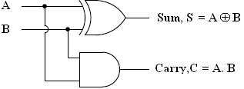
BINARY ADDER
HALF ADDER
The first one representing the SUM output is that of an EX-OR gate, the second one representing the CARRY output is that of an AND gate.
LOGIC DIAGRAM
MODULE- 2
CSET105: Digital Design
35

Slide 18
BINARY ADDER
FULL ADDER
The full adder circuit overcomes the limitation of the half-adder, which can be used to add two bits only.
A full adder is a combinational circuit that forms the arithmetic sum of three input bits.
It consists of 3 inputs and 2 outputs. Two of the input variables, represent the significant bits to be added.
The third input represents carry from previous lower significant position.
MODULE- 2
CSET105: Digital Design
36

Slide 19
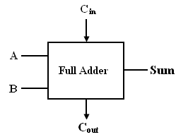
BINARY ADDER
FULL ADDER
Inputs |  |  | Outputs
A | B | C_{in} | Sum (S) | Carry (C_{out})
0 | 0 | 0 | 0 | 0
0 | 0 | 1 | 1 | 0
0 | 1 | 0 | 1 | 0
0 | 1 | 1 | 0 | 1
1 | 0 | 0 | 1 | 0
1 | 0 | 1 | 0 | 1
1 | 1 | 0 | 0 | 1
1 | 1 | 1 | 1 | 1
LOGIC DIAGRAM
TRUTH TABLE
MODULE- 2
CSET105: Digital Design
37

Slide 20
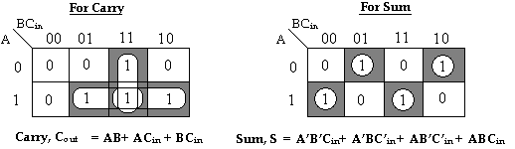
BINARY ADDER
FULL ADDER
K-MAP
The Boolean expressions for the SUM and CARRY outputs are given by the equations,
Sum, S= A’B’C_{in}+ A’BC’_{in} + AB’C’_{in} + ABC_{in}
Carry, C_{out} = AB+ AC_{in} + BC_{in .}
MODULE- 2
CSET105: Digital Design
38

Slide 21
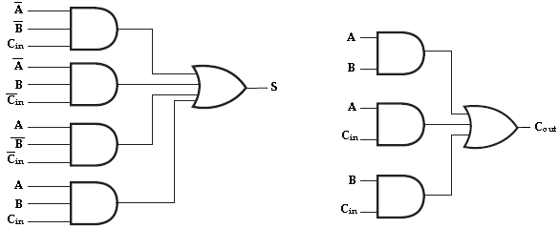
BINARY ADDER
FULL ADDER
The logic diagram for the above functions is shown as,
Implementation of full-adder in Sum of Products
MODULE- 2
CSET105: Digital Design
39

Slide 22
BINARY ADDER
FULL ADDER
The logic diagram of the full adder can also be implemented with two half-adders and one OR gate.
The S output from the second half adder is the exclusive-OR of C_{in} and the output of the first half-adder, giving
Sum = A’BC’_{in} + AB’C’_{in} + ABC_{in} + A’B’C_{in .}
= C’_{in} (A’B+AB’) + C_{in} (AB+A’B’)
= C’_{in} (A’B+AB’) + C_{in} (A’B+AB’)’
= C_{in} ⊕ (A’B+AB’)
= C_{in} ⊕ (A ⊕ B) [x ⊕ y = x’y+ xy’]
MODULE- 2
CSET105: Digital Design
40

Slide 23
BINARY ADDER
FULL ADDER
Carry, C_{out} = AB+ AC_{in}+ BC_{in.}
= AB+ AC_{in}+ BC_{in} (A +A’)
= ABC_{in}+ AB+ AC_{in}+ A’BC_{in}
= AB (C_{in}+1) + AC_{in}+ A’BC_{in} [C_{in}+1= 1]
= AB+ AC_{in}+ A’BC_{in}
= AB+ AC_{in} (B+B’) + A’BC_{in}
= ABC_{in}+ AB+ A’BC_{in}+ AB’C_{in}
= AB (C_{in}+1) + A’BC_{in}+ AB’C_{in} [C_{in}+1= 1]
= AB+ A’BC_{in}+ AB’C_{in}
= AB+ C_{in} (A’B+AB’)
MODULE- 2
CSET105: Digital Design
41

Slide 24
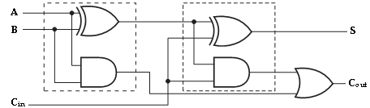
BINARY ADDER
FULL ADDER
Implementation of full adder with two half-adders and an OR gate
MODULE- 2
CSET105: Digital Design
42

Slide 25
BINARY
SUBTRACTOR
MODULE- 2
CSET105: Digital Design
43

Slide 26

BINARY SUBTRACTOR
HALF SUBTRACTOR
A half Subtractor is a combinational circuit that can be used to subtract one binary digit from another to produce a DIFFERENCE output and a BORROW output.
The BORROW output here specifies whether a ‘1’ has been borrowed to perform the subtraction.
Block schematic of half Subtractor
MODULE- 2
CSET105: Digital Design
44

Slide 27
BINARY SUBTRACTOR
HALF SUBTRACTOR
The truth table of half Subtractor, showing all possible input combinations and the corresponding outputs are shown below.
Input |  | Output
A | B | Difference (D) | Borrow (B_{out})
0 | 0 | 0 | 0
0 | 1 | 1 | 1
1 | 0 | 1 | 0
1 | 1 | 0 | 0
MODULE- 2
CSET105: Digital Design
45

Slide 28
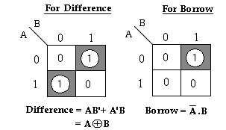
BINARY SUBTRACTOR
HALF SUBTRACTOR
K-map simplification for half Subtractor:
The Boolean expressions for the DIFFERENCE and BORROW outputs are given by the equations,
Difference, D = A’B+ AB’= A ⊕ B
Borrow, B_{out} = A’ . B
MODULE- 2
CSET105: Digital Design
46

Slide 29
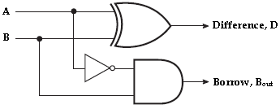
BINARY SUBTRACTOR
HALF SUBTRACTOR
Logic Implementation of Half-Subtractor
MODULE- 2
CSET105: Digital Design
47

Slide 30
BINARY SUBTRACTOR
HALF SUBTRACTOR
Comparing a half Subtractor with a half-adder, we find that the expressions for the SUM and DIFFERENCE outputs are just the same.
The expression for BORROW in the case of the half-Subtractor is also similar to what we have for CARRY in the case of the half-adder.
If the input A i.e. the minuend is complemented, an AND gate can be used to implement the BORROW output.
MODULE- 2
CSET105: Digital Design
48

Slide 31
BINARY SUBTRACTOR
FULL SUBTRACTOR
A full Subtractor performs subtraction operation on two bits, a minuend and a subtrahend, and also takes into consideration whether a ‘1’ has already been borrowed by the previous adjacent lower minuend bit or not.
As a result, there are three bits to be handled at the input of a full Subtractor, namely the two bits to be subtracted and a borrow bit designated as B_{in}.
MODULE- 2
CSET105: Digital Design
49

Slide 32
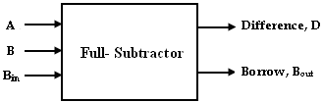
BINARY SUBTRACTOR
FULL SUBTRACTOR
There are two outputs, namely the DIFFERENCE output D and the BORROW output B_{o}. The BORROW output bit tells whether the minuend bit needs to borrow a ‘1’ from the next possible higher minuend bit.
Block schematic of full Subtractor
MODULE- 2
CSET105: Digital Design
50

Slide 33
BINARY SUBTRACTOR
FULL SUBTRACTOR
Inputs |  |  | Outputs
A | B | B_{in} | Difference(D) | Borrow(B_{out})
0 | 0 | 0 | 0 | 0
0 | 0 | 1 | 1 | 1
0 | 1 | 0 | 1 | 1
0 | 1 | 1 | 0 | 1
1 | 0 | 0 | 1 | 0
1 | 0 | 1 | 0 | 0
1 | 1 | 0 | 0 | 0
1 | 1 | 1 | 1 | 1
Truth Table
MODULE- 2
CSET105: Digital Design
51

Slide 34
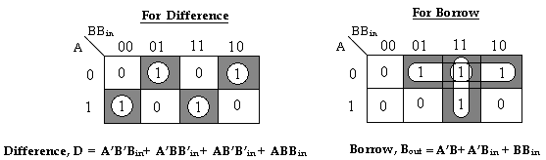
BINARY SUBTRACTOR
FULL SUBTRACTOR
K-map simplification for full Subtractor:
The Boolean expressions for the DIFFERENCE and BORROW outputs are given by the equations,
Difference, D = A’B’B_{in}+ A’BB’_{in} + AB’B’_{in} + ABB_{in}
Borrow, B_{out} = A’B+ A’C_{in} + BB_{in .}
MODULE- 2
CSET105: Digital Design
52

Slide 35
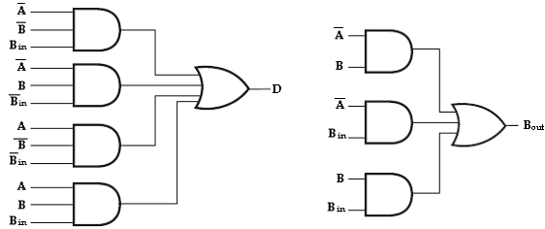
BINARY SUBTRACTOR
FULL SUBTRACTOR
Implementation of full Subtractor
MODULE- 2
CSET105: Digital Design
53

Slide 36
BINARY SUBTRACTOR
FULL SUBTRACTOR
The logic diagram of the full Subtractor can also be implemented with two half Subtractor and one OR gate.
The difference, D output from the second half Subtractor is the exclusive-OR of B_{in} and the output of the first half Subtractor, giving
Difference, D = A’BB’_{in} + AB’B’_{in} + ABB_{in} + A’B’B_{in .}
= B’_{in} (A’B+AB’) + B_{in} (AB+A’B’)
= B’_{in} (A’B+AB’) + B_{in} (A’B+AB’)’ [(x’y+xy’)’= (xy+x’y’)]
= B_{in} ⊕ (A’B+AB’)
= B_{in} ⊕ (A ⊕ B) [x ⊕ y = x’y+ xy’]
MODULE- 2
CSET105: Digital Design
54

Slide 37
BINARY SUBTRACTOR
FULL SUBTRACTOR
Borrow, B_{out} = A’B+ BB_{in}+ A’B_{in.}
= A’B+ BB_{in}+ A’B_{in} (B +B’)
= A’BB_{in}+ A’B+ BB_{in}+ A’B’B_{in}
= A’B (B_{in}+1) + BB_{in}+ A’B’B_{in} [B_{in}+1= 1]
= A’B+ BB_{in}+ A’B’B_{in}
= A’B+ BB_{in} (A+A’) + A’B’B_{in} [A+A’= 1]
= A’BB_{in}+ A’B+ ABB_{in}+ A’B’B_{in}
= A’B (B_{in}+1) + ABB_{in}+ A’B’B_{in} [B_{in}+1= 1]
= A’B+ ABB_{in}+ A’B’B_{in}
= A’B+ B_{in} (AB+A’B’)
= A’B+ B_{in} (A’B+AB’)’ [(x’y+xy’)’=(xy+x’y’)]
MODULE- 2
CSET105: Digital Design
55

Slide 38
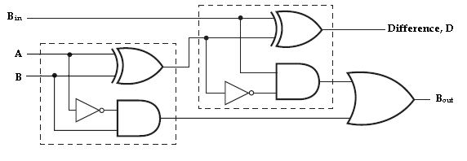
BINARY SUBTRACTOR
FULL SUBTRACTOR
Therefore, we can implement full Subtractor using two half Subtractor and OR gate as,
Implementation of full Subtractor with two half Subtractor and an OR gate
MODULE- 2
CSET105: Digital Design
56

Slide 39
BINARY ADDER & SUBTRACTOR
APPLICATIONS
Adders & Subtractors are wildly used in in computer’s ALU (Arithmetic logic unit) to compute addition as well as CPU (Central Processing unit) and GPU (Graphics Processing unit) for graphics applications to reduce the circuit complexity.
Adder and subtractor are basically used for performing arithmetical functions like addition, subtraction, multiplication and division in electronic calculators and digital instruments.
MODULE- 2
CSET105: Digital Design
56

Slide 40
BINARY ADDER & SUBTRACTOR
APPLICATIONS
Microcontrollers use adders for arithmetic additions, PC (program counter) and timers.
It is also used in microprocessors to calculate address, table indices, increment and decrement operators and slimier operations
It is also used in networking and DSP (Digital signal processor) oriented system
MODULE- 2
CSET105: Digital Design
56

Slide 41
PARALLEL ADDER
MODULE- 2
CSET105: Digital Design
57

Slide 42
PARALLEL ADDER
A single full adder is capable of adding two one bit numbers and an input carry. In order to add a binary number with more than one bit an additional full adders must be employed.
The n-bit parallel adder can be constructed using “n” number of full adder circuits in parallel.
The block diagram of n-bit parallel adder using number of full adder circuits connected in cascade i.e. the carry output of each adder is connected to the carry input of the next higher order adder is shown in figure.
MODULE- 2
CSET105: Digital Design
58

Slide 43
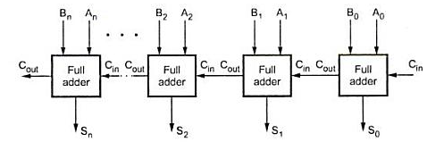
PARALLEL ADDER
n-bit parallel Adder
MODULE- 2
CSET105: Digital Design
59

Slide 44
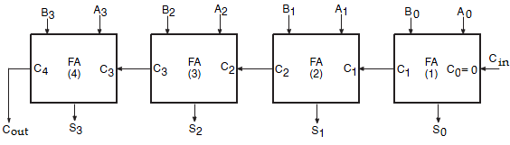
PARALLEL ADDER
The 4-bit binary adder using full adder circuits is capable of adding two 4-bit numbers resulting in a 4-bit sum and a carry output as shown in figure below.
4-bit binary parallel Adder
MODULE- 2
CSET105: Digital Design
60

Slide 45
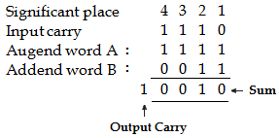
PARALLEL ADDER
Since all the bits of augend and addend are fed into the adder circuits simultaneously and the additions in each position are taking place at the same time, this circuit is known as parallel adder.
Let the 4-bit words to be added be represented by, A₃ A₂ A₁ A₀= 1 1 1 1 and B₃ B₂ B₁ B₀= 0 0 1 1.
MODULE- 2
CSET105: Digital Design
61

Slide 46
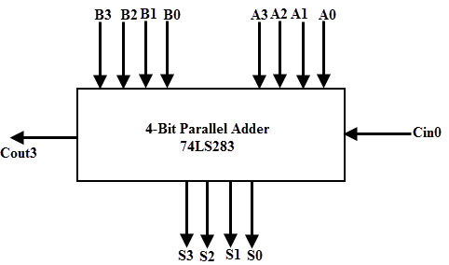
PARALLEL ADDER
Logic diagram of 4-bit parallel adder
MODULE- 2
CSET105: Digital Design
62

Slide 47
PARALLEL ADDER
The bits are added with full adders, starting from the least significant position, to form the sum bit and carry bit.
The input carry C₀ in the least significant position must be 0. The carry output of the lower order stage is connected to the carry input of the next higher order stage.
Hence this type of adder is called ripple-carry adder.
MODULE- 2
CSET105: Digital Design
63

Slide 48
PARALLEL ADDER
In the least significant stage, A₀, B₀ and C₀ (which is 0) are added resulting in sum S₀ and carry C₁. This carry C₁ becomes the carry input to the second stage.
Similarly in the second stage, A₁, B₁ and C₁ are added resulting in sum S₁ and carry C_{2,} in the third stage, A₂, B₂ and C₂ are added resulting in sum S₂ and carry C_{3,} in the third stage, A₃, B₃ and C₃ are added resulting in sum S₃ and C_{4,} which is the output carry.
Thus the circuit results in a sum (S₃ S₂ S₁ S₀) and a carry output (C_{out}).
MODULE- 2
CSET105: Digital Design
64

Slide 49
BINARY
MULTIPLIER
MODULE- 2
CSET105: Digital Design
79

Slide 50
BINARY MULTIPLIER
Multiplication of binary numbers is performed in the same way as in decimal numbers.
The multiplicand is multiplied by each bit of the multiplier starting from the least significant bit.
Each such multiplication forms a partial product. Such partial products are shifted one position to left.
The final product is obtained from the sum of partial products.
MODULE- 2
CSET105: Digital Design
80

Slide 51
BINARY MULTIPLIER
2-Bit by 2-Bit Multiplier
Consider the multiplication of two 2-bit numbers. The multiplicand bits are B₁ and B₀, the multiplier bits are A₁ and A₀, and the product is P₃, P₂, P₁ and P₀.
The first partial product is formed by multiplying B₀ by A₁A₀. The multiplication of two bits such as A₀ and B₀ produces a 1 if both bits are 1; otherwise, it produces a 0.
This is identical to an AND operation. Therefore the partial product can be implemented with AND gates as shown in the diagram.
MODULE- 2
CSET105: Digital Design
81

Slide 52
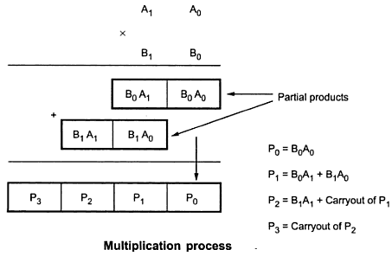
BINARY MULTIPLIER
2-Bit by 2-Bit Multiplier
The second partial product is formed by multiplying A₁ by B₁B₀ and shifted one position to the left. The two partial products are added with two half adder (HA) circuits.
MODULE- 2
CSET105: Digital Design
82

Slide 53
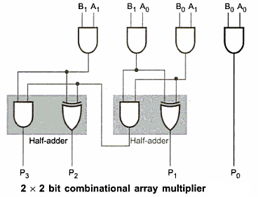
BINARY MULTIPLIER
2-Bit by 2-Bit Multiplier
MODULE- 2
CSET105: Digital Design
83

Slide 54
BINARY MULTIPLIER
2-Bit by 2-Bit Multiplier
Usually there are more bits in the partial products and it is necessary to use full adders to produce the sum of the partial products.
The least significant bit of the product does not have to go through an adder since it is formed by the output of the first AND gate.
A combinational circuit binary multiplier with more bits can be constructed in a similar fashion. A bit of the multiplier is ANDed with each bit of the multiplicand in as many levels as there are bits in the multiplier.
MODULE- 2
CSET105: Digital Design
84

Slide 55
BINARY MULTIPLIER
4-Bit by 4-Bit Multiplier
The binary output in each level of AND gates are added with the partial product of the previous level to form a new partial product. The last level produces the final product result.
Consider a multiplier circuit that multiplies a binary number of four bits by a number of four bits.
Let the multiplicand be represented by B₃, B₂, B₁, B₀ and the multiplier by A₃, A₂, A₁, and A₀.
MODULE- 2
CSET105: Digital Design
85

Slide 56
BINARY MULTIPLIER
4-Bit by 4-Bit Multiplier
Since 4x4 multiplication process we need 16 AND gates and three 4-bit parallel adders to produce a product of eight bits.
As shown in figure each shifted multiplicand which is multiplied by either 0 or 1 depending on the corresponding, multiplier bit is called partial product.
The final 8-bit product is obtained by adding all partial products.
MODULE- 2
CSET105: Digital Design
86

Slide 57
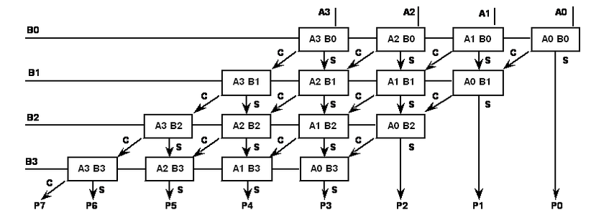
BINARY MULTIPLIER
4-Bit by 4-Bit Multiplier
MODULE- 2
CSET105: Digital Design
87

Slide 58
BINARY MULTIPLIER
4-Bit by 4-Bit Multiplier
The multiplication of B₀ and A₀ produces a 1 if both bits are 1; otherwise it produces 0. This is identical to AND gates operation. Therefore the partial products can be implemented with AND gates.
The 4-bit partial products are added using 4-bit parallel adder. During addition of first partial product three most significant bits of it are added to the second partial product.
As we take only three bits from the partial product, the fourth bit (MSB) is considered as 0.
MODULE- 2
CSET105: Digital Design
88

Slide 59
BINARY MULTIPLIER
4-Bit by 4-Bit Multiplier
The three most significant bits and carry out of first partial sum are then added to the third partial product.
Finally the three most significant bits and carry out of second partial sum are added to the fourth partial product the carryout and third sum represents the five most significant bits of the product.
Least significant bits of first and second partial sum represent P₁ and P₂ respectively & product B₀A₀ represents P₀.
MODULE- 2
CSET105: Digital Design
89

Slide 60
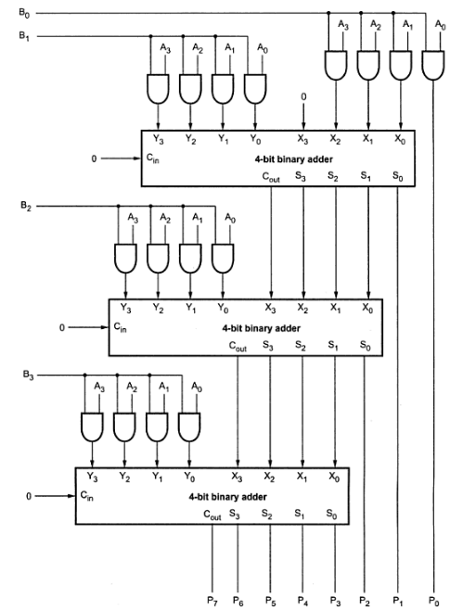
BINARY MULTIPLIER
4-Bit by 4-Bit Multiplier
MODULE- 2
CSET105: Digital Design
90

Slide 61
MAGNITUDE COMPARATOR
MODULE- 2
CSET105: Digital Design
126

Slide 62

MAGNITUDE COMPARATOR
A magnitude comparator is a combinational circuit that compares two given numbers (A and B) and determines whether one is equal to, less than or greater than the other.
The output is in the form of three binary variables representing the conditions A = B, A>B and A<B, if A and B are the two numbers being compared.
Block diagram of magnitude comparator
MODULE- 2
CSET105: Digital Design
127

Slide 63
MAGNITUDE COMPARATOR
2-Bit Magnitude Comparator
Inputs |  |  |  | Outputs
A₁ | A₀ | B₁ | B₀ | A>B | A=B | A<B
0 | 0 | 0 | 0 | 0 | 1 | 0
0 | 0 | 0 | 1 | 0 | 0 | 1
0 | 0 | 1 | 0 | 0 | 0 | 1
0 | 0 | 1 | 1 | 0 | 0 | 1
0 | 1 | 0 | 0 | 1 | 0 | 0
0 | 1 | 0 | 1 | 0 | 1 | 0
0 | 1 | 1 | 0 | 0 | 0 | 1
0 | 1 | 1 | 1 | 0 | 0 | 1
1 | 0 | 0 | 0 | 1 | 0 | 0
1 | 0 | 0 | 1 | 1 | 0 | 0
1 | 0 | 1 | 0 | 0 | 1 | 0
1 | 0 | 1 | 1 | 0 | 0 | 1
1 | 1 | 0 | 0 | 1 | 0 | 0
1 | 1 | 0 | 1 | 1 | 0 | 0
1 | 1 | 1 | 0 | 1 | 0 | 0
1 | 1 | 1 | 1 | 0 | 1 | 0
Truth Table
MODULE- 2
CSET105: Digital Design
128

Slide 64
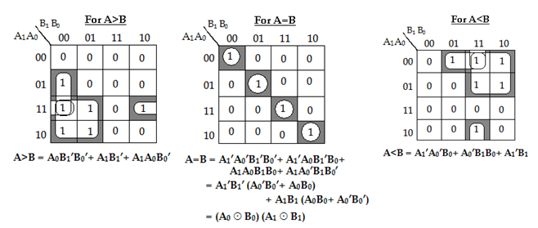
MAGNITUDE COMPARATOR
2-Bit Magnitude Comparator
K-Map Simplification
MODULE- 2
CSET105: Digital Design
129

Slide 65
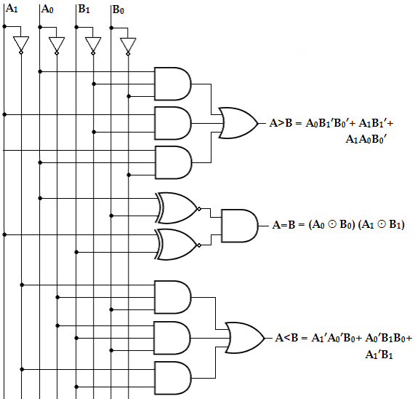
MAGNITUDE COMPARATOR
2-Bit Magnitude Comparator
Logic Diagram
MODULE- 2
CSET105: Digital Design
130

Slide 66
MAGNITUDE COMPARATOR
4-Bit Magnitude Comparator
Let us consider the two binary numbers A and B with four digits each. Write the coefficient of the numbers in descending order as,
A = A₃A₂A₁A₀
B = B₃ B₂ B₁ B₀
Each subscripted letter represents one of the digits in the number. It is observed from the bit contents of two numbers that A = B when A₃ = B₃, A₂ = B₂, A₁ = B₁ and A₀ = B₀.
MODULE- 2
CSET105: Digital Design
131

Slide 67
MAGNITUDE COMPARATOR
4-Bit Magnitude Comparator
When the numbers are binary they possess the value of either 1 or 0, the equality relation of each pair can be expressed logically by the equivalence function as
Xi = Ai Bi + Ai ′ Bi ′ for i = 0, 1, 2, 3
Or, Xi = (A ⊕ B)′ Or, Xi ′ = A ⊕ B
Or, Xi = (Ai Bi ′ + Ai ′Bi )′
where, Xi =1 only if the pair of bits in position i are equal (i.e., if both are 1 or both are 0).
MODULE- 2
CSET105: Digital Design
132

Slide 68
MAGNITUDE COMPARATOR
4-Bit Magnitude Comparator
To satisfy the equality condition of two numbers A and B, it is necessary that all Xi must be equal to logic 1. This indicates the AND operation of all Xi variables.
In other words, we can write the Boolean expression for two equal 4-bit numbers.
(A = B) = X₃X₂X₁ X₀. (where X = A xnor B)
The binary variable (A=B) is equal to 1 only if all pairs of digits of the two numbers are equal.
MODULE- 2
CSET105: Digital Design
133

Slide 69
MAGNITUDE COMPARATOR
4-Bit Magnitude Comparator
To determine if A is greater than or less than B, we inspect the relative magnitudes of pairs of significant bits starting from the most significant bit.
If the two digits of the most significant position are equal, the next significant pair of digits is compared. The comparison process is continued until a pair of unequal digits is found.
It may be concluded that A>B, if the corresponding digit of A is 1 and B is 0. If the corresponding digit of A is 0 and B is 1, we conclude that A<B.
MODULE- 2
CSET105: Digital Design
134

Slide 70
MAGNITUDE COMPARATOR
4-Bit Magnitude Comparator
In a 4-bit comparator the condition of A>B can be possible in the following four cases:
  If A3 = 1 and B3 = 0
  If A3 = B3 and A2 = 1 and B2 = 0
  If A3 = B3, A2 = B2 and A1 = 1 and B1 = 0
  If A3 = B3, A2 = B2, A1 = B1 and A0 = 1 and B0 = 0
  Similarly the condition for A<B can be possible in the following four cases:
  If A3 = 0 and B3 = 1
  If A3 = B3 and A2 = 0 and B2 = 1
  If A3 = B3, A2 = B2 and A1 = 0 and B1 = 1
  If A3 = B3, A2 = B2, A1 = B1 and A0 = 0 and B0 = 1
MODULE- 2
CSET105: Digital Design
134

Slide 71
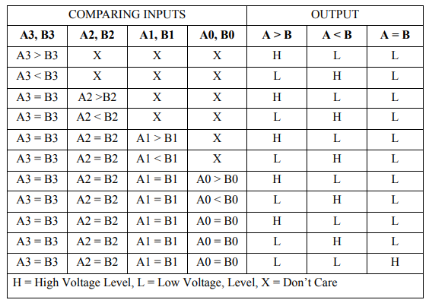
MAGNITUDE COMPARATOR
4-Bit Magnitude Comparator
MODULE- 2
CSET105: Digital Design
134

Slide 72
MAGNITUDE COMPARATOR
4-Bit Magnitude Comparator
Therefore, we can derive the logical expression of such sequential comparison by,
(A>B) = A₃B₃′ +X₃A₂B₂′ +X₃X₂A₁B₁′ +X₃X₂X₁A₀B₀′
(A<B) = A₃′B₃ +X₃A₂′B₂ +X₃X₂A₁′B₁ +X₃X₂X₁A₀′B₀
The symbols (A>B) and (A<B) are binary output variables that are equal to 1 when A>B or A<B, respectively.
The gate implementation of the three output variables just derived is simpler than it seems because it involves a certain amount of repetition.
The unequal outputs can use the same gates that are needed to generate the equal output.
MODULE- 2
CSET105: Digital Design
135

Slide 73
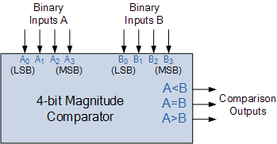
MAGNITUDE COMPARATOR
Block diagram of 4-Bit magnitude comparator (IC7485)
MODULE- 2
CSET105: Digital Design
136

Slide 74
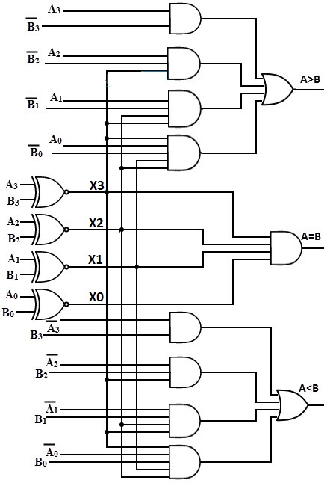
MAGNITUDE COMPARATOR
Logic diagram of 4-Bit magnitude comparator
MODULE- 2
CSET105: Digital Design
136

Slide 75
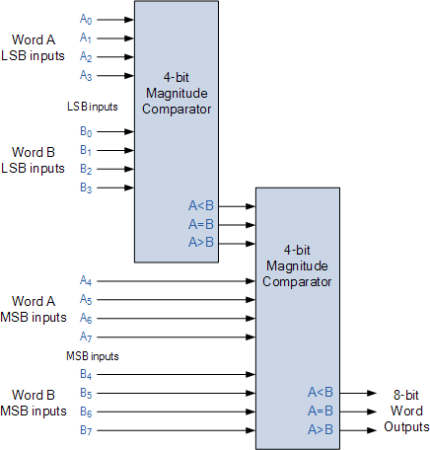
MAGNITUDE COMPARATOR
Block diagram of 8-Bit magnitude comparator
MODULE- 2
CSET105: Digital Design
136

Slide 76
MAGNITUDE COMPARATOR
Applications of Magnitude Comparator
Comparators are used in central processing units (CPUs) and microcontrollers (ALU).
These are used in control applications in which the binary numbers representing physical variables such as temperature, position, etc. are compared with a reference value.
Comparators are also used as process controllers and for Servo motor control.
Analogue-to-Digital converters, (ADC)
MODULE- 2
CSET105: Digital Design
133

Slide 77
MULTIPLEXERS
MODULE- 2
CSET105: Digital Design
148

Slide 78
MULTIPLEXERS
A Multiplexer or MUX, is a combinational circuit with more than one input line, one output line and more than one selection line.
A multiplexer selects binary information present from one of many input lines, depending upon the logic status of the selection inputs, and routes it to the output line.
Normally, there are 2^{n} input lines and n selection lines whose bit combinations determine which input is selected. The multiplexer is often labeled as MUX in block diagrams.
MODULE- 2
CSET105: Digital Design
149

Slide 79
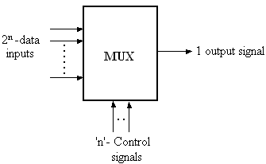
MULTIPLEXERS
A multiplexer is also called a data selector, since it selects one of many inputs and steers the binary information to the output line.
Block diagram of Multiplexer
MODULE- 2
CSET105: Digital Design
150

Slide 80
MULTIPLEXERS
2:1 MUX
The 2:1 multiplexer acts like an electronic switch that selects one of the two sources.
The circuit has two data input lines, one output line and one selection line, S.
When S= 0, the upper AND gate is enabled and I₀ has a path to the output.
When S=1, the lower AND gate is enabled and I₁ has a path to the output.
MODULE- 2
CSET105: Digital Design
151

Slide 81
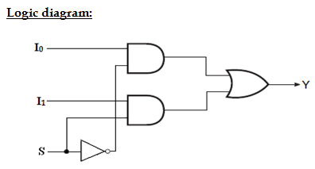
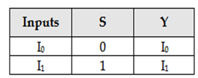
MULTIPLEXERS
2:1 MUX
MODULE- 2
CSET105: Digital Design
152

Slide 82
MULTIPLEXERS
4:1 MUX
A 4-to-1-line multiplexer has four (2^{n}) input lines, two (n) select lines and one output line.
It is the multiplexer consisting of four input channels and information of one of the channels can be selected and transmitted to an output line according to the select inputs combinations.
Selection of one of the four input channel is possible by two selection inputs.
MODULE- 2
CSET105: Digital Design
153

Slide 83
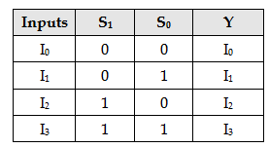
MULTIPLEXERS
4:1 MUX
Each of the four inputs I₀ through I₃, is applied to one input of AND gate. Selection lines S₁ and S₀ are decoded to select a particular AND gate.
The outputs of the AND gate are applied to a single OR gate that provides the 1-line output.
Truth table
MODULE- 2
CSET105: Digital Design
154

Slide 84
MULTIPLEXERS
4:1 MUX
The data output is equal to I₀ only if S₁= 0 and S₀= 0; Y= I₀S₁’S₀’.
The data output is equal to I₁ only if S₁= 0 and S₀= 1; Y= I₁S₁’S₀.
The data output is equal to I₂ only if S₁= 1 and S₀= 0; Y= I₂S₁S₀’.
The data output is equal to I₃ only if S₁= 1 and S₀= 1; Y= I₃S₁S₀.
When these terms are ORed, the total expression for the data output is,
Y= I₀S₁’S₀’+ I₁S₁’S₀ +I₂S₁S₀’+ I₃S₁S_{0.}
MODULE- 2
CSET105: Digital Design
157

Slide 85
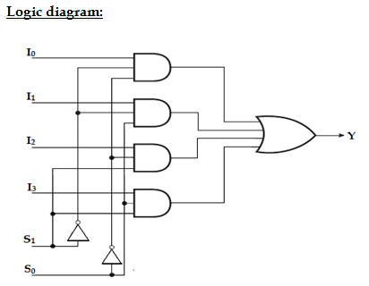
MULTIPLEXERS
4:1 MUX
MODULE- 2
CSET105: Digital Design
155

Slide 86
MULTIPLEXERS
4:1 MUX
To demonstrate the circuit operation, consider the case when S₁S₀= 10.
The AND gate associated with input I₂ has two of its inputs equal to 1 and the third input connected to I₂.
The other three AND gates have at least one input equal to 0, which makes their outputs equal to 0.
The OR output is now equal to the value of I₂, providing a path from the selected input to the output.
MODULE- 2
CSET105: Digital Design
156

Slide 87
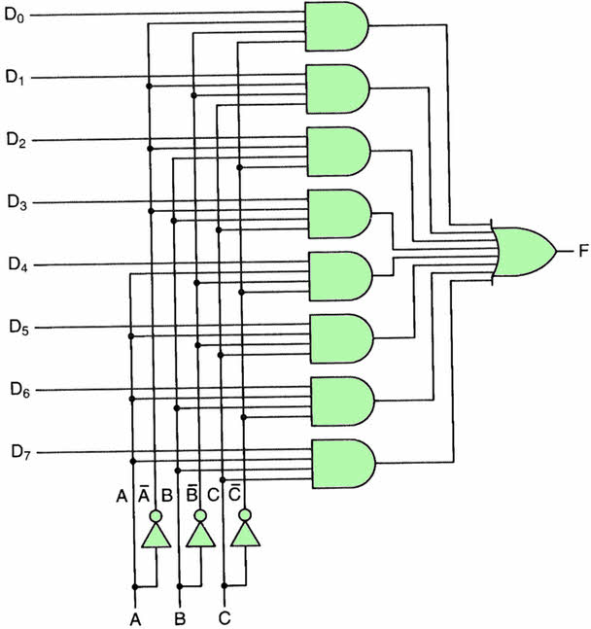
MULTIPLEXERS
8:1 MUX
MODULE- 2
CSET105: Digital Design
158

Slide 88
MULTIPLEXERS
MUX APPLICATIONS
Communication system –The efficiency of communication system can be increased considerably using multiplexer. Multiplexer allow the process of transmitting different type of data such as audio, video at the same time using a single transmission line.
Telephone network – In telephone network, multiple audio signals are integrated on a single line for transmission with the help of multiplexers. In this way, multiple audio signals can be isolated and eventually, the desire audio signals reach the intended recipients.
Transmission from the computer system of a satellite – Multiplexer can be used for the transmission of data signals from the computer system of a satellite or spacecraft to the ground system using the GPS (Global Positioning System) satellites.
MODULE- 2
CSET105: Digital Design
159

Slide 89
MULTIPLEXERS
MULTIPLEXERS TREE
It is possible to expand the range of input for multiplexer beyond the available range in the integrated circuits.
This can be accomplished by interconnecting several multiplexers. For example two 8:1 mux can be used together to form a 16:1 mux and two 16:1 mux can be used to realize the 32:1 mux.
Even we can realize 32:1 mux can be realized with a smaller sized mux like 8:1 or 4:1 or 2:1 by properly assigning the selection lines to those mux circuits.
MODULE- 2
CSET105: Digital Design
160

Slide 90
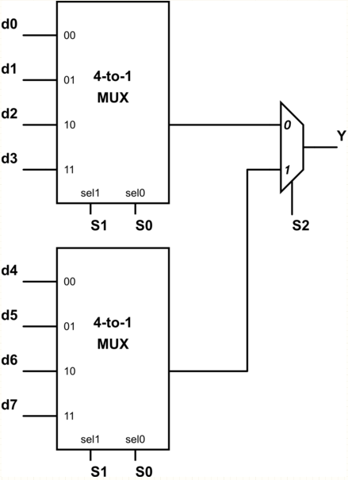
MULTIPLEXERS
MULTIPLEXERS TREE
8:1 Mux using 4:1 & 2:1 MUX
MODULE- 2
CSET105: Digital Design
161

Slide 91
MULTIPLEXERS
MULTIPLEXERS TREE
Here, the number of selection lines require to implement 8:1 mux is 3 (S2,S1,S0). The select inputs S1 and S0 of both multiplexers provided to the selections lines of 4:1 mux i.e S1, S0. Whereas the S3 selection input of the second level 2:1 multiplexer is connected to S3 selection line.
So for S2 = 0, the upper multiplexer is selected and input lines d0 to d3 are selected according to the selected inputs and data is transmitted to an output through the OR gate. When S2 = 1, the lower multiplexer is activated and input lines d4 to d7 are selected according to the selected inputs.
MODULE- 2
CSET105: Digital Design
162

Slide 92
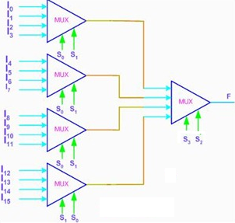
MULTIPLEXERS
MULTIPLEXERS TREE
16:1 Mux using 4:1 MUX
MODULE- 2
CSET105: Digital Design
163

Slide 93
MULTIPLEXERS
  Implementation of boolean function using MUX
Example1: Implement the following boolean function using 8:1 mux, F (A, B, C) = ∑m (1, 3, 5, 6).
Solution:
Variables, n= 3 (A, B, C)
Select lines= 3 (S2, S₁, S₀)
Input lines = 2³ = 8 (D₀, D₁, D₂, D_{3,} D₄, D₅, D₆, D₇)
The three variables A, B, C are applied to the selection lines.
The minterms to be included (1, 3, 5 and 7) are chosen by making their corresponding input lines equal to logic-1.
Minterms 0, 2, 4 and 7 are not included by making their input lines equal to logic-0.
MODULE- 2
CSET105: Digital Design
164

Slide 94
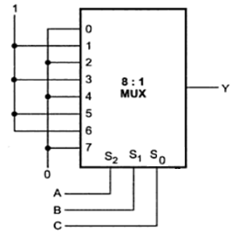
MULTIPLEXERS
  Implementation of boolean function using MUX
MODULE- 2
CSET105: Digital Design
165

Slide 95
MULTIPLEXERS
  Implementation of boolean function using MUX
Example2: Implement the following boolean function using 4:1 multiplexer, F (A, B, C) = ∑m (1, 3, 5, 6).
Solution:
Variables, n= 3 (A, B, C)
Select lines= n-1 = 2 (S₁, S₀)
2^{n-1} to MUX i.e., 2² to 1 = 4 to 1 MUX
Input lines= 2^{n-1} = 2² = 4 (D₀, D₁, D₂, D₃)
Implementation table:
Apply variables B and C to the select lines. The procedures for implementing the function are:
List the input of the multiplexer
List under them all the minterms in two rows as shown below.
MODULE- 2
CSET105: Digital Design
166

Slide 96
MULTIPLEXERS
  Implementation of boolean function using MUX
The first half of the minterms is associated with A’ and the second half with A. The given function is implemented by encircling the minterms of the function and applying the following rules to find the values for the inputs of the multiplexer.
If both the minterms in the column are not circled, apply 0 to the corresponding input.
If both the minterms in the column are circled, apply 1 to the corresponding input.
If the bottom minterm is circled and the top is not circled, apply A to the input.
If the top minterm is circled and the bottom is not circled, apply A’ to the input.
MODULE- 2
CSET105: Digital Design
167

Slide 97
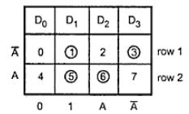
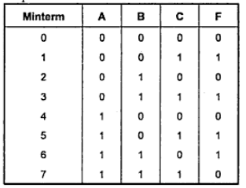
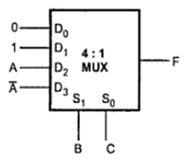
MULTIPLEXERS
  Implementation of boolean function using MUX
Implementation table
Truth table
Mux implementation
MODULE- 2
CSET105: Digital Design
168

Slide 98
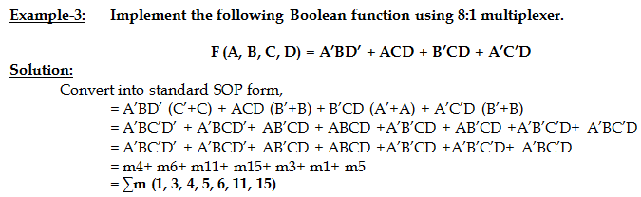
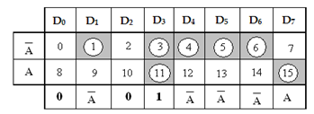
MULTIPLEXERS
  Implementation of boolean function using MUX
MODULE- 2
CSET105: Digital Design
169

Slide 99
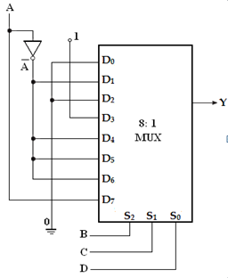
MULTIPLEXERS
  Implementation of boolean function using MUX
MODULE- 2
CSET105: Digital Design
170

Slide 100
DEMULTIPLEXERS
MODULE-4
CSET105: Digital Design
171

Slide 101
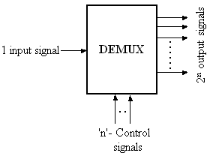
DEMULTIPLEXERS
Demultiplexer means one into many. Demultiplexing is the process of taking information from one input and transmitting the same over one of several outputs.
A demultiplexer is a combinational logic circuit that receives information on a single input and transmits the same information over one of several (2^{n}) output lines.
MODULE-4
CSET105: Digital Design
172

Slide 102
DEMULTIPLEXERS
The block diagram of a demultiplexer has one input signal, ‘n’ select signals and 2^{n} output signals.
The select inputs determine to which output the data input will be connected.
As the serial data is changed to parallel data, i.e., the input caused to appear on one of the n output lines, the demultiplexer is also called a “data distributer” or a “serial-to-parallel converter”.
MODULE-4
CSET105: Digital Design
173

Slide 103
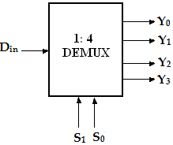
DEMULTIPLEXERS
  1:4 DEMUX
A 1-to-4 demultiplexer has a single input, D_{in}, four outputs (Y₀ to Y₃) and two select inputs (S₁ and S₀).
The input variable D_{in} has a path to all four outputs, but the input information is directed to only one of the output lines.
MODULE-4
CSET105: Digital Design
174

Slide 104
DEMULTIPLEXERS
  1:4 DEMUX
D_{in} | S₁ | S₀ | Y₀ | Y₁ | Y₂ | Y₃
0 | 0 | 0 | 0 | 0 | 0 | 0
1 | 0 | 0 | 1 | 0 | 0 | 0
0 | 0 | 1 | 0 | 0 | 0 | 0
1 | 0 | 1 | 0 | 1 | 0 | 0
0 | 1 | 0 | 0 | 0 | 0 | 0
1 | 1 | 0 | 0 | 0 | 1 | 0
0 | 1 | 1 | 0 | 0 | 0 | 0
1 | 1 | 1 | 0 | 0 | 0 | 1
Truth table of 1-to-4 line Demultiplexer
MODULE-4
CSET105: Digital Design
175

Slide 105
DEMULTIPLEXERS
  1:4 DEMUX
From the truth table, it is clear that the data input, D_{in} is connected to the output Y₀, when S₁= 0 and S₀=0 and the data input is connected to output Y₁ when S₁=0 and S₀=1.
Similarly, the data input is connected to output Y₂ and Y₃ when S₁=1 and S₀=0 and when S₁=1 and S₀=1, respectively.
Also, from the truth table, the expression for outputs can be written as follows,
Y₀= S₁’S₀’D_{in} Y₁= S₁’S₀D_{in} Y₂= S₁S₀’D_{in} Y₃= S₁S₀D_{in}
MODULE-4
CSET105: Digital Design
176

Slide 106
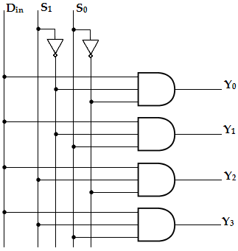
DEMULTIPLEXERS
  1:4 DEMUX
Logic diagram of 1-to-4 line demultiplexer
MODULE-4
CSET105: Digital Design
177

Slide 107
DEMULTIPLEXERS
  1:4 DEMUX
Now, using the above expressions, a 1-to-4 line demultiplexer can be implemented using four 3-input AND gates and two NOT gates.
Here, the input data line D_{in}, is connected to all the AND gates.
The two select lines S₁, S₀ enable only one gate at a time and the data that appears on the input line passes through the selected gate to the associated output line.
MODULE-4
CSET105: Digital Design
178

Slide 108
DEMULTIPLEXERS
  1:8 DEMUX
A 1-to-8 line demultiplexer has a single input, D_{in}, eight outputs (Y₀ to Y₇) and three select inputs (S_{2,} S₁ and S₀). It distributes one input line to eight output lines based on the select inputs.
D_{in} | S₂ | S₁ | S₀ | Y₇ | Y₆ | Y₅ | Y₄ | Y₃ | Y₂ | Y₁ | Y₀
0 | x | x | x | 0 | 0 | 0 | 0 | 0 | 0 | 0 | 0
1 | 0 | 0 | 0 | 0 | 0 | 0 | 0 | 0 | 0 | 0 | 1
1 | 0 | 0 | 1 | 0 | 0 | 0 | 0 | 0 | 0 | 1 | 0
1 | 0 | 1 | 0 | 0 | 0 | 0 | 0 | 0 | 1 | 0 | 0
1 | 0 | 1 | 1 | 0 | 0 | 0 | 0 | 1 | 0 | 0 | 0
1 | 1 | 0 | 0 | 0 | 0 | 0 | 1 | 0 | 0 | 0 | 0
1 | 1 | 0 | 1 | 0 | 0 | 1 | 0 | 0 | 0 | 0 | 0
1 | 1 | 1 | 0 | 0 | 1 | 0 | 0 | 0 | 0 | 0 | 0
1 | 1 | 1 | 1 | 1 | 0 | 0 | 0 | 0 | 0 | 0 | 0
MODULE-4
CSET105: Digital Design
179

Slide 109
DEMULTIPLEXERS
  1:8 DEMUX
From the above truth table, it is clear that the data input is connected with one of the eight outputs based on the select inputs.
Now from this truth table, the expression for eight outputs can be written as follows:
Y₀= S₂’S₁’S₀’D_{in} Y₄= S₂ S₁’S₀’D_{in}
Y₁= S₂’S₁’S₀D_{in} Y₅= S₂ S₁’S₀D_{in}
Y₂= S₂’S₁S₀’D_{in} Y₆= S₂ S₁S₀’D_{in}
Y₃= S₂’S₁S₀D_{in} Y₇= S₂S₁S₀D_{in}
MODULE-4
CSET105: Digital Design
180

Slide 110
DEMULTIPLEXERS
  1:8 DEMUX
Now using the above expressions, the logic diagram of a 1-to-8 demultiplexer can be drawn as shown.
Here, the single data line, D_{in} is connected to all the eight AND gates, but only one of the eight AND gates will be enabled by the select input lines.
For example, if S₂S₁S₀= 000, then only AND gate-0 will be enabled and thereby the data input, D_{in} will appear at Y₀. Similarly, the different combinations of the select inputs, the input D_{in} will appear at the respective output.
MODULE-4
CSET105: Digital Design
181

Slide 111
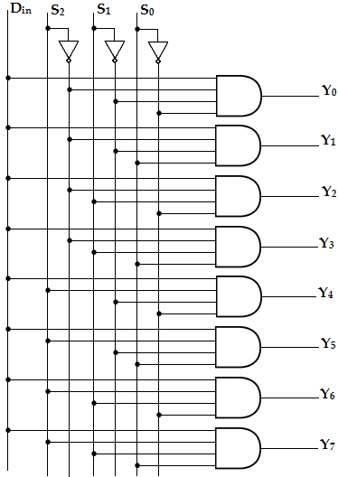
DEMULTIPLEXERS
  1:8 DEMUX
MODULE-4
CSET105: Digital Design
182

Slide 112
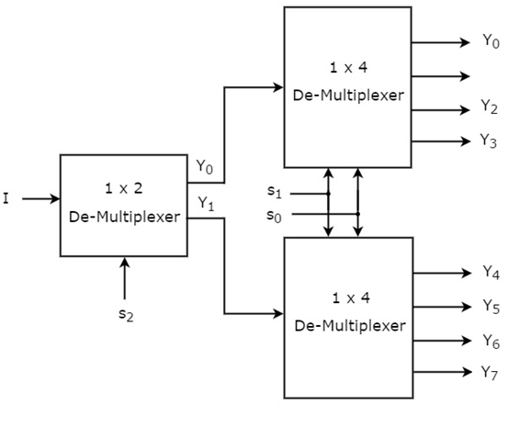
DEMULTIPLEXERS
  DEMULTIPLEXERS TREE
Example: Design 1:8 demultiplexer using 1:4 & 1:2 DEMUX.
MODULE-4
CSET105: Digital Design
183

Slide 113
DEMULTIPLEXERS
  IMPLEMENTATION OF BOOLEAN EXPRESSION USING DEMUX
Example1: Implement the following boolean function using 1:8 Demux. F (A, B, C) = ∑m (1, 3, 5, 6).
Inputs |  |  | Outputs
A | B | C | Y
0 | 0 | 0 | 0
0 | 0 | 1 | 1
0 | 1 | 0 | 0
0 | 1 | 1 | 1
1 | 0 | 0 | 0
1 | 0 | 1 | 1
1 | 1 | 0 | 1
1 | 1 | 1 | 0
MODULE-4
CSET105: Digital Design
184

Slide 114
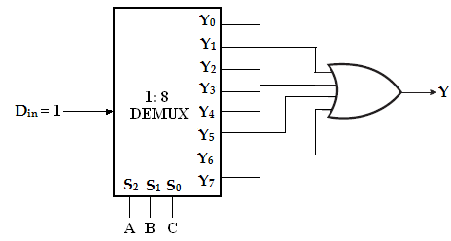
DEMULTIPLEXERS
  IMPLEMENTATION OF BOOLEAN EXPRESSION USING DEMUX
MODULE-4
CSET105: Digital Design
185

Slide 115
DEMULTIPLEXERS
  IMPLEMENTATION OF BOOLEAN EXPRESSION USING DEMUX
Example2: Implement full subtractor using demux
Inputs |  |  | Outputs
A | B | B_{in} | Difference(D) | Borrow(B_{out})
0 | 0 | 0 | 0 | 0
0 | 0 | 1 | 1 | 1
0 | 1 | 0 | 1 | 1
0 | 1 | 1 | 0 | 1
1 | 0 | 0 | 1 | 0
1 | 0 | 1 | 0 | 0
1 | 1 | 0 | 0 | 0
1 | 1 | 1 | 1 | 1
MODULE-4
CSET105: Digital Design
186

Slide 116

DEMULTIPLEXERS
  IMPLEMENTATION OF BOOLEAN EXPRESSION USING DEMUX
Full Subtractor using 1:8 demux
MODULE-4
CSET105: Digital Design
187

Slide 117
DECODERS
MODULE-4
CSET105: Digital Design
188

Slide 118
DECODERS
A decoder is a combinational circuit that converts binary information from ‘n’ input lines to a maximum of ‘2^{n}’ unique output lines.
The encoded information is presented as ‘n’ inputs producing ‘2^{n}’ possible outputs. The 2^{n} output values are from 0 through 2^{n}-1.
A decoder is provided with enable inputs to activate decoded output based on data inputs. When any one enable input is unasserted, all outputs of decoder are disabled.
MODULE-4
CSET105: Digital Design
189

Slide 119

DECODERS
Block diagram of decoders
MODULE-4
CSET105: Digital Design
190

Slide 120
DECODERS
2 : 4 Decoders
A binary decoder is used when it is necessary to activate exactly one of 2^{n} outputs based on an n-bit input value.
Here the 2 inputs are decoded into 4 outputs, each output representing one of the minterms of the two input variables.
As shown in the truth table, if enable input is 1 (EN= 1) only one of the outputs (Y₀ – Y₃), is active for a given input.
MODULE-4
CSET105: Digital Design
191

Slide 121
DECODERS
2 : 4 Decoders
Inputs |  |  | Outputs
Enable | A | B | Y₃ | Y₂ | Y₁ | Y₀
0 | x | x | 0 | 0 | 0 | 0
1 | 0 | 0 | 0 | 0 | 0 | 1
1 | 0 | 1 | 0 | 0 | 1 | 0
1 | 1 | 0 | 0 | 1 | 0 | 0
1 | 1 | 1 | 1 | 0 | 0 | 0
Truth table
MODULE-4
CSET105: Digital Design
192

Slide 122

DECODERS
2 : 4 Decoders
Logic Diagram
MODULE-4
CSET105: Digital Design
193

Slide 123
DECODERS
3 : 8 Decoders
A 3-to-8 line decoder has three inputs (A, B, C) and eight outputs (Y₀- Y₇). Based on the 3 inputs one of the eight outputs is selected.
This decoder is used for binary-to-octal conversion. The input variables may represent a binary number and the outputs will represent the eight digits in the octal number system.
The output line whose value is equal to 1 represents the minterm equivalent of the binary number presently available in the input lines.
MODULE-4
CSET105: Digital Design
194

Slide 124
DECODERS
3 : 8 Decoders
Inputs |  |  | Outputs
A | B | C | Y₀ | Y₁ | Y₂ | Y₃ | Y₄ | Y₅ | Y₆ | Y₇
0 | 0 | 0 | 1 | 0 | 0 | 0 | 0 | 0 | 0 | 0
0 | 0 | 1 | 0 | 1 | 0 | 0 | 0 | 0 | 0 | 0
0 | 1 | 0 | 0 | 0 | 1 | 0 | 0 | 0 | 0 | 0
0 | 1 | 1 | 0 | 0 | 0 | 1 | 0 | 0 | 0 | 0
1 | 0 | 0 | 0 | 0 | 0 | 0 | 1 | 0 | 0 | 0
1 | 0 | 1 | 0 | 0 | 0 | 0 | 0 | 1 | 0 | 0
1 | 1 | 0 | 0 | 0 | 0 | 0 | 0 | 0 | 1 | 0
1 | 1 | 1 | 0 | 0 | 0 | 0 | 0 | 0 | 0 | 1
Truth table
MODULE-4
CSET105: Digital Design
195

Slide 125

DECODERS
3 : 8 Decoders
Logic Diagram
MODULE-4
CSET105: Digital Design
196

Slide 126
DECODERS
Applications
Instruction decoder is the part of the CPU
Memory address decoding
Decoder outputs can be used to drive a 7 segment display (TTL 74LS47)
Binary Decoders such as binary or BCD ,decimal or octal etc and commonly available decoder IC’s (TTL 74LS138 3-to-8 line binary decoder or the 74ALS154 4-to-16 line decoder)
MODULE-4
CSET105: Digital Design
197

Slide 127
DECODERS
Cascading Decoders
Example: Design a 4 to 16 line decoders using 2 to 4 line decoders
To implement 4:16 decoder we need five 2:4 line decoders.
Decoder-1 is used to enable one of the decoder 2, 3, 4 and 5. Inputs of the first decoders are A and B i.e. MSB inputs of 4:16 decoders.
The inputs of decoders are connected together forming C and D inputs of 4:16 decoders.
When AB=00 decoder-1 is enabled, for AB=01 decoder-2 is enabled, for AB=10 decoder-3 is selected, and for AB=11 decoder-4 is enabled.
MODULE-4
CSET105: Digital Design
198

Slide 128

DECODERS
Cascading Decoders
MODULE-4
CSET105: Digital Design
199

Slide 129
DECODERS
Realization of Boolean Expression using Decoders
The combination of decoder and external logic gates can be used to implement single or multiple output function. The decoder can have one of the two output states either active or active high.
For active high output :
SOP function implementation
  When the decoder output is active high it generates minterms for input variables (i.e) it makes the selected output logic1. In such cases to implement the sop function we have to take sum of selected product terms generated by decoder. This can be implemented by ORing the selected decoder output.
MODULE-4
CSET105: Digital Design
200

Slide 130

DECODERS
Realization of Boolean Expression using Decoders
MODULE-4
CSET105: Digital Design
201

Slide 131

DECODERS
Realization of Boolean Expression using Decoders
POS function implementation: When the decoder output is active high POS function in similar manner as per SOP function except function output is complemented. This can be achieved by connecting NOR gates instead of OR gates .
Single output function implementation using decoder and gate
MODULE-4
CSET105: Digital Design
202

Slide 132
ENCODERS
MODULE-4
CSET105: Digital Design
203

Slide 133

ENCODERS
An encoder is a combinational circuit that converts binary information from 2^{n} input lines to a maximum of ‘n’ unique output lines.
An encoder is a digital circuit that performs the inverse operation of a decoder. Hence, the opposite of the decoding process is called encoding. The general structure of encoder circuit is,
MODULE-4
CSET105: Digital Design
204

Slide 134
ENCODERS
Generally, digital encoders produce outputs of 2-bit, 3-bit or 4-bit codes depending upon the number of data input lines.
An "n-bit" binary encoder has 2^{n} input lines and n-bit output lines with common types that include 4-to-2, 8-to-3 and 16-to-4 line configurations.
The output lines of a digital encoder generate the binary equivalent of the input line whose value is equal to “1”.
MODULE-4
CSET105: Digital Design
205

Slide 135


ENCODERS
4 to 2 Encoder
MODULE-4
CSET105: Digital Design
206

Slide 136
ENCODERS
Priority Encoder
One of the main disadvantages of standard digital encoders is that they can generate the wrong output code when there is more than one input present at logic level "1".
For example, if we make inputs D₁ and D₂ HIGH at logic "1" both at the same time, the resulting output is neither at "01" or at "10" but it will be at "11" which is an output binary number that is different to the actual input present.
MODULE-4
CSET105: Digital Design
207

Slide 137
ENCODERS
Priority Encoder
One simple way to overcome this problem is to "Priorities" the level of each input pin and if there was more than one input at logic level "1" the actual output code would only correspond to the input with the highest designated priority.
Then this type of digital encoder is known commonly as a Priority Encoder or P-encoder for short.
MODULE-4
CSET105: Digital Design
205

Slide 138
ENCODERS
Priority Encoder
A priority encoder is an encoder circuit that includes the priority function.
In priority encoder, if two or more inputs are equal to 1 at the same time, the input having the highest priority will take precedence. The higher the subscript number, higher the priority of the input.
Input D₃, has the highest priority. So, regardless of the values of the other inputs, when D₃ is 1, the output for xy is 11. D₂ has the next priority level. The output is 10, if D₂= 1 provided D₃= 0. The output for D₁ is generated only if higher priority inputs are 0, and so on down the priority levels.
MODULE-4
CSET105: Digital Design
209

Slide 139


ENCODERS
4 to 2 Priority Encoder
MODULE-4
CSET105: Digital Design
210

Slide 140

ENCODERS
4 to 2 Priority Encoder
MODULE-4
CSET105: Digital Design
211

Slide 141

ENCODERS
4 to 2 Priority Encoder
4-Input Priority Encoder
MODULE-4
CSET105: Digital Design
212

Slide 142

ENCODERS
8 to 3 Priority Encoder
MODULE-4
CSET105: Digital Design
213

Slide 143
ENCODERS
Encoder Applications
(i). Keyboard Encoder
Priority encoders can be used to reduce the number of wires needed in a particular circuits or application that have multiple inputs.
For example, assume that a microcomputer needs to read the 104 keys of a standard QWERTY keyboard where only one key would be pressed either “HIGH” or “LOW” at any one time.
One way would be to connect all 104 wires from the individual keys on the keyboard directly to the computers input but this would be impractical for a small home PC.
MODULE-4
CSET105: Digital Design
214

Slide 144
ENCODERS
Encoder Applications
Another alternative and better way would be to interface the keyboard to the PC using a priority encoder.
The 104 individual buttons or keys could be encoded into a standard ASCII code of only 7-bits (0 to 127 decimal) to represent each key or character of the keyboard and then input as a much smaller 7-bit B.C.D code directly to the computer.
Keypad encoders such as the 74C923 20-key encoder are available to do just that.
MODULE-4
CSET105: Digital Design
215

Slide 145
ENCODERS
Encoder Applications
(ii) Positional Encoders
Another more common application is in magnetic positional control as used on ships navigation or for robotic arm positioning etc.
Here for example, the angular or rotary position of a compass is converted into a digital code by a 74LS148 8-to-3 line priority encoder and input to the systems computer to provide navigational data and an example of a simple 8 position to 3-bit output compass encoder is shown below.
Magnets and reed switches could be used at each compass point to indicate the needles angular position.
MODULE-4
CSET105: Digital Design
216

Slide 146

ENCODERS
Encoder Applications
MODULE-4
CSET105: Digital Design
217

Slide 147

ENCODERS
Encoder Applications
MODULE-4
CSET105: Digital Design
218

Slide 148
ENCODERS
Encoder Applications
(iii). Interrupt Requests
Priority Encoders used for detecting interrupts in microprocessor applications.
Here the microprocessor uses interrupts to allow peripheral devices such as the disk drive, scanner, mouse, or printer etc, to communicate with it.
But the microprocessor can only “talk” to one peripheral device at a time so needs some way of knowing when a particular peripheral device wants to communicate with it.
MODULE-4
CSET105: Digital Design
219

Slide 149
ENCODERS
Encoder Applications
The processor does this by using “Interrupt Requests” or “IRQ” signals to assign priority to all the peripheral devices to ensure that the most important peripheral device is serviced first.
The order of importance of the devices will depend upon their connection to the priority encoder.
Because implementing such a system using priority encoders such as the standard 74LS148 priority encoder IC involves additional logic circuits, purpose built integrated circuits such as the 8259 Programmable Priority Interrupt Controller is available.
MODULE-4
CSET105: Digital Design
220

Slide 150

ENCODERS
Encoder Applications
MODULE-4
CSET105: Digital Design
221

Slide 151

THANK YOU

