Slide 1

MODULE-3
DESIGN OF SEQUENTIAL LOGIC CIRCUITS
ECE2003 – DIGITAL LOGIC DESIGN
Bennett University

Slide 2

MODULE-6
Design of Sequential Logic Circuits
Latches, Flip-Flops-SR, D, JK & T, Shift Registers-SISO, SIPO, PISO,PIPO, Design of synchronous sequential circuits- State table and state diagrams, Design of counters-Modulo-n, Johnson, Ring, Up/Down, Design of Mealy and Moore FSM -Sequence detection.
MODULE-3
CSET105 – DIGITAL DESIGN
2

Slide 3
INTRODUCTION TO SEQUENTIAL
LOGIC CIRCUITS
MODULE-3
CSET105 – DIGITAL DESIGN
3

Slide 4
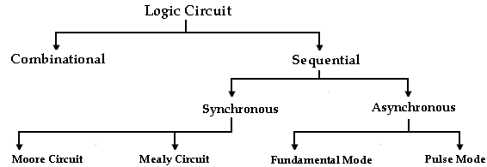
INTRODUCTION TO SEQUENTIAL LOGIC
Classification of Digital Logic Circuits
MODULE-3
CSET105 – DIGITAL DESIGN
4

Slide 5
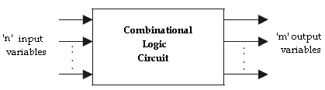
INTRODUCTION TO SEQUENTIAL LOGIC
Digital electronics is classified into combinational logic and sequential logic.
In combinational logic circuits, the outputs at any instant of time depend only on the input signals present at that time.
For a change in input, the output occurs immediately.
Combinational Circuit- Block Diagram
MODULE-3
CSET105 – DIGITAL DESIGN
5

Slide 6
INTRODUCTION TO SEQUENTIAL LOGIC
There are many applications in which digital outputs are required to be generated in accordance with the sequence in which the input signals are received.
The requirement can’t be satisfied with combinational circuits.
In sequential logic circuits, it consists of combinational circuits to which storage elements are connected to form a feedback path.
The storage elements are devices capable of storing binary information either 1 or 0.
The information stored in the memory elements at any given time defines the present state of the sequential circuit.
MODULE-3
CSET105 – DIGITAL DESIGN
6

Slide 7
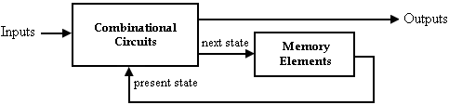
INTRODUCTION TO SEQUENTIAL LOGIC
The present state and the external circuit determine the output and the next state of sequential circuits.
Thus in sequential circuits, the output variables depend not only on the present input variables but also on the past history of input variables.
Sequential Circuit- Block Diagram
MODULE-3
CSET105 – DIGITAL DESIGN
7

Slide 8
INTRODUCTION TO SEQUENTIAL LOGIC
Combinational vs Sequential Circuit
S.No | Combinational logic | Sequential logic
1 | The output variable, at all times depends on the combination of input variables. | The output variable depends not only on the present input but also depend upon the past history of inputs.
2 | Memory unit is not required | Memory unit is required to store the past history of input variables.
3 | Faster in speed | Slower than combinational circuits.
4 | Easy to design | Comparatively difficult to design.
5 | Eg. MUX, Decoder, Parallel adder | Eg. Counter, Shift Register, Serial adder
MODULE-3
CSET105 – DIGITAL DESIGN
8

Slide 9
LATCHES
MODULE-3
CSET105 – DIGITAL DESIGN
9

Slide 10
LATCHES
Latches and Flip-Flops are the basic building blocks of the most sequential circuits.
Latches are used for a sequential device that checks all of its inputs continuously and changes its outputs accordingly at any time independent of clocking signal.
Enable signal is provided with the latch. When enable signal is active output changes occur as the input changes.
But when enable signal is not activated input changes do not affect the output.
Flip-Flop is used for a sequential device that normally samples its inputs and changes its outputs only at times determined by clocking signal.
MODULE-3
CSET105 – DIGITAL DESIGN
10

Slide 11
LATCHES
SR Latch using NOR
The simplest type of latch is the set-reset (SR) latch. It can be constructed from either two NOR gates or two NAND gates.
The two NOR gates are cross-coupled so that the output of NOR gate 1 is connected to one of the inputs of NOR gate 2 and vice versa.
The latch has two outputs Q and Q’ and two inputs, set and reset.
Before going to analyze the SR latch, we recall that a logic 1 at any input of a NOR gate forces its output to a logic 0.
Let us understand the operation of this circuit for various input/ output possibilities.
MODULE-3
CSET105 – DIGITAL DESIGN
11

Slide 12
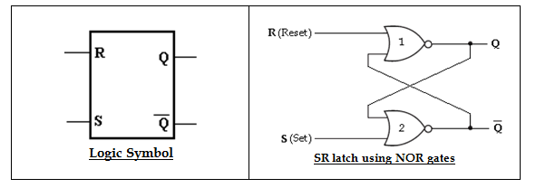
LATCHES
SR Latch using NOR
MODULE-3
CSET105 – DIGITAL DESIGN
12

Slide 13
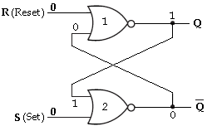

LATCHES
SR Latch using NOR
Case 1: S= 0 and R= 0
(Initially, Q= 1 and Q’= 0)
Case 1: S= 0 and R= 0
(Initially, Q= 0 and Q’= 1)
MODULE-3
CSET105 – DIGITAL DESIGN
13

Slide 14
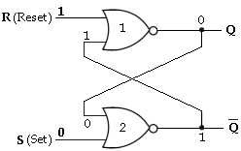
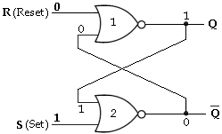
LATCHES
SR Latch using NOR
Case 2: S= 0 and R= 1
Case 3: S= 1 and R= 0
MODULE-3
CSET105 – DIGITAL DESIGN
14

Slide 15
LATCHES
SR Latch using NOR
Case 4: S= 1 and R= 1
When R and S both are at logic 1, they force the outputs of both NOR gates to the low state, i.e., (Q=0 and Q’=0).
So, we call this an indeterminate or prohibited state, and represent this condition in the truth table as an asterisk (*).
This condition also violates the basic definition of a latch that requires Q to be complement of Q’.
Thus in normal operation this condition must be avoided by making sure that 1’s are not applied to both the inputs simultaneously.
MODULE-3
CSET105 – DIGITAL DESIGN
15

Slide 16
LATCHES
SR Latch using NOR
S | R | Present state | Next state | State
 |  | Q_{n} | Q_{n+1}
0 0 | 0 0 | 0 1 | 0 1 | No Change (NC)
0 0 | 1 1 | 0 1 | 0 0 | Reset
1 1 | 0 0 | 0 1 | 1 1 | Set
1 1 | 1 1 | 0 1 | x x | Indeterminate*
Truth table
MODULE-3
CSET105 – DIGITAL DESIGN
16

Slide 17
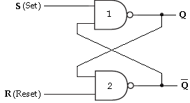
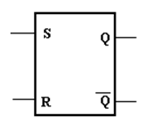
LATCHES
SR Latch using NAND
The SR latch can also be implemented using NAND gates. The inputs of this Latch are S and R.
To understand how this circuit functions, recall that a low on any input to a NAND gate forces its output high.
Logic Symbol
SR latch using NAND gates
MODULE-3
CSET105 – DIGITAL DESIGN
17

Slide 18
LATCHES
SR Latch using NAND
S | R | Q_{n} | Q_{n+1} | State
0 0 | 0 0 | 0 1 | x x | Indeterminate*
0 0 | 1 1 | 0 1 | 1 1 | Set
1 1 | 0 0 | 0 1 | 0 0 | Reset
1 1 | 1 1 | 0 1 | 0 1 | No Change (NC)
Truth table
MODULE-3
CSET105 – DIGITAL DESIGN
18

Slide 19
LATCHES
Gated Latch using NAND
In the SR latch, the output changes occur immediately after the input changes i.e, the latch is sensitive to its S and R inputs all the time.
A latch that is sensitive to the inputs only when an enable input is active. Such a latch with enable input is known as gated SR latch.
The circuit behaves like SR latch when EN= 1. It retains its previous state when EN= 0.
MODULE-3
CSET105 – DIGITAL DESIGN
19

Slide 20
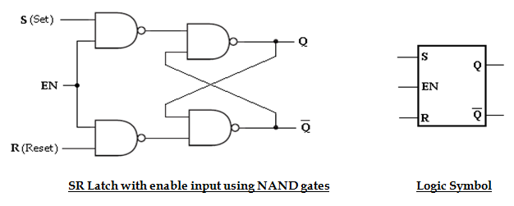
LATCHES
Gated Latch using NAND
MODULE-3
CSET105 – DIGITAL DESIGN
20

Slide 21
LATCHES
Gated Latch using NAND
EN | S | R | Q_{n} | Q_{n+1} | State
1 1 | 0 0 | 0 0 | 0 1 | 0 1 | No Change (NC)
1 1 | 0 0 | 1 1 | 0 1 | 0 0 | Reset
1 1 | 1 1 | 0 0 | 0 1 | 1 1 | Set
1 1 | 1 1 | 1 1 | 0 1 | x x | Indeterminate *
0 0 | x x | x x | 0 1 | 0 1 | No Change (NC)
Truth table
MODULE-3
CSET105 – DIGITAL DESIGN
21

Slide 22
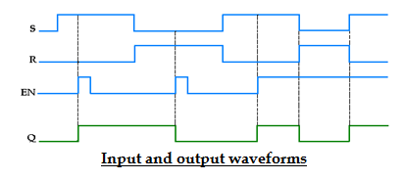
LATCHES
Gated Latch using NAND
MODULE-3
CSET105 – DIGITAL DESIGN
22

Slide 23
LATCHES
D - Latch using NAND
In SR latch, when both inputs are same (00 or 11), the output either does not change or it is invalid.
In many practical applications, these input conditions are not required.
These input conditions can be avoided by making them complement of each other.
Therefore, only two input conditions exists, either S=0 and R=1 or S=1 and R=0.
This modified SR latch is known as D latch.
MODULE-3
CSET105 – DIGITAL DESIGN
23

Slide 24
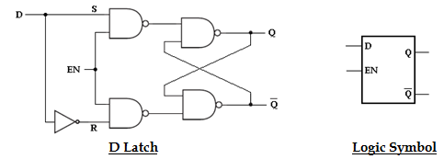
LATCHES
D - Latch using NAND
MODULE-3
CSET105 – DIGITAL DESIGN
24

Slide 25
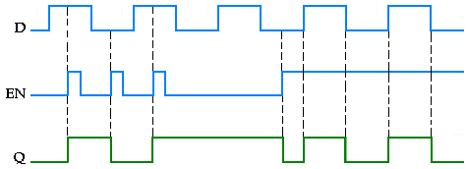
LATCHES
D - Latch using NAND
EN | D | Q_{n} | Q_{n+1} | State
1 1 0 | 0 1 x | x x x | 0 1 Q_{n} | Reset Set No Change (NC)
Truth table
Input and output waveforms
MODULE-3
CSET105 – DIGITAL DESIGN
25

Slide 26
FLIP-FLOPS
MODULE-3
CSET105 – DIGITAL DESIGN
26

Slide 27
FLIP-FLOPS
Triggering of Flip flops
The state of a Flip-Flop is switched by a momentary change in the input signal.
This momentary change is called a trigger and the transition it causes is said to trigger the Flip-Flop.
Clocked Flip-Flops are triggered by pulses. A clock pulse starts from an initial value of 0, goes momentarily to 1 and after a short time, returns to its initial 0 value.
Level Triggering: In the level triggering the output state is allowed to change according to inputs when active (either positive or negative) is maintained at the enable input.
Latches are controlled by enable signal, and they are level triggered, either positive level triggered or negative level triggered.
MODULE-3
CSET105 – DIGITAL DESIGN
27

Slide 28
FLIP-FLOPS
Triggering of Flip flops
There are two types of level triggered latches:
  (i). Positive level triggered: The output of the latch responds to the input changes only when the enable input is 1(HIGH).
  (ii). Negative level triggered: The output of the latch responds to the input changes only when the enable input is 0 (LOW).
MODULE-3
CSET105 – DIGITAL DESIGN
28

Slide 29
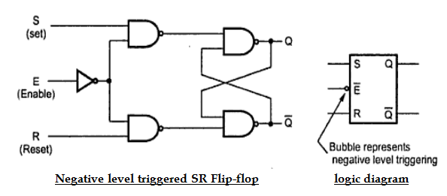
FLIP-FLOPS
Triggering of Flip flops
MODULE-3
CSET105 – DIGITAL DESIGN
29

Slide 30
FLIP-FLOPS
Triggering of Flip flops
Edge Triggering: In the edge triggering the output responds to the changes in the input only at the positive or negative edges of the clock pulse at the clock input.
Flip-Flops are different from latches. Flip-Flops are pulse or clock edge triggered instead of level triggered.
(i). Positive edge triggering: Here the output responds to the changes in the input only at the positive edge of the clock pulse at the clock input.
MODULE-3
CSET105 – DIGITAL DESIGN
30

Slide 31
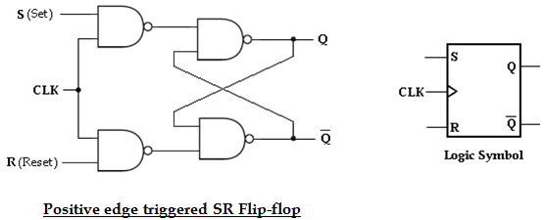
FLIP-FLOPS
Triggering of Flip flops
(ii). Negative edge triggering: Here the output responds to the changes in the input only at the negative edge of the clock pulse at the clock input.
MODULE-3
CSET105 – DIGITAL DESIGN
31

Slide 32
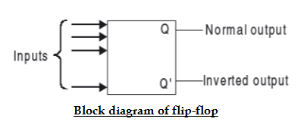
FLIP-FLOPS
Flip flops
The basic 1-bit digital memory circuit is known as a flip-flop. Flip-Flops are synchronous bistable devices (has two outputs Q and Q’).
In this case, the term synchronous means that the output changes state only at a specified point on the triggering input called the clock (CLK), i.e., changes in the output occur in synchronization with the clock. It can have only two states, either the 1 state or the 0 state.
MODULE-3
CSET105 – DIGITAL DESIGN
32

Slide 33
FLIP-FLOPS
Flip flops
Flip-flops can be obtained by using NAND or NOR gates.
If Q is 1 i.e., Set, then Q' is 0; if Q is 0 i.e., Reset, then Q' is 1. That means Q and Q' cannot be at the same state simultaneously.
There are different types of flip-flops depending on how their inputs and clock pulses cause transition between two states.
We will discuss four different types of flip-flops SR, D, JK, and T.
Basically D, J-K, and T are three different modifications of the S-R flip-flop.
MODULE-3
CSET105 – DIGITAL DESIGN
33

Slide 34
FLIP-FLOPS
SR Flip flops
The S and R inputs of the S-R Flip-Flop are called synchronous inputs because data on these inputs are transferred to the Flip-Flop's output only on the triggering edge of the clock pulse.
The circuit is similar to SR latch except enable signal is replaced by clock pulse (CLK).
On the positive edge of the clock pulse, the circuit responds to the S and R inputs.
MODULE-3
CSET105 – DIGITAL DESIGN
34

Slide 35
FLIP-FLOPS
SR Flip flops
When S is HIGH and R is LOW, the Q output goes HIGH on the triggering edge of the clock pulse, and the Flip-Flop is SET.
When S is LOW and R is HIGH, the Q output goes LOW on the triggering edge of the clock pulse, and the Flip-Flop is RESET.
When both S and R are LOW, the output does not change from its prior state.
An invalid condition exists when both S and R are HIGH.
MODULE-3
CSET105 – DIGITAL DESIGN
35

Slide 36
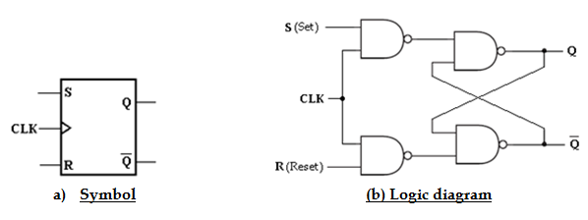
FLIP-FLOPS
SR Flip flops
MODULE-3
CSET105 – DIGITAL DESIGN
36

Slide 37
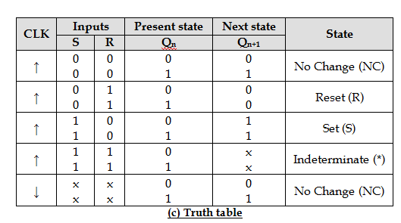
FLIP-FLOPS
SR Flip flops
MODULE-3
CSET105 – DIGITAL DESIGN
37

Slide 38
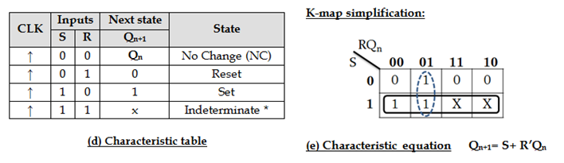
FLIP-FLOPS
SR Flip flops
MODULE-3
CSET105 – DIGITAL DESIGN
38

Slide 39
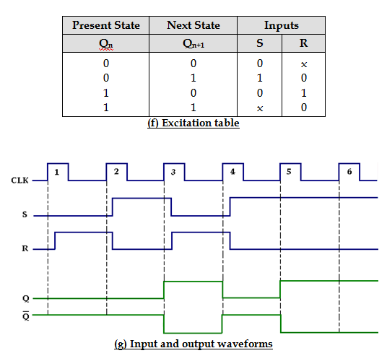
FLIP-FLOPS
SR Flip flops
MODULE-3
CSET105 – DIGITAL DESIGN
39

Slide 40
FLIP-FLOPS
D Flip flops
Like in D latch, in D Flip-Flop the basic SR Flip-Flop is used with complemented inputs.
The D Flip-Flop is similar to D-latch except clock pulse is used instead of enable input.
To eliminate the undesirable condition of the indeterminate state in the RS Flip-Flop is to ensure that inputs S and R are never equal to 1 at the same time. This is done by D Flip-Flop.
The D (delay or data) Flip-Flop has one input called delay input and clock pulse input.
MODULE-3
CSET105 – DIGITAL DESIGN
40

Slide 41
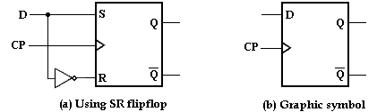
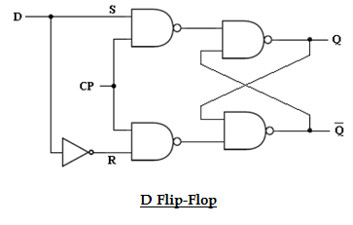
FLIP-FLOPS
D Flip flops
MODULE-3
CSET105 – DIGITAL DESIGN
41

Slide 42
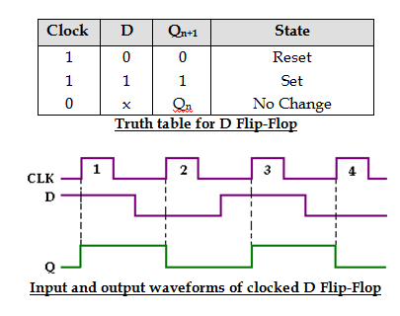
FLIP-FLOPS
D Flip flops
MODULE-3
CSET105 – DIGITAL DESIGN
42

Slide 43
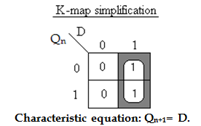
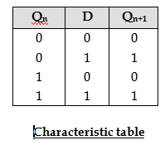
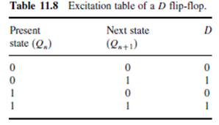
FLIP-FLOPS
D Flip flops
CSET105 – DIGITAL DESIGN
43

Slide 44
FLIP-FLOPS
JK Flip flops
JK means Jack Kilby, Texas Instrument (TI) Engineer, who invented IC in 1958.
JK Flip-Flop has two inputs J(set) and K(reset). A JK Flip-Flop can be obtained from the clocked SR Flip-Flop by augmenting two AND gates.
The data input J and the output Q’ are applied to the first AND gate and its output (JQ’) is applied to the S input of SR Flip-Flop.
Similarly, the data input K and the output Q is applied to the second AND gate and its output (KQ) is applied to the R input of SR Flip-Flop.
CSET105 – DIGITAL DESIGN
44

Slide 45
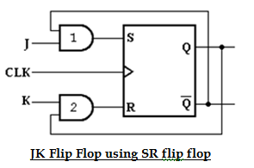
FLIP-FLOPS
JK Flip flops
CSET105 – DIGITAL DESIGN
45

Slide 46
FLIP-FLOPS
JK Flip flops
Case1: J= K= 0
When J=K= 0, both AND gates are disabled. Therefore clock pulse have no effect, hence the Flip-Flop output is same as the previous output.
Case2: J= 0, K= 1
When J= 0 and K= 1, AND gate 1 is disabled i.e., S= 0 and R= 1. This condition will reset the Flip-Flop to 0.
Case3: J= 1, K= 0
When J= 1 and K= 0, AND gate 2 is disabled i.e., S= 1 and R= 0. Therefore the Flip-Flop will set on the application of a clock pulse.
Case4: J= K= 1
When J=K= 1, it is possible to set or reset the Flip-Flop. If Q is High, AND gate 2 passes on a reset pulse to the next clock. When Q is low, AND gate 1 passes on a set pulse to the next clock. Either way, Q changes to the complement of the last state i.e., toggle. Toggle means to switch to the opposite state.
CSET105 – DIGITAL DESIGN
46

Slide 47
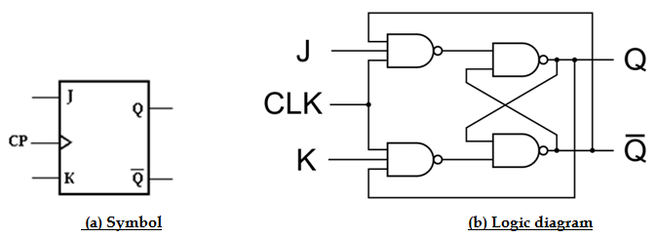
FLIP-FLOPS
JK Flip flops
The function of JK flip flop using SR flip flop and AND gate can also be performed by adding extra input terminal to input terminals of NAND gates. Figure (b) shows the modified circuit of JK flip flop which has only NAND gates.
CSET105 – DIGITAL DESIGN
47

Slide 48
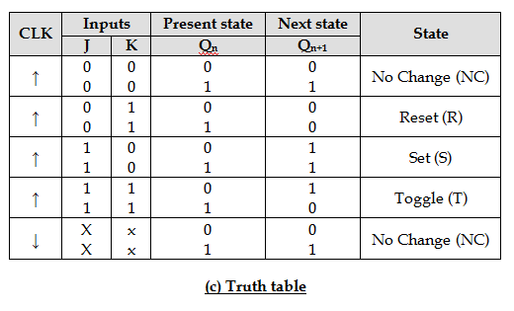
FLIP-FLOPS
JK Flip flops
CSET105 – DIGITAL DESIGN
48

Slide 49
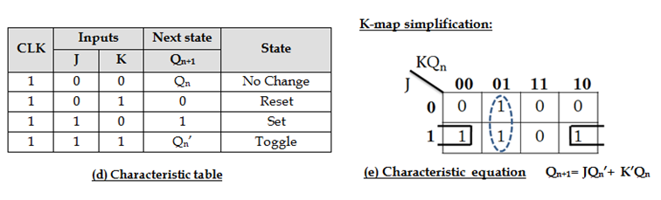
FLIP-FLOPS
JK Flip flops
CSET105 – DIGITAL DESIGN
49

Slide 50
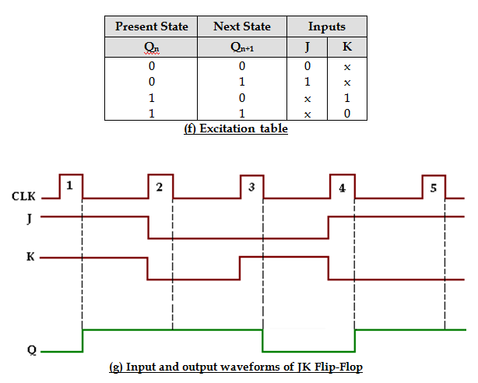
FLIP-FLOPS
JK Flip flops
CSET105 – DIGITAL DESIGN
50

Slide 51
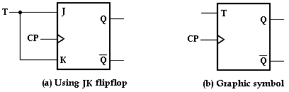
FLIP-FLOPS
T Flip flops
The T (Toggle) Flip-Flop is a modification of the JK Flip-Flop. It is obtained from JK Flip-Flop by connecting both inputs J and K together, i.e., single input.
Regardless of the present state, the Flip-Flop complements its output when the clock pulse occurs while input T= 1.
CSET105 – DIGITAL DESIGN
51

Slide 52
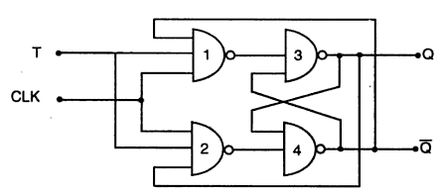
FLIP-FLOPS
T Flip flops
CSET105 – DIGITAL DESIGN
52

Slide 53
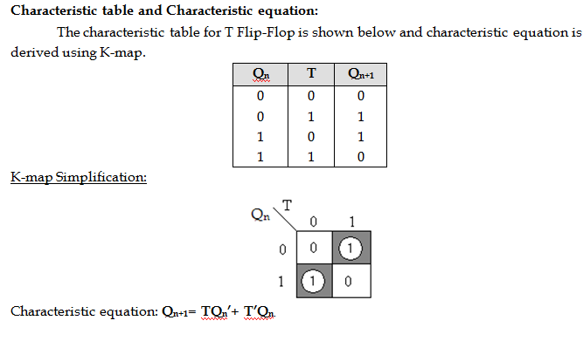
FLIP-FLOPS
T Flip flops
CSET105 – DIGITAL DESIGN
53

Slide 54
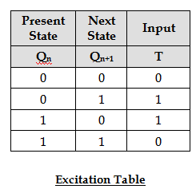
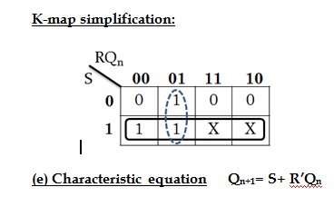
FLIP-FLOPS
T Flip flops
CSET105 – DIGITAL DESIGN
54

Slide 55
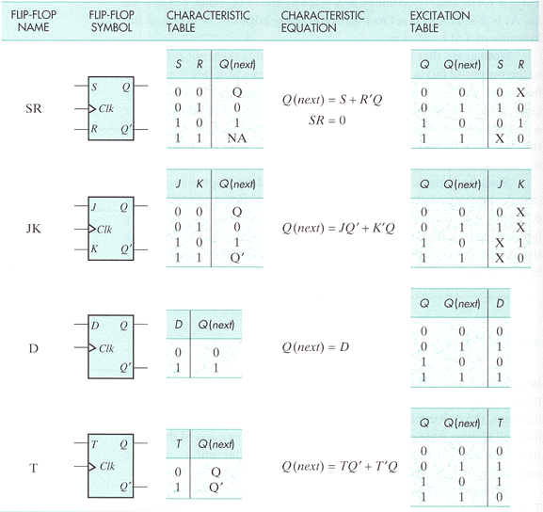
FLIP-FLOPS
Flip flops Summary
CSET105 – DIGITAL DESIGN
55

Slide 56
SHIFT REGISTERS
CSET105 – DIGITAL DESIGN
56

Slide 57
SHIFT REGISTERS
SHIFT REGISTERS
A register is simply a group of Flip-Flops that can be used to store a binary number. There must be one Flip-Flop for each bit in the binary number. For instance, a register used to store an 8-bit binary number must have 8 Flip-Flops.
The Flip-Flops must be connected such that the binary number can be entered (shifted) into the register and possibly shifted out. A group of Flip-Flops connected to provide either or both of these functions is called a shift register.
CSET105 – DIGITAL DESIGN
57

Slide 58
SHIFT REGISTERS
SHIFT REGISTER
The bits in a binary number (data) can be removed from one place to another in either of two ways.
The first method involves shifting the data one bit at a time in a serial fashion, beginning with either the most significant bit (MSB) or the least significant bit (LSB). This technique is referred to as serial shifting.
The second method involves shifting all the data bits simultaneously and is referred to as parallel shifting.
CSET105 – DIGITAL DESIGN
58

Slide 59
SHIFT REGISTERS
SHIFT REGISTER TYPES
There are two ways to shift into a register (serial or parallel) and similarly two ways to shift the data out of the register.
This leads to the construction of four basic register types:
Serial in- serial out,
Serial in- parallel out,
Parallel in- serial out,
Parallel in- parallel out.
CSET105 – DIGITAL DESIGN
59

Slide 60
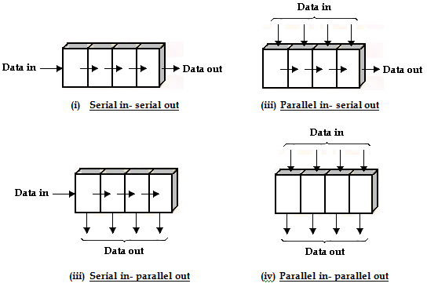
SHIFT REGISTERS
SHIFT REGISTER TYPES
CSET105 – DIGITAL DESIGN
60

Slide 61
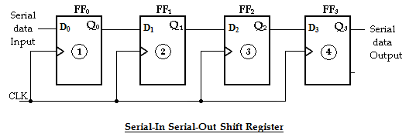
SHIFT REGISTERS
Serial-In Serial-Out (SISO) Shift register
The serial in/serial out shift register accepts data serially, i.e., one bit at a time on a single line. It produces the stored information on its output also in serial form.
CSET105 – DIGITAL DESIGN
61

Slide 62
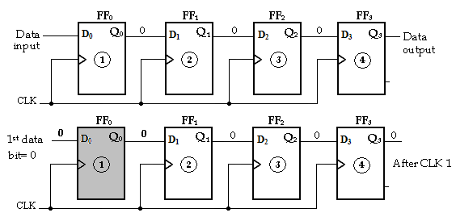
SHIFT REGISTERS
Serial-In Serial-Out (SISO) Shift register Example
(If 1010 is applied) – Serial In
CSET105 – DIGITAL DESIGN
62

Slide 63
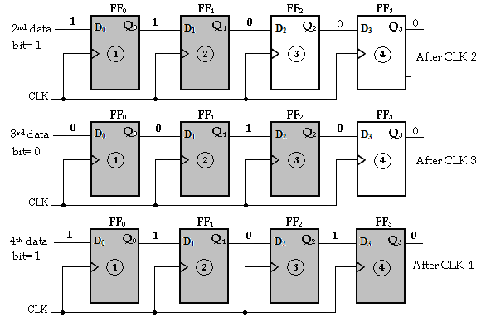
SHIFT REGISTERS
Serial-In Serial-Out (SISO) Shift register Example
(If 1010 is applied) – Serial In
CSET105 – DIGITAL DESIGN
63

Slide 64
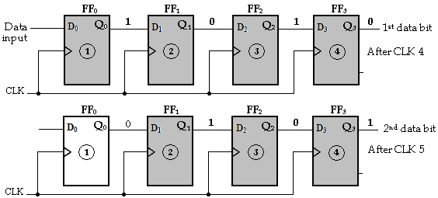
SHIFT REGISTERS
Serial-In Serial-Out (SISO) Shift register Example
(If 1010 is applied) – Serial Out
CSET105 – DIGITAL DESIGN
64

Slide 65
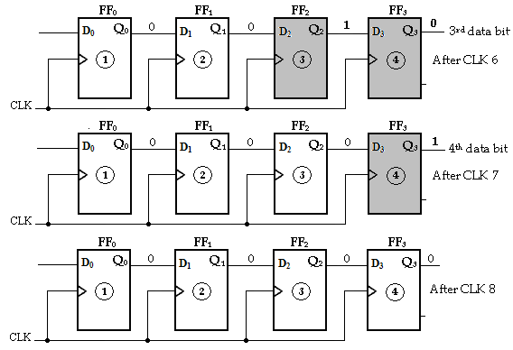
SHIFT REGISTERS
Serial-In Serial-Out (SISO) Shift register Example
(If 1010 is applied) – Serial Out
CSET105 – DIGITAL DESIGN
65

Slide 66
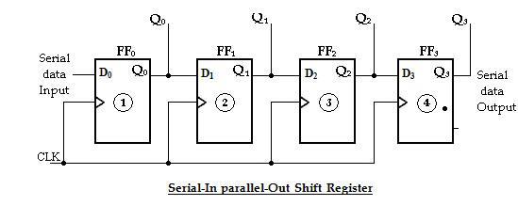
SHIFT REGISTERS
Serial-In Parallel-Out (SIPO) Shift register
In this shift register, data bits are entered into the register in the same as serial-in serial-out shift register. But the output is taken in parallel. Once the data are stored, each bit appears on its respective output line and all bits are available simultaneously instead of on a bit-by-bit.
CSET105 – DIGITAL DESIGN
66

Slide 67
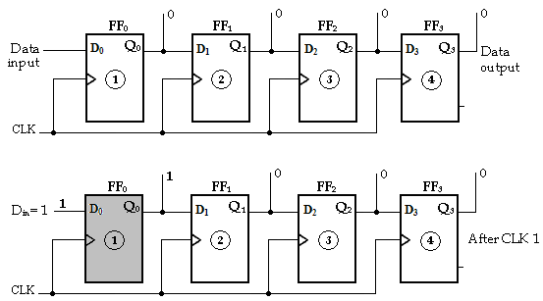
SHIFT REGISTERS
Serial-In Parallel-Out (SIPO) Shift register
Example (1111) Serial in
CSET105 – DIGITAL DESIGN
67

Slide 68
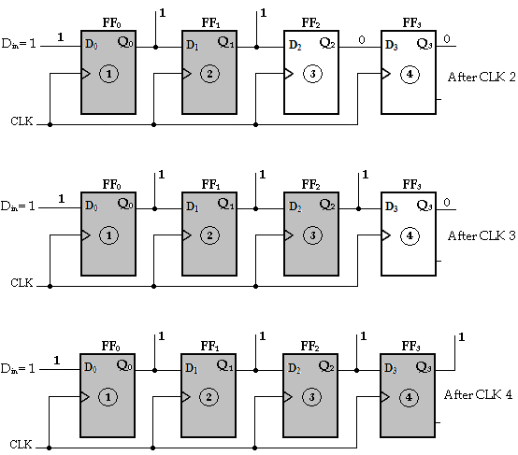
SHIFT REGISTERS
Serial-In Parallel-Out (SIPO) Shift register
Example (1111) Serial in
CSET105 – DIGITAL DESIGN
68

Slide 69
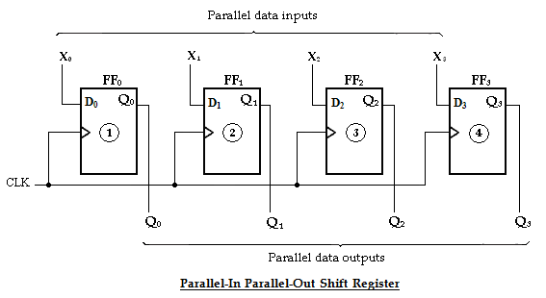
SHIFT REGISTERS
Parallel-In Parallel-Out (PIPO) Shift register
In this type, there is simultaneous entry of all data bits and the bits appear on parallel outputs simultaneously.
CSET105 – DIGITAL DESIGN
69

Slide 70
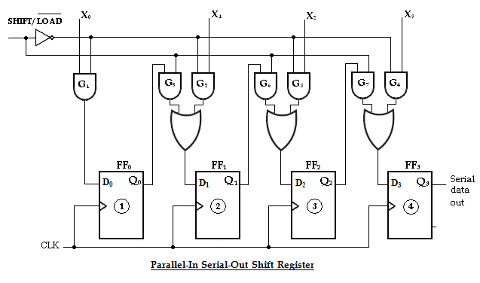
SHIFT REGISTERS
Parallel-In Serial-Out (PISO) Shift register
CSET105 – DIGITAL DESIGN
70

Slide 71
SHIFT REGISTERS
Parallel-In Serial-Out (PISO) Shift register
In this type, the bits are entered in parallel i.e., simultaneously into their respective stages on parallel lines.
There are four data input lines, X₀, X₁, X₂ and X₃ for entering data in parallel into the register.
SHIFT/ LOAD input is the control input, which allows four bits of data to load in parallel into the register.
CSET105 – DIGITAL DESIGN
71

Slide 72
SHIFT REGISTERS
Parallel-In Serial-Out (PISO) Shift register
When SHIFT/LOAD is LOW, gates G₁, G₂, G₃ and G₄ are enabled, allowing each data bit to be applied to the D input of its respective Flip-Flop.
When a clock pulse is applied, the Flip-Flops with D = 1 will set and those with D = 0 will reset, thereby storing all four bits simultaneously.
CSET105 – DIGITAL DESIGN
72

Slide 73
SHIFT REGISTERS
Parallel-In Serial-Out (PISO) Shift register
When SHIFT/LOAD is HIGH, gates G₁, G₂, G₃ and G₄ are disabled and gates G₅, G₆ and G₇ are enabled, allowing the data bits to shift right from one stage to the next.
The OR gates allow either the normal shifting operation or the parallel data-entry operation, depending on which AND gates are enabled by the level on the SHIFT/LOAD input.
CSET105 – DIGITAL DESIGN
73

Slide 74
COUNTERS
SHIFT REGISTER COUNTERS
A shift register counter is basically a shift register with the serial output connected back to the serial input to produce special sequences.
Two of the most common types of shift register counters are:
Johnson counter (Shift Counter),
Ring counter
CSET105 – DIGITAL DESIGN
74

Slide 75
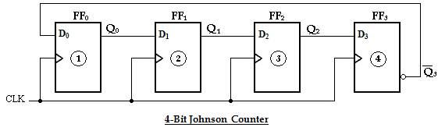
COUNTERS
JOHNSON COUNTERS
CSET105 – DIGITAL DESIGN
75

Slide 76
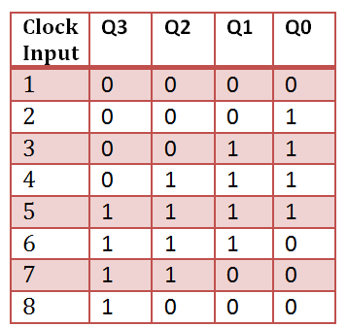
COUNTERS
JOHNSON COUNTERS
76

Slide 77

COUNTERS
JOHNSON COUNTERS
77

Slide 78

COUNTERS
RING COUNTERS
CSET105 – DIGITAL DESIGN
78

Slide 79

COUNTERS
RING COUNTERS
CSET105 – DIGITAL DESIGN
79

Slide 80

COUNTERS
RING COUNTERS
CSET105 – DIGITAL DESIGN
80

Slide 81
SHIFT REGISTERS
Applications of Shift register
Serial to parallel converters
Keyboard encoders
Universal Asynchronous Receiver Transmitter (UART)
Pulse extender
Data processing (Multiplication)
Delay line memory
CSET105 – DIGITAL DESIGN
81

Slide 82
COUNTERS
CSET105 – DIGITAL DESIGN
82

Slide 83
COUNTERS
TYPES OF COUNTER
Flip-Flops can be connected together to perform counting operations. Such a group of Flip- Flops is a counter.
The number of Flip-Flops used and the way in which they are connected determine the number of states (called the modulus) and also the specific sequence of states that the counter goes through during each complete cycle.
Counters are classified into two broad categories according to the way they are clocked:
Asynchronous counters,
Synchronous counters.
83

Slide 84
COUNTERS
TYPES OF COUNTER
In asynchronous (ripple) counters, the first Flip-Flop is clocked by the external clock pulse and then each successive Flip-Flop is clocked by the output of the preceding Flip-Flop.
In synchronous counters, the clock input is connected to all of the Flip-Flops so that they are clocked simultaneously.
Within each of these two categories, counters are classified primarily by the type of sequence, the number of states, or the number of Flip-Flops in the counter.
84

Slide 85
COUNTERS
SYNC. Vs ASYNC. COUNTER
S.No | Asynchronous (ripple) counter | Synchronous counter
1 | All the Flip-Flops are not clocked simultaneously. | All the Flip-Flops are clocked simultaneously.
2 | The delay times of all Flip-Flops are added. Therefore there is considerable propagation delay. | There is minimum propagation delay.
3 | Speed of operation is low | Speed of operation is high.
4 | Logic circuit is very simple even for more number of states. | Design involves complex logic circuit as number of state increases.
5 | Minimum numbers of logic devices are needed. | The number of logic devices is more than ripple counters.
6 | Cheaper than synchronous counters. | Costlier than ripple counters.
85

Slide 86

COUNTERS
2-BIT SYNC. UP COUNTER
86

Slide 87

COUNTERS
2-BIT SYNC. UP COUNTER
87

Slide 88

COUNTERS
3-BIT SYNC. UP COUNTER
88

Slide 89

COUNTERS
3-BIT SYNC. UP COUNTER
89

Slide 90

COUNTERS
3-BIT SYNC. UP COUNTER
90

Slide 91

COUNTERS
4-BIT SYNC. UP COUNTER
91

Slide 92

COUNTERS
4-BIT SYNC. UP COUNTER
92

Slide 93
COUNTERS
3-BIT UP/DOWN COUNTER
An up/down counter is a bidirectional counter, capable of progressing in either direction through a certain sequence.
A 3-bit binary counter that advances upward through its sequence (0, 1, 2, 3, 4, 5, 6, 7) and then can be reversed so that it goes through the sequence in the opposite direction (7, 6, 5, 4, 3, 2, 1,0) is an illustration of up/down sequential operation.
93

Slide 94

COUNTERS
3-BIT UP/DOWN COUNTER
94

Slide 95

COUNTERS
3-BIT UP/DOWN COUNTER
95

Slide 96

COUNTERS
2-BIT ASYNC. UP COUNTER
96

Slide 97

COUNTERS
2-BIT ASYNC. UP COUNTER
97

Slide 98

COUNTERS
3-BIT ASYNC. UP COUNTER
98

Slide 99

COUNTERS
3-BIT ASYNC. UP COUNTER
99

Slide 100

COUNTERS
4-BIT ASYNC. UP COUNTER
100

Slide 101

COUNTERS
4-BIT ASYNC. UP COUNTER
101

Slide 102

COUNTERS
4-BIT ASYNC. DOWN COUNTER
102

Slide 103

COUNTERS
4-BIT ASYNC. DOWN COUNTER
103

Slide 104
COUNTERS
SYNC. MOD COUNTER DESIGN
The counter can be designed using any types of Flip flop. But in general T-Flip flop is used to design counter.
The use of MOD counter in to counter value for specific number of times.
For example, MOD-5 Counter means it can counter the values from 0 to 4 and it get reset. So, it count in the sequence of 000,001,0110,011,100,000,001,etc.,
The number of flip flop required to design MOD counter is depends on the number of count it performs.
104

Slide 105
COUNTERS
SYNC. MOD COUNTER DESIGN
Determine the number of Flip-Flop needed
Choose the type of Flip Flop and its excitation table
Determine Transition table
K-Map simplification procedures for driving expressions
Draw the logic diagram
105

Slide 106

COUNTERS
Example:1 Design of MOD-6 Counter using JK Flip flop
106

Slide 107

COUNTERS
Example:1 Design of MOD-6 Counter using JK Flip flop
107

Slide 108

COUNTERS
Example:1 Design of MOD-6 Counter using JK Flip flop
108

Slide 109

COUNTERS
Example:1 Design of MOD-6 Counter using JK Flip flop
109

Slide 110

COUNTERS
Example:2 Design of MOD-6 Counter using T Flip flop
110

Slide 111


COUNTERS
Example:2 Design of MOD-6 Counter using T Flip flop
111

Slide 112

COUNTERS
Example:2 Design of MOD-6 Counter using T Flip flop
112

Slide 113

THANK YOU

